Slide 1
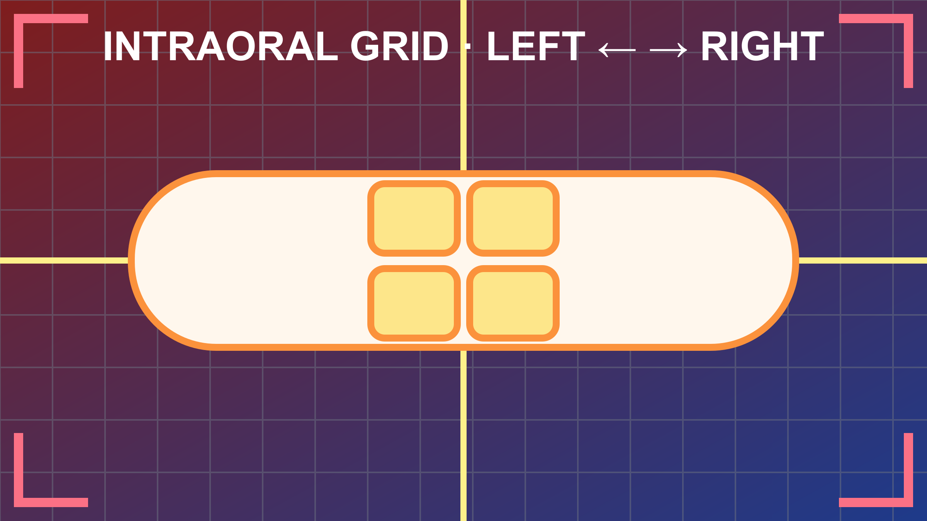
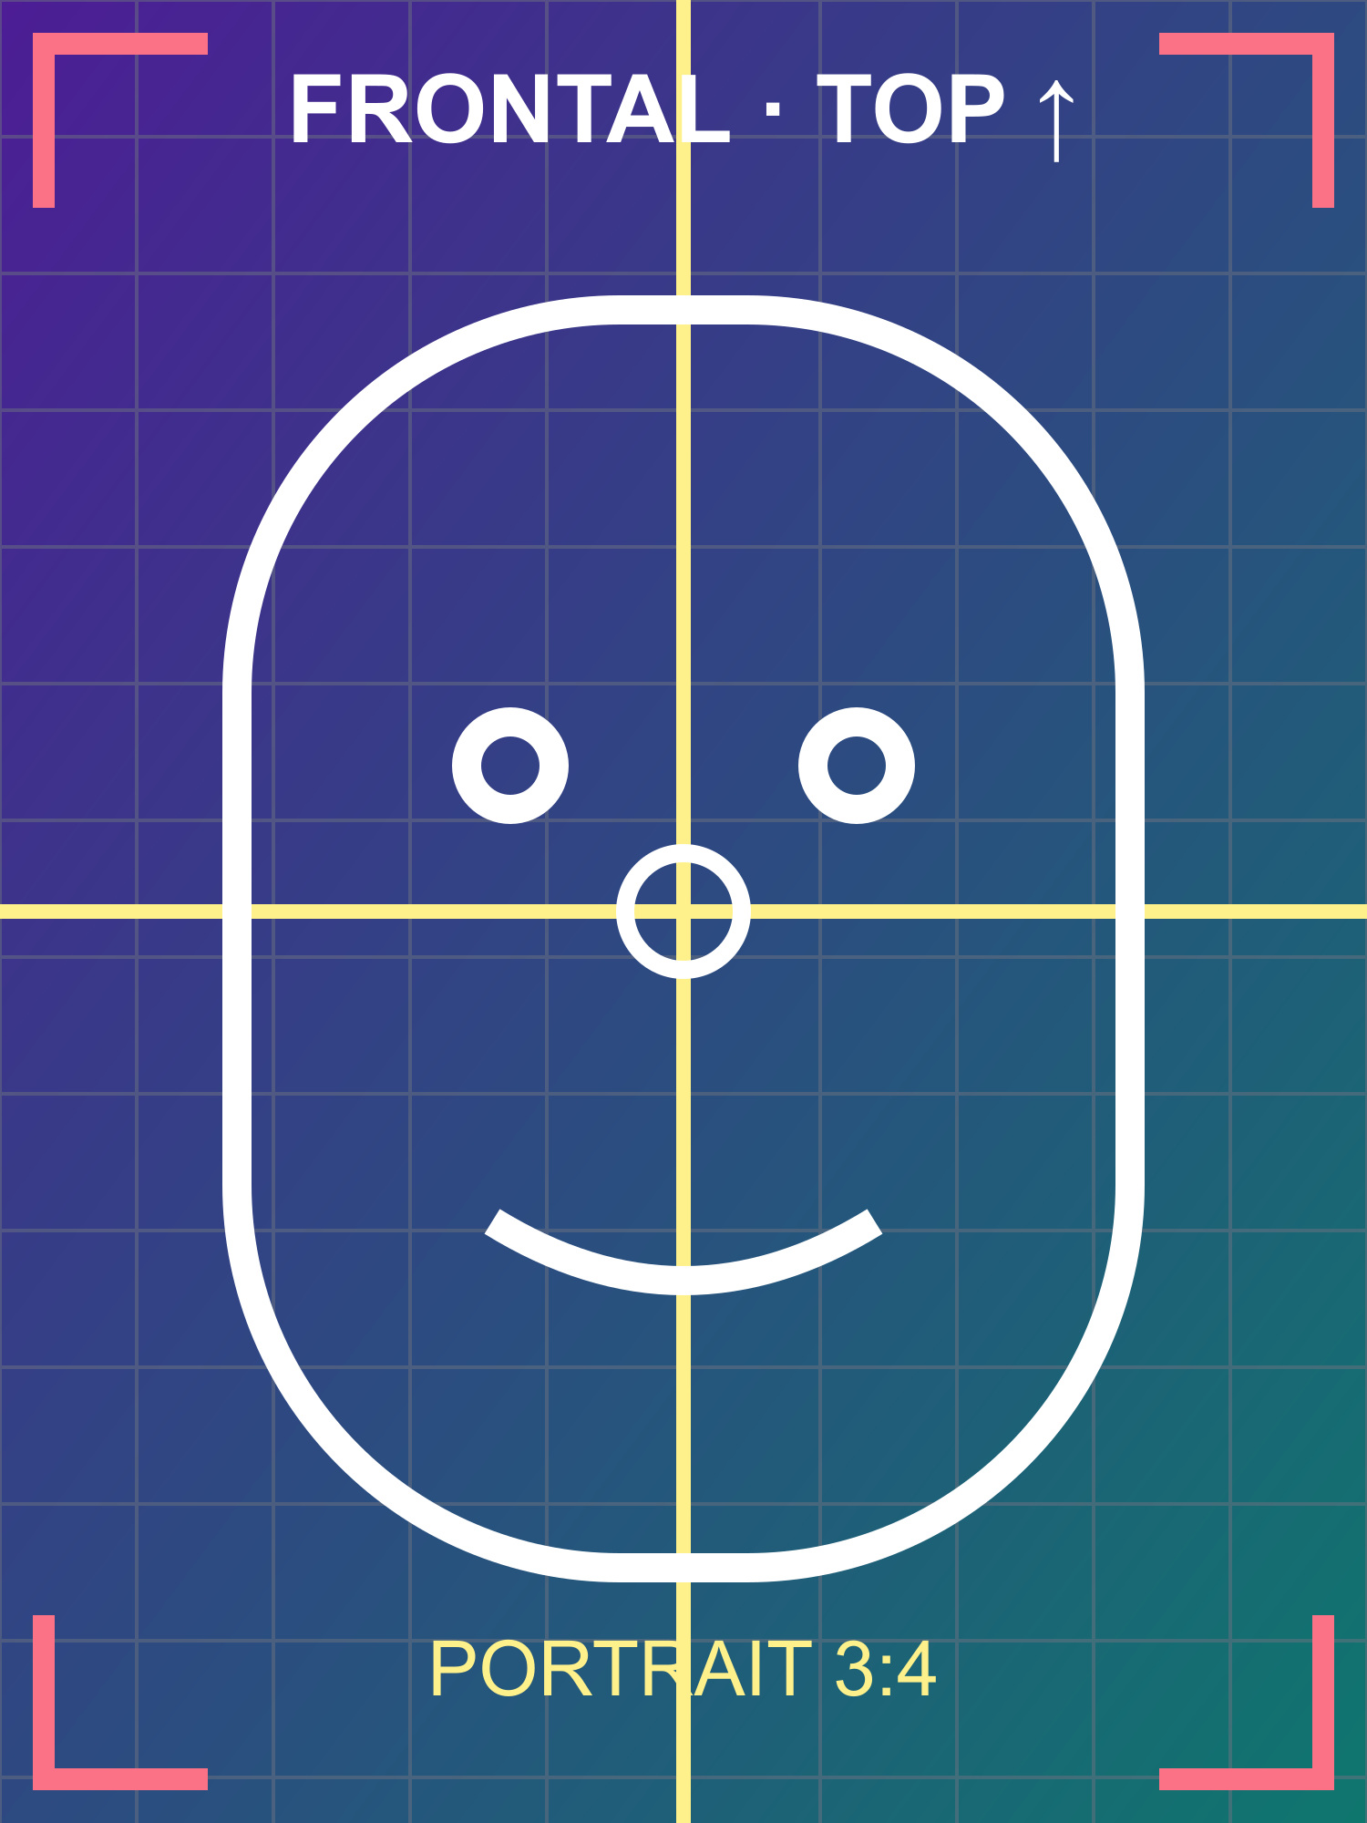
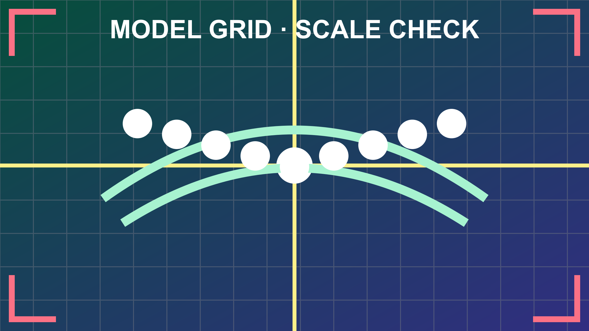
ÜOH: +1.0 mm sağ [acceptance-edit]
AOH: −0.5 mm sol
Overjet: 2.5 mm
Overbite: 3.0 mm

Slide 2
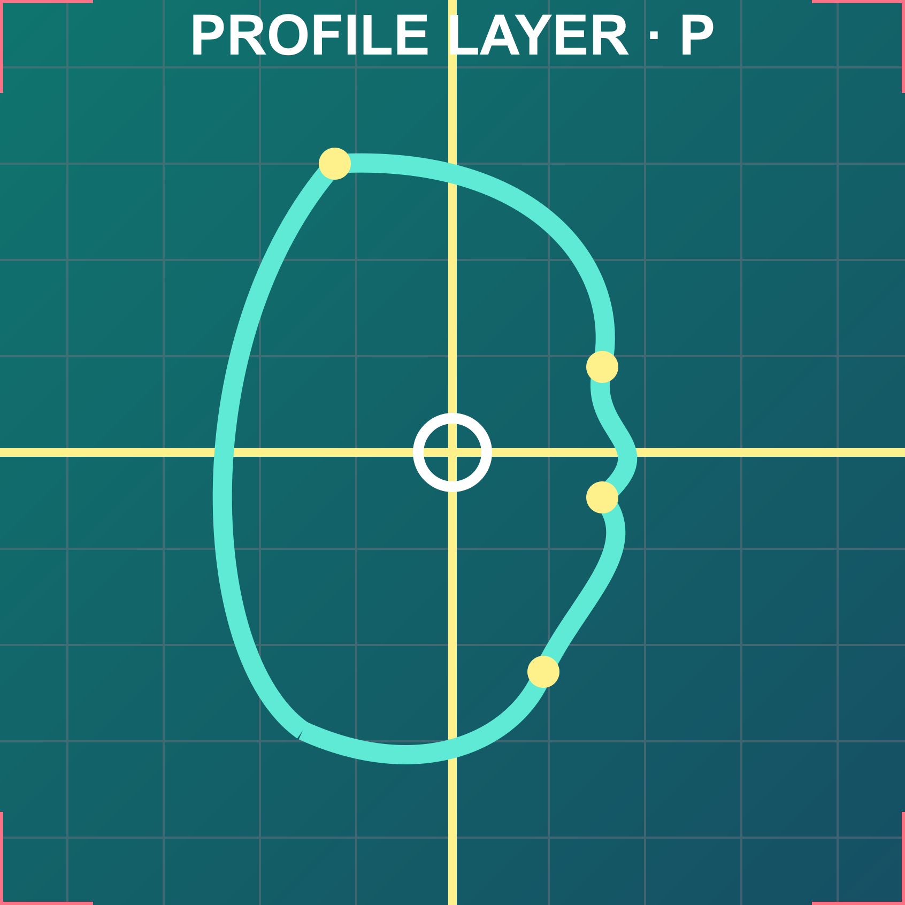
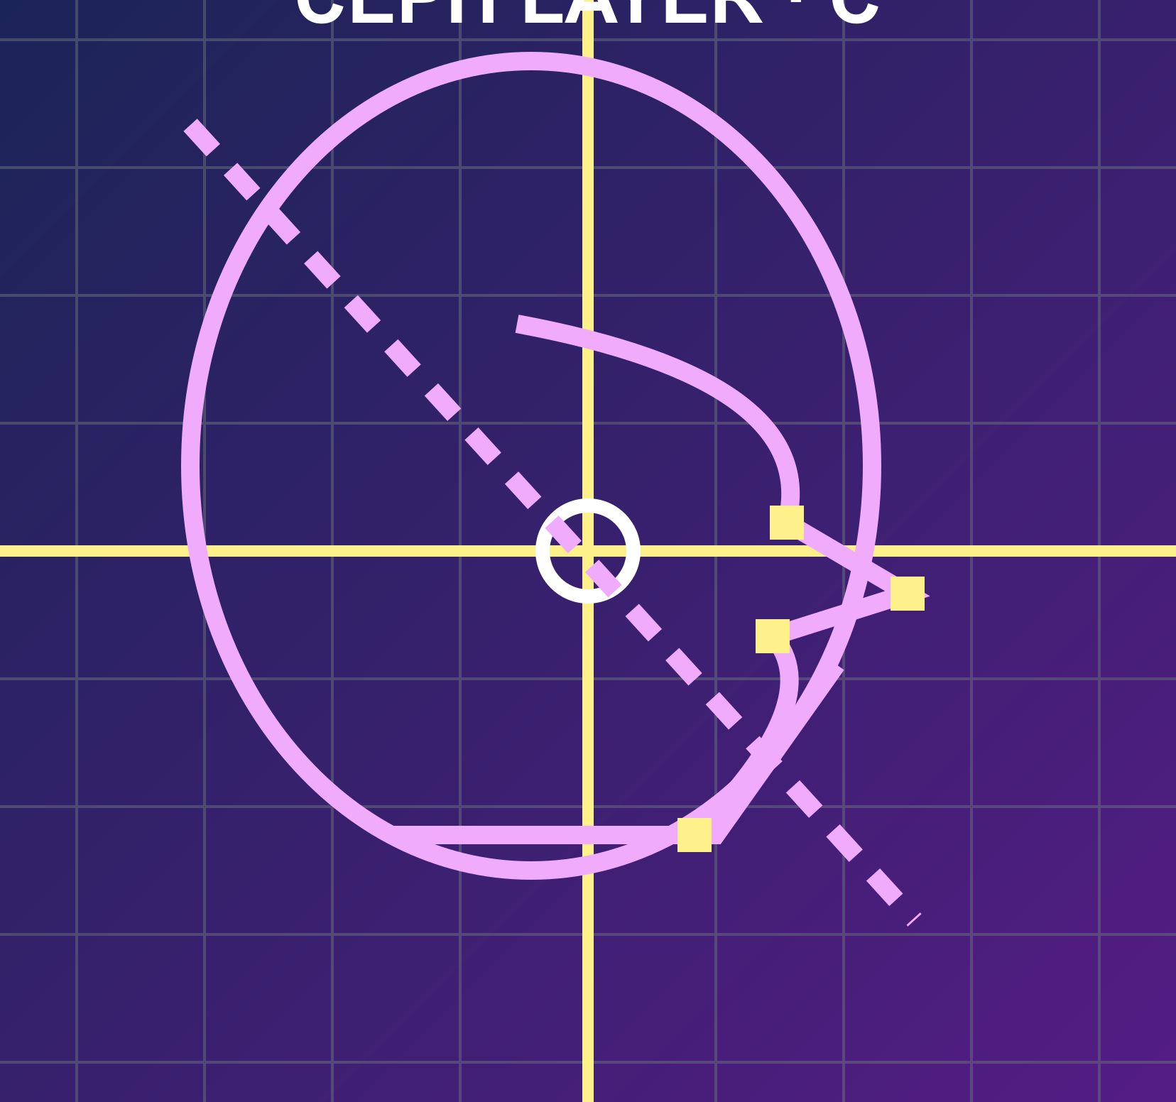

Slide 3
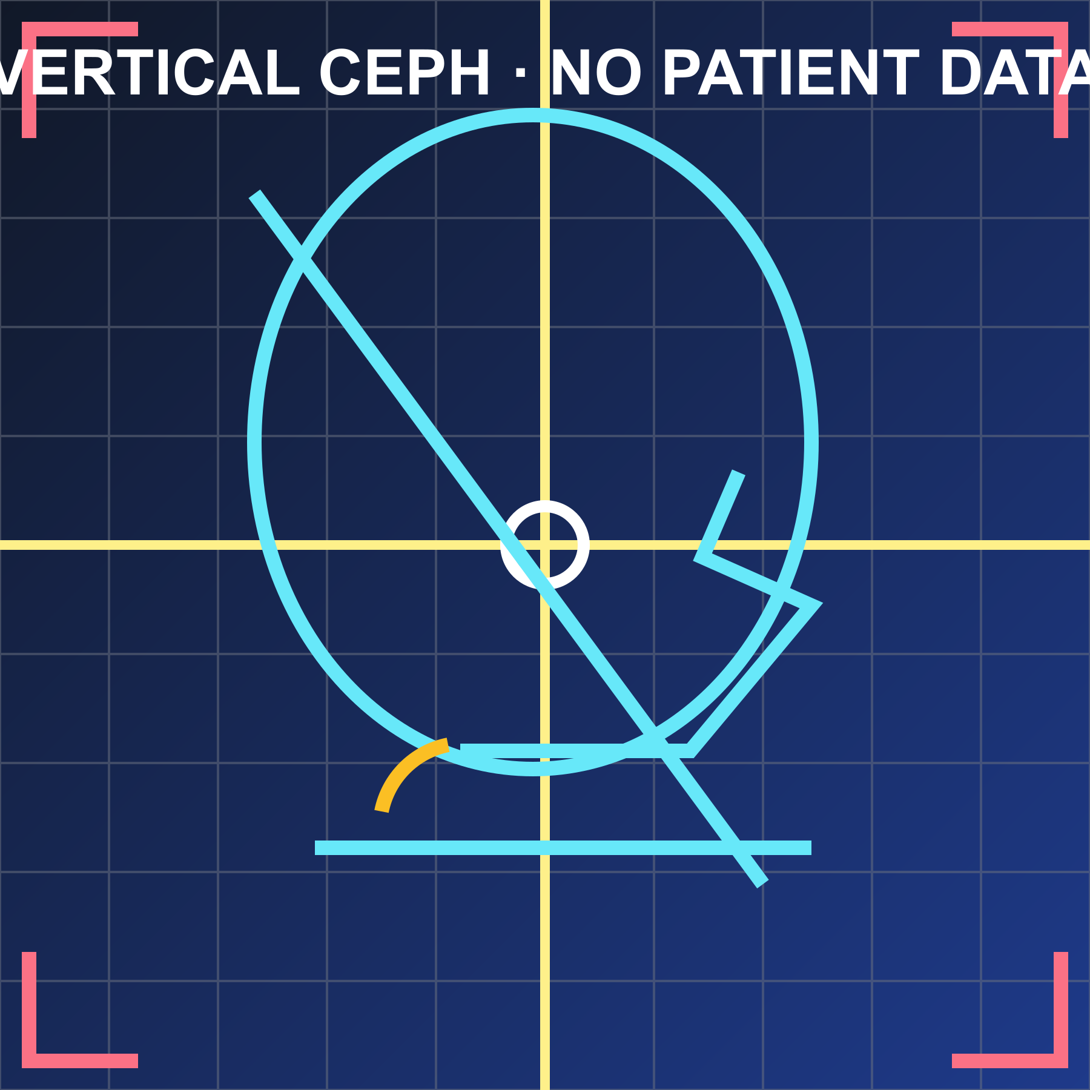
Measurement | Reference | T0
SN–GoGn | 32 ± 5° | +36.5°*
Saddle angle | 123 ± 5° | +124.0°
Articular angle | 143 ± 6° | +141.0°
Gonial angle | 130 ± 7° | +137.5°
Inner-angle sum | 396 ± 3° | +397.0°
Jarabak | 59–63% | −58.5%
ANS–Me / N–Me | 55 ± 0.1% | +55.2%
Maxillary height | 60 ± 3° | +61.0°
Facial axis | 90 ± 3.5° | +89.5°
S–Ar / Ar–Go | 75 ± 10% | +78.0%
Gonial ratio | 75%; 54.5/70.6 | +76%; 55/72
FMA | 25 ± 4.5° | +29.0°
Y-axis | 59.4 ± 5.5° | +61.0°
Occlusal plane / SN | 14.4 ± 2.5° | +15.0°
Occlusal / mandibular | 17.6 ± 5° | +18.0°
Palatal plane / SN | 7 ± 5° | +6.5°
Palatal / mandibular | 26° | +27.0°
Synthetic interpretation: mild vertical growth pattern.
Notes:
Gate 1 synthetic fixture only.
Verify native table editing, notes placement, crop, and alignment after reopen.

Slide 4
# | Problem | Goal | Plan
1 | Synthetic upper grid shows a moderate alignment discrepancy across two reference columns. | Center the synthetic reference markers while preserving the intended spacing. | Use staged guide alignment and confirm the result against the center line at each checkpoint.
2 | Synthetic lower grid has a small rotational discrepancy relative to the reference axis. | Make the lower guide parallel to the horizontal reference line. | Apply a controlled fractional rotation, then recheck translation and scale.
3 | Synthetic overlay markers do not initially coincide. | Superimpose all primary markers without changing the aspect ratio. | Adjust uniform scale and translation; preserve the locked aspect ratio.
4 | Synthetic crop boundary includes excess background. | Keep all crop markers visible and remove unused margin. | Apply a symmetric crop and verify each corner marker remains visible.
5 | Synthetic text block approaches the approved readable limit. | Preserve legibility and avoid clipping. | Report overflow before export instead of silently shrinking the text.

