Slide 1
Introduction to statistical tests in R
Alper Celik Ph.D.
Centre for Computational Medicine

Slide 2
Outline:
What is a statistical test? What it is not?
Very rapid introduction to distributions
Common statistical tests
t.test
Wilcoxon Rank-Sum
Kolmogrov-Smirnov
Fisher's exact test
Chi-Square test
Effect Sizes
Cohen'd d
Cliff's Delta
Multiple testing correction
Multiple distributions
R demo
R demo outline
Random number generation
Statistical tests
T test
Wilcox test
KS test
Fisher's exact test
Chi-Square test
Cohen's D
Cliff's delta
Anova
Kruskall Wallis test
Multiple testing corrections
Performing statistical tests programmatically

Slide 3
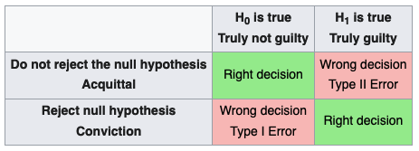
What is a statistical test?
A statistical test is based on a null hypothesis
Given the distribution assumptions are true as statistical test aims to determine:
What is the probability of observing our data if the null hypothesis is true (this is the definition of p value).
In other words, it’s a method of disproving not proving a hypothesis
It does not tell us about the relationship between the outcomes and the factors that affect those outcomes

Slide 4
Very rapid introduction to distributions:
Bernoulli
Discrete distribution, takes value 1 with probability of p
e.g. Coin toss (p=0.5, heads=1)
Hypergeometric
Probability of getting k items from a bag of n where there is a finite population of N items that contains K objects of interets
e.g. # of genes that are differentially expressed AND come from a certain pathway
Binomial
# of successes in a series of bernoulli trials with fixed probability
e.g. # of heads in n coin tosses
Normal (Gaussian)
Described with a location (mean) paramteter and a dispersion (standard deviation) parameter.
When the process that generates the data is infinitely complex things tend to look more "normal"

Slide 5
Very rapid introduction to distributions:
Poisson
# independent of events occurring in a given interval where events happen with a known constant mean rate
e.g. # of patients arriving in the emergency room between 12-5AM
Negative Binomial
# of successes of independent events until k number of failures.
Poisson is a special case of negative biomial where the mean and the variance are the same value
Useful for events that can be "overdispersed"
e.g. # of reads mapping to a gene in RNA-Seq with replicates
Chi Squared (X²)
Sum of squares of k independent normal random variables.
Used in contingency tables
e.g. # of individuals with known phenotypes finite phenotypes between disease and control group

Slide 6
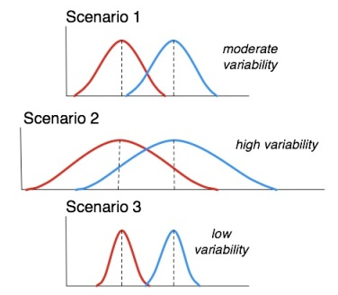
Common statistical tests, t test:
Can be one sample, two sample
Two sample test can be paired and unpaired
Assumes that the population(s) are normally distributed
Compares the means of the two distributions (two sample)
Or compares the mean of the population to a known value (one sample)
t test assumes that the variances of the samples are also identical. When this assumptions is not true we can use Welch's t-test

Slide 7
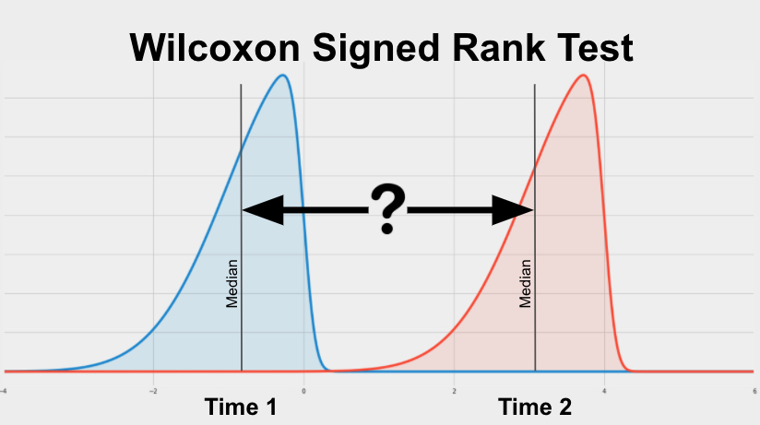
Common statistical tests, wilcoxon:
A non-parametric test
Can be one sample or two samples
Does not assume that the distribution is normal
When samples are paired the test is called Wilcoxon-signed rank test
When unpaired the test is called Mann-Whitney test
For non-normal data has more power than t test (more likely to detect significance)
For normal datat t test has higher power

Slide 8
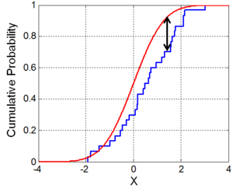
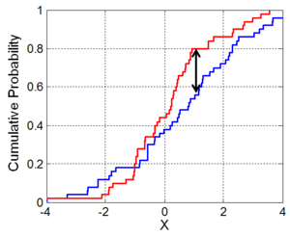
Common statistical tests, kolmogorov-smirnov test:
A non-parametric test
Compares the equality of of continuous one-dimensional distributions
Two sample test compares the distributions of the population
One sample test compares the distribution to a reference probability distribution
We calculate the distance between the empirical distribution function
It can be modified to be used as a goodness of fit test

Slide 9

Common statistical tests, fisher's exact test:
A statistical test for 2x2 contingency tables
Can be used when sample sizes are small (or not)
It can calculate the exact deviation from hypergeometric distribution
Commonly used in GO term or pathway enrichment analysis

Slide 10
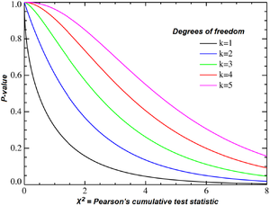
Common statistical tests, Chi-square test:
Tries to determine if there is a difference between the expected and observed frequencies in one or more categories
It can be used to compare #s of elements in each category between different conditions/populations
Doesn't work very well when sample sizes are small < 5 or 7 in each box
Used in contingency tables of any size
Need to know your "degrees or freedom"

Slide 11
Effect sizes, how big is the difference:
A t test tells us the probablility of seeing the difference we see if the null hypothesis is correct. It does not tell us if the difference between the means is large.
Here "large" depends on the mean and standard deviation of the two populations we are comparing, we need to "dynamically" adjust our expectations to reflect these population properties.
Cohen's d
Defined as the difference between two means divided by the standard deviation of data (pooled if two sample)
Values <0.2 considered small >0.8 considered large but all context dependent
Can also be used to estimate sample sizes needed for power analysis.
Cliff's delta
Non-parametric effect size
Originally designed for ordinal data but can be used for any number of distributions
It is a measure of how often values in one distribution is larger than the values in the other

Slide 12
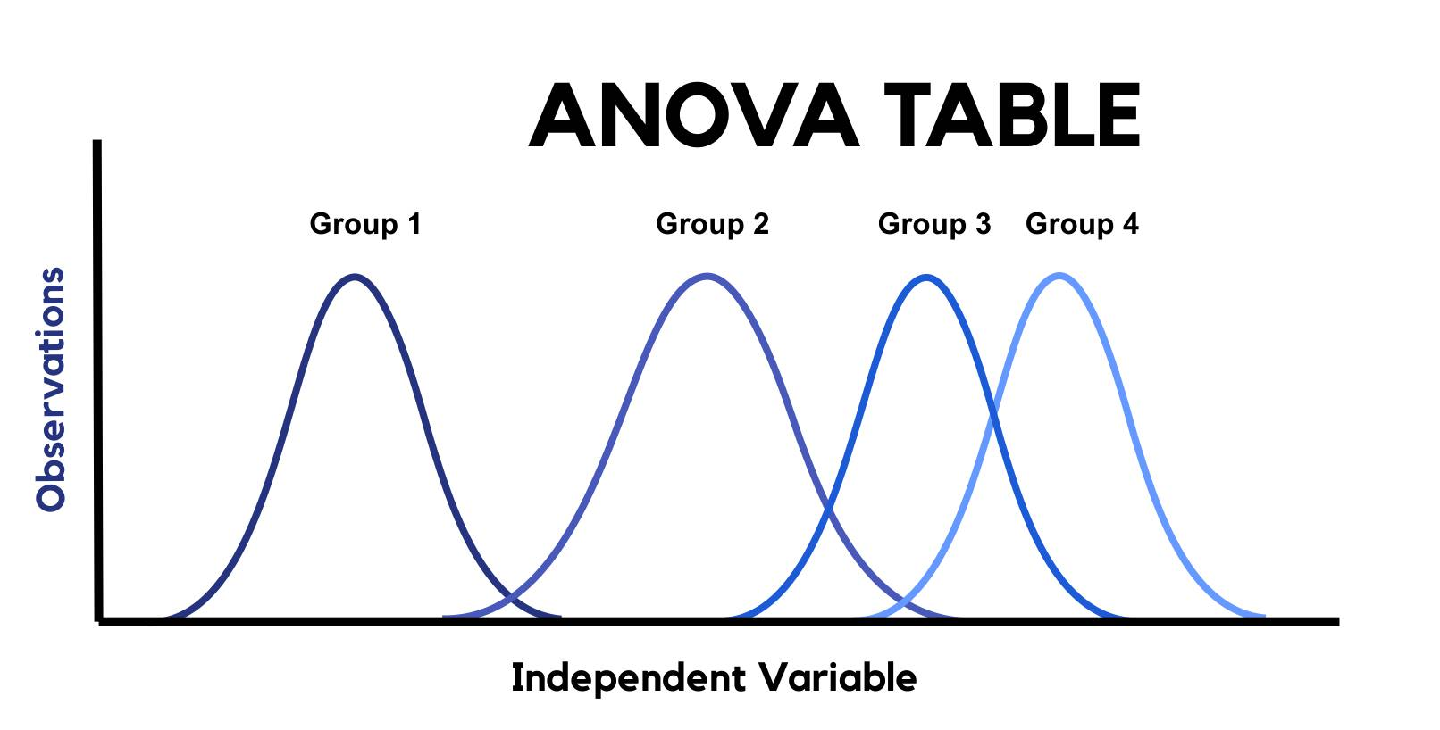
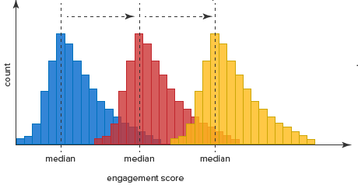
Multiple samples/populations:
Analysis of variance (ANOVA):
The null hypothesis states that the samples some from the same distribution regardless of grouping
It can tell us if any of the groups have a different mean (groups 1,2,3,4 left)
But cannot tell which one
Assumes normal distribution with equal variance
Kruskall-Wallis
Non-parametric method
One-way anova on ranks
It is an extension of the Mann-Whitney test
Like anova can tell is if any of the samples "dominates over" other samples but cannot tell which one.

Slide 13

Parametric vs non-parametric
Parametric:
Pros
If you know your distribution stronger test
It's not limited to Normal distribution you can test for any known (or invented distribution)
Cons
Need to know the distribution
Strength decreases rapildy as assumptions are violated
Non-Parametric:
Pros
No need to worry about distributions
Cons
Weak test, might miss subtle changes

Slide 14
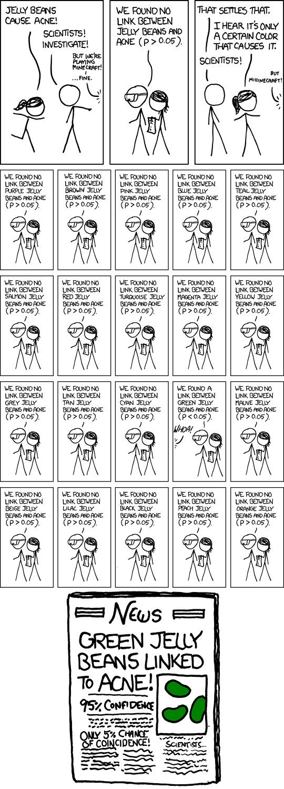
Multiple testing corrections
P value is the probability of observing what we observed if the null hypothesis is true
This is per test!
If we perform 20 tests the probability of seeing at least one significant result becomes 20 x 0.05=1
There are many different correction methods most common are Bonferroni and Benjamini–Hochberg
Assumes test are independent

Slide 15
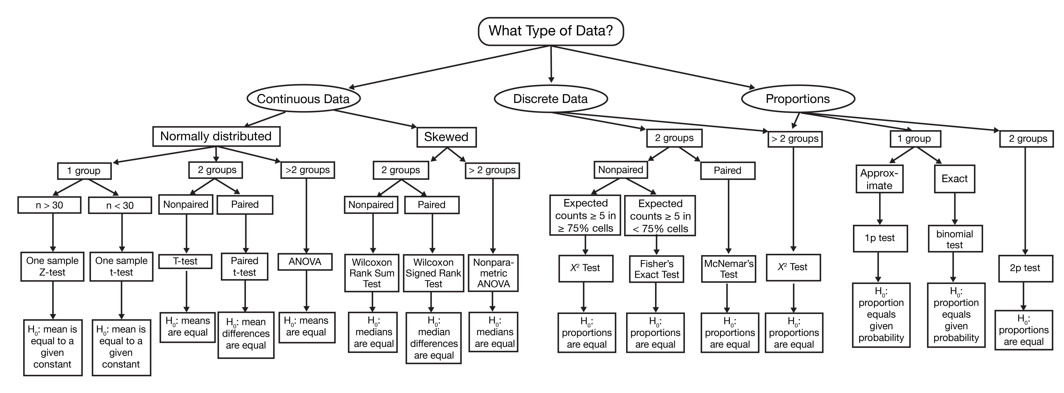
Which test to use?

Slide 16
R demo

