Slide 1
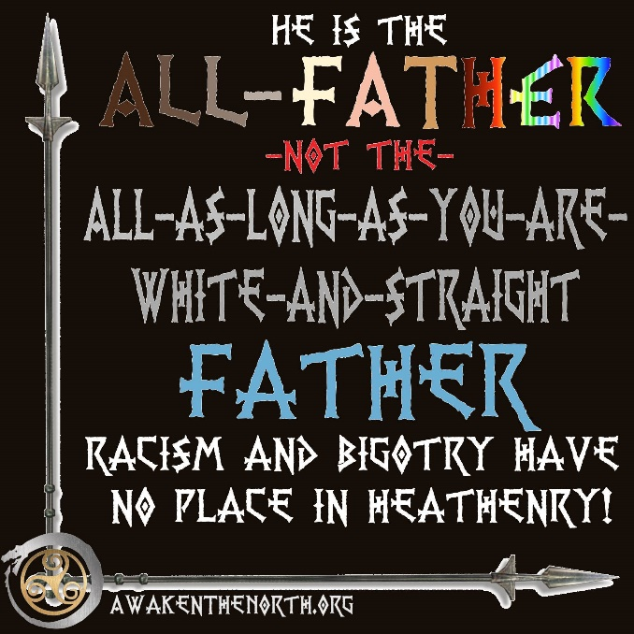
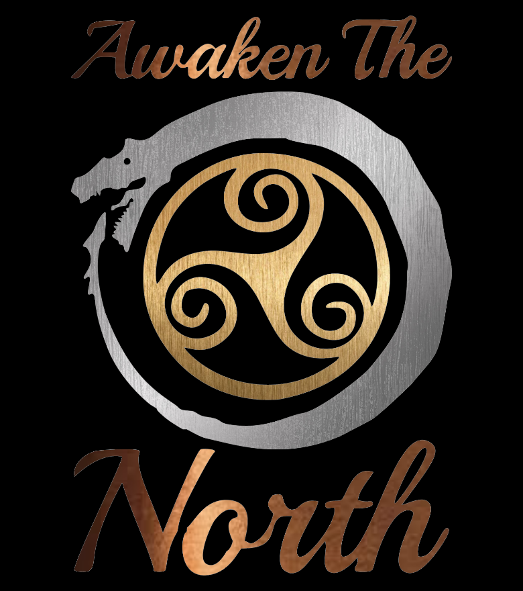
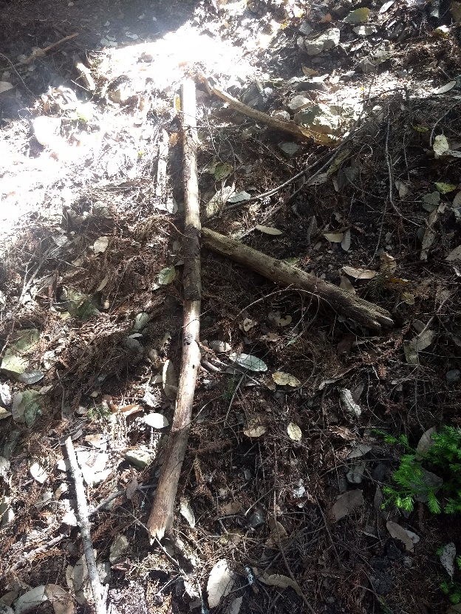
Awaken The North is a diverse organization that not only builds and forms small communities but also offers help to those seeking specific guidance, from help finding kindreds in their area, to learning of the Old Ways, to growing in their walks of faith and knowledge of the Gods, and beyond.
What is Inclusive Heathenry?
“When the Gods call you, they don’t care what color you are”
You may have run into folks that say, “Heathenry is the province of Northern European descendants.” That is the song of the racist, of the white supremacist… That is not what we believe. As Freyia Norling said, “When the Gods call you, they don’t care what color you are.” Your are welcome… no matter your race, your gender, or your gender identity. You. Are. Welcome.
Be Welcome,
in Frith
Contact Us
Email: cors@awakenthenorth.org
Phone: (417) 213-2372
http://www.awakenthenorth.org/

Slide 2
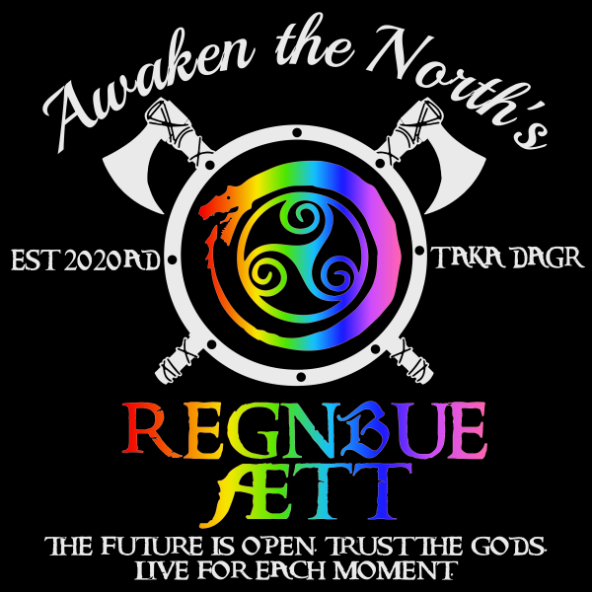
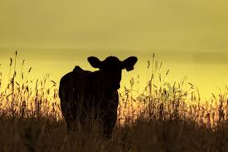
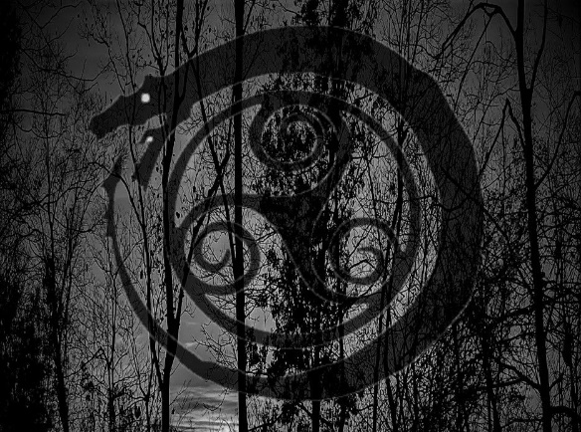

“When you see evil,
Call it out,
And do not let your enemies know peace”
Kaupmaðr
Felag
Heathens helping Heathens
Are you’re a crafter or business person? Awaken The North believes in Heathens helping Heathens! Join our network of Kaupmaðr Felga: "Fellowship of Merchants“ in Old Norse. This is a market to share the wares and offerings of some of the finest Heathen craftsmen in the world!
awakenthenorth.org/kaupmadr-felag/
The Hávamál, or ‘Words of Hávi [the High One]’, is presented as a single poem in the Codex Regius, a collection of Old Norse poems from the Viking age
Regnbue Ætt, from Old Norse, meaning Rainbow Clan, is Awaken the North’s own LGBTQIA+ Community!
Awaken The North embraces our brothers and sisters in the LGBTQIA+ Community. The Rainbow Clan has been established as a supportive haven; this is a safe space for anyone to talk about their unique experiences, struggles, and triumphs. You are welcome at our fire. Seize the Day!
Hail to the einherjar! Awaken The North honors our Warriors. Goði Beast has authored a version of the Hávamál in every day English; Oðin’s wisdom without the "thee's" and "thou’s”. We also have a pocket altar available! For every piece purchased, Awaken The North will donate a Hávamál and pocket altar to a member of our armed forces. We support our Heathen Sisters and Brothers who defend us all!
awakenthenorth.org/pocket-altar-requests/

