Slide 1
An epidemiological analysis: Children and the Syrian civil war
Celeste Connell
How is the Syrian civil war impacting the health of Syrian children?

Slide 2
Motivation and Background
Syrian war is an ongoing civil war that began on March 15th, 2011.
5.7 million Syrians have fled Syria
6.1 million people are internally displaced
400,000+ Syrians have been killed.
Children are one of the most vulnerable groups
Using empirical data to study the correlation between war/violence and the health/education of children
How is the Syrian civil war impacting the health and educational needs of Syrian children?
Notes:
The Syrian war is an ongoing civil war that began on March 15th, 2011. As of March 2019, an estimated 5.7 million Syrians have fled Syria, and over 6.1 million people are internally displaced. The United Nations estimated in 2016 that 400,000 Syrians were killed in the first five years of the war. The death toll has risen since. The World Health Organization cites the Syrian crisis as the worst humanitarian crisis yet in the 21st century.
Children are one of the most vulnerable groups in any population, especially in times of war, during which their physical and mental health are jeopardized, as well as their social and educational needs. Children are at risk for malnutrition, illness, abuse, and being recruited as fighters.
I'm using empirical data to study the correlation between the Syrian War and decreased educational and health attributes of Syrian children. This data can be used to see if any sub-populations are more at risk than others (e.g. children of certain governorates, age groups, gender, etc.)
My driving question for this project is: How is the Syrian civil war impacting the health and educational needs of Syrian children?

Slide 3
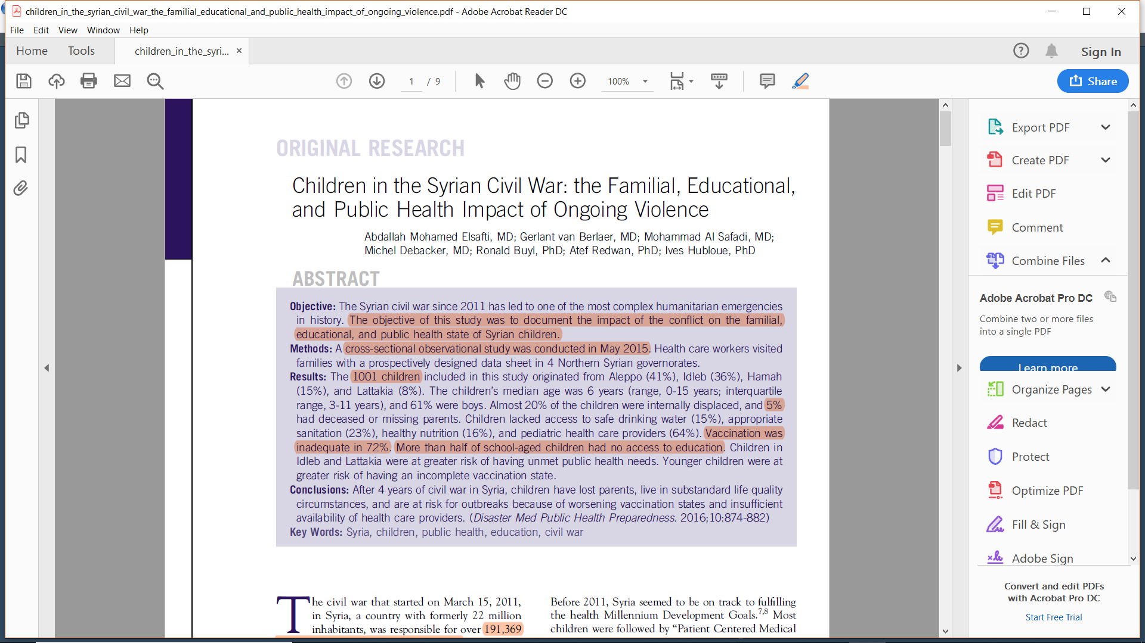
Approach
Cross-sectional observational study
Conducted in 2 days in May 2015 by 30 data collectors
Traveled house-to-house in 4 Northern Syrian governorates
Every child under 15 years eligible for inclusion
Notes:
In medical research and social science, a cross-sectional study is a type of observational study that analyzes data from a population, or a representative subset, at a specific point in time—that is, cross-sectional data.

Slide 4
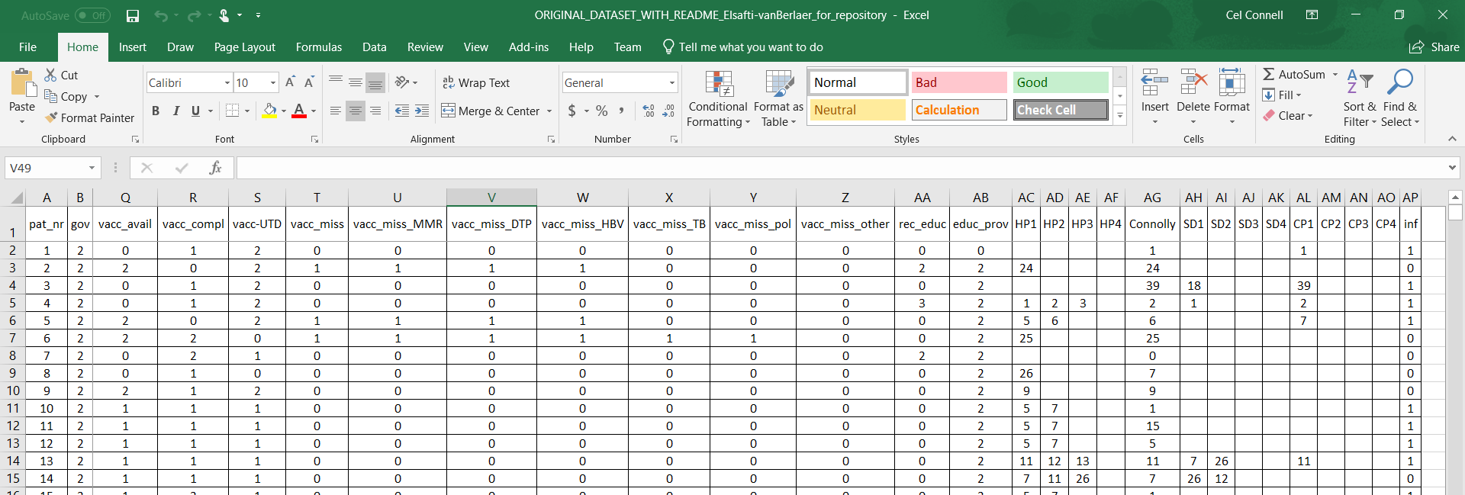
About the Data
Excel file containing 3 sheets (1 data, 2 metadata)
Each row represents one Syrian child (1002 after removing ineligible participants)
42 columns/variables (governate, age, gender;
Coded
Notes:
Descriptive: patient ID, age category, gender, legal guardian, whether or not they’ve been displaced from their home
Nutritional info (safe drinking source, breastfeed, safe and healthy food available), vaccination, malnutrition, school, who provides school, signs of infectious disease, etc.

Slide 5

Metadata

Slide 6
Anticipated Details
Create novel plots and graphs with ggplot
Descriptive epidemiology
How many children of our total sample are displaced? Breastfeeding? Vaccinated? In school? Have an infectious disease? Have access to healthy food, safe water, and healthcare?
Run chi-squared analyses and mixed effect models to determine if specific sub-populations are more at risk than others
Analytic epidemiology
Are certain age groups, genders, or specific governorates more at risk of displacement, not being breastfed, not being vaccinated, dropping out of school, not having access to food/water/healthcare than others?
Notes:
I will create novel plots and graphs of some of the data that will fairly match the plots created by Elsafti et al.
Additionally, Elsafti et al. conducted a "chi-squared analysis to identify factors associated with the health problems by using water access, proper sanitation, healthy food, accessible health care, and vaccination state as outcome variables and by using [governorate], age category... and gender as predictors". I will replicate my own chi-squared analysis, as well as various mixed effect models, using similar predictors and response variables, to determine if certain sub-populations are more at risk than others.

Slide 7
Anticipated Results
DESCRIPTIVE EPIDEMIOLOGY
ANALYTIC EPIDEMIOLOGY
20% displaced to IDP camps
9% did not have access to clean drinking water
15% did not have access to appropriate sanitation
15% did not have access to nutrition
32% suffered from malnutrition
51% of school-aged children were not in school
64% could not access health care providers
34% had unknown vaccination status
- Of the 64% that were vaccinated, 43% were not up to date
RESULTS OF ELSAFTI ET AL.’S CHI SQUARED ANALYSIS: “The risk for children to have unmet needs depended mainly on the governorate in which they resided”
- Not linked to gender or age
My analyses will likely reflect this, but I’m curious about the results of my mixed effect models, which might yield more computing power than chi-squared.
Notes:
“The risk for children to have unmet needs depended mainly on the governorate in which they resided… these problems were not linked to gender or age, except for vaccination state: the smaller the children, the more at risk they were for having an incomplete vaccination state.”

Slide 8
Works Cited
Elsafti AM, van Berlaer G, Al Safadi M, Debacker M, Buyl R, Redwan A, Hubloue I (2016) Children in the Syrian Civil War: the Familial, Educational, and Public Health Impact of Ongoing Violence. Disaster Medicine and Public Health Preparedness 10(06): 874-882. https://doi.org/10.1017/dmp.2016.165
Elsafti AM, van Berlaer G, Al Safadi M, Debacker M, Buyl R, Redwan A, Hubloue I (2016) Data from: Children in the Syrian civil war: the familial, educational, and public health impact of ongoing violence. Dryad Digital Repository. https://doi.org/10.5061/dryad.73ff4

