Slide 1
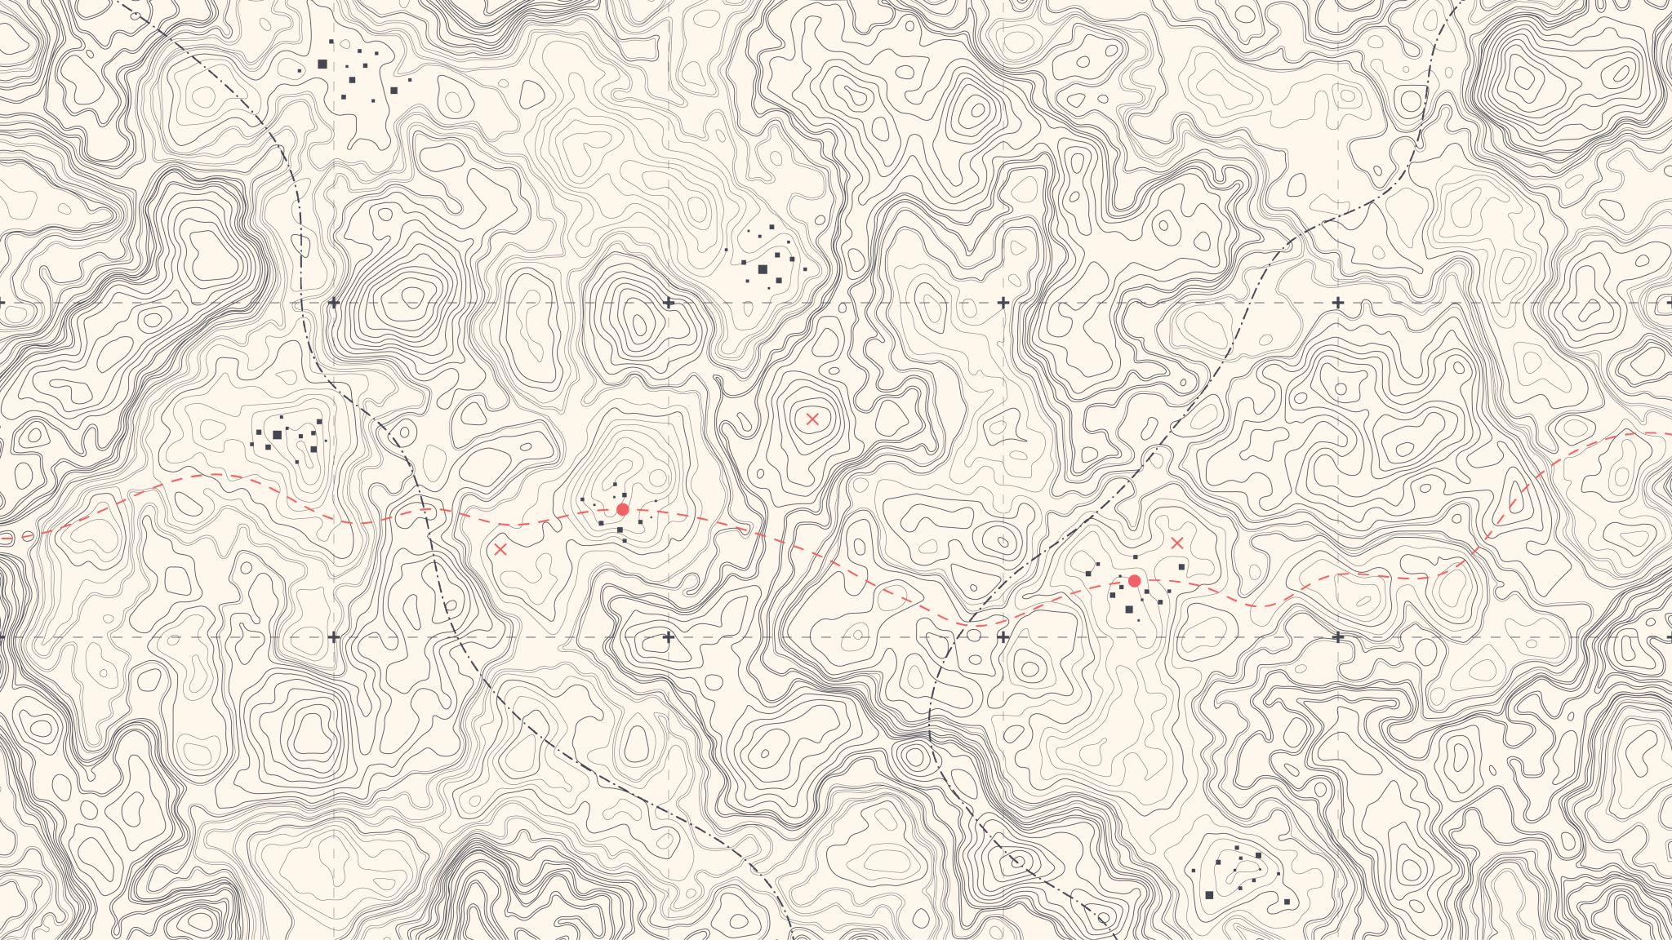
Spatial Data in R
Mostly, using terra for rasters and using sf for vectors (e.g., shapefiles)

Slide 2
Different data formats
Rasters
Created with pixels
Each pixel has a value
Can never have smooth edges and will lose quality when you zoom in
Most commonly stored as .tif
R packages: terra, raster, stars
Vectors
Created with math / equations or with defined coordinates
Often, points, polygons, or lines when thinking about spatial data
Shapefiles (.shp) are a common example
R packages: sf, terra

Slide 3
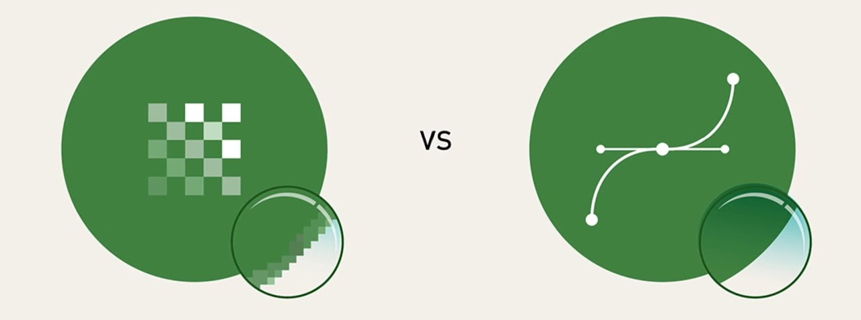
Different data formats

Slide 4
The (worst) parts of working with spatial data
Finding good spatial data
Getting the spatial data in a format that works easily with R
Spatial data can be stored in various file types
Spatial data can be very messy
Computation time / computer storage
Some spatial data can be massive and can really bog down your computer

Slide 5
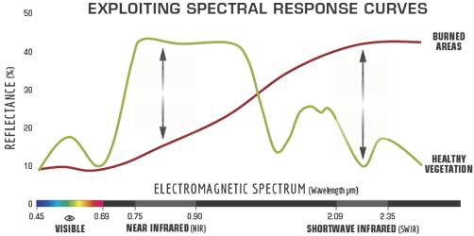
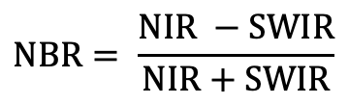
Remote sensing and wildfires
Monitoring trends in burn severity (MTBS) relies on remotely sensed data (the normalized burn ratio; NBR) directly before and after a fire occurs to classify burn severity
$$NBR= \frac{NIR −SWIR}{NIR+SWIR}$$

Slide 6
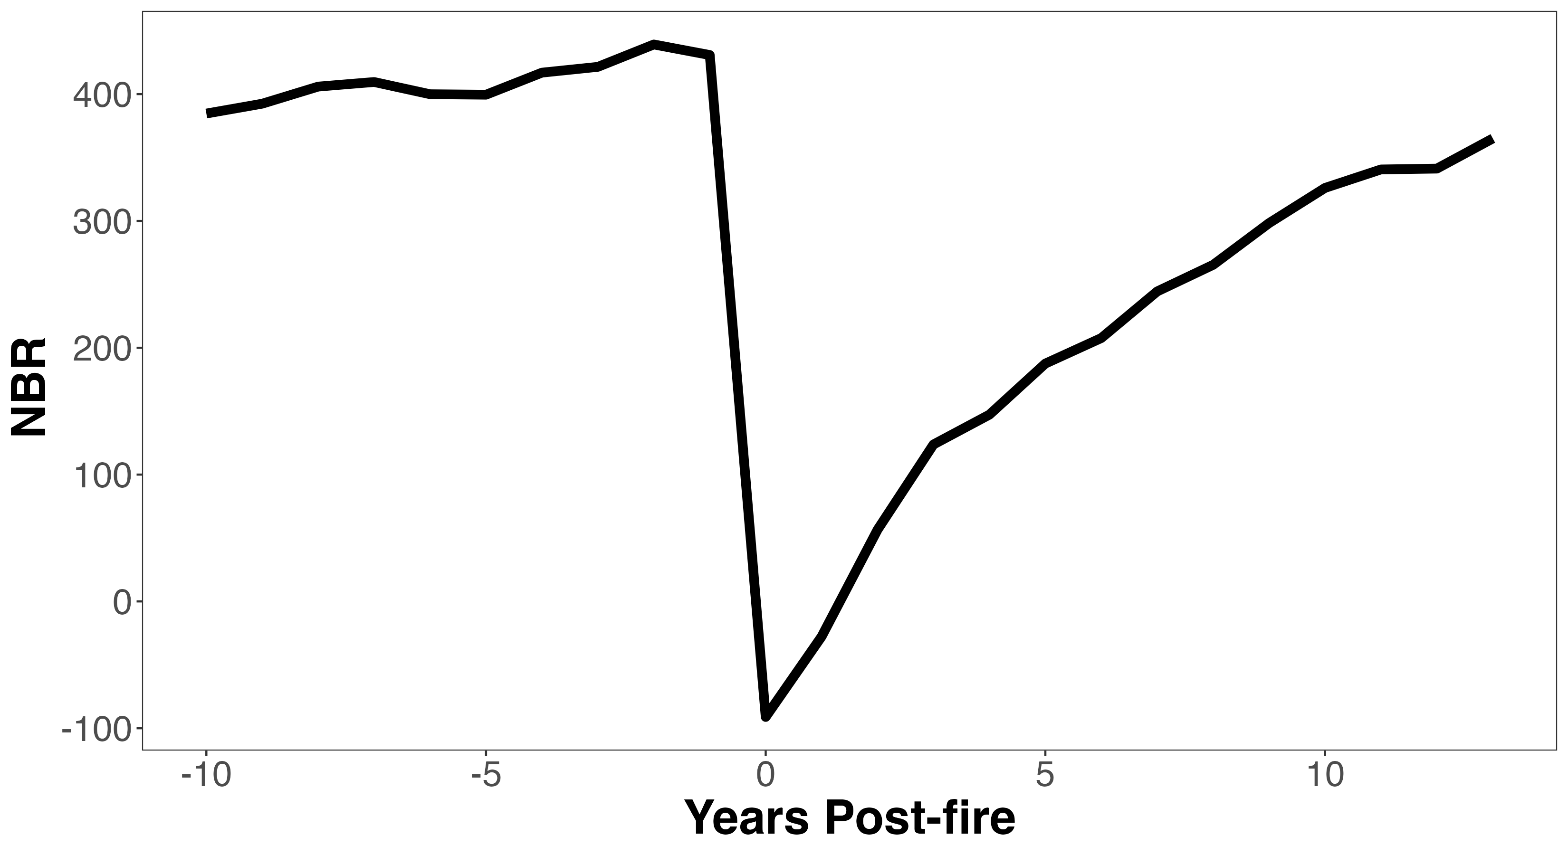
Remote sensing and wildfires
Monitoring trends in burn severity (MTBS) relies on remotely sensed data (the normalized burn ratio; NBR) directly before and after a fire occurs to classify burn severity
dNBR

Slide 7



Remote sensing and Post-fire REcovery
Remotely sensed burn severity can be predictive of post-fire recovery outcomes
Spectral recovery uses time series of remotely sensed indices (e.g., NBR) to mirror post-fire vegetation recovery

