Slide 1
SubSea: An Efficient Heuristic Algorithm for Subgraph Isomorphism
Vladimir Lipets
Ben-Gurion University of the Negev
Joint work with
Prof. Ehud Gudes

Slide 2
Motivation
Subgraph isomorphism is important and very general form of pattern matching that finds practical application in areas such as:
  pattern recognition and computer vision,
  image processing,
  computer-aided design, graph grammars,
  graph transformation,
  biocomputing,
  search operation in chemical database,
  numerous others.

Slide 3
Motivation
Theoretically, subgraph isomorphism is a common generalization of many important graph problems:
  Hamiltonian paths,
  cliques,
  matchings,
  girth

Slide 4
A hierarchy of pattern matching problems
Graph isomorphism
Subgraph isomorphism
Maximum common subgraph
Approximate subgraph isomorphism
Graph edit distance

Slide 5
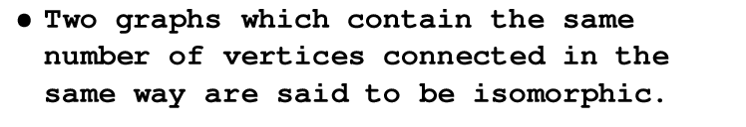
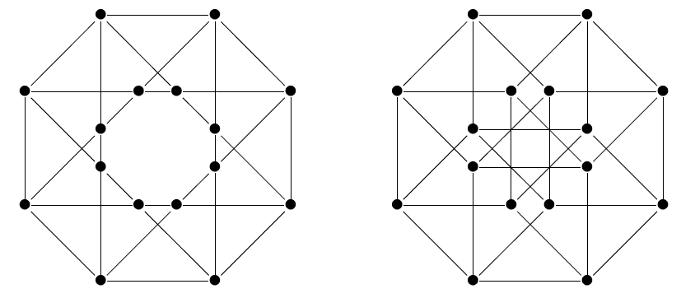
Isomorphic Graps

Slide 6
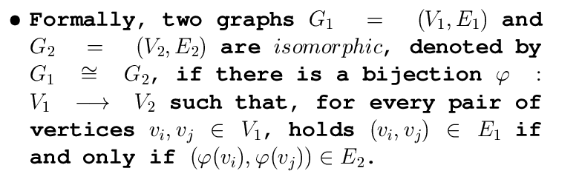
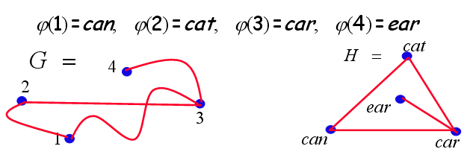
Graph Isomorphism

Slide 7
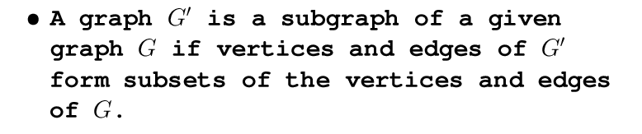
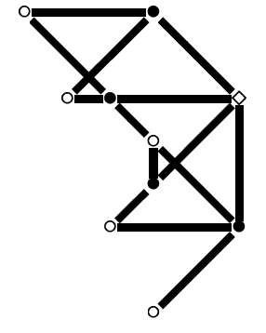
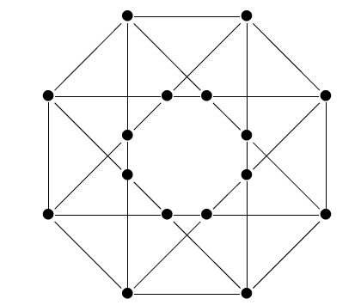
Subgraph of a given graph

Slide 8
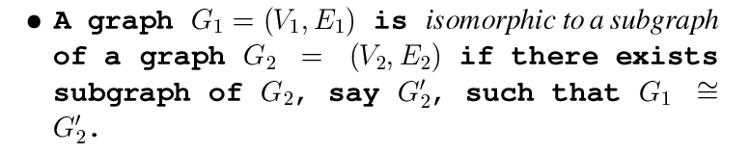
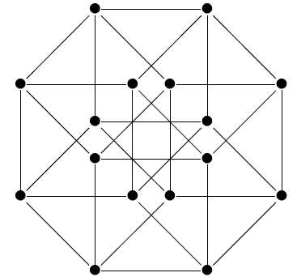
Subgraph Isomorphism

Slide 9
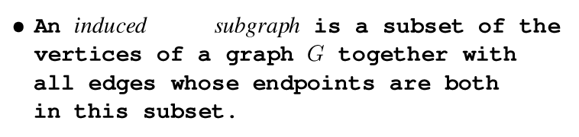
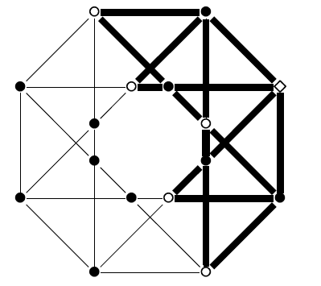
Induced Subgraph

Slide 10
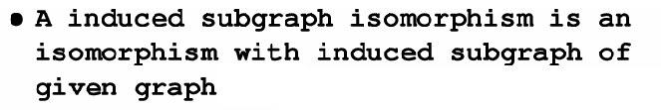
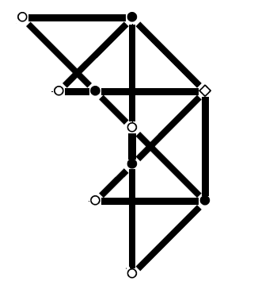
Induced Subgraph Isomorphism

Slide 11
Subgraph Isomorphism and Related Problems
Given a pattern graph G and a target graph H
Decision problem: Answer whether H contains a subgraph isomorphic to G
Search problem: Return an occurrence of G as a subgraph of H
Counting problem: Return a count of the number of subgraphs of H that are isomorphic to G
Enumeration problem: Return all occurrences of G as a subgraph of H

Slide 12
Subgraph Isomorphism and Related Problems
Given a pattern G and a text H
General problem: Both G and H are general graphs
Restricted problem: Both G and H are input graphs belonging to a particular class, such as trees or planar graphs
Fixed problem: G is a general graph but H is a fixed graph, or viceversa

Slide 13
Ullman’s Algorithm
Ullmann proposed a depth first search based algorithm with a smart pruning procedure (refinement procedure),which is now the most popular and frequently used algorithm for this problem because of its generality and effectiveness.

Slide 14
Our Approach
We present a novel approach to the problem of finding all subgraphs and
induced subgraphs of a (target) graph which are isomorphic to another
(pattern) graph.
To attain efficiency we use a special representation of
the pattern graph. We also combine our search algorithm with some known
bisection algorithms.

Slide 15
Bisection: Problem Definition
A bisection of a graph G=(V,E) is a pair of disjoint subsets of V with equal size.
The cost of a bisection is the number of edges with endpoints in different subsets.
The problem of Graph Bisection takes as input a graph G, and returns a bisection of minimum cost.

Slide 16
Bisection: NP-completness
Maximum cut problem can be reduced to minimum bisection, thereby showing that minimum bisection is NP-complete.
First note that maximum bisection can easily be reduced to minimum bisection (or vice-versa).

Slide 17
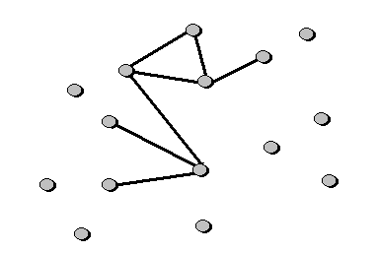
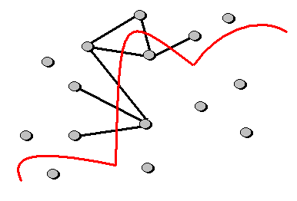
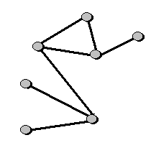
Bisection: NP-completness
Given a graph G with n vertices, we claim that the width of the maximum cut for G is equal to that of the maximum bisection of the graph G' given by appending n isolated vertices to G.

Slide 18
Bisection: Graph Models
G(n,p,r) is a probability distribution on graphs with vertex set {1, 2, ... n} in which the presence of each possible edge is independent, with probability p for edges within {1, 2, ... n/2} or {n/2 + 1, ... ,n} and probability r<p for other edges.

Slide 19

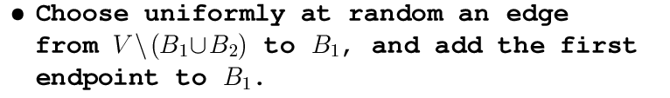
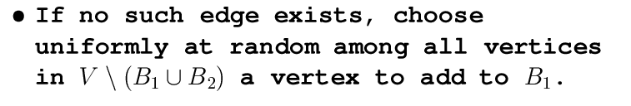


Bisection: Randomized Black Holes

Slide 20
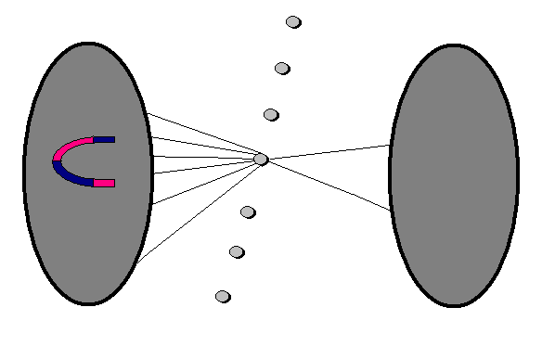
Black Holes: Heuristic
Assuming that the black holes are currently contained in opposite sides of a minimal bisection, we are likely to add to each hole a vertex from the correct side because there will be more edges from this side.

Slide 21
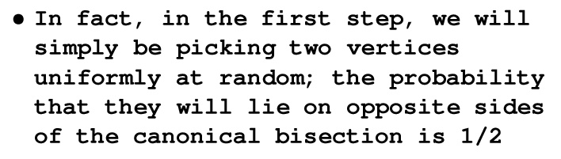
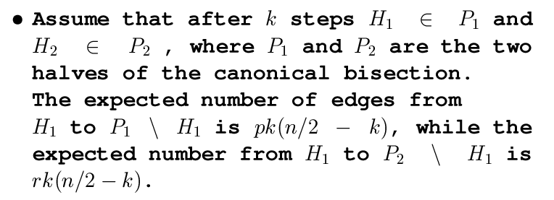
Black Holes: Likelihood of success

Slide 22

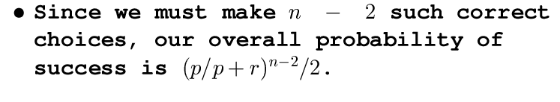
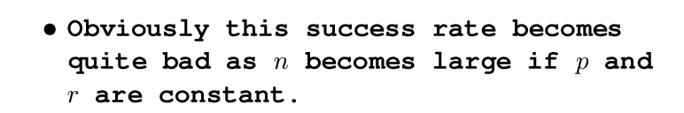
Black Holes: Likelihood of success

Slide 23
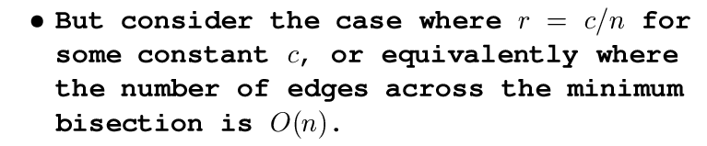
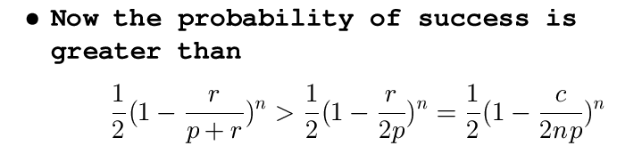
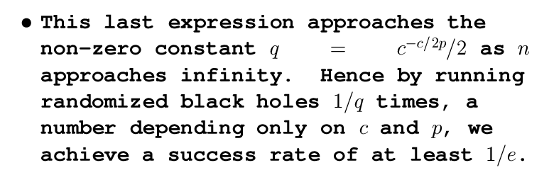
Black Holes: Likelihood of success

Slide 24
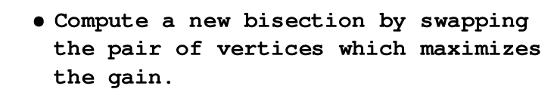

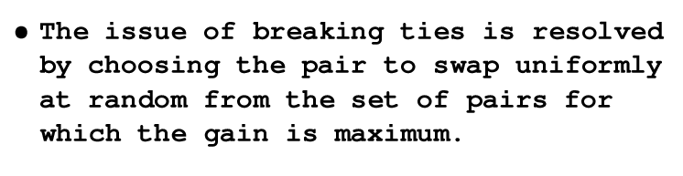
Bisection: Simple Greedy Method

Slide 25
Bisection: Kernigan-Lin Method
Make a copy of the graph
On the copy graph, swap the pair with the largest gain, even if this gain is negative, and mark the vertices as “swapped”. Break ties randomly
Repeat the previous step on unmarked vertices until no points are left to be swapped.
Pick k such that the cost of the bisection at the kth step of the above process was smallest. Break ties (again) randomly
Swap these first k pairs of vertices on the original graph

Slide 26
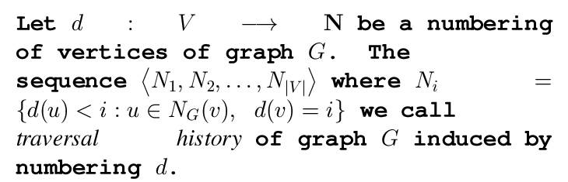
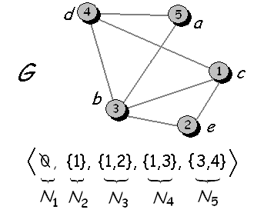
Pattern Representation: Traversal History

Slide 27
Traversal History: The DFS approach
Our first approach based on a modification of the well known DFS (Depth-First Search) algorithm which provides a general technique for traversing a graph
Recall, that the DFS traversing is not deterministic, i.e. for any graph G a number of traversals is possible.

Slide 28
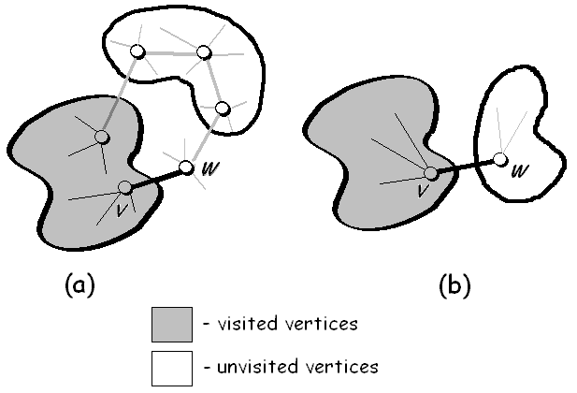
Traversal History: The DFS approach
We extend the traversing strategy by some heuristic rules, to provide a “fastest” return to the visited nodes

Slide 29
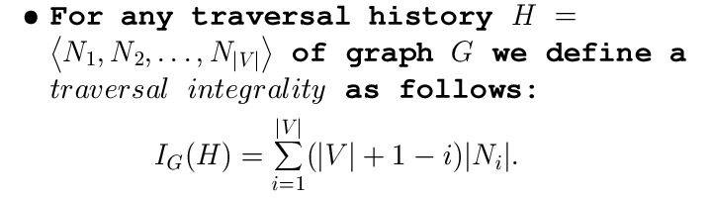
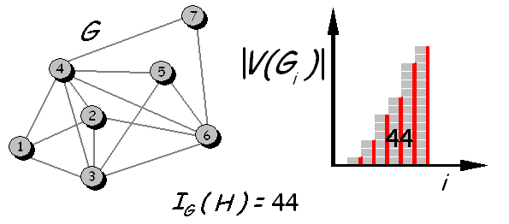
Traversal History: Traversal Integrality Approach

Slide 30
Traversal Integrality Approach: Black Hole
We provide a simple (and very fast) randomized method for finding the induced traverse history with the largest (or the smallest) traverse integrity.
This method is very similar to the Black Holes Bisection algorithm.

Slide 31

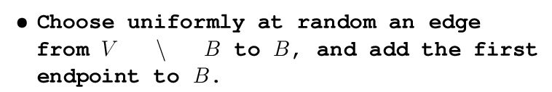


Traversal Integrality Approach: Black Hole

Slide 32
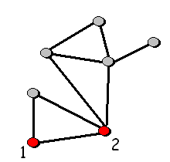

Traversal History: Starting vettices
We extend these two approaches, to find a traversal history by given two starting vertices.

Slide 33
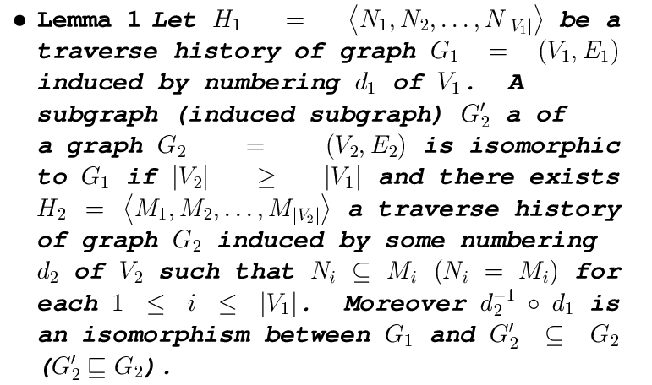
Search Technique: Main Lemma
We seek for subgraphs satisfying condition of the following obvious lemma:

Slide 34
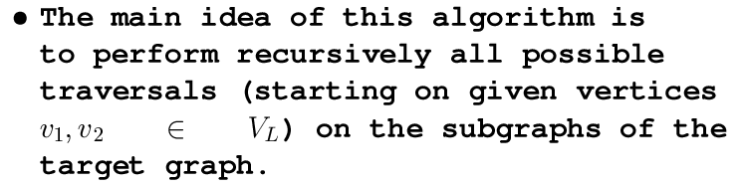

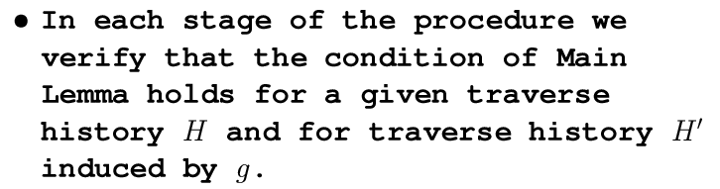
Search Technique: Main Idea

Slide 35
Motivation of presented heuristics
If the condition of Main Lemma failed in the earlier stage, then it's running time is reduced.
Using the heuristics presented earlier, forces the above checking to be done as soon as possible, thereby decreasing the expected running time.

Slide 36
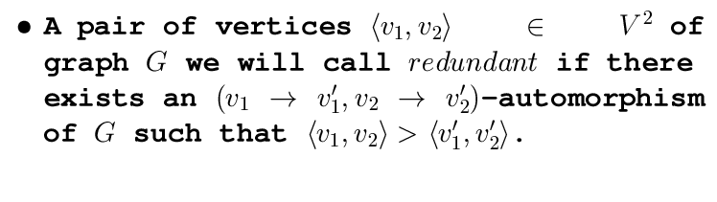


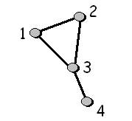

Precomputation Stage: Redundant pair

Slide 37
Precomputation Stage: All pattern traversals
We find a corresponding traverse history for each not redundant pair of adjacent vertices of the given pattern graph.
Note that each edge of the pattern graph may derive 0, 1 or 2 traverse histories.
This approach enables us to minimize the number of stored traversals, when a set of automorphisms of G is non-empty, thereby reducing the running time of the main search algorithm.

Slide 38





Example: Precomutation Stage

Slide 39
Main Algorithm
Complete the Precomutation Stage
Divide vertices of a given target graph in two parts using bisection methods provided.
For each edge with endpoints in distinct parts of the obtained bisection we find the set of all subgraphs containing this edge and isomorphic to a given pattern graph.
After performing these steps, we continue to apply recursively the same approach on two subgraphs of a target induced by two parts of bisection.

Slide 40
Bisectiom Methods: Motivation
When we finished to seek for isomorphic subgraphs containing any given edge of the target graph – we can remove this edge.
Using of bisection methods provide a smart heuristic order to remove edges. Namely, we attain to remove the minimal number of edges, minimizing the edge-size of the largest connected component.

Slide 41
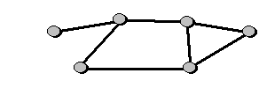

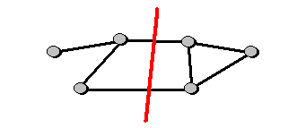


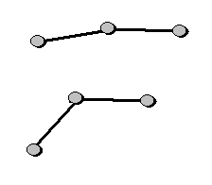
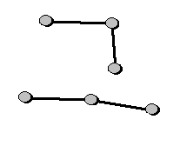
Example: Main algorithm

Slide 42
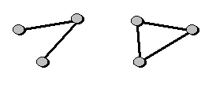

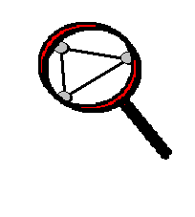
Example: Main algorithm

Slide 43
Experiments
Experimental comparison with some others algorithms was performed on several types of graphs.
The comparison results suggest that the approach provided here is the most effective.

