Slide 1
Governed Database Deployments
A secure, auditable and pull-based model for database changes

Slide 2
Executive Summary
Database changes are traditionally high-risk and hard to audit
Limited auditability and weak governance are common
This model introduces governance without increasing complexity
The solution has been validated in a working Docker-based lab
Notes:
High-level overview for directors and architecture board.

Slide 3
Problems with the Current Model
Direct database access by humans or scripts
DDL changes without rollback guarantees
DML failures are hard to recover safely
Limited traceability and auditing
BMC ticket link
Notes:
These issues are typical in legacy and EBS-like systems.
DDL data definition language
DML data manipulation language

Slide 4
Design Goals
Strong governance and full auditability
Clear separation of responsibilities
No inbound database exposure
Compatibility with legacy systems (Oracle EBS)
Possibility to expand to other systems
Notes:
Stress compliance, security, and operational safety.

Slide 5
Current vs Proposed
Current: Semi-automated SQL execution
Current: High operational risk and weak audit trail
Proposed: Git-governed, pull-based execution
Proposed: Deterministic and auditable deployments
Notes:
Contrast the old and new models clearly.

Slide 6
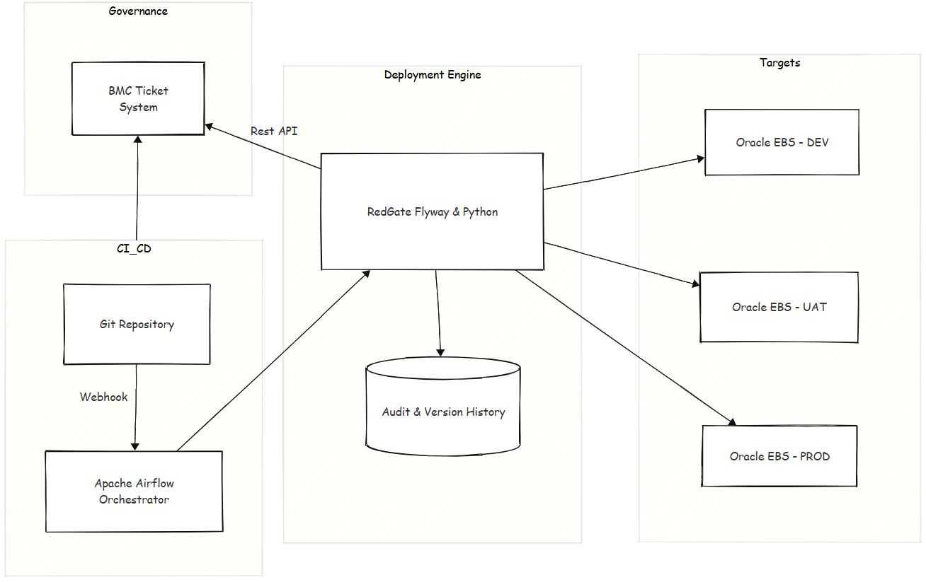
Target Architecture
Notes:
In Apache Airflow, a DAG (Directed Acyclic Graph) is the central concept used to define and orchestrate workflows. It is a collection of tasks organized with dependencies and relationships, specifying the order in which they should run.

Slide 7
Pull-Based Execution Flow
Developers commit versioned SQL migrations to Git
Git triggers Airflow through a controlled webhook
Airflow orchestrates execution without holding secrets
Flyway applies migrations with strict ordering and validation
Database evolves with full history and traceability
Notes:
Explain how this mirrors ArgoCD-style pull models.

Slide 8
Security Model
No credentials stored in source control
Secrets injected at runtime via Airflow Connections
Outbound-only connectivity (no inbound DB access)
Principle of Least Privilege enforced
Notes:
Important slide for security teams and DBAs.

Slide 9
Operational Benefits
Safe handling of DDL and DML failures
Explicit recovery via forward-only migrations
Repeatable and idempotent deployments
Clear promotion accross environments

Slide 10
What This Enables
Support for Oracle EBS and other systems (Oracle thin, MySQL, Postgres, ...)
Compliance-ready database change management
Scalable foundation for enterprise environments
Notes:
Close with future scalability and roadmap.

