Slide 1


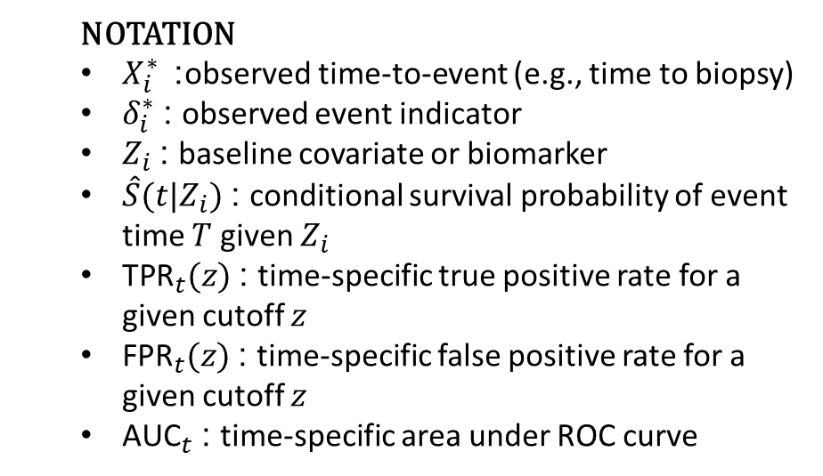
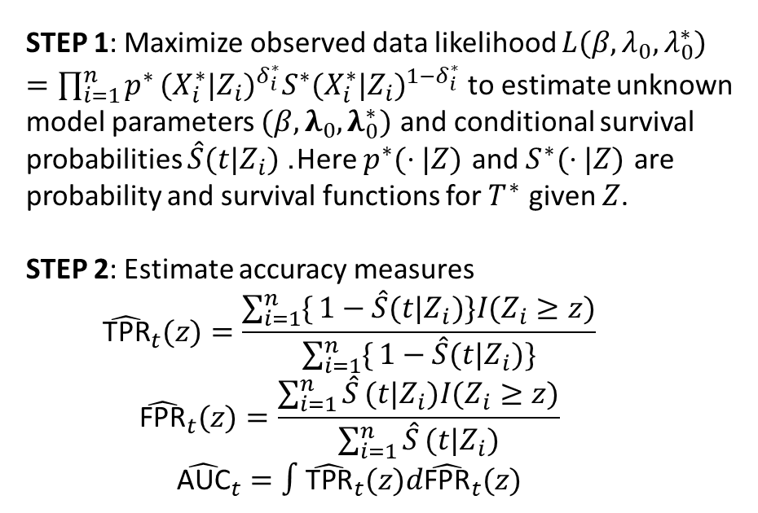

INPUT DATA
RISK ESTIMATION
ACCURACY MEASURES
Outcomes Biomarkers
$\left[\begin{matrix}(X_{1}^{∗},δ_{1}^{∗}) \\ ⋮ \\ (X_{n}^{∗},δ_{n}^{∗})\end{matrix}\right]$ + $\left[\begin{matrix}Z_{1} \\ ⋮ \\ Z_{n}\end{matrix}\right]$
$$\left[\begin{matrix}\hat{S}(1|Z_{1}) & ⋯ & \hat{S}(T|Z_{1}) \\ ⋮ & ⋱ & ⋮ \\ \hat{S}(1|Z_{n}) & ⋯ & \hat{S}(T|Z_{n})\end{matrix}\right]$$
$$\left[\begin{matrix}({\text{TPR}}_{1}(z),{\text{FPR}}_{1}(z),{\text{AUC}}_{1}) \\ ⋮ \\ ({\text{TPR}}_{T}(z),{\text{FPR}}_{T}(z),{\text{AUC}}_{T})\end{matrix}\right]$$
STEP 1
STEP 2
NOTATION
$X_{i}^{∗}$ : observed time-to-event (e.g., time to biopsy)
$δ_{i}^{∗}$: observed event indicator
$Z_{i}$: baseline covariate or biomarker
$\hat{S}(t|Z_{i})$: conditional survival probability of event time $T$ given $Z_{i}$
${\text{TPR}}_{t}(z)$: time-specific true positive rate for a given cutoff $z$
${\text{FPR}}_{t}(z)$: time-specific false positive rate for a given cutoff $z$
${\text{AUC}}_{t}$: time-specific area under ROC curve
STEP 1: Maximize observed data likelihood $L(β,λ_{0},λ_{0}^{∗})=\prod_{i=1}^{n}{p^{∗}}(X_{i}^{∗}|Z_{i})^{δ_{i}^{∗}}S^{∗}(X_{i}^{∗}|Z_{i})^{1−δ_{i}^{∗}}$ to estimate unknown model parameters $(β,λ_{0},λ_{0}^{∗})$ and conditional survival probabilities $\hat{S}(t|Z_{i})$. Here $p^{∗}(⋅|Z)$ and $S^{∗}(⋅|Z)$ are probability and survival functions for $T^{∗}$ given $Z$.
STEP 2: Estimate accuracy measures
$${\hat{\text{TPR}}}_{t}(z)=\frac{\sum_{i=1}^{n}{\{}1−\hat{S}(t|Z_{i})\}I(Z_{i}≥z)}{\sum_{i=1}^{n}{\{}1−\hat{S}(t|Z_{i})\}}$$
$${\hat{\text{FPR}}}_{t}(z)=\frac{\sum_{i=1}^{n}{\hat{S}}(t|Z_{i})I(Z_{i}≥z)}{\sum_{i=1}^{n}{\hat{S}}(t|Z_{i})}$$
$${\hat{\text{AUC}}}_{t}=∫{\hat{\text{TPR}}}_{t}(z)d{\hat{\text{FPR}}}_{t}(z)$$

