Slide 1
EZ Wallet a digital identity on the Solana Blockchain
Supporting digital rights for refugeEs, forcibly displaced communities and stateless people
Istanhack 2022 submission by Steve Murphy

Slide 2
The Problem
Globally, more than 1 billion people lack identity papers. In our modern world this excludes from services and socio-economic participation, it limits access, for example, to work, housing, a mobile phone and a bank
Refugees, asylum seekers, stateless persons, and other forcibly displaced persons should have a legally recognized as well as a digital identity. Individuals will be able to request UNHCR to certify their identity.
UNHCR and other aid agencies need to improve their service delivery by using the internet and mobile services more extensively.

Slide 3
The Solution
Let’s use the Solana blockchain to provide a free, secure wallet – let’s call it EZ Wallet
The EZ Wallet supports a persons rights to a digital identity.
The EZ Wallet is portable and secure and can be accessed from anywhere in the world
The EZ Wallet can contain cash, proof of digital identity and rights to receive items and services.

Slide 4
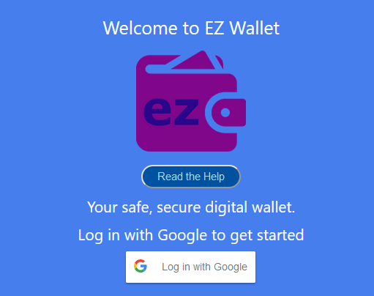
Welcome to EZ Wallet

Slide 5
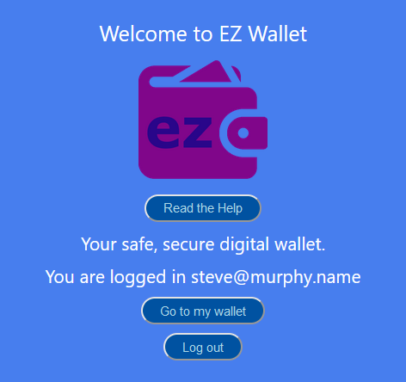
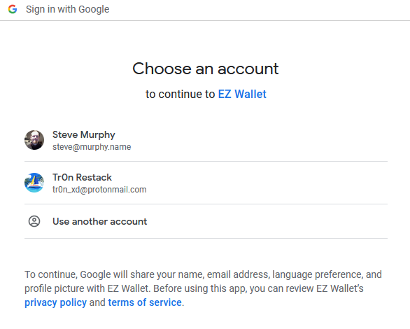
Log in via Google account (OAuth)

Slide 6
EZ Wallet is… EASY ☺
Since we are supporting persons who can be displaced, persecuted or fleeing disasters, the solution needs to be easy
Let’s prioritise usability and simplicity over complexity
At the same time let’s make sure the solution is secure – that’s why we use blockchain and Google OAuth

Slide 7
Where is the private key… ?
Hard wallets, ledgers, browser plugins, paper backups of private keys… all could be lost
Private key management is also complex
EZ Wallet manages private keys in the cloud, avoiding this problem for the user

Slide 8
Our New Concept – EZ Wallet
EZ Wallet is an easy, secure “cloud based wallet”
You don’t need to manage private keys yourself
All authentication is done via Google Oauth
Lastly, EZ Wallet is free for everyone

Slide 9


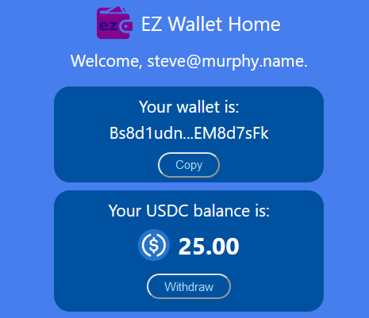



EZ Wallet can hold USDC funds

Slide 10
What can the wallet hold?
EZ Wallet can hold funds (USDC)
EZ Wallet can hold your digital identity
EZ Wallet can hold tokens to represent items and services

Slide 11
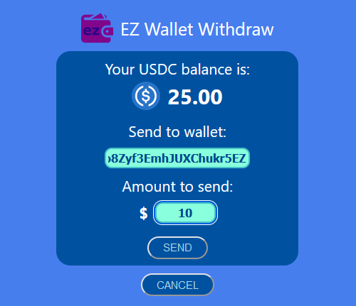
Withdraw Funds

Slide 12
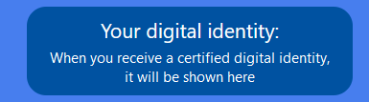
Certified Digital Identity

Slide 13
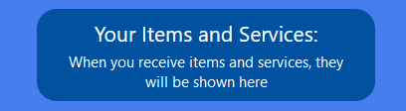
Items and Services

Slide 14
EZ Wallet
A secure, easy blockchain wallet can support the rights of displaced and vulnerable persons
The EZ Wallet can be used by aid organisiations like UNHCR for delivering certified a digital identity, CBI (cash based interventions) and other items and services
Thanks for this Hackathon! – Steve ☺

