Slide 1
DDD Pacemaker
COMPSYS303
Group 9

Slide 2
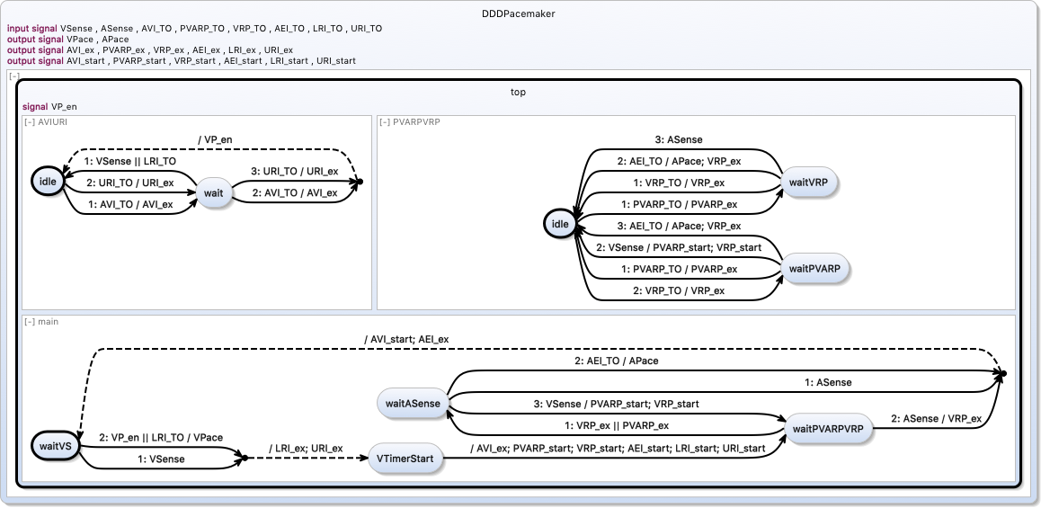
SCCharts Design

Slide 3
The SCCharts/C Interface
- SCCharts abstracts concurrent state switching via reset() and tick() calls. - C features: ‘opening’ DE2 peripherals, e.g. buttons. These can trigger SCCharts input signals, e.g. VSense and ASense.
- LEDs to display SCCharts output signals (and logic for how long) - Timers for each signal (URI, LRI, PVARP, VRP, AVI, AEI). This provides SCCharts with asserts/de-asserts on signal timeout, used in SCCharts for state switching logic.
Summary:
SCCharts = system logic, C = manages I/O signals before and after tick()

Slide 4
Mode 1 Testing
Key1 – ASense high (connected to LED1)
Key0 – VSense high (connected to LED0)
APace – LED3 high VPace – LED2 high Tests:
VS after AP → VP shouldn’t go high AS after VP → AP shouldn’t go high VS after AP, but spammed a bit to check VRP is ‘blocking’ VS and AS simulating correct heart operation (no paces)

Slide 5
Mode 2 Testing
Non-blocking bidirectional UART initiated in C
DE2 transmits interpreted as negative pulses
Tests:
All three options checked = correct heart operation
Disease Mode 1: SA Node Autorhythmic unchecked – atrial beating slows from 100bpm (natural operation) to 60bpm (natural AV node beating). Slowing causes activation of APace
Disease Mode 2: SA Node Autorhythmic AND AV Node Autorhythmic unchecked – more extreme slowing than when SA Node was failing, erratic atrial paces that don’t have trigger an ASense
Disease Mode 3: SA Node Autorhythmic checked, AV conduction disabled – no co-ordination between atria -> ventricles; atrial is at correct bpm (since SA node is fine), but ventricles are slow and being paced

