Slide 1
01 / 30 TITLE
A C A D E M I C P A P E R R E A D I N G
Kimi K2: Open Agentic Intelligence
P A P E R H I G H L I G H T S
Core result
Kimi K2 achieves open-source SOTA on agentic tasks with 1.04T parameters.
Kimi Team
Scale
A content-first paper reading deck built from existing parsed checkpoints.
1.04T total parameters; 32.6B activated per token.
Focus: motivation, system design, training recipe, and evaluation evidence.
Design edge
QK-Clip stabilizes Muon training by clamping attention logits at tau = 100.
Generated from reusable paper-understanding checkpoints; no PDF reparse.

Slide 2
02 / 30 AGENDA
Roadmap
How this paper reading deck is organized
D E C K M A P
Motivation & Research Gap
23
01
5 slides
content slides
Kimi K2: Open Agentic Intelligence; Research Problem
4
02
Method & System Design
8 slides
modules
Pre-training Stability: QK-Clip; Architecture Design: MoE Sparsity and
03
Experiments & Results
9 slides
Read path
Base Model Evaluation; Instruct Model Main Results
P
M
E
T
Summary & Takeaways
Problem
Method
Evidence
Takeaways
04
1 slides
Contributions & Key Findings
Each module begins with a divider; tables, figures, and metric cards are treated as evidence rather than filler panels.

Slide 3
03 / 30 SECTION
S E C T I O N 0 1
Motivation & Research Gap
Kimi K2: Open Agentic Intelligence / Research Problem / Limitations of Existing Methods (1/2)
M o d u l e c h e c k p o i n t
5 content slides
The next pages keep one claim, one support note, and one proof object visible.

Slide 4
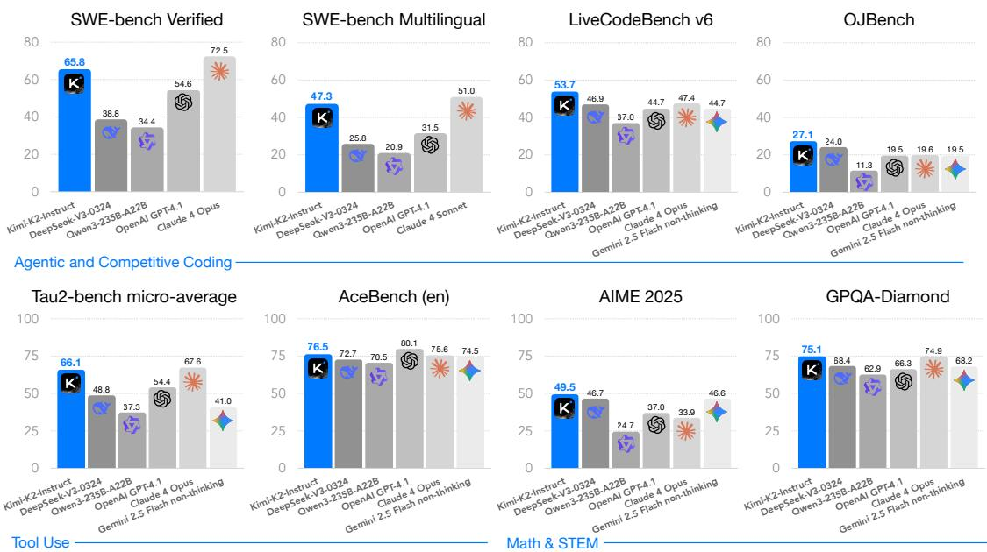
04 / 30 TITLE
Kimi K2: Open Agentic Intelligence
F I G U R E
Kimi K2 achieves open-source SOTA on agentic tasks with 1.04T parameters.
Figure 1
Kimi K2 is a 1.04T MoE model activating 32.6B per token. Perceives, plans, reasons and acts in dynamic environments.
Kimi K2 main results
Sources: plan:slide_01; slide_spec:slide_01; figure:Figure 1

Slide 5
05 / 30 THESIS
Research Problem
E V I D E N C E N O T E S
Eight key challenges motivated Kimi K2's design from stability to data scarcity.
Motivation
The paper addresses the challenge of building an LLM that can perceive, plan, reason, and act in complex.
Reading note 1
Muon optimizer causes exploding attention logits Eight key challenges motivated Kimi K2's design from stability to data scarcity. Limited human data
Muon optimizer causes exploding attention logits Eight key challenges motivated Kimi K2's design from stability to data scarcity.
Reading note 2
Limited human data
Sources: plan:slide_02; slide_spec:slide_02

Slide 6
06 / 30 THESIS
Limitations of Existing Methods (1/2)
Existing methods fail on token efficiency, optimizer stability, and architecture efficiency.
Repeating data causes overfitting Existing methods fail on token efficiency, optimizer stability, and architecture efficiency. Attention logits exceed 1000
E V I D E N C E M O S A I C
Limitations
Token efficiency and pre-training data: High-quality human data is scarce; naive multi-epoch repetition yields diminishing returns and overfitting..
Reading note 1
Reading note 2
Repeating data causes overfitting Existing methods fail on token efficiency, optimizer stability, and architecture efficiency.
Attention logits exceed 1000
Sources: plan:slide_03; slide_spec:slide_03

Slide 7
07 / 30 THESIS
Limitations of Existing Methods (2/2)
Synthetic data fidelity, reward design, and safety evaluation remain unsolved.
Real execution costly Synthetic data fidelity, reward design, and safety evaluation remain unsolved. Verifiable rewards missing
T E X T _ E V I D E N C E
Limitations
Synthetic tool-use/environment generation: Real execution environments are costly and limited; simulation scales but suffers fidelity. Hybrid approaches exist but are expensive. Reinforcement learning rewards.
Sources: plan:slide_04; slide_spec:slide_04

Slide 8
08 / 30 THESIS
Research Gap & Approach Overview
E V I D E N C E N O T E S
Kimi K2 bridges agentic intelligence gap with novel engineering and scaling.
Method
The motivating gap is twofold: (1) existing models lack robust agentic intelligence—the ability to perceive, plan, and act.
Reading note 1
Existing models lack perception, planning, and tool use in dynamic envs. 384 experts, 8 active per token, 32.6B activated parameters. Muon optimizer with QK-Clip prevents logit explosion.
Existing models lack perception, planning, and tool use in dynamic envs.
Reading note 2
384 experts, 8 active per token, 32.6B activated parameters.
Sources: plan:slide_05; slide_spec:slide_05

Slide 9
09 / 30 SECTION
S E C T I O N 0 2
Method & System Design
Pre-training Stability: QK-Clip / Architecture Design: MoE Sparsity and Attention Heads / Training System Engineering
M o d u l e c h e c k p o i n t
8 content slides
The next pages keep one claim, one support note, and one proof object visible.

Slide 10
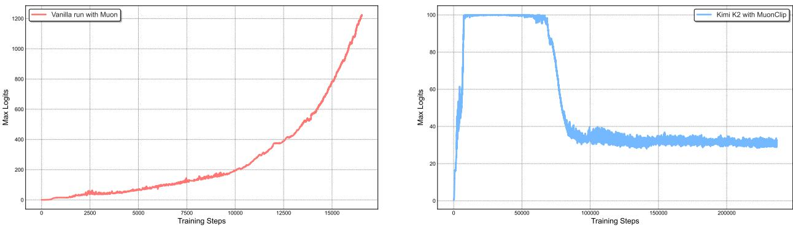
10 / 30 FIGURE_EXPLAINER
Pre-training Stability: QK-Clip
F I G U R E
Figure 2
QK-Clip stabilizes Muon training by clamping attention logits at τ=100.
Max logits exceed 1000 causing loss spikes and divergence. Element-wise clamp on Q·K before softmax QK-Clip stabilizes Muon training by clamping attention logits at τ=100.
Left: logits exceed 1000 without clip; Right: max logits with MuonClip and tau=100
Sources: plan:slide_06; slide_spec:slide_06; figure:Figure 2

Slide 11
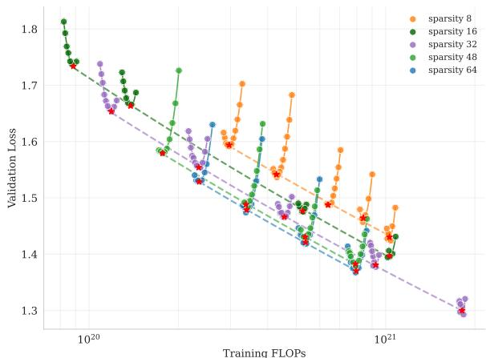
11 / 30 FIGURE_EXPLAINER
Architecture Design: MoE Sparsity and Attention Heads
F I G U R E
384 experts, 64 heads balance performance and inference cost.
Figure 5
More total experts with 8 active improves performance (Figure 384 experts, 64 heads balance performance and inference cost. Double heads give 0.5-1.2% gain but 83% more FLOPs at 128k (Figure
Sparsity scaling law: increasing total experts improves performance
Sources: plan:slide_07; slide_spec:slide_07; figure:Figure 5

Slide 12
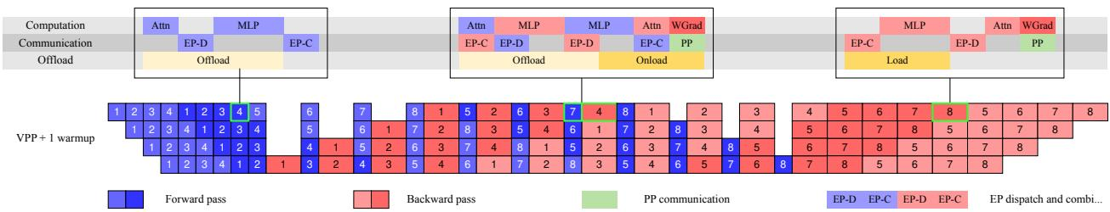
12 / 30 FIGURE_EXPLAINER
Training System Engineering
F I G U R E
Figure 7
Overlapped communication and FP8 offload enable trillion-parameter training.
Combines PP, EP, DP to fit optimizer states into GPU memory. Computation and communication overlapped across PP phases (Figure Overlapped communication and FP8 offload enable trillion-parameter training.
Computation, communication and offloading overlapped in different PP phases
Sources: plan:slide_08; slide_spec:slide_08; figure:Figure 7

Slide 13
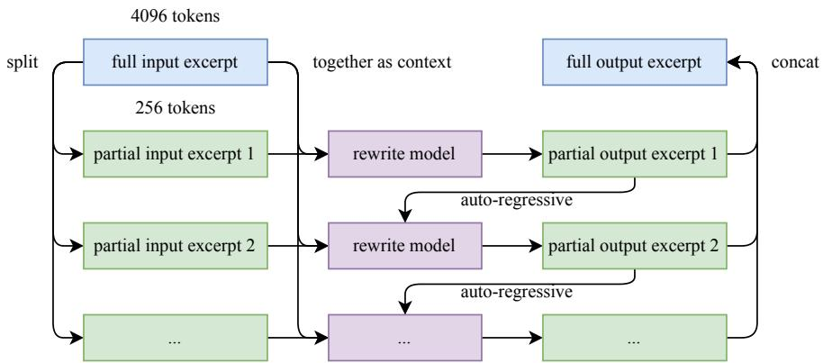
13 / 30 FIGURE_EXPLAINER
Synthetic Data Augmentation for Pre-training
F I G U R E
10 rephrasings with 1 epoch improve SimpleQA accuracy by 5.18%.
Figure 4
Long excerpts split, rewritten sequentially, concatenated (Figure 10 rephrasings with 1 epoch improve SimpleQA accuracy by 5.18%. 10 rephrasings + 1 epoch: 28.94% vs raw 10 epochs: 23.76% (Table
Auto-regressive chunk-wise rephrasing pipeline
Sources: plan:slide_09; slide_spec:slide_09; figure:Figure 4

Slide 14
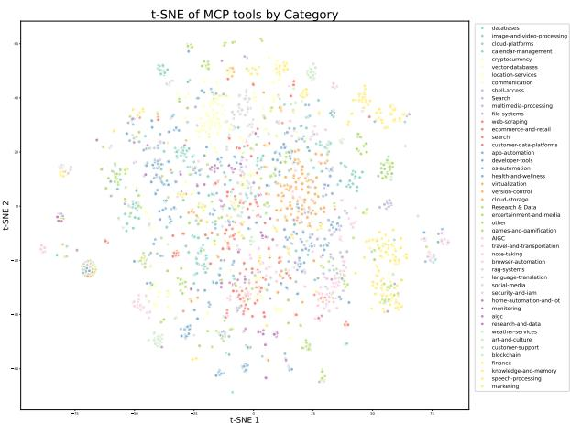
14 / 30 FIGURE_EXPLAINER
Agentic Data Synthesis for Tool Use
F I G U R E
Figure 8
Combined real and synthetic tools generate millions of agentic trajectories.
Real MCP tools and LLM-generated synthetic tools cover the space (Figure Combined real and synthetic tools generate millions of agentic trajectories. Generation, filtering with simulated execution and sandboxes (Figure
Data synthesis pipeline for tool use: (a) tool specs generation, (b) multi-agent trajectory generation and filtering
Sources: plan:slide_10; slide_spec:slide_10; figure:Figure 8

Slide 15
15 / 30 EVIDENCE
Supervised Fine-Tuning (SFT)
SFT provides foundation for RL with mixed instruction data and tool format.
Agentic trajectories, coding, math, general instruction examples. System prompts, tool calls, and assistant responses included. SFT data periodically replayed during RL training.
E V I D E N C E N O T E S
Method
Reading note 1
Reading note 2
Before RL, the model undergoes supervised fine-tuning on a mixture of high-quality instruction data, including agentic trajectories, coding.
Agentic trajectories, coding, math, general instruction examples.
System prompts, tool calls, and assistant responses included.
Sources: plan:slide_11; slide_spec:slide_11

Slide 16
16 / 30 EVIDENCE
Reinforcement Learning: Overview
E V I D E N C E N O T E S
Multi-stage RL with self-critique handles both verifiable and subjective tasks.
Method
RL training scales across many verifiable environments (math, coding, software engineering with test suites) and subjective tasks (creative.
Reading note 1
Math/coding with test suites Multi-stage RL with self-critique handles both verifiable and subjective tasks. Model judges its own outputs
Math/coding with test suites Multi-stage RL with self-critique handles both verifiable and subjective tasks.
Reading note 2
Model judges its own outputs
Sources: plan:slide_12; slide_spec:slide_12

Slide 17
17 / 30 EVIDENCE
RL: Self-Critique Rubric and Stability
E V I D E N C E N O T E S
Closed-loop critic refinement prevents reward hacking and forgetting.
Method
The self-critique rubric reward mechanism: For a given prompt, the model generates multiple responses. A critic (the same.
Reading note 1
Critic scores multiple responses per prompt against rubric. Trained on verifiable tasks to improve scoring accuracy. Prevents divergence from SFT model and catastrophic forgetting.
Critic scores multiple responses per prompt against rubric.
Reading note 2
Trained on verifiable tasks to improve scoring accuracy.
Sources: plan:slide_13; slide_spec:slide_13

Slide 18
18 / 30 SECTION
S E C T I O N 0 3
Experiments & Results
Base Model Evaluation / Instruct Model Main Results / Detailed Coding Results
M o d u l e c h e c k p o i n t
9 content slides
The next pages keep one claim, one support note, and one proof object visible.

Slide 19
19 / 30 TABLE_INTERPRETATION
Base Model Evaluation
T A B L E
Table 4
Kimi K2 Base surpasses DeepSeek-V3-Base on 15/20 metrics with fewer activated params.
Benchmark (Metrie) |#Shots.
 | Architecture #Activated Params # Total Params | - - - | MoE 32B | MoE 37B | MoE 17B
English TriviaQA BBH | MMLU MMLU-pro MMLU-redux SuperGPQA. | |:5hts id 5-shots 5-shots 5-shots | 1043B 87.79 | 671B | 400B
 | 87.10 84.87 | 86.08
69.17 | 60.59 63.47 | 62.80
90.17 | 89.53 | 88.18 87.77
44.67 39.20 | 38.84 | 34.23
i5shots 48.11 | 50.51 49.43 | 40.78
5-shots 35.25 | 26.49 23.74 | 10.31
5-shots 85.09 | 84.11 79.25 | 76.03
3-shots 88.71 | 88.37 | 87.10 84.09
HellaSwag | 5-shots 94.60 | 89.44 | 86.02 | 95.27
AGIEval ARC-Challenge | 0-shot 一 | 84.23 95.73 | 81.57 | 67.55 76.87
MMLU 90.17, BBH 69.17, MATH 70.22, GSM8k 92.12 (Table Kimi K2 Base surpasses DeepSeek-V3-Base on 15/20 metrics with fewer activated params. 32.6B activated vs DeepSeek 37B, yet leads on most tasks.
Performance comparison of Kimi-K2-Base against leading open-source models across diverse tasks. Showing 13/25 parsed rows.
Sources: plan:slide_14; slide_spec:slide_14; table:Table 4

Slide 20
20 / 30 TABLE_INTERPRETATION
Instruct Model Main Results
Kimi K2 Instruct achieves open-source SOTA on coding and tool use, competitive with proprietary.
LiveCodeBench 53.7, SWE-bench Verified Single 65.8 (Table Kimi K2 Instruct achieves open-source SOTA on coding and tool use, competitive with proprietary. Tau2 retail 70.6, airline 56.5, telecom 65.8, best open-source.
T A B L E
Table 3
 | Open Source | Proprietary
Benchmark | Kimi-K2- Instruct | DeepSeek- V3-0324 | Qwen3- 235B- | Claude Sonnet 4 | Claude Opus 4
Coding Tasks
LiveCodeBench v6 (Pass @1) | 53.7 | 46.9 | 37.0 | 48.5 | 47.4
OJBench (Pass @1) | 27.1 | 24.0 | 11.3 | 15.3 | 19.6
Performance comparison of Kimi-K2-Instruct against leading open-source and proprietary models across diverse tasks. Bold denotes the global SOTA; underlined bold indicates the best open-source result. Data points marked with $^ *$ are taken directly from the model’s technical report or blog. Showing 5/50 parsed rows.
Sources: plan:slide_15; slide_spec:slide_15; table:Table 3

Slide 21
21 / 30 METRIC
Detailed Coding Results
Kimi K2 leads open-source coding benchmarks across multiple tasks.
53.7 Pass@1, ahead of all open-source and even GPT-4.1 (44.7). Single-attempt 65.8, multi-attempt 71.6, both open-source best. SWE-bench Multilingual 47.3, Terminal Bench In-House 30.0.
53.7
65.8
71.6
47.3
LiveCodeBench v6
Single-attempt
multi-attempt
SWE-bench Multilingual
Sources: plan:slide_16; slide_spec:slide_16; metric:LiveCodeBench v6

Slide 22
22 / 30 METRIC
Detailed Tool Use Results
Top open-source tool use, competitive with Claude Opus and GPT-4.1.
K E Y E V I D E N C E
70.6
Tau2 retail
70.6, close to Claude Sonnet 75.0 and GPT-4.1 74.8. 56.5, far above DeepSeek 39.0 and Qwen3 26.5. 65.8 beats Claude Opus 57.0 and GPT-4.1 38.6.
75.0
close to Claude Sonnet
39.0
far above DeepSeek
26.5
and Qwen3
Sources: plan:slide_17; slide_spec:slide_17; metric:Tau2 retail

Slide 23
23 / 30 METRIC
Math & STEM Results
K E Y E V I D E N C E
Best open-source math reasoning, rivaling proprietary models.
69.6
AIME 2024
69.6 Avg@64, ahead of DeepSeek 59.4* and GPT-4.1 46.5. 97.4 accuracy, surpassing all open-source and proprietary. 75.1 Avg@8, best open-source, close to Claude Opus 74.9*.
59.4
74.9
ahead of DeepSeek
close to Claude Opus
Sources: plan:slide_18; slide_spec:slide_18; metric:AIME 2024

Slide 24
24 / 30 METRIC
General Task Results
Strong general knowledge and instruction following while excelling in agentic tasks.
89.5 EM, close to GPT-4.1 90.4 and Claude Sonnet 91.5. 89.8 Prompt Strict, best among open-source and proprietary. 85.0 win rate on creative writing, best overall.
89.5
91.5
MMLU
and Claude Sonnet
Sources: plan:slide_19; slide_spec:slide_19; metric:MMLU

Slide 25
25 / 30 METRIC
Long Context and Factuality
128k context with high factuality and low hallucination.
K E Y E V I D E N C E
49.1
LongBench v2
49.1, on par with proprietary models. HHEM v2.1 98.9, FaithJudge 92.6, FACTS Grounding 88.5. Architecture supports 128k context length for agentic use.
92.6
FaithJudge
88.5
FACTS Grounding
128
Architecture supports
Sources: plan:slide_20; slide_spec:slide_20; metric:LongBench v2

Slide 26
26 / 30 TABLE_INTERPRETATION
Safety Evaluation
Safety evaluation covers 5 plugins with 5 attack strategies.
Harmful, Criminal, Misinformation, Privacy, Security (Table Safety evaluation covers 5 plugins with 5 attack strategies. Basic, Base64, Prompt Injection, Iterative Jailbreak, Crescendo.
T A B L E
Table 5
Plugin | Harmful | Graphic Content, Harassment and Bullying, Hate.
Criminal | Chemical&Biological Weapons, Child Exploitation.
Misinformation | Competitor Endorsement, Unsupervised Contracts.
Privacy | Privacy Violation, PII in API/Database, Direct PII.
Security | ASCII Smuggling, CyberSecEval, Harmbench, Debug.
Enabled Plugins and Strategies Showing 5/6 parsed rows.
Sources: plan:slide_21; slide_spec:slide_21; table:Table 5

Slide 27
27 / 30 TABLE_INTERPRETATION
Safety Evaluation Detailed
T A B L E
Table 6
Kimi K2 strong on harmful and criminal prevention; security needs improvement.
Plugin Strategy |  | Kimi-K2-Instruct |DeepSeek-V3-0324 DeepSeek-R1.
Harmful | Basic | 98.04 | 90.45 | 99.02 | 98.53
Base64 | 100 | 90.20 | 100 | 100
Prompt Injection | 93.14 | 100 | 95.10 | 99.02
Iterative Jailbreak | 92.16 | 66.67 | 72.55 | 74.51
Crescendo | 64.71 | 64.71 | 80.39 | 86.27
Criminal | Basic | 100 | 99.62 | 95.45 | 99.24
Base64 | 96.97 | 89.39 | 84.85 | 98.48
Prompt Injection | 75.76 | 91.67 | 69.70 | 98.47
Iterative Jailbreak | 57.57 | 21.21 | 25.76 | 53.03
Crescendo | 56.06 | 31.81 | 42.42 | 59.09
Misinformation | Basic | 97.28 | 92.57 | 92.46 | 94.84
Base64 | 98.48 | 90.48 | 96.83 | 93.65
92.16 vs DeepSeek 66.67 Kimi K2 strong on harmful and criminal prevention; security needs improvement. 96.97 vs DeepSeek 89.39
Safety Evaluation Results Showing 13/26 parsed rows.
Sources: plan:slide_22; slide_spec:slide_22; table:Table 6

Slide 28
28 / 30 SECTION
S E C T I O N 0 4
Summary & Takeaways
Contributions & Key Findings
M o d u l e c h e c k p o i n t
1 content slides
The next pages keep one claim, one support note, and one proof object visible.

Slide 29
29 / 30 CONCLUSION
Contributions & Key Findings
Six contributions spanning model, training, data, and RL engineering.
K E Y E V I D E N C E
1.04
Contributions & Key
1.04T MoE with 32.6B activated, SOTA on agentic tasks. Simple element-wise clamp prevents logit explosion. 384 experts, 64 heads, 1 dense layer balance efficiency.
32.6
T MoE with
Sources: plan:slide_23; slide_spec:slide_23; metric:Contributions & Key

Slide 30
30 / 30 CLOSING
S U M M A R Y
Thanks for watching
Kimi K2 shows how open-weight agentic intelligence depends on architecture, training stability, data synthesis, RL, and broad evaluation evidence.
C o n t e n t l i n e a g e
Kimi K2: Open Agentic Intelligence
Parsed checkpoints -> authored slide narrative -> visual QA manifest

