Slide 1
L A B N O T E
Claim Verification Board
Deep Residual Learning for Image Recognition
This route uses a blueprint grammar: rectangular ledgers, axis lines, and evidence boards.
S I G N A L 1
Claim-first cards expose the problem, method, and evidence path.
S I G N A L 2
Source figures and tables stay traceable inside editable proof panels.
S I G N A L 3
Nonvisual audit converts layout defects into scoped repair rules.
Fresh parse -> four route validation
blind rectangular research board / no protected baseline grammar
01/29

Slide 2
Experiment Map
The deck is organized as a sequence of claim/evidence ledgers.
01
Premise & Stakes
Research Problem; Limitations of Existing Methods –
3 slides
02
Mechanism & Method
Network Architecture / Stage Design; Training Details – SGD and
2 slides
03
Evidence & Results
Deep Residual Learning Framework –; Residual Building Block – Two‑Layer
14 slides
04
Implications
Deep Residual Learning for Image; Normalization, Nonlinearities, and No Gating
3 slides
blind rectangular research board / no protected baseline grammar
02/29

Slide 3
M O D U L E 0 1
Premise & Stakes
Research Problem / Limitations of Existing Methods – Vanishing/Exploding / Limitations – The Degradation Problem
blind rectangular research board / no protected baseline grammar
03/29

Slide 4
P R E M I S E
04/29
Research Problem
C L A I M
E V I D E N C E / T E X T _ E V I D E N C E
Training deeper networks suffers from a degradation problem.
Motivation
R E A D I N G N O T E
The paper addresses the problem of training much deeper convolutional neural networks for image recognition. Concretely, it asks: can we reliably train.
Deeper plain networks have higher training error than shallower ones. Reformulating mapping.
Evidence is preserved from this run's fresh parse checkpoints.
Sources: plan:slide_02; slide_spec:slide_02

Slide 5
P R E M I S E
05/29
Limitations of Existing Methods – Vanishing/Exploding Gradients
C L A I M
E V I D E N C E / T E X T _ E V I D E N C E
Vanishing gradients were mitigated but degradation remained.
Motivation
R E A D I N G N O T E
Early deep models suffered from gradients that vanish or explode during backpropagation, making it very hard to train networks with many layers..
Early deep networks struggled with gradient flow during backpropagation. Normalized initialization and.
Evidence is preserved from this run's fresh parse checkpoints.
Sources: plan:slide_03; slide_spec:slide_03

Slide 6
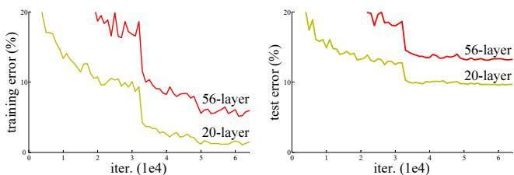
P R E M I S E
06/29
Limitations – The Degradation Problem
C L A I M
Deeper plain networks have higher training error than shallower.
On CIFAR-10, 56-layer has higher training and test error. Training error increases, indicating optimization difficulty.
E V I D E N C E / F I G U R E
Training error on CIFAR-10 showing degradation of deeper plain network.
Sources: plan:slide_04; slide_spec:slide_04; figure:Figure 1

Slide 7
M O D U L E 0 2
Mechanism & Method
Network Architecture / Stage Design / Training Details – SGD and Learning
blind rectangular research board / no protected baseline grammar
07/29

Slide 8
M E C H A N I S M
08/29
Network Architecture / Stage Design
C L A I M
ResNets are composed of stages with doubling filters at.
When size halves, channels double to maintain complexity. First block of each stage uses stride 2.
E V I D E N C E / T A B L E
Focused table view
Stage | Readable evidence
layer name / output size | 18-layer 34-layer 50-layer 101-layer 152-layer
conv1 / 112×112 | 7×7, 64, stride 2
conv2_x / 56×56 | 3 ×3 max pool, stride 2
3×3,64×23×3,64 / 3×3,64×33×3,64 | 1×1,643×3,641×1,256; ×3; 1×1,643×3,641×1,256; ×3; 1×1,643×3,641×1,256; ×3
conv3.x / 28×28 | 3×3,128×23×3,128; 3×3,128×43×3,128; 1×1, 1283×3,1281×1,512; ×4; 1×1, 1283×3,1281×1,512; ×4.
Architecture details for different ResNet depths.
Sources: plan:slide_10; slide_spec:slide_10; table:Table 1

Slide 9
M E C H A N I S M
09/29
Training Details – SGD and Learning Rate Schedule
C L A I M
E V I D E N C E / T A B L E
SGD with momentum 0.9, weight decay 1e-4, He initialization.
Focused table view
Hyperparameter | Value
Optimizer | SGD with momentum 0.9
Weight decay | 1e-4
Initial lr | 0.1
lr schedule | Divide by 10 at plateaus
R E A D I N G N O T E
Learning rate reduced at plateaus (approx 30,60,80 epochs). ImageNet training runs 600k.
Key settings for ImageNet and CIFAR-10.
Sources: plan:slide_14; slide_spec:slide_14; table:Training Hyperparameters

Slide 10
M O D U L E 0 3
Evidence & Results
Deep Residual Learning Framework – Overview / Residual Building Block – Two‑Layer Block / Residual Building Block – Bottleneck Three‑Layer
blind rectangular research board / no protected baseline grammar
10/29

Slide 11
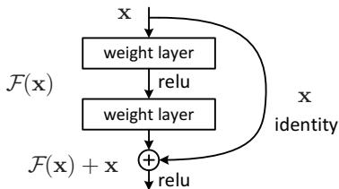
E V I D E N C E
11/29
Deep Residual Learning Framework – Overview
C L A I M
E V I D E N C E / F I G U R E
Residual formulation with identity shortcuts enables deeper networks.
R E A D I N G N O T E
Stacked layers fit residual function instead of desired mapping. Addition of input.
Residual learning: a building block with identity shortcut.
Sources: plan:slide_05; slide_spec:slide_05; figure:Figure 2

Slide 12
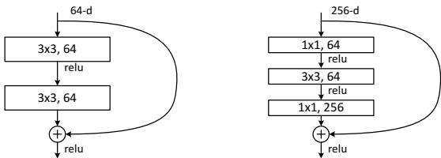
E V I D E N C E
12/29
Residual Building Block – Two‑Layer Block
C L A I M
Simple two-layer block used in ResNet-18/34.
Block: Conv3x3-BN-ReLU-Conv3x3-BN plus identity shortcut. Identity shortcut adds no parameters or computational overhead.
E V I D E N C E / F I G U R E
Left: two-layer building block for ResNet-34.
Sources: plan:slide_06; slide_spec:slide_06; figure:Figure 5

Slide 13
E V I D E N C E
13/29
Residual Building Block – Bottleneck Three‑Layer Block
C L A I M
Bottleneck block reduces parameters for deeper nets.
First 1x1 reduces channels, 3x3 operates, last 1x1 restores. Reduces computation compared to two 3x3 layers.
E V I D E N C E / F I G U R E
Right: bottleneck building block for ResNet-50/101/152.
Sources: plan:slide_07; slide_spec:slide_07; figure:Figure 5

Slide 14
E V I D E N C E
14/29
Shortcut Connection Variants (Options A, B, C)
C L A I M
E V I D E N C E / T A B L E
Projection shortcuts (Option B) used for deeper models.
Focused table view
Option | Description | Top-1 error (34-layer)
A | Identity zero-padding | 25.03%
B | Projection when dims differ | 24.52%
C | All projections | 24.19%
R E A D I N G N O T E
Projection only when dimensions differ Projection shortcuts (Option B) used for deeper.
Options A, B, C for handling dimension changes.
Sources: plan:slide_08; slide_spec:slide_08; table:Shortcut Options Comparison

Slide 15
E V I D E N C E
15/29
Dimension Matching – Identity vs Projection Shortcuts
C L A I M
E V I D E N C E / M E T R I C
Identity shortcuts with zero-padding or projection handle dimension changes.
21.43%
Top-1 error (ResNet-152)
R E A D I N G N O T E
When dimensions differ, pad with zeros to match channels. Projection with stride.
5.71%
Top-5 error (ResNet-152)
34
Parameters
Sources: plan:slide_09; slide_spec:slide_09; metric:Dimension Matching -

Slide 16
E V I D E N C E
16/29
Key Mathematical Formulations
C L A I M
E V I D E N C E / M E T R I C
Residual learning defined by y = F(x) + x.
21.43%
Top-1 error (ResNet-152)
R E A D I N G N O T E
Element-wise addition of input to residual function output. When dimensions differ, use.
5.71%
Top-5 error (ResNet-152)
34
Parameters
Sources: plan:slide_12; slide_spec:slide_12; metric:Key Mathematical Formulations

Slide 17
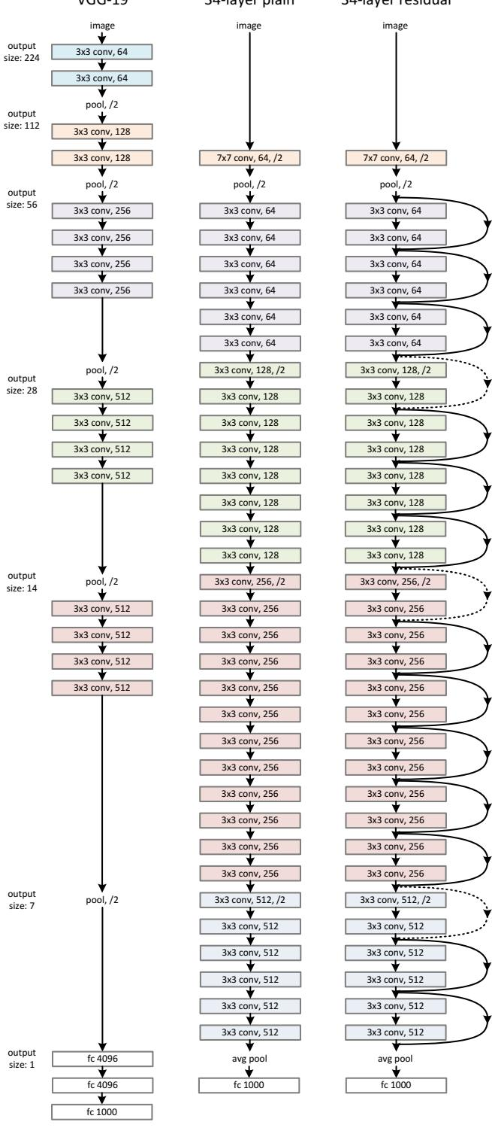
E V I D E N C E
17/29
Technical Pipeline – Network Assembly
C L A I M
E V I D E N C E / F I G U R E
ResNet assembled by stacking residual blocks with design rules.
R E A D I N G N O T E
Two-layer for shallow, bottleneck for deep nets. Same filters per stage ResNet assembled by stacking residual blocks with.
Example network architectures for ImageNet: VGG-19, plain-34, ResNet-34.
Sources: plan:slide_13; slide_spec:slide_13; figure:Figure 3

Slide 18
E V I D E N C E
18/29
Data Preprocessing and Augmentation
C L A I M
E V I D E N C E / M E T R I C
Standard augmentation: random crop, flip, color, mean subtraction.
21.43%
Top-1 error (ResNet-152)
R E A D I N G N O T E
Randomly sample shorter side in [256,480], then 224x224 crop. Pad to 40x40.
5.71%
Top-5 error (ResNet-152)
34
Parameters
Sources: plan:slide_15; slide_spec:slide_15; metric:Data Preprocessing Augmentation

Slide 19
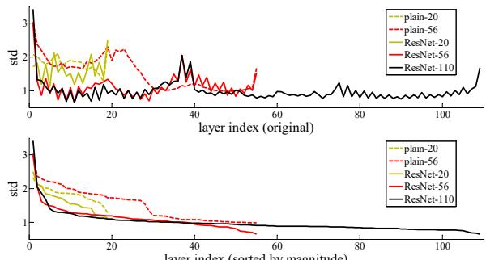
E V I D E N C E
19/29
Monitoring and Verification – Layer Responses
C L A I M
E V I D E N C E / F I G U R E
Residual responses are small, confirming easier learning.
R E A D I N G N O T E
For ResNet-20 on CIFAR-10, std ~0.1 for deepest layers. When desired mapping.
Standard deviations of layer responses on CIFAR-10, showing small residual values.
Sources: plan:slide_16; slide_spec:slide_16; figure:Figure 7

Slide 20
E V I D E N C E
20/29
Testing/Inference for Classification
C L A I M
E V I D E N C E / M E T R I C
10-crop and multi-scale fully-convolutional evaluation used.
21.43%
Top-1 error (ResNet-152)
R E A D I N G N O T E
Four corners and center crop plus flips, average softmax. Fully-convolutional at scales.
5.71%
Top-5 error (ResNet-152)
34
Parameters
Sources: plan:slide_17; slide_spec:slide_17; metric:Benchmark score

Slide 21
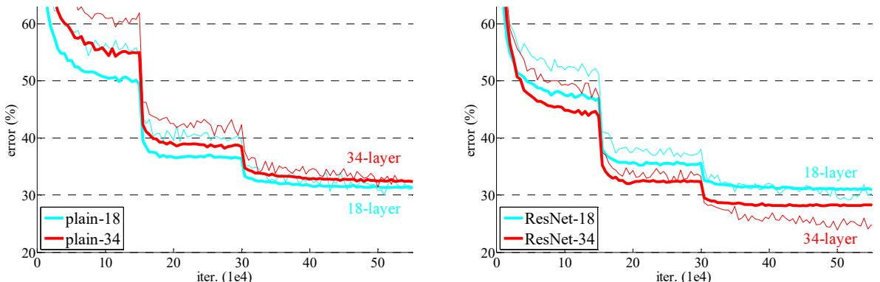
E V I D E N C E
21/29
ImageNet Classification Results – Plain vs ResNet
C L A I M
ResNet eliminates degradation; deeper nets improve accuracy.
Top-1 error: 25.03% vs 28.54% (Table ResNet eliminates degradation; deeper nets improve accuracy. ResNet-152 achieves 21.43%.
E V I D E N C E / F I G U R E
Training curves on ImageNet: plain vs ResNet.
Sources: plan:slide_19; slide_spec:slide_19; figure:Figure 4

Slide 22
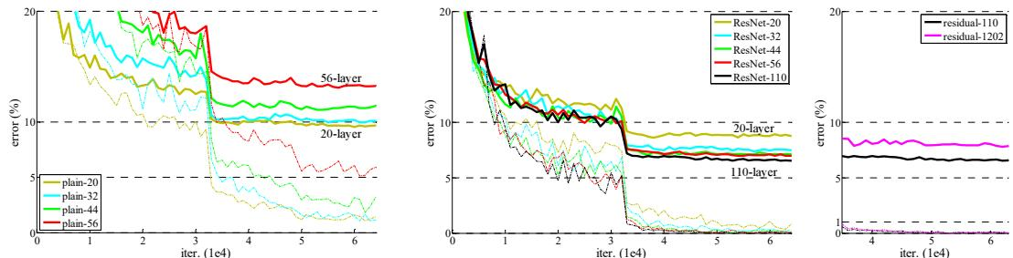
E V I D E N C E
22/29
CIFAR-10 Classification Results
C L A I M
ResNet-110 achieves state-of-the-art 6.43% error.
6.43% test error on CIFAR-10 with data augmentation. Residual formulation crucial for training deep nets on.
E V I D E N C E / F I G U R E
Training curves on CIFAR-10 for plain and ResNet.
Sources: plan:slide_20; slide_spec:slide_20; figure:Figure 6

Slide 23
E V I D E N C E
23/29
Object Detection Results on PASCAL VOC and MS.
C L A I M
E V I D E N C E / T A B L E
ResNet-101 backbone improves detection mAP by 3-7%.
Focused table view
training data | 07+12 | 07++12
test data | VOC 07 test | VOC 12 test
VGG-16 | 73.2 | 70.4
ResNet-101 | 76.4 | 73.8
R E A D I N G N O T E
Baseline Faster R-CNN with ResNet-101 vs 73.2% VGG-16. Baseline, with refinements reaches.
Baseline Faster R-CNN mAP on PASCAL VOC.
Sources: plan:slide_21; slide_spec:slide_21; table:Table 7

Slide 24
E V I D E N C E
24/29
Localization Results on ImageNet
C L A I M
E V I D E N C E / T A B L E
ResNet reduces localization error to 9.0% test (from 25.3% VGG).
Focused table view
LOC method | LOC network | testing | LOC error on GT CLS | classifi cation network | top-5 LOC error on predicted CLS
VGG's [41] | VGG-16 | 1-crop | 33.1 [41]
RPN | ResNet-101 | 1-crop | 13.3
RPN | ResNet-101 | dense | 11.7
RPN | ResNet-101 | dense |  | ResNet-101 | 14.4
RPN+RCNN|id | ResNet-101 | dense |  | ResNet-101 | 10.6
R E A D I N G N O T E
Single ResNet-101 with dense testing on validation. RPN + RCNN refinement on.
Large margin improvement in localization error.
Sources: plan:slide_22; slide_spec:slide_22; table:Table 13

Slide 25
M O D U L E 0 4
Implications
Deep Residual Learning for Image Recognition / Normalization, Nonlinearities, and No Gating / Adaptation for Downstream Tasks – Detection/Localization
blind rectangular research board / no protected baseline grammar
25/29

Slide 26
I M P L I C A T I O N S
26/29
Deep Residual Learning for Image Recognition
C L A I M
ResNet enables training of very deep networks for image.
Reformulates layers as residual functions to ease optimization. 152-layer ResNet achieves 21.43% top-1 error on ImageNet.
E V I D E N C E / F I G U R E
Training error (left) and test error (right) on CIFAR-10 with 20-layer and 56-layer “plain” networks. The deeper network
Sources: plan:slide_01; slide_spec:slide_01; figure:Figure 1

Slide 27
I M P L I C A T I O N S
27/29
Normalization, Nonlinearities, and No Gating
C L A I M
E V I D E N C E / T E X T _ E V I D E N C E
Identity shortcuts ensure gradient flow without gating.
Method
R E A D I N G N O T E
Batch Normalization (BN) is applied after each convolution and before activation (ReLU). In each residual block, ReLU is applied after the addition.
Batch normalization applied before ReLU activation. Nonlinearity applied after F(x)+x, not before..
Evidence is preserved from this run's fresh parse checkpoints.
Sources: plan:slide_11; slide_spec:slide_11

Slide 28
I M P L I C A T I O N S
28/29
Adaptation for Downstream Tasks – Detection/Localization
C L A I M
E V I D E N C E / T E X T _ E V I D E N C E
ResNet backbone for Faster R-CNN with frozen BN.
Method
R E A D I N G N O T E
For object detection and localization, ResNet is adapted as a backbone for Faster R-CNN. The pretrained ImageNet ResNet is used. The shared.
Total stride ≤16 ResNet backbone for Faster R-CNN with frozen BN. No.
Evidence is preserved from this run's fresh parse checkpoints.
Sources: plan:slide_18; slide_spec:slide_18

Slide 29
Inspection Ready
The final branch keeps content traceability while avoiding both protected visual grammars.
Parse once
Benchmark
Bounded repair
Evidence remains linked to parsed checkpoints.
Evidence remains linked to parsed checkpoints.
Evidence remains linked to parsed checkpoints.
blind rectangular research board / no protected baseline grammar
29/29

