Slide 1

다목적 비디오 검색을 위한
차세대 인공 신경망 기술 개발
1. Datasets setting
Dept of AI

Slide 2
목차 / List
1장
Result & Report
01
- Papers/ Datasets-sites/ Google Youtube
2장
Block / Limits
02
- Cons and Problems
3장
Future Plans & Tasks
03
- Anticipated Concepts
4장
Discussion & Comments
04
- Freely

Slide 3
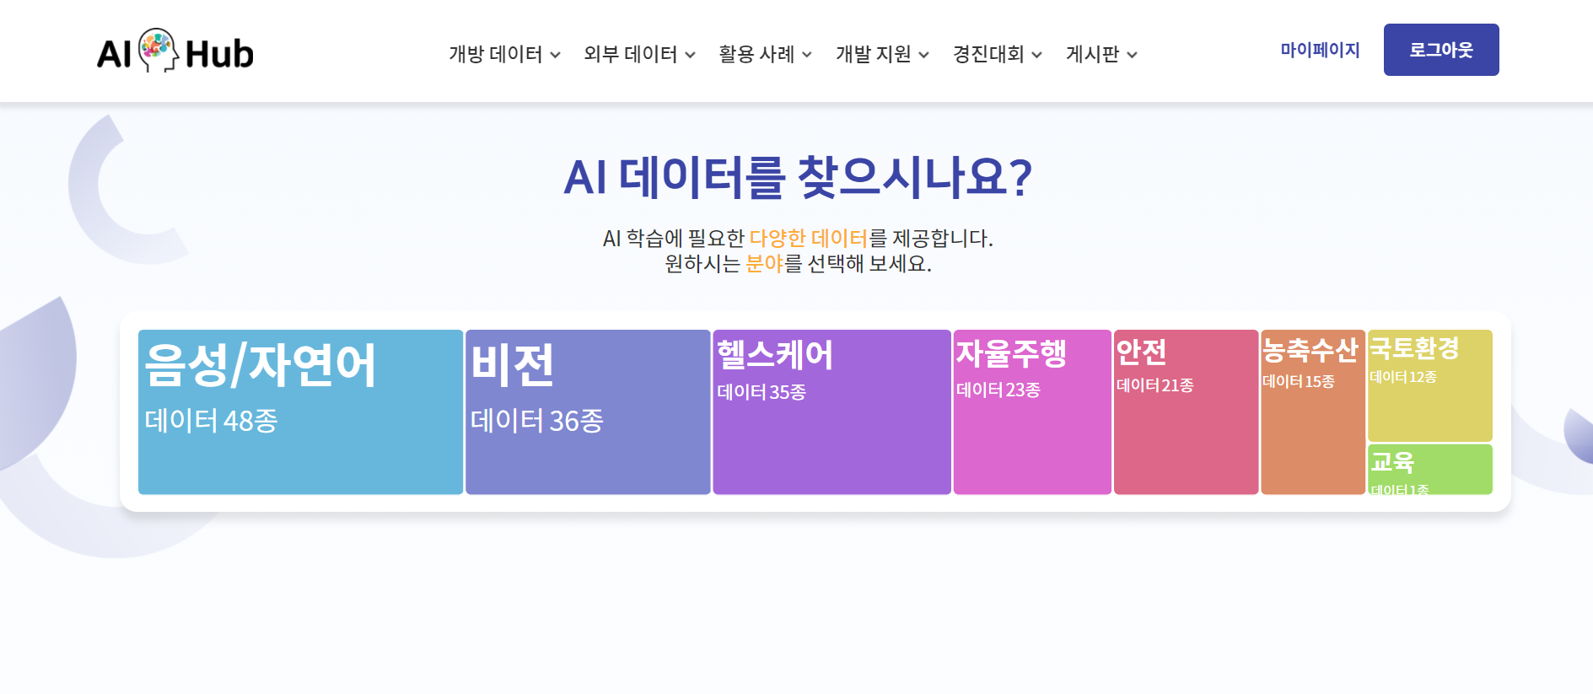
1. Result & Report
1) https://aihub.or.kr/ : AI 학습에 필요한 다양한 데이터셋을 제공

Slide 4
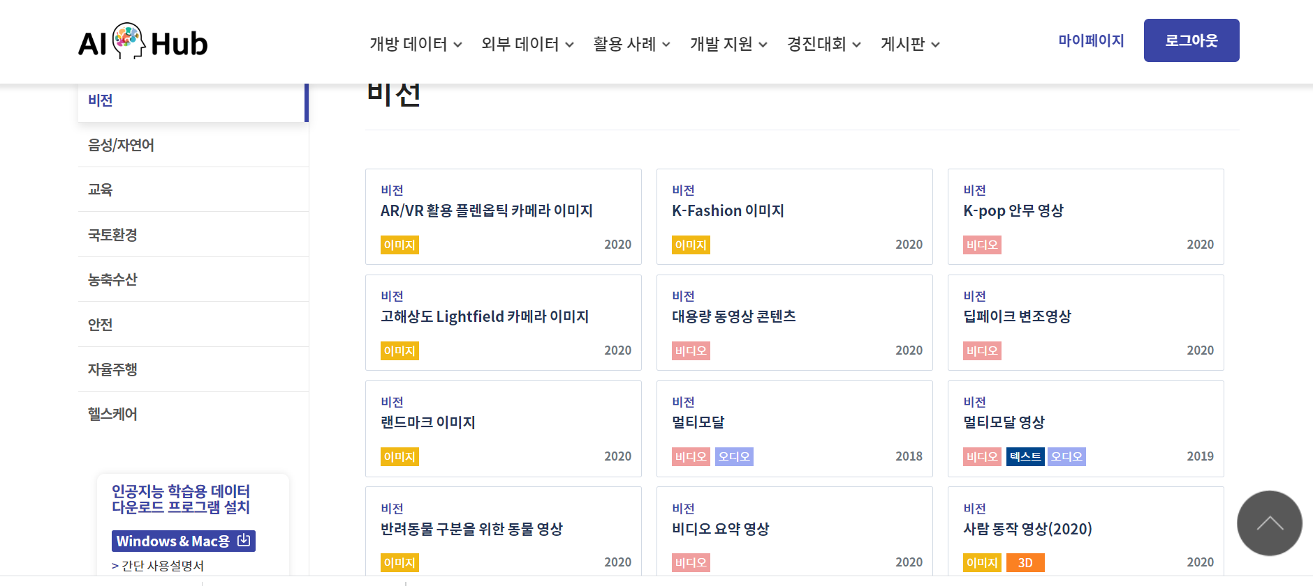
1. Result & Report
1) https://aihub.or.kr/ : AI 학습에 필요한 다양한 데이터셋을 제공

Slide 5
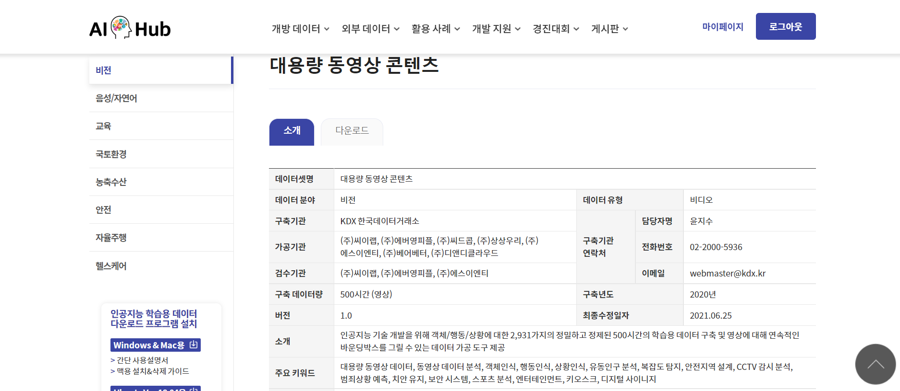
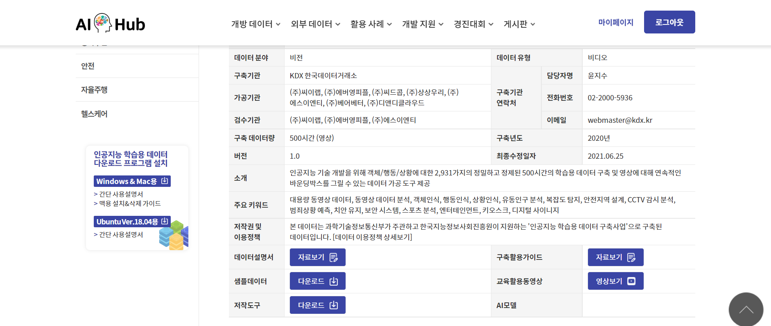
1. Result & Report
1) https://aihub.or.kr/ : AI 학습에 필요한 다양한 데이터셋을 제공
3-1) 대용량 동영상 컨텐츠

Slide 6
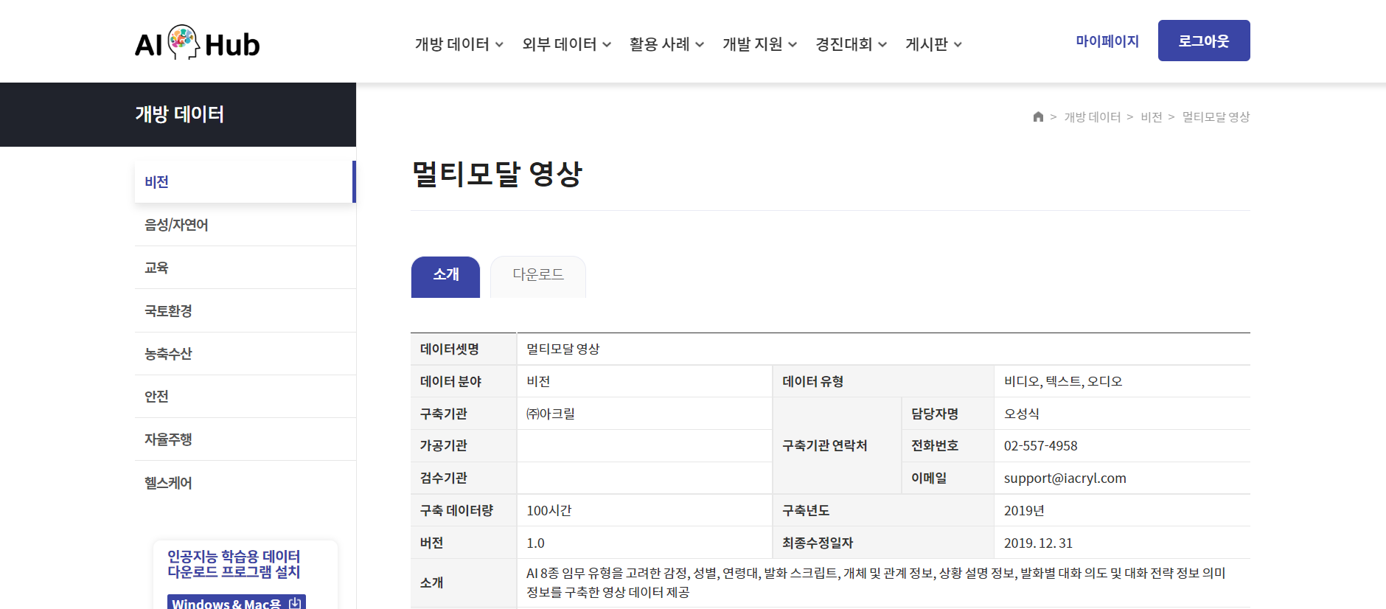
1. Result & Report
1) https://aihub.or.kr/ : AI 학습에 필요한 다양한 데이터셋을 제공
3-2) 멀티모달 영상

Slide 7
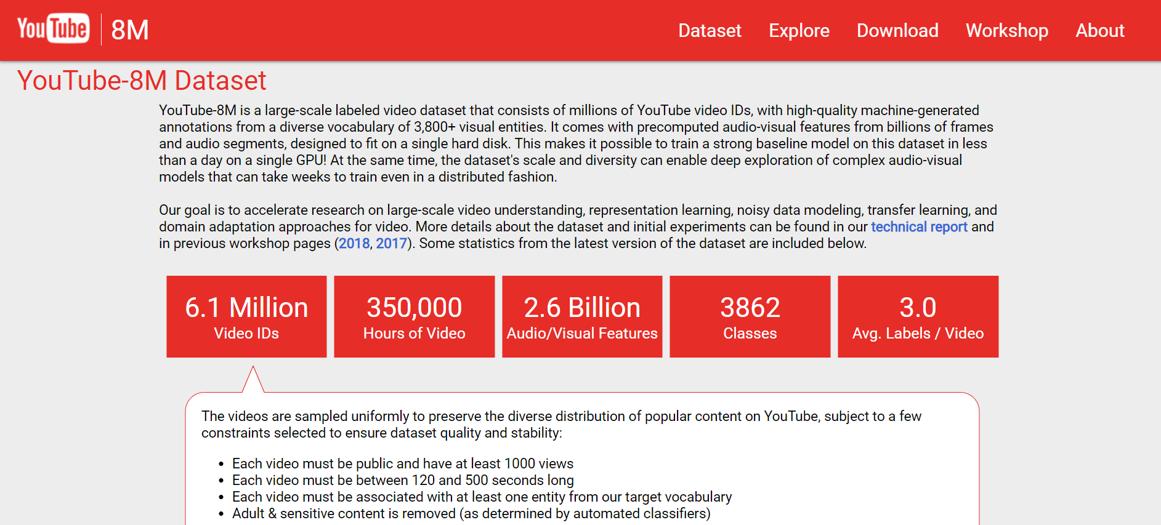
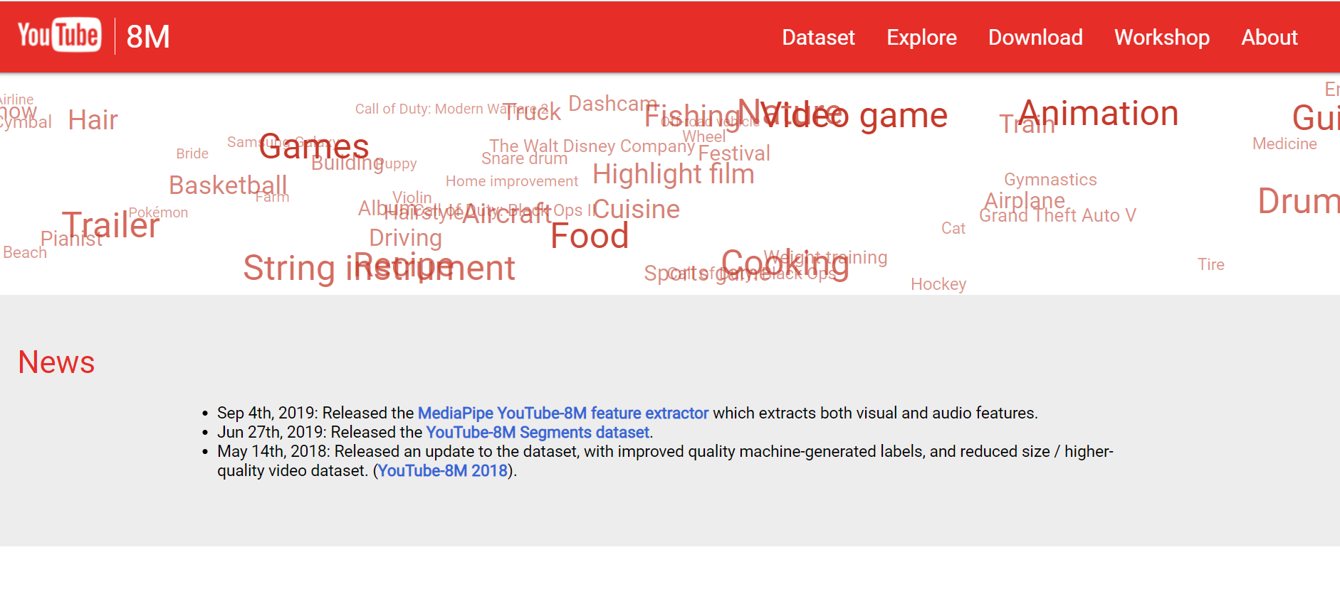
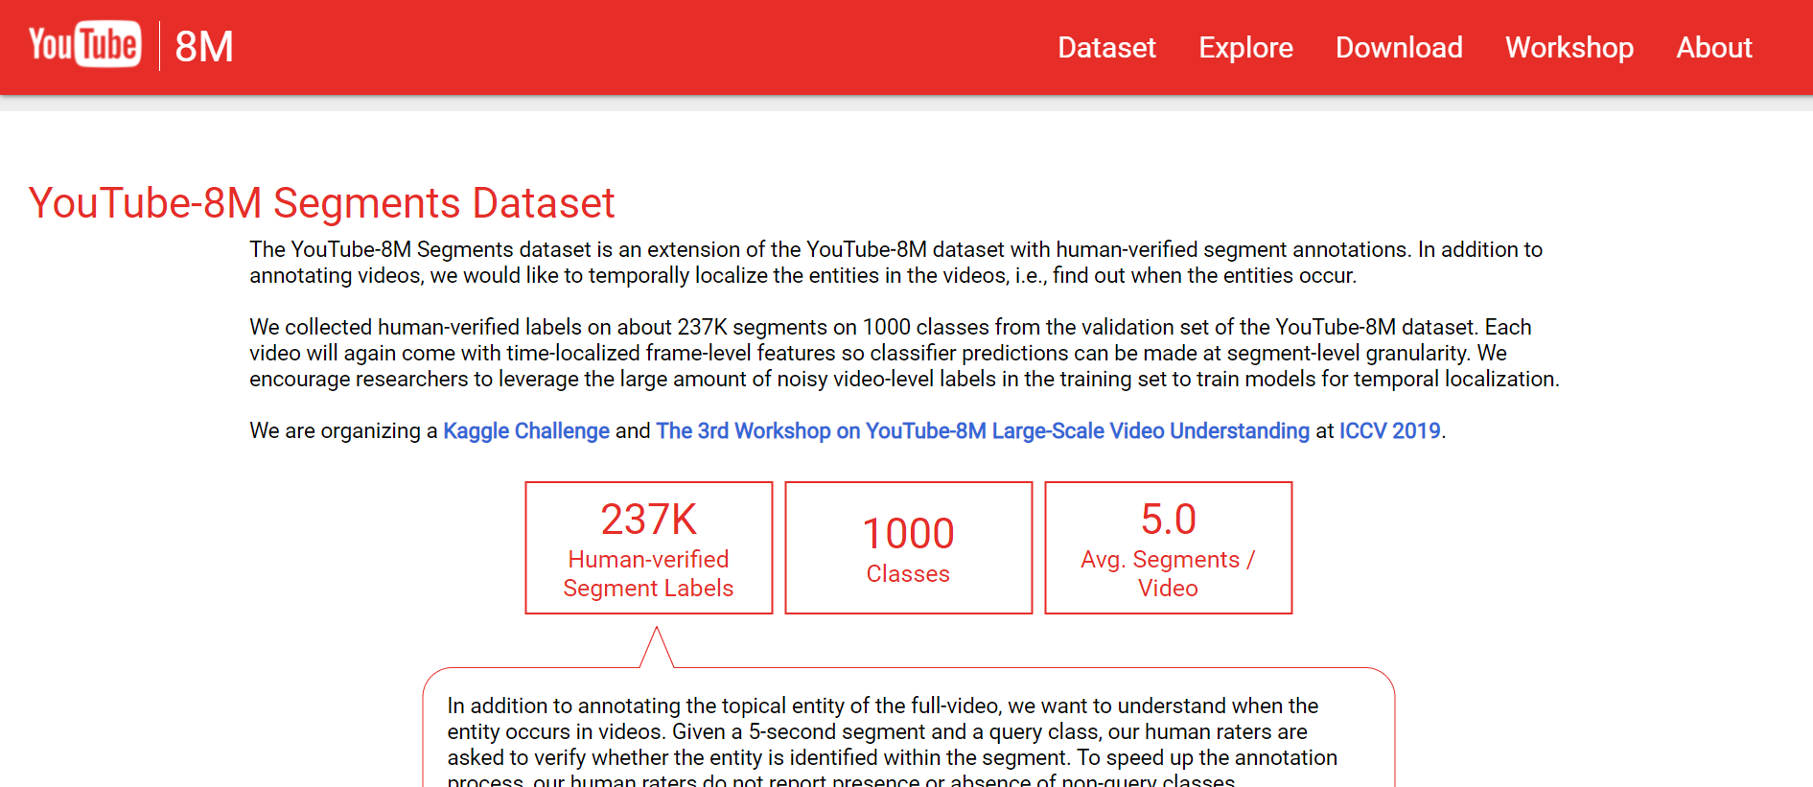
1. Result & Report
2) https://youtube8m/index.html: Youtube에서 제공하는 dataset

Slide 8
1. Result & Report
2) https://youtube8m/index.html: Youtube에서 제공하는 dataset
Why Youtube?
- 국내에서 제공되는 데이터셋의 크기가 충분하지 않을 수 있음.
- 국내 플랫폼 유저들이 여러 언어로 동영상을 검색할 가능성을 배제할 수 없음.

Slide 9
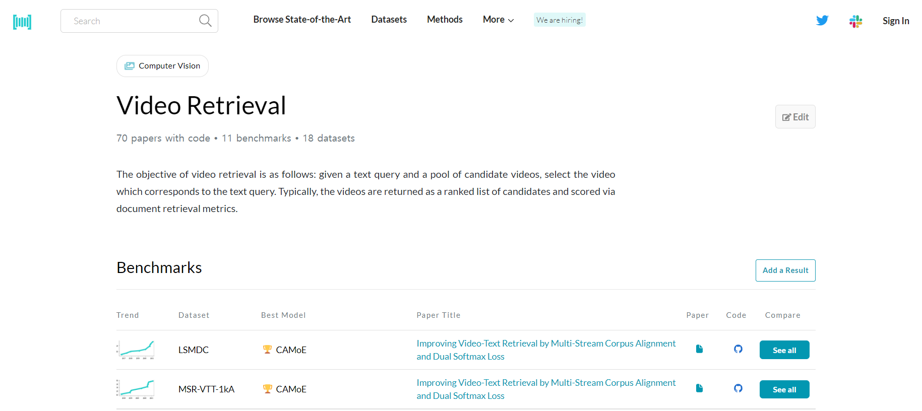
1. Result & Report
3) Google Search Keyword : Text – based Video Retrieval >
https://paperswithcode.com/task/video-retrieval/codeless
arXiv:2109.04290v2 [cs.CV] 13 Sep 2021

Slide 10
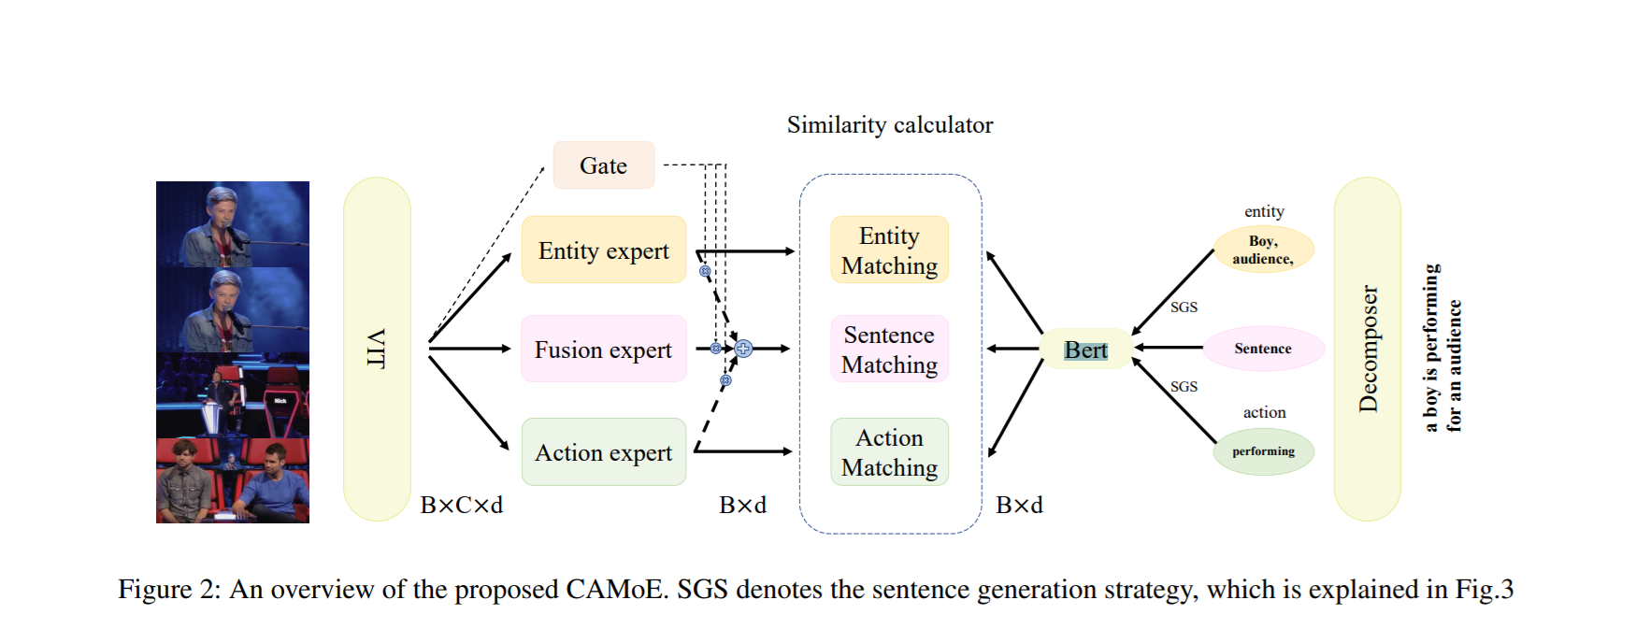
1. Result & Report
Paper : Improving Video-Text Retrieval by Multi-Stream Corpus Alignment and Dual Softmax Loss

Slide 11
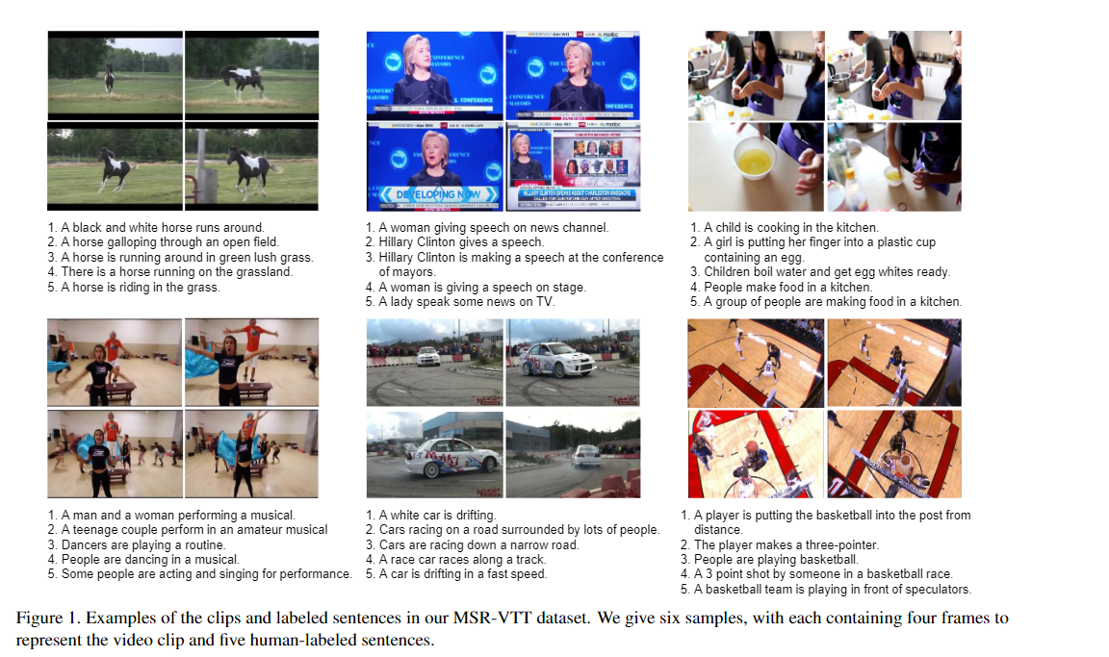
1. Result & Report
3) MSR-VTT dataset

Slide 12
1. Result & Report
Paper : Improving Video-Text Retrieval by Multi-Stream Corpus Alignment and Dual Softmax Loss
MSR-VTT :
10000 videos / captions from 202 movies
MSVD :
1970 videos with a split of 1200, 100, and 670 as the train, validation, and test set rep.
LSMDC :
Large Scale Movie Description and Understanding Challenge
118081 videos / captions from 202 movies

Slide 13
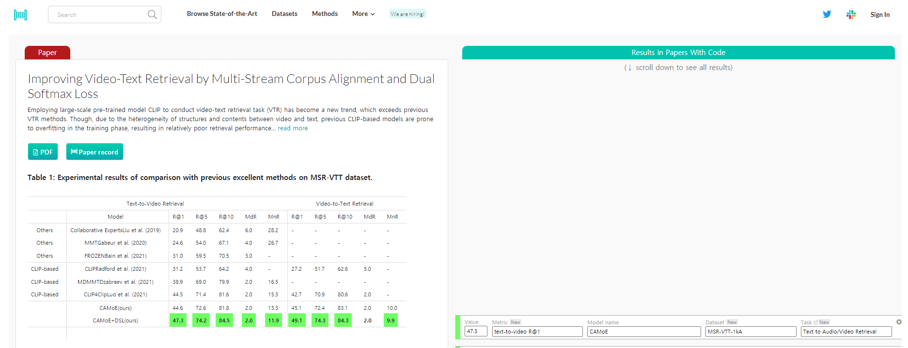
1. Result & Report
Paper : Improving Video-Text Retrieval by Multi-Stream Corpus Alignment and Dual Softmax Loss
Model Name / Task
Text -> Video / Video -> Text 설정 가능

Slide 14
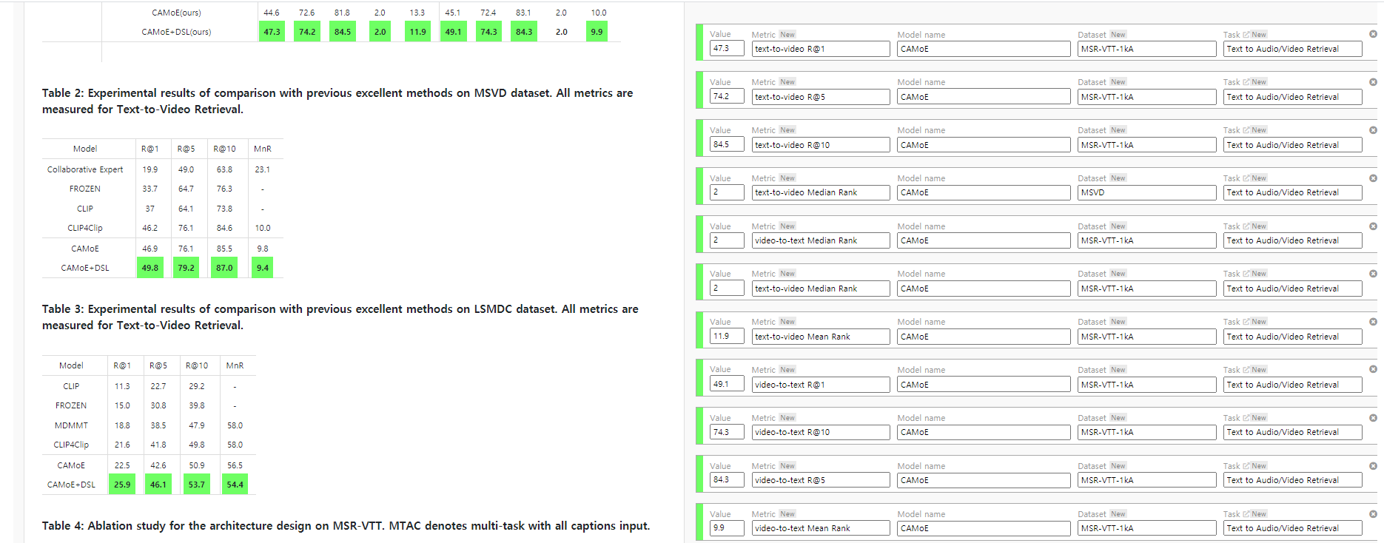
2. Block & Limits
Paper : Improving Video-Text Retrieval by Multi-Stream Corpus Alignment and Dual Softmax Loss

Slide 15
2. Block & Limits
Paper : Improving Video-Text Retrieval by Multi-Stream Corpus Alignment and Dual Softmax Loss
1. Not enough pairs between captions and video clips
2. Preprocessing Problem could be raised.

Slide 16

3. Future Plans & Tasks

