Slide 1
Successive Approximation Register (SAR) Analog to Digital Converter (ADC)
By Espen Klein Nilsen
and Vegard Midtbøen

Slide 2
Content
Introduction
Requirements
Solution
Conclusion

Slide 3
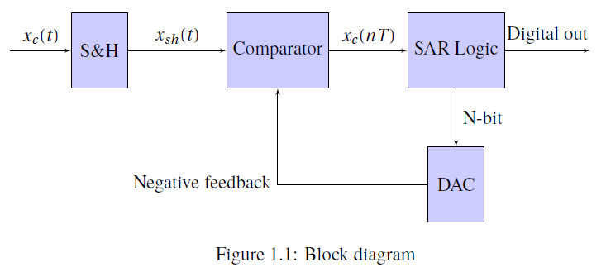
Introduction
Sample-and-Hold
Comparator
Digital-to-Analog Converter
SAR Logic

Slide 4
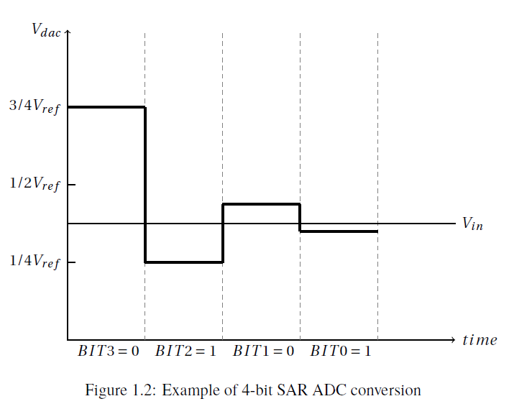
Introduction
SAR ADC

Slide 5
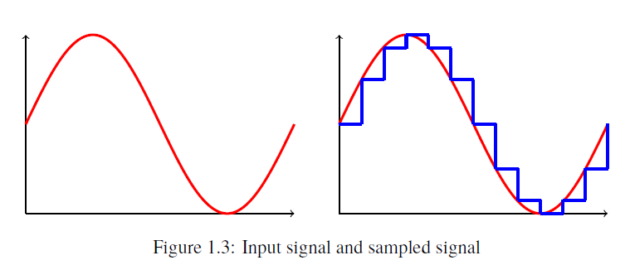
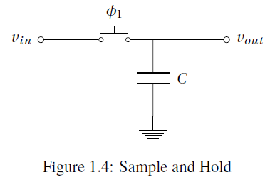
Introduction
Sample-and-Hold
Snatches a value of a analog signal and holds it constant
Φ1:on
  C charges to Vin
Φ1:off
  → Vout = Vin

Slide 6
Introduction
Comparator
Compares two input signals
Outputs logic high or low

Slide 7
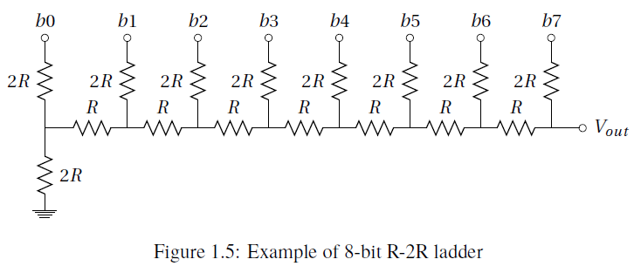
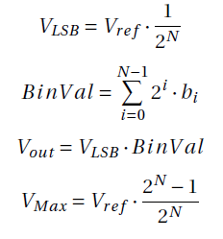
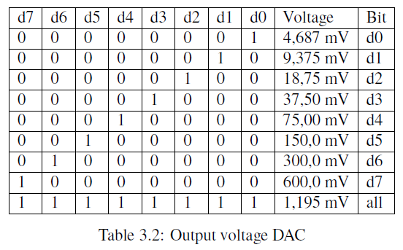
Introduction
Digital-to-Analog Converter
R-2R ladder

Slide 8
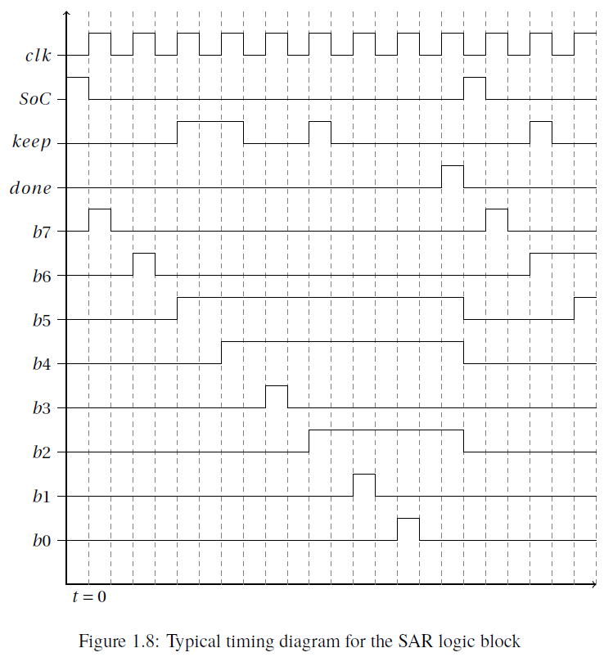
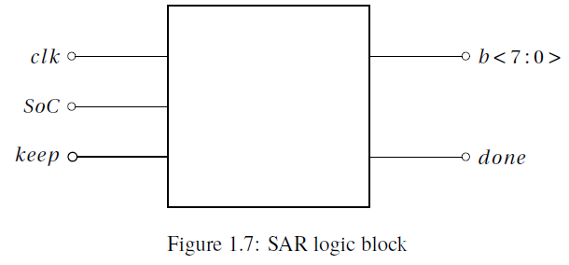
Introduction
SAR Logic

Slide 9
Requirements
SAR ADC
Input sampling rate: 1 M samples/s
Output resolution: 8 bits
Supply voltage: VDD = 1.2V , and VSS = 0V
No missing codes
Monotonic

Slide 10
Requirements
DAC
Sampling rate: 8 M samples/s
Resolution: 8 bits
Supply voltage: VDD = 1.2V , and VSS = 0V
DNL < ± 0.5 LSB
INL < ± 0.5 LSB
VOUT (P-P) >= 0.6V
Cload = 50 fF

Slide 11
Requiremtns
Comprartor
Delay <= 0.5 clock cycle
Supply Voltage: VDD = 1.2V and VSS = 0V
Offset < 0.5 LSB
Gain > VDD/Vref /2n
Cload = 50 fF

Slide 12
Results
Sample-and-Hold
Comparator
Digital-to-Analog Converter
SAR logic
SR Latch
Output buffers

Slide 13
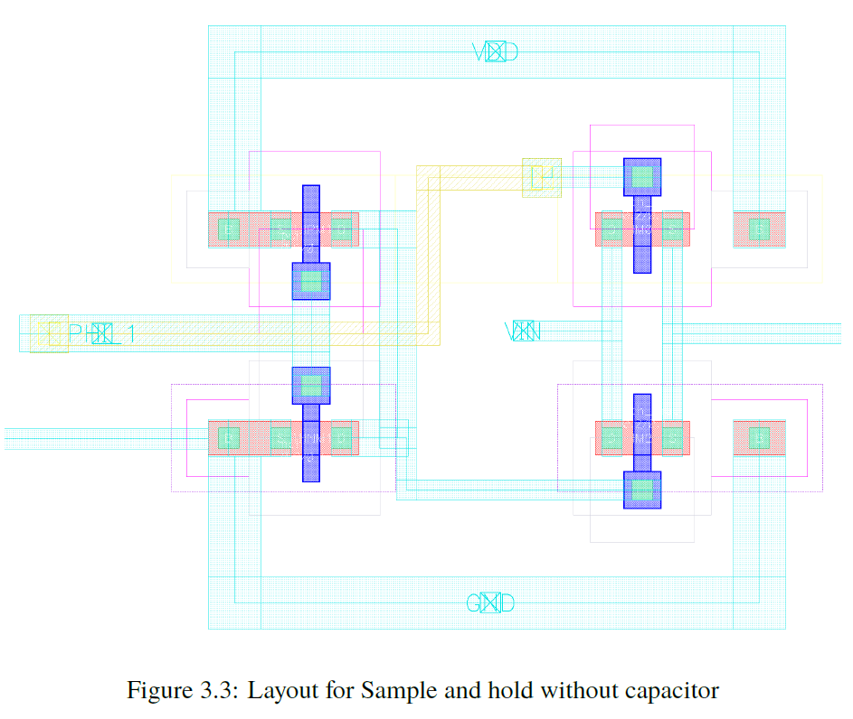
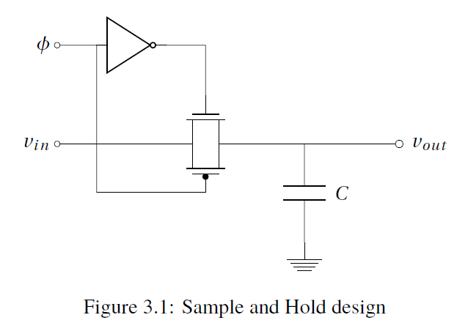
Results
Sample-and-Hold Implementation and Layout
Transmission gate
Inverter

Slide 14
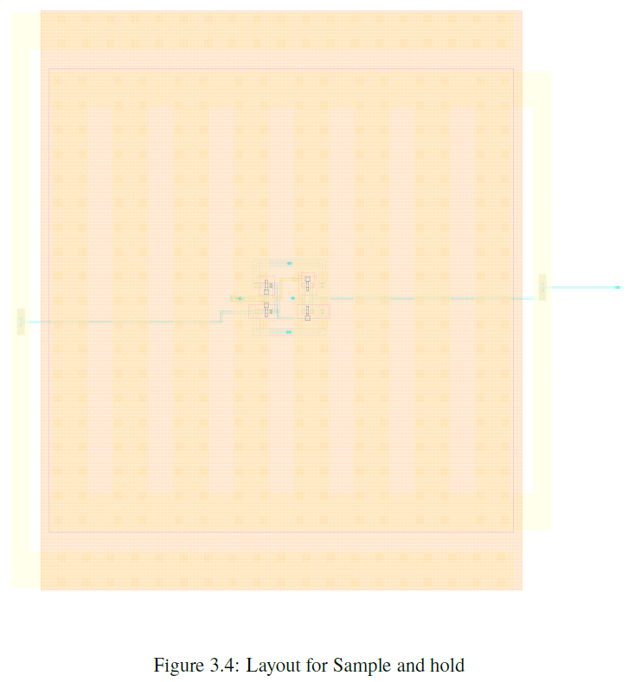
Results
Sample-and-Hold Implementation and Layout

Slide 15
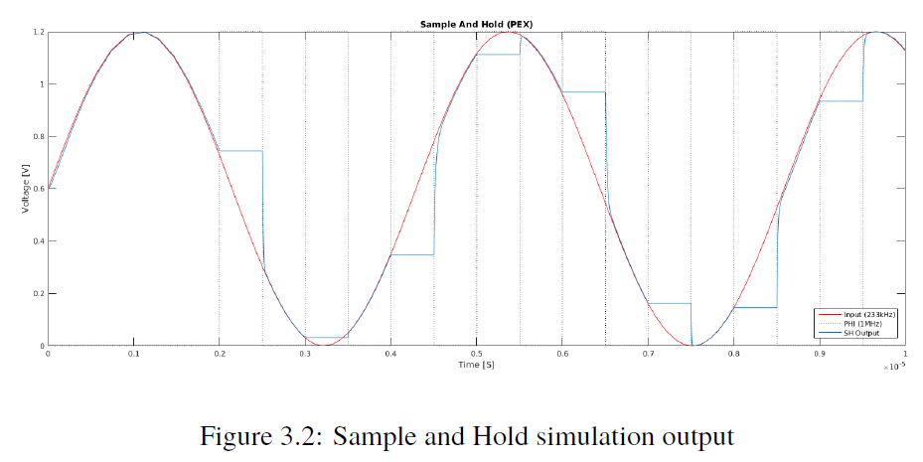
Results
Sample-and-Hold Simulation

Slide 16
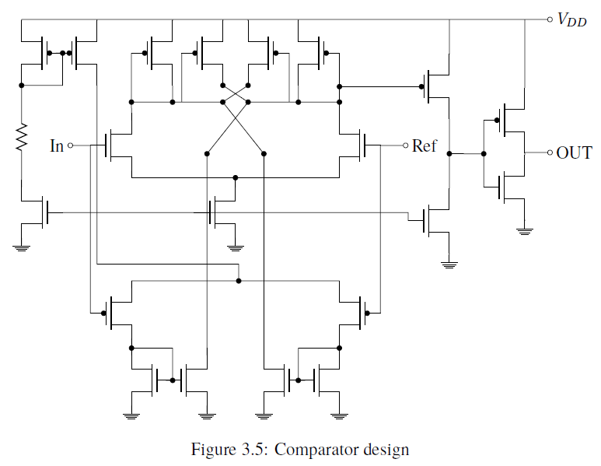
Results
Comparator Implementation and Layout

