Slide 1
Successive Approximation Register (SAR) Analog to Digital Converter (ADC)
By Espen Klein Nilsen
and Vegard Midtbøen

Slide 2
Content
Introduction
Requirements
Solution
Conclusion

Slide 3
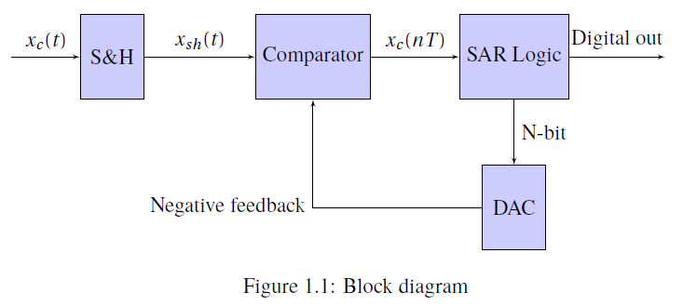
Introduction SAR ADC
Sample-and-Hold
Comparator
Digital-to-Analog Converter
SAR Logic

Slide 4
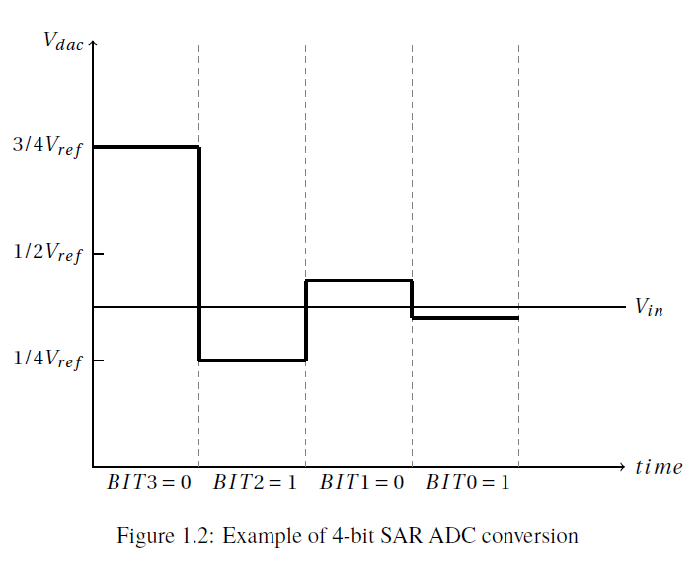
Introduction SAR ADC

Slide 5
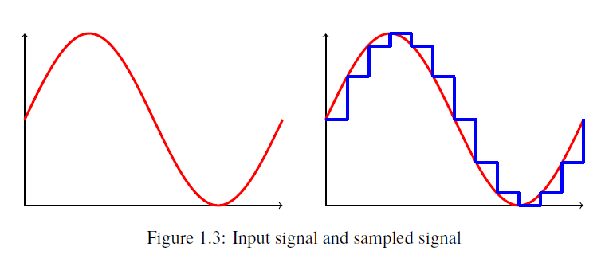
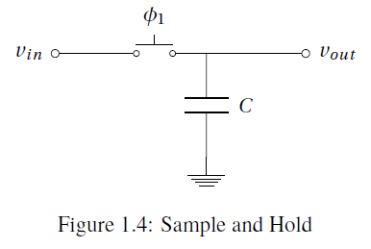
Introduction Sample-and-Hold
Snatches a value of a analog signal and holds it constant
Φ1:on
C charges to Vin
Φ1:off
→ Vout = Vin

Slide 6
Introduction Comparator
Compares two input signals
Outputs logic high or low

Slide 7
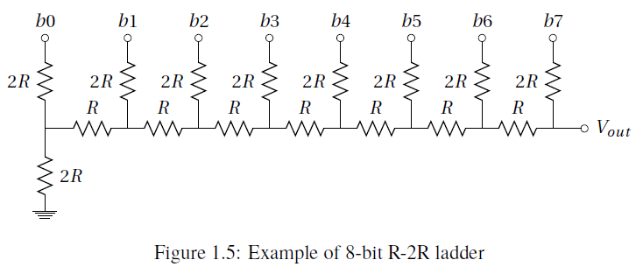
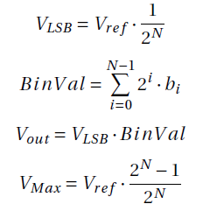
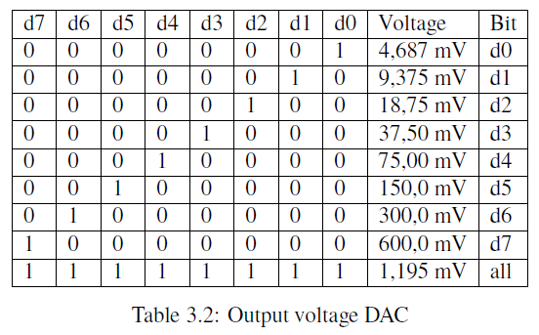
Introduction Digital-to-Analog Converter
R-2R ladder

Slide 8
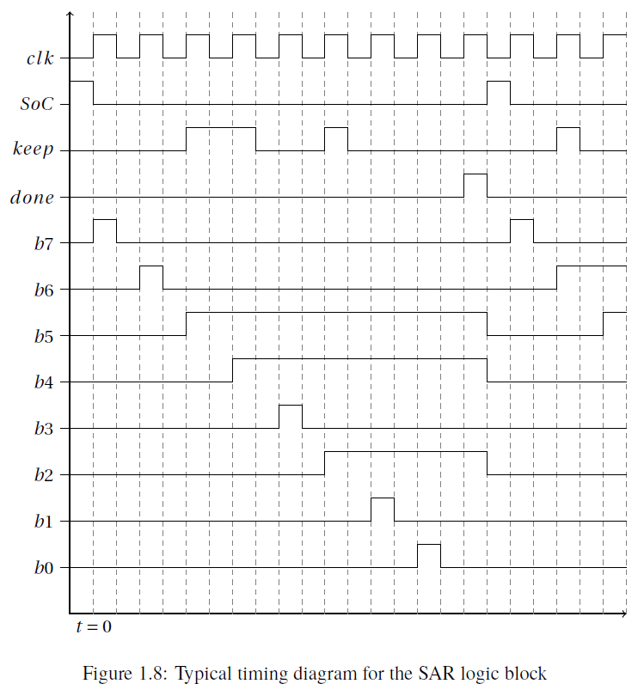
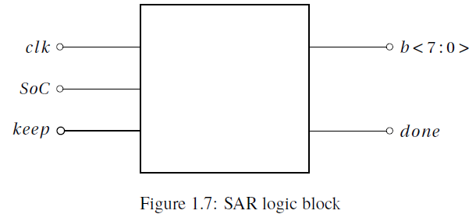
Introduction SAR Logic

Slide 9
Requirements SAR ADC
Input sampling rate: 1 M samples/s
Output resolution: 8 bits
Supply voltage: VDD = 1.2V , and VSS = 0V
No missing codes

Slide 10
Requirements DAC
Sampling rate: 8 M samples/s
Resolution: 8 bits
Supply voltage: VDD = 1.2V , and VSS = 0V
DNL < ± 0.5 LSB
INL < ± 0.5 LSB
VOUT (P-P) >= 0.6V
Cload = 50 fF

Slide 11
Requirements Comparator
Delay <= 0.5 clock cycle
Supply Voltage: VDD = 1.2V and VSS = 0V
Offset < 0.5 LSB
Gain > VDD/Vref /2n
Cload = 50 fF

Slide 12
Results
Sample-and-Hold
Comparator
Digital-to-Analog Converter
SAR logic
SR Latch
Output buffers

Slide 13
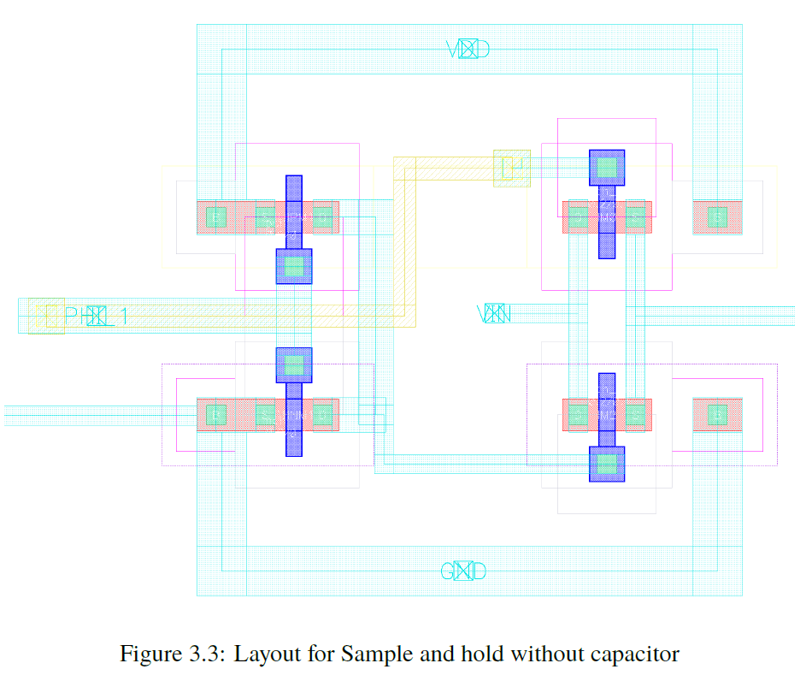
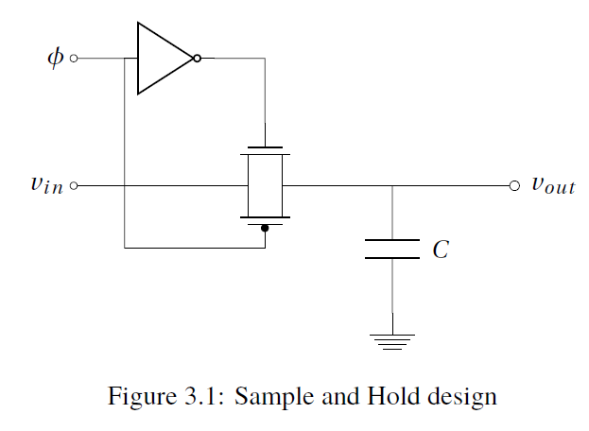
Results Sample-and-Hold Implementation and Layout
Transmission gate
Inverter

Slide 14
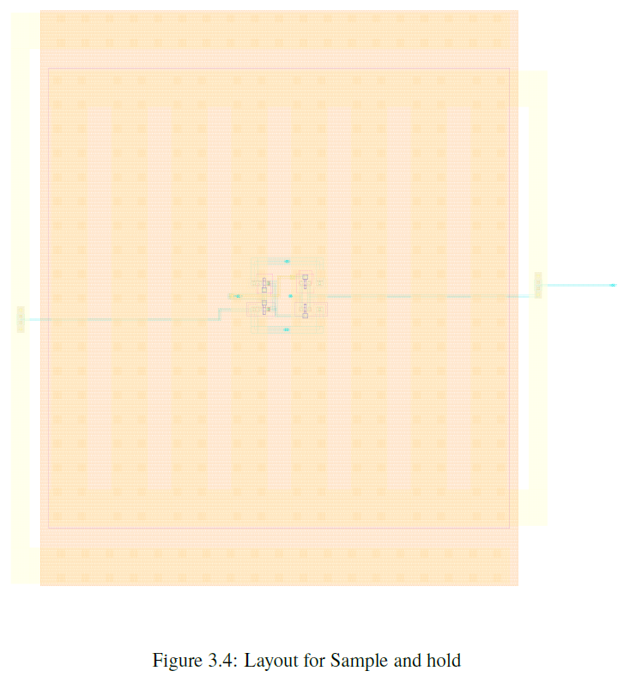
Results Sample-and-Hold Implementation and Layout

Slide 15
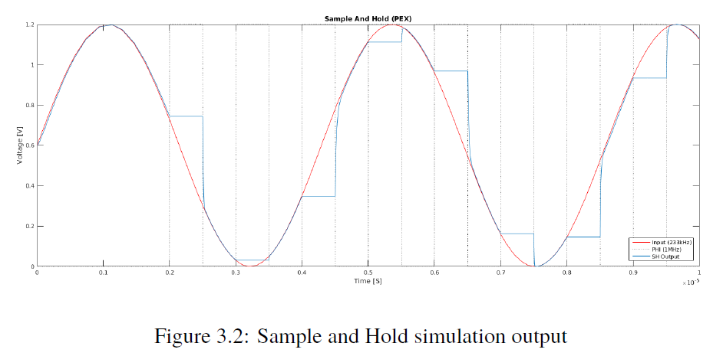
Results Sample-and-Hold Simulation

Slide 16
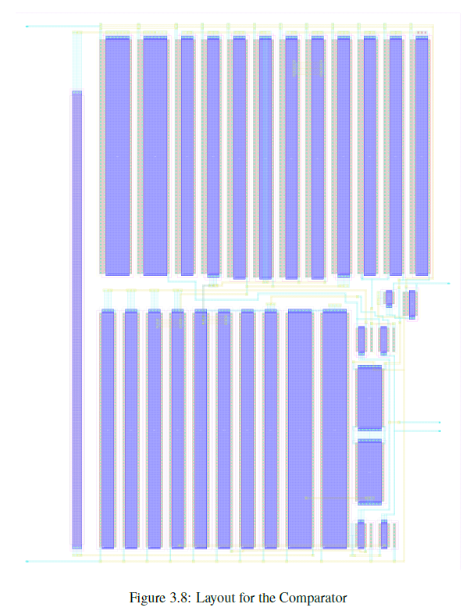
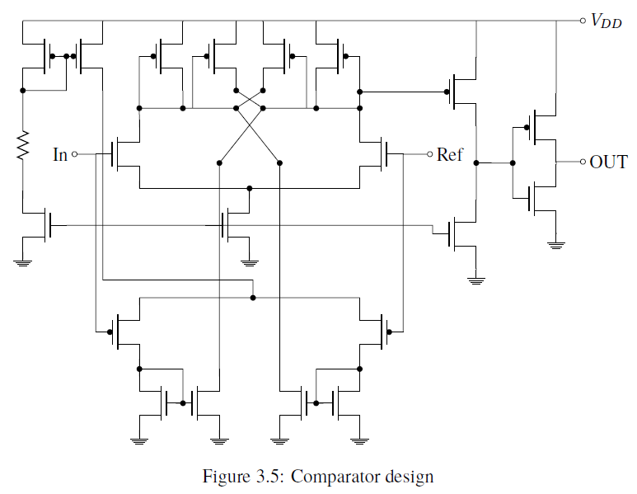
Results Comparator Implementation and Layout
Rail-to-rail input
Large transistors

Slide 17
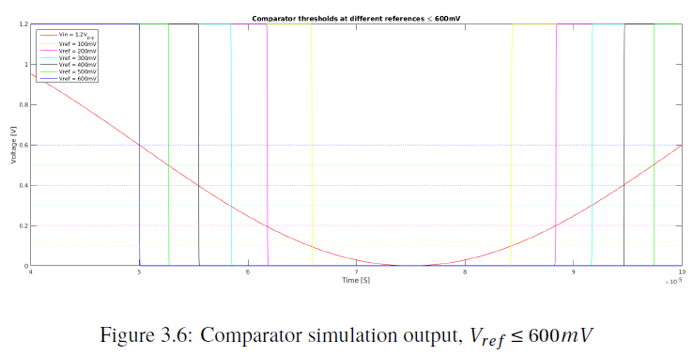
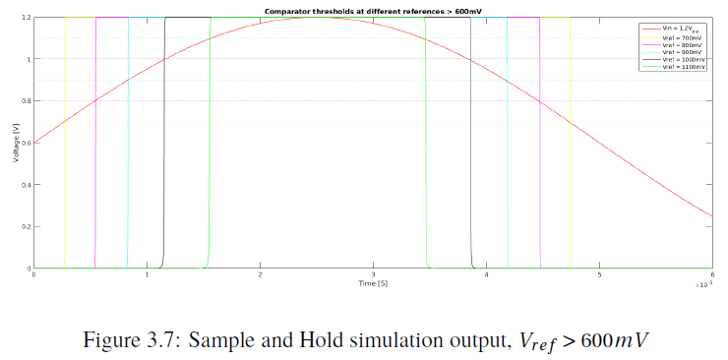
Results Comparator Simulation

Slide 18
Results Requirement fulfillment
Achieved
Delay
Offset
Gain

Slide 19
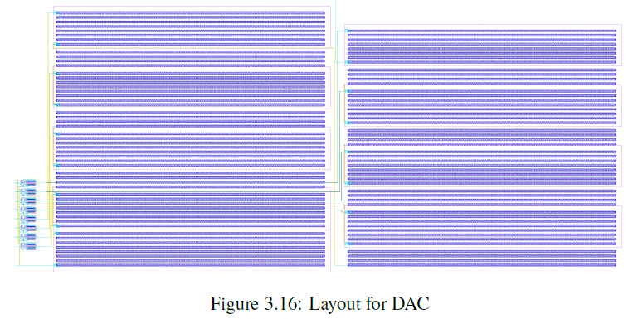
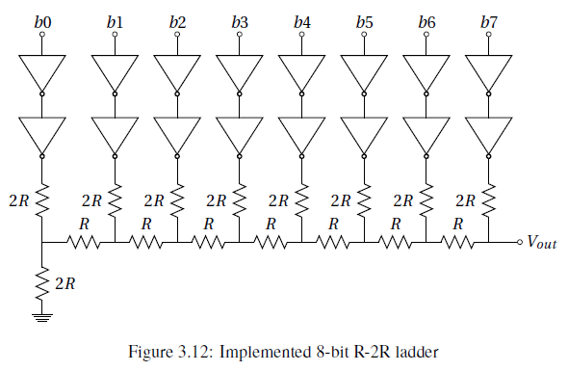
Results Digital-to-Analog Converter Implementation and Layout
R-2R
Buffers convert from 1V to 1.2V
Each resistance divided in four
R = 320 kOhm

Slide 20
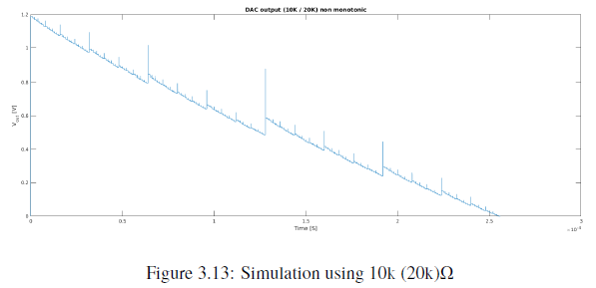
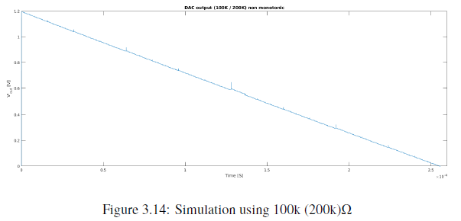
Results Digital-to-Analog Converter Simulation
R = 10K
2R = 20K
R = 100K
2R = 200K

Slide 21
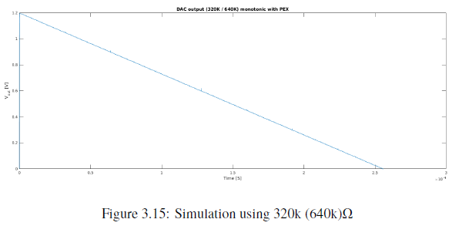
Results Digital-to-Analog Converter Simulation
R = 320K
2R = 640K

Slide 22
Results Requirement fulfillment
Achieved
Sampling rate of 8 M samples/s (10 M ok)
INL and DNL (software calculations)
Monotonic
Output voltage

Slide 23
Results SAR logic
Not simulated on its own
Verified with the complete system

Slide 24
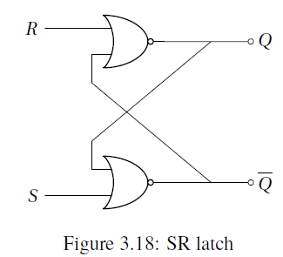
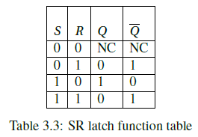
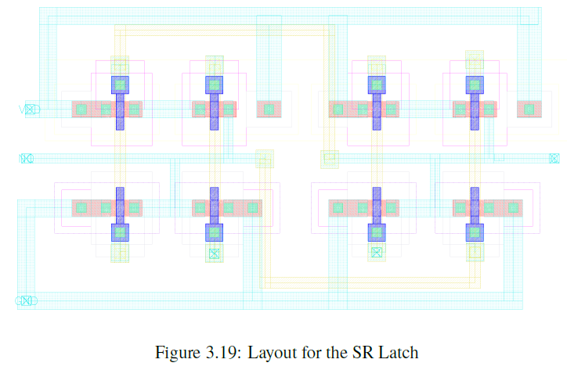
Results SR Latch
Needed to include SR Latch for control of sample-and-hold

Slide 25
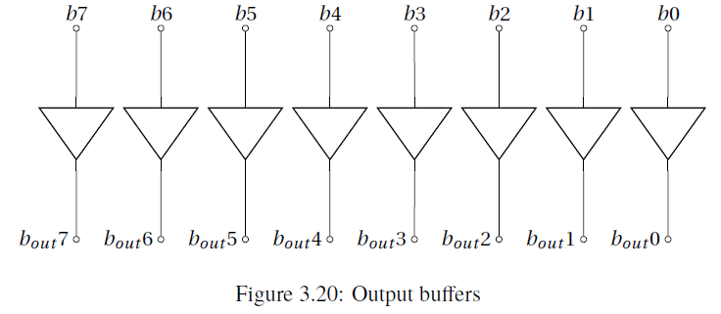
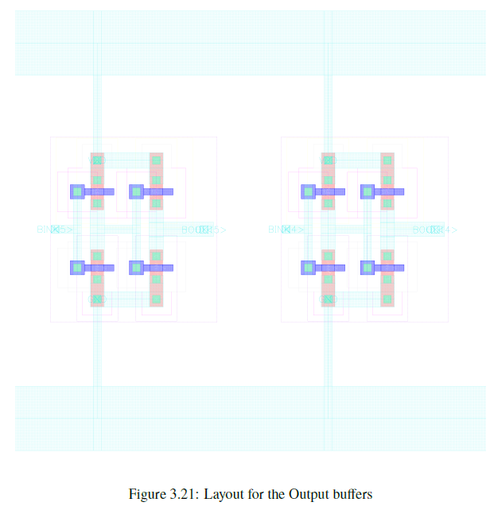
Results Output buffers
High impedance for the DAC
Not simulated

Slide 26
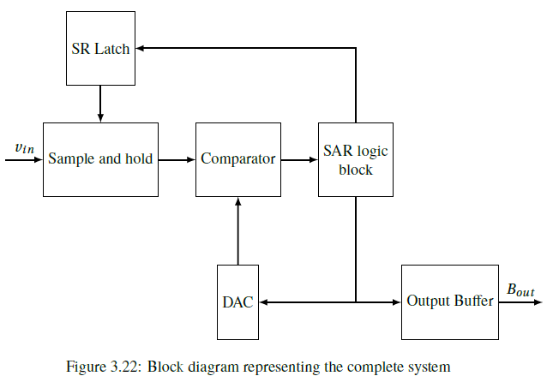
Results SAR System Implementation and Layout
The total area consumed:
220µm x 140µm

Slide 27
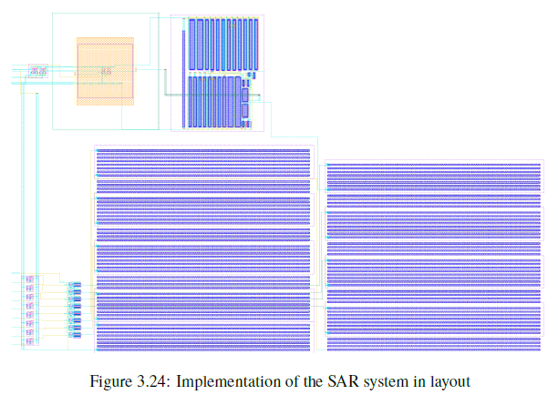
Results SAR System Implementation and Layout

Slide 28
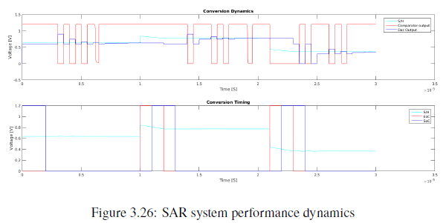
Results SAR System Simulation

Slide 29
Results Requirement fulfillment
Achieved
Input sampling rate of 1 M samples/s
Output resolution: 8 bits
Not Verified
No missing codes

Slide 30
Conclusion
Improvements
DAC design
SR latch
Layout
Almost all requirements fulfilled

