Slide 1
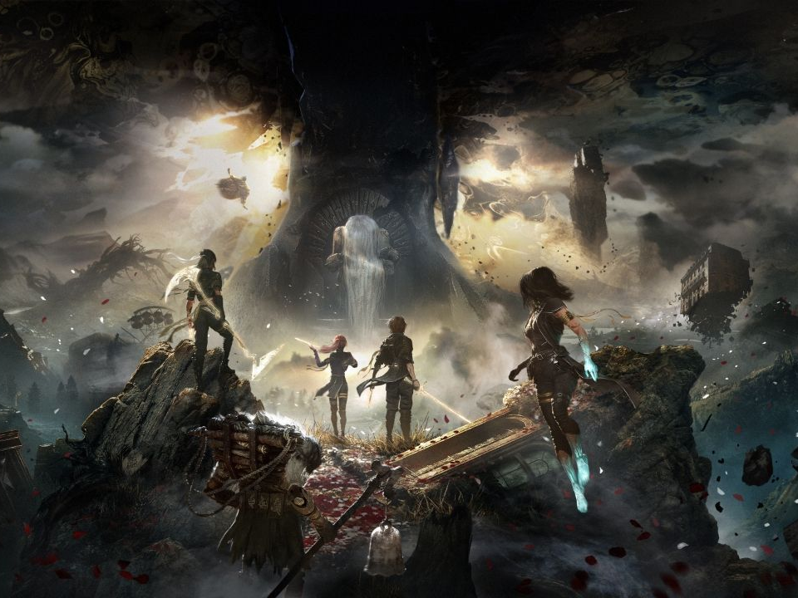
Clair Obscur: Expedition 33
A Unique Blend of Art, Action, and RPG

Slide 2
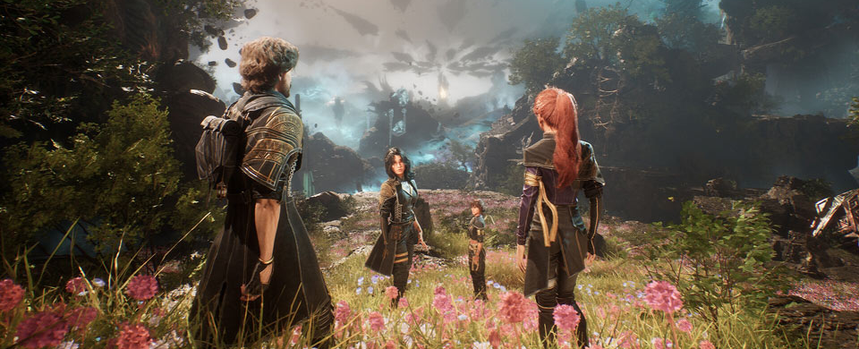
What Is Expedition 33?
• A narrative-driven action-RPG with a strong artistic identity
• Inspired by chiaroscuro aesthetics (contrast of light and dark)
• Aimed at players who enjoy atmospheric storytelling

Slide 3
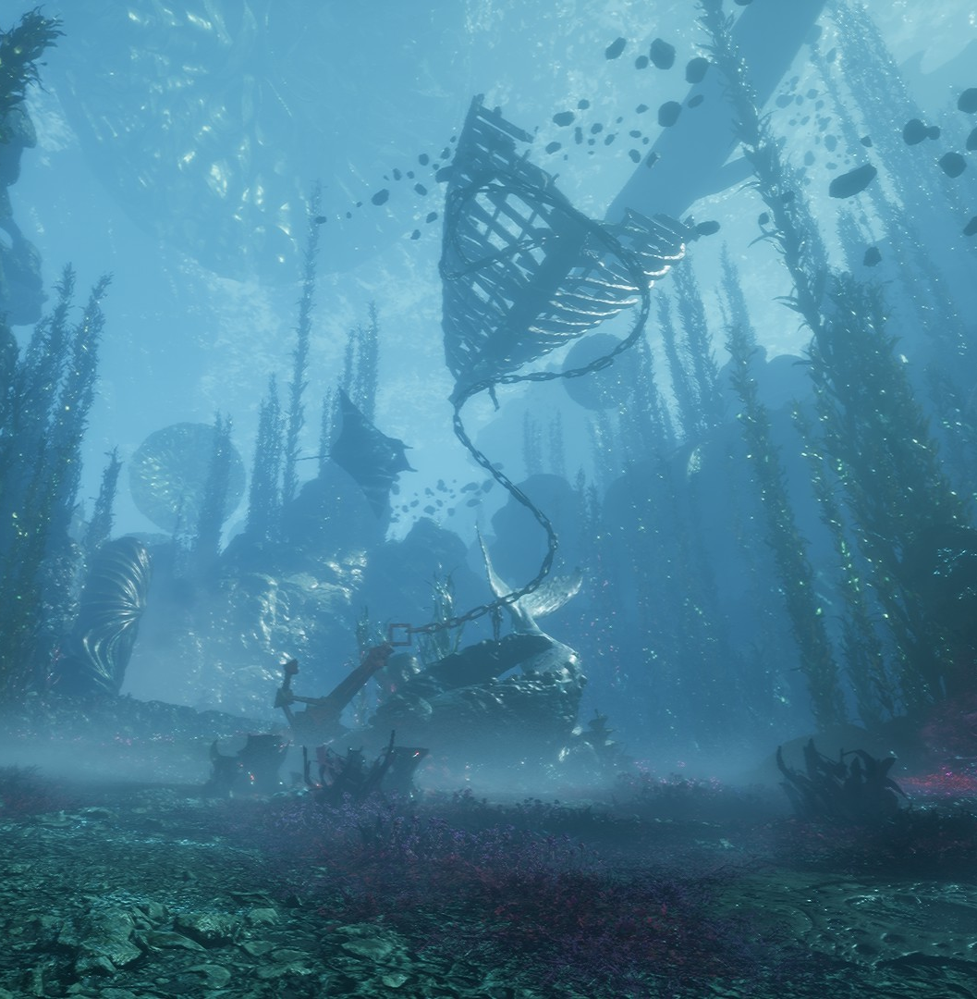
The World
• A decaying realm shaped by cycles of light and shadow
• Environmental storytelling reveals history through ruins, symbols, and architecture
• Every zone reflects emotional themes

Slide 4
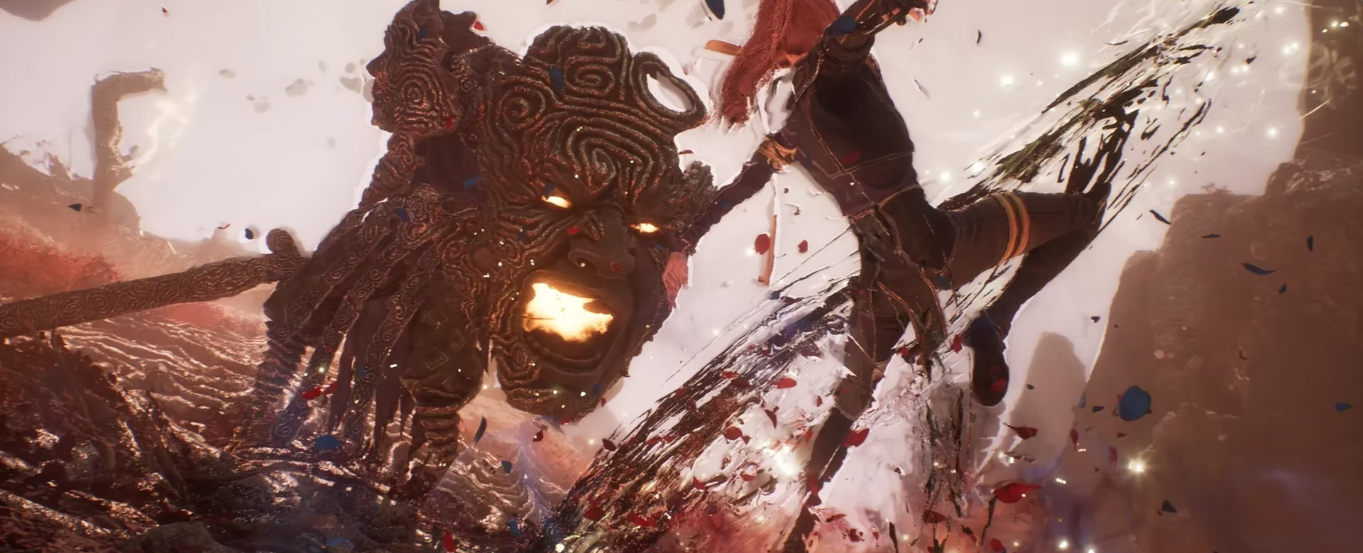
Core Gameplay
• Action combat mixing light/dark mechanics
• Tactical dodging, timing, and skill-based encounters
• Exploration with meaningful environmental interactions

Slide 5
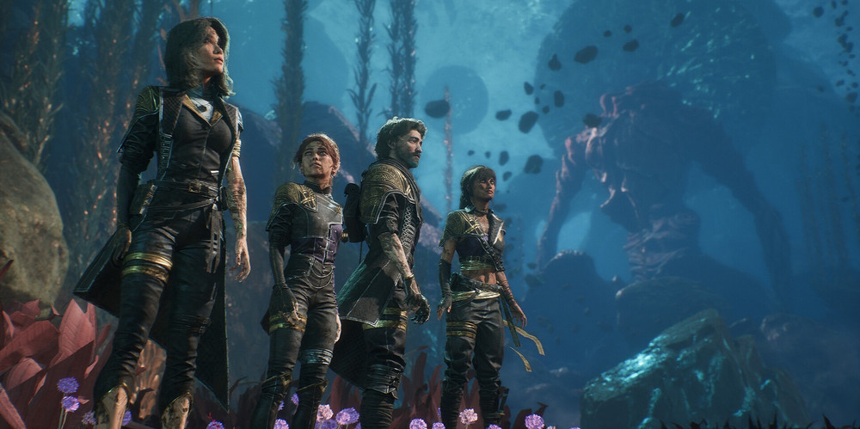
RPG Elements
• Character progression with unlockable abilities
• Equipment upgrades and stat-based improvements
• Narrative choices influencing your journey

Slide 6
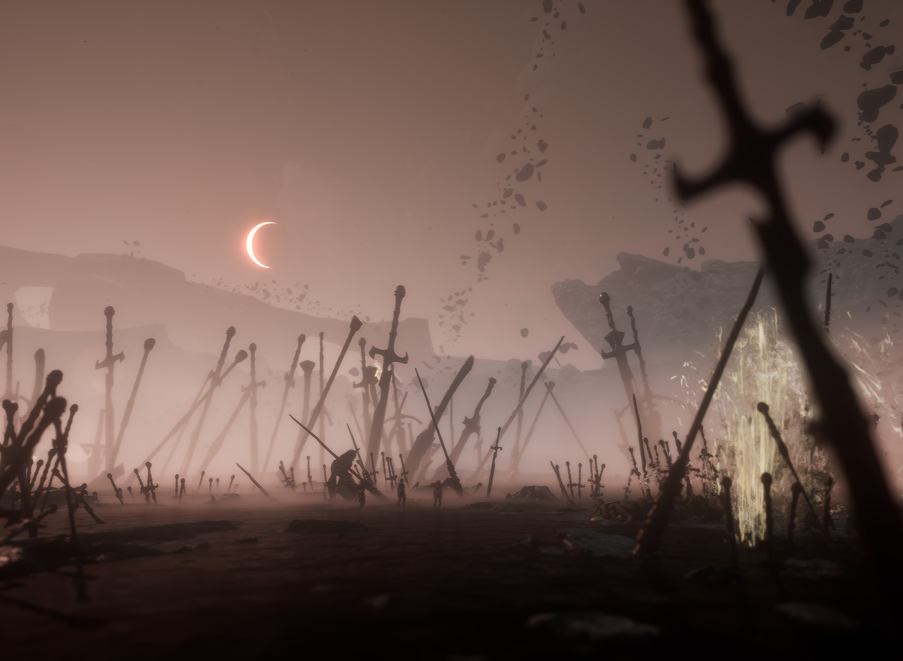
Atmosphere & Art Direction
• Unique painterly style that blends realism and abstraction
• Emotional tone supported by music, lighting, and world design
• One of the strongest selling points of the game

Slide 7

Why You Should Play It
• A fresh artistic vision rarely seen in modern RPGs
• Deep immersion through visuals, sound, and narrative
• Innovative gameplay loop mixing action, puzzles, and RPG systems

Slide 8
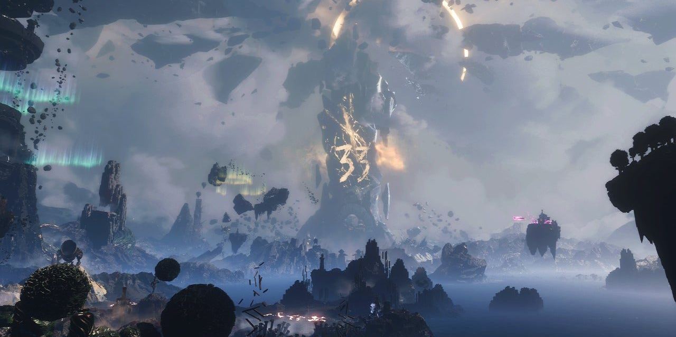
Conclusion
Clair Obscur: Expedition 33 is a standout action-RPG offering a rich world,
deep atmosphere, and unique gameplay mechanics. A perfect choice for players
seeking originality and emotional storytelling.

