Slide 1
ORIGIN OF LIFE · THEORY
From Rule-Taking
to Rule-Making Chemistry
A minimal population–environment feedback model
Celia Blanco
Centro de Astrobiología · CSIC–INTA

Slide 2
THE QUESTION
When does chemistry stop
adapting to its conditions —
and start authoring them?
2 / 14

Slide 3
CONTEXT
Classical origin-of-life models
WELL STUDIED
USUALLY FIXED
Replicators
The environment
Autocatalytic sets
Hypercycles
Protocells
Reaction conditions imposed externally
Not shaped by the chemistry it hosts
No feedback into selection
Fidelity, replication, inheritance.
But life is defined by reshaping its surroundings.
3 / 14

Slide 4
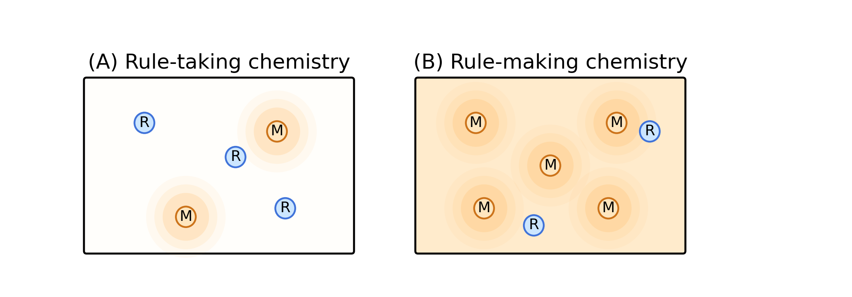
THE DISTINCTION
Two chemistries
Rule-takers (R) depend on the environment. Rule-makers (M) reshape it — at a cost.
4 / 14

Slide 5
THE MODEL
Minimal coupling: population ↔ environment
E
environment
produces (α)
no effect on R’s rate
R
enhances (p)
M
rule-taker
rule-maker
fraction 1 – y
fraction y · pays cost c
R sits in E but ignores it (π_R = 1). Only M’s replication rate responds to E.
5 / 14

Slide 6
THE DYNAMICS
Two coupled equations
POPULATION (replicator equation)
ẏ = y (1 – y) · ( s – c + p E – 1 )
ENVIRONMENT (production – decay)
Ė = α y – β E
M produces E. A larger E raises M’s replication rate — more M, more E.
6 / 14

Slide 7
THE THRESHOLD
One number controls the regime
p_{eff} = p α / β > p_{c} = c + 1 – s
EFFECTIVE FEEDBACK
COST BARRIER
how strongly modifiers help,
what rule-makers give up
weighted by how long they last
to modify the environment
Cross it, and a second stable state appears.
7 / 14

Slide 8
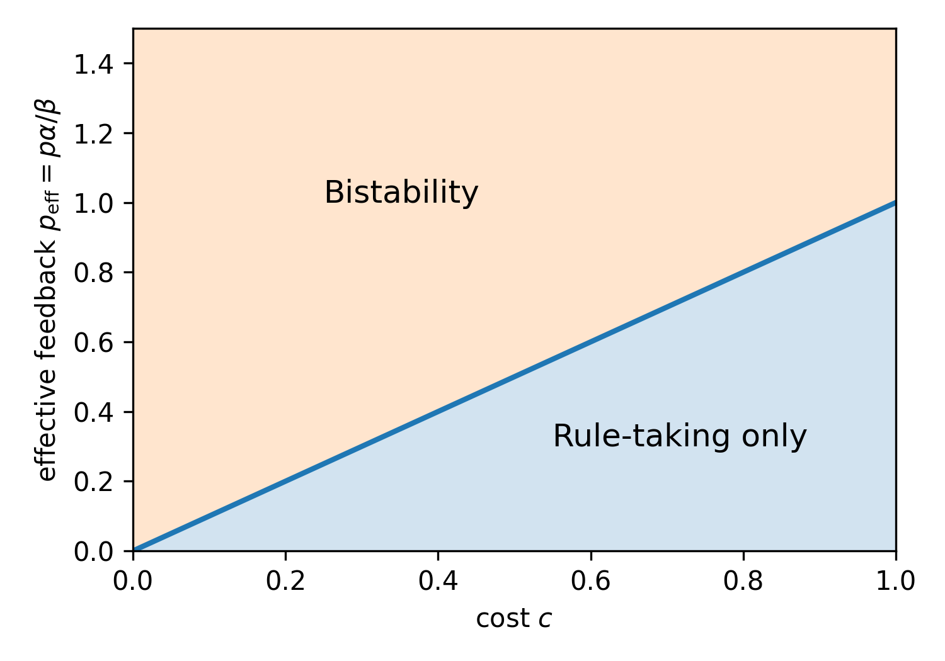
PHASE DIAGRAM
Cost versus feedback strength
ABOVE THE LINE
Rule-takers and rule-makers each form a stable state.
BELOW THE LINE
Only rule-taking persists — modifiers can’t pay for themselves.
Stronger feedback compensates for higher cost — linearly.
8 / 14

Slide 9
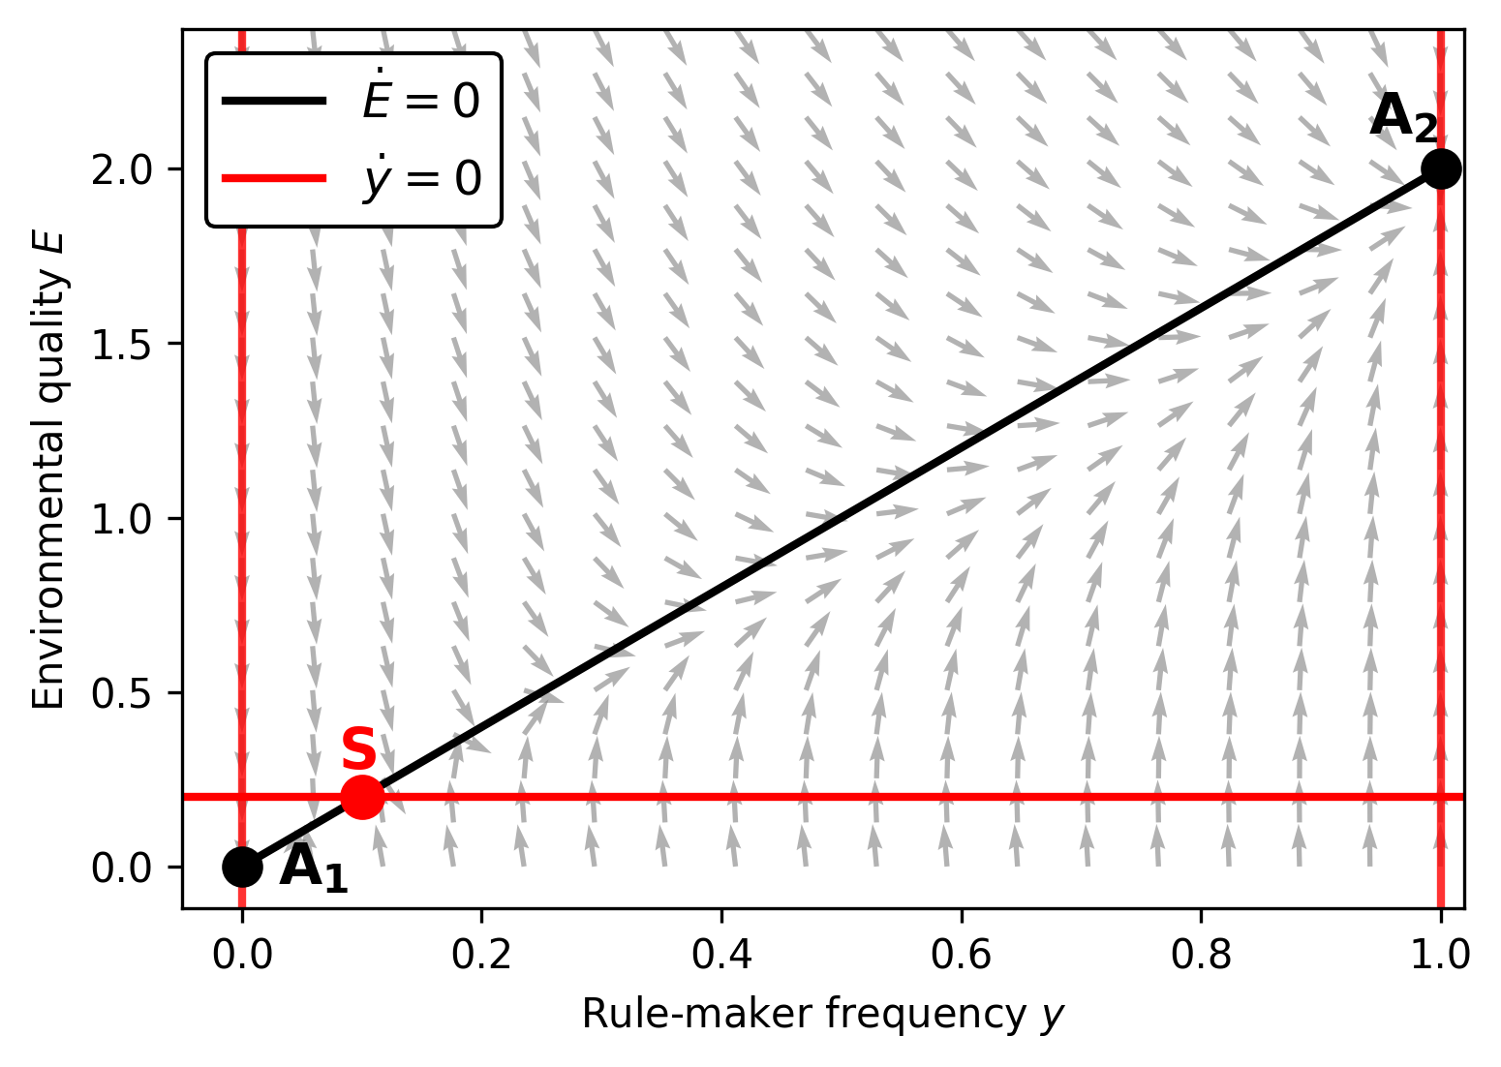
GEOMETRY
A saddle divides the basin
TWO ATTRACTORS
A₁ = rule-takers only. A₂ = rule-makers dominate.
ONE SADDLE
Its stable manifold draws the separatrix between the two fates.
9 / 14

Slide 10
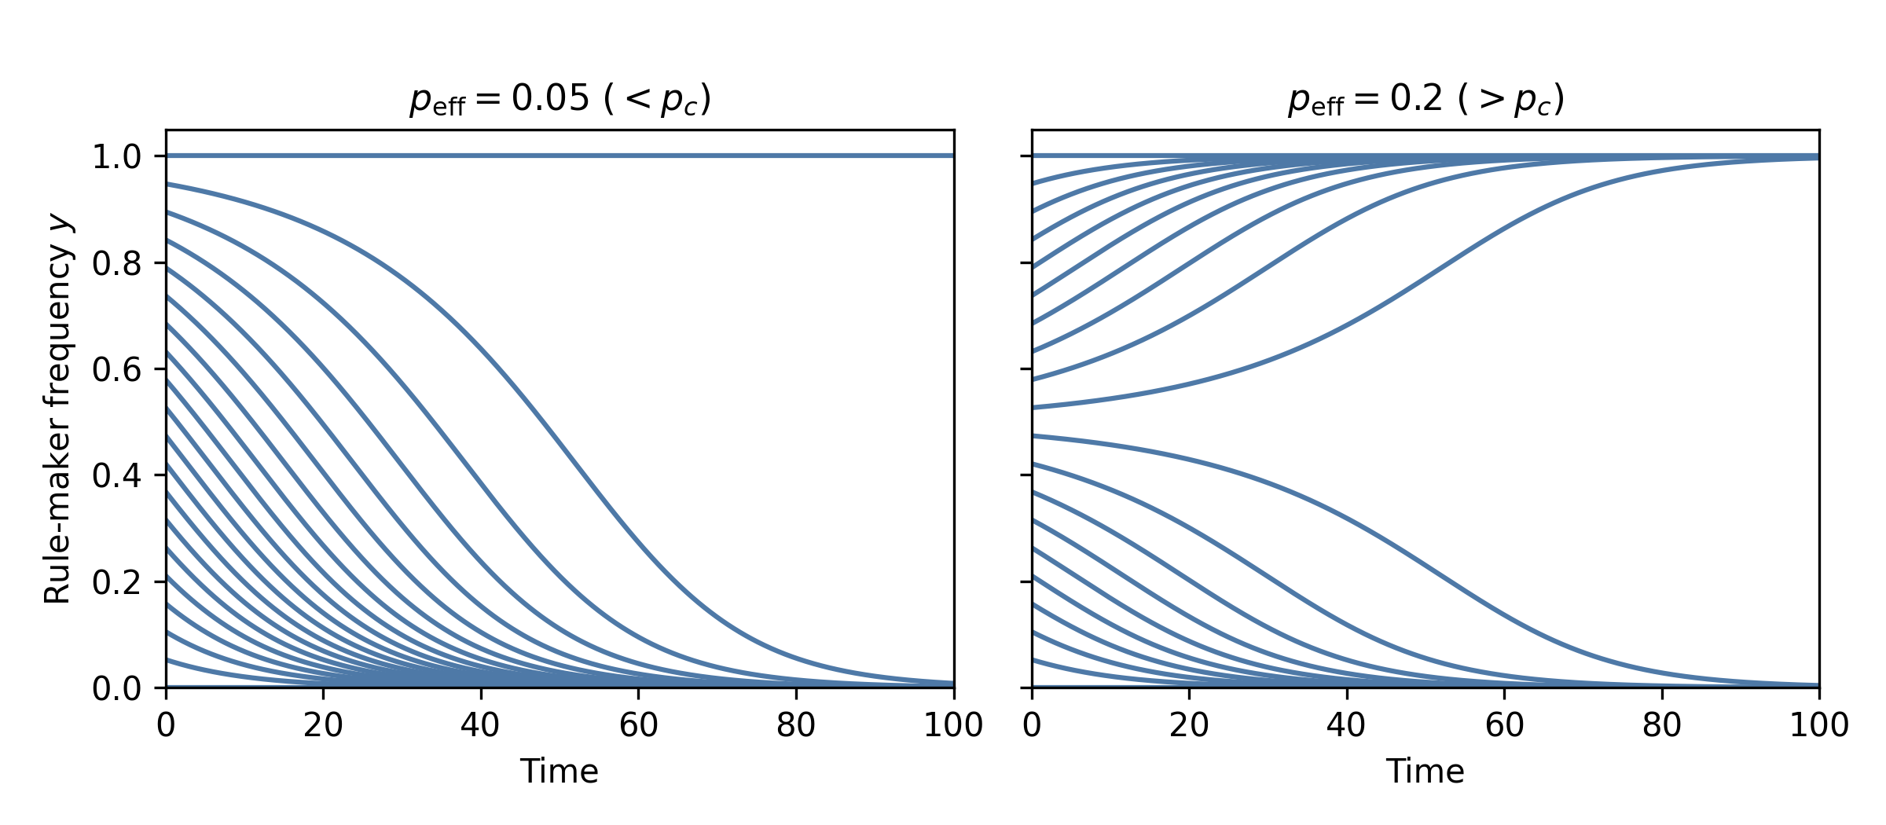
CASE 1 — NO MEMORY
Composition alone decides
When the environment relaxes instantly, only a sharp frequency threshold matters.
10 / 14

Slide 11
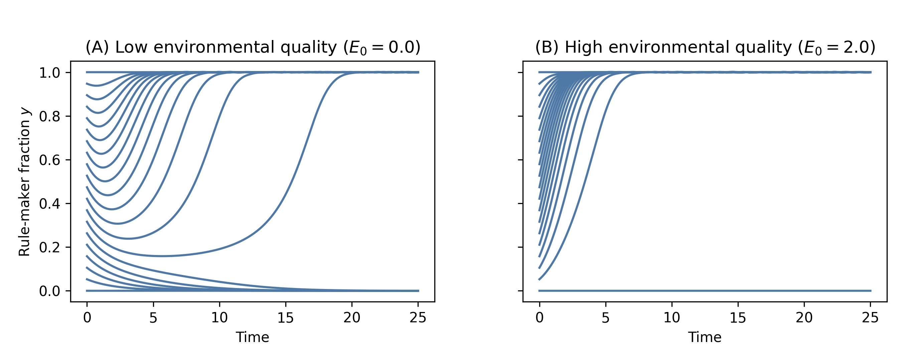
CASE 2 — ENVIRONMENTAL MEMORY
History reshapes the basin
Because E remembers, a favourable past lets even rare rule-makers invade.
11 / 14

Slide 12
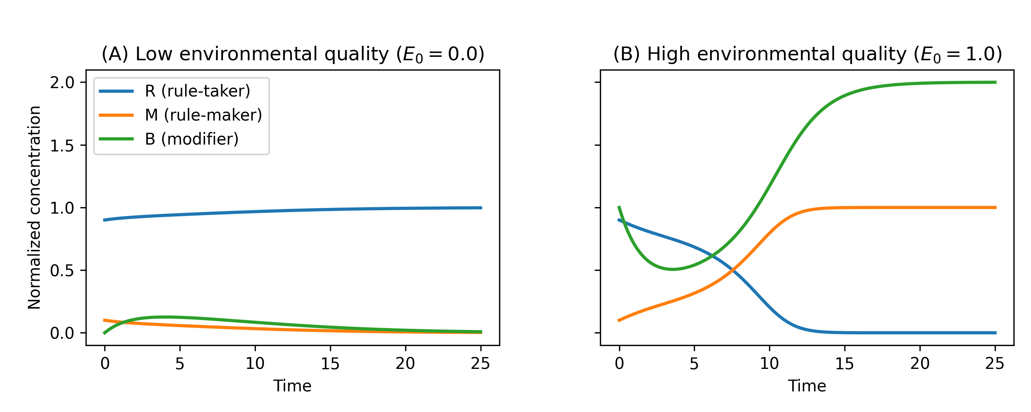
CHEMICAL REALIZATION
Same dynamics, real molecules
MINIMAL REACTION NETWORK
R + S → 2R
rule-taker replication
M + S → 2M
rule-maker replication
M + S + B → 2M + B
modifier-assisted (catalytic)
M + S → M + B
modifier production (costly)
B → ∅
modifier decay
12 / 14

Slide 13
TAKE HOME
Three ideas to keep
01
02
03
Persistence creates inheritance
History opens basins
Autonomy is conditional
Modifiers that outlast a generation transmit conditions, not genes — a chemistry-level form of heredity.
A favourable environment lowers the threshold for rule-makers — even when they start rare.
Bistability is not guaranteed: feedback must be strong, persistent, and seeded by the right history.
13 / 14

Slide 14
CLOSING THOUGHT
Replication makes a chemistry persist.
Feedback lets it set the conditions for its own persistence.
That second step is rare — and may be where chemistry began to look like life.
Thank you.
celia.blanco@cab.inta-csic.es

