Slide 1

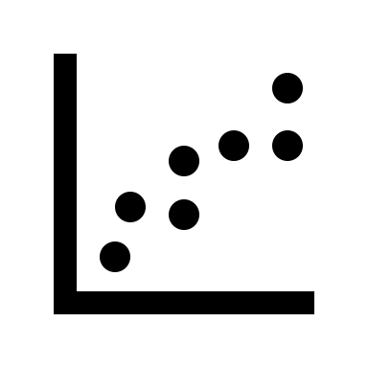
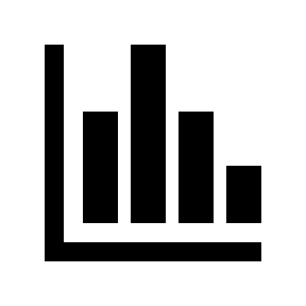

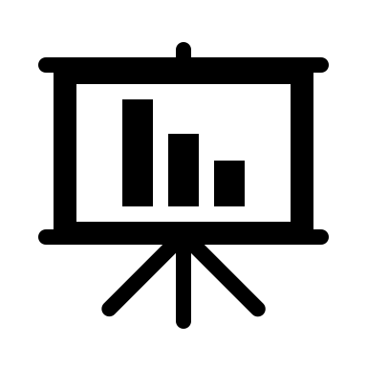
Automating data analysis workflow
submodules
Library of custom-made modules containing a variety of functions
e.g., plotting
e.g., file handling
e.g., APIs
e.g., mathematical modelling
User
main.py
Assign instrument-specific object
Read data
Create functions
Make custom analysis and visualization using attributes and functions from instrument-specific object
Custom modelling of data
Customizing and perfecting visualization
Create attributes
e.g., meta data
e.g., experimental parameters
e.g., convert units
e.g., calculate physical parameters
… by using functions from submodules
e.g., modelling data
e.g., statistics
Extract data from instrument
.csv
.xslx

