Slide 1

Lending Club Loan Analysis

Slide 2
Outline
Data Exploration and Data Cleaning
Introduction
Data Analysis and Visualization
Data Prediction Model
Business Impact
1
2
3
4
5

Slide 3
1. Introduction - Company and Dataset
Company
A peer to peer lending. The "bridge" between investors and borrowers.
Investors provide funds for potential borrowers and earn a profit depending on the risk they take.
Dataset
Loan data for all loans issued through the 2007-2015
Including the current loan status and latest payment information.
Contains 890 thousand observations and 74 variables.
Borrowers
Apply for loans
Get funded
Repay
Investors
Earn
Reinvest
Data source: https://www.kaggle.com/wendykan/lending-club-loan-data

Slide 4
1. Introduction - Variables
Varaibles | Description
annual_inc | The self-reported annual income provided by the borrower during registration
annual_inc_joint | The combined self-reported annual income provided by the co-borrowers during registration
application_type | Indicates whether the loan is an individual application or a joint application with two co-borrowers
dti | A ratio calculated using the borrower’s total monthly debt payments on the total debt obligations, excluding mortgage and the requested LC loan, divided by the borrower’s self-reported monthly income.
dti_joint | A ratio calculated using the co-borrowers' total monthly payments on the total debt obligations, excluding mortgages and the requested LC loan, divided by the co-borrowers' combined self-reported monthly income
emp_length | Employment length in years. Possible values are between 0 and 10 where 0 means less than one year and 10 means ten or more years.
emp_title | The job title supplied by the Borrower when applying for the loan.
funded_amnt | The total amount committed to that loan at that point in time.
Others:
credit scores
zip codes
state
...

Slide 5
2. Data Exploration and Data Cleaning

Slide 6
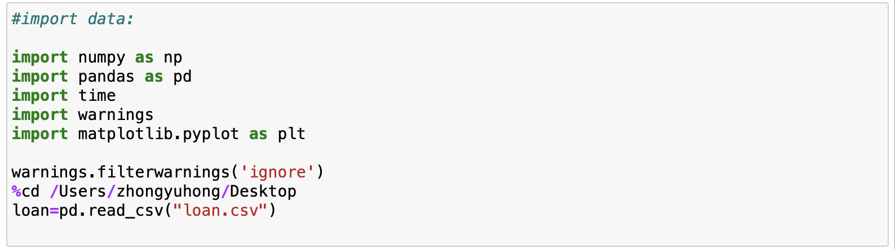
Import data

Slide 7
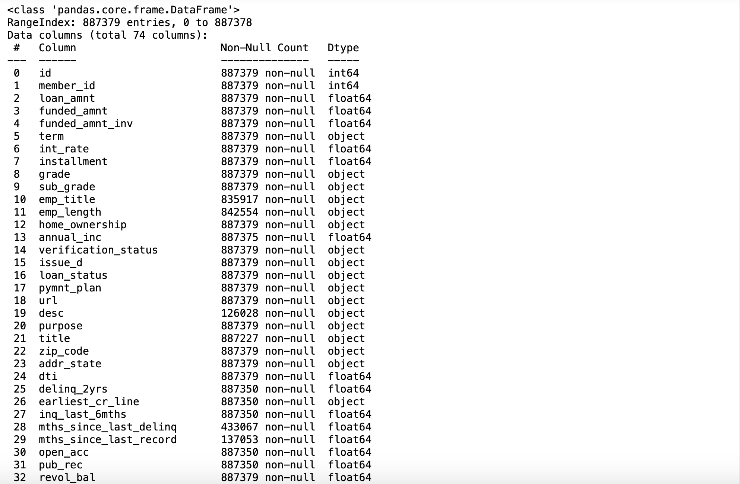
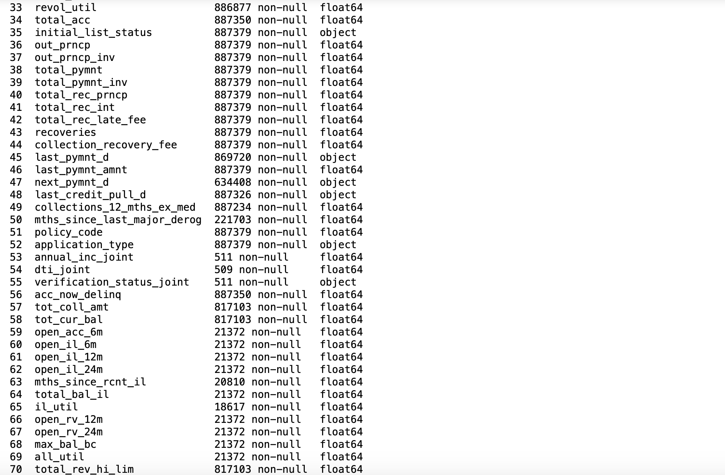
Inspecting the data frame properties

Slide 8
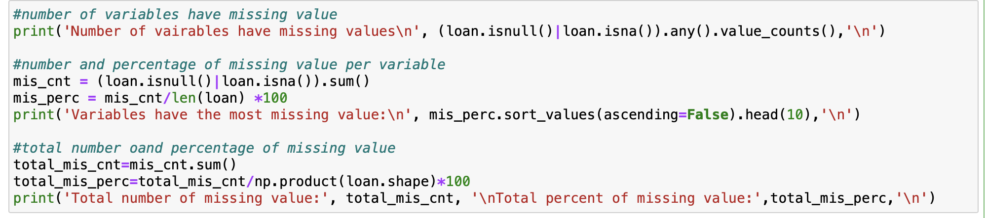
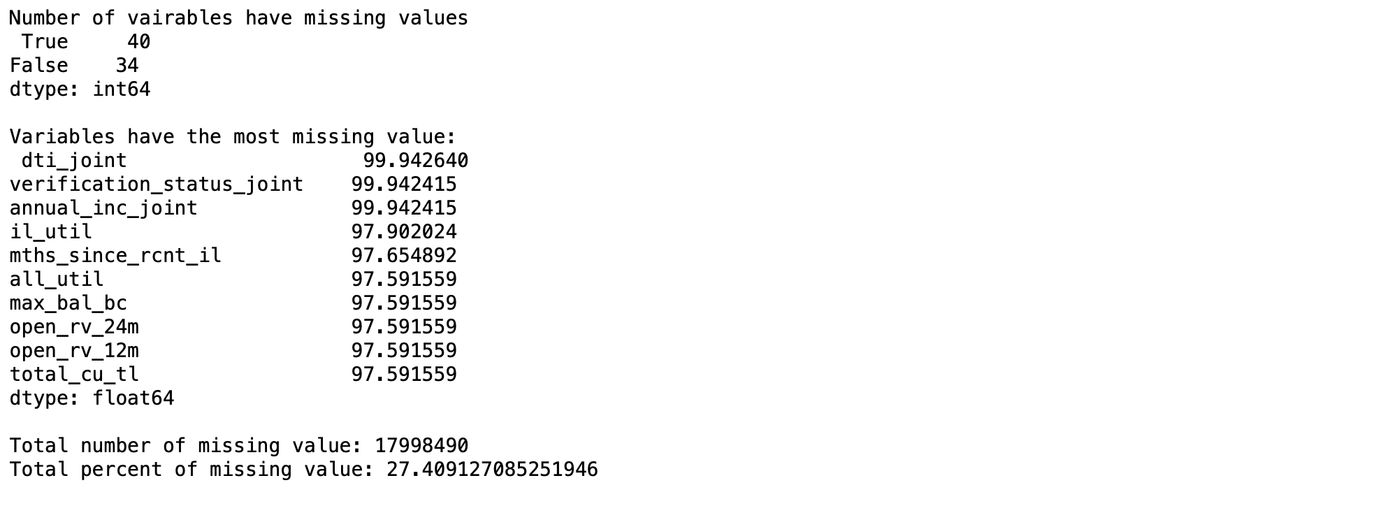
Inspecting the Missing Value

Slide 9
Drop the variables with more than 70% missing values

Slide 10
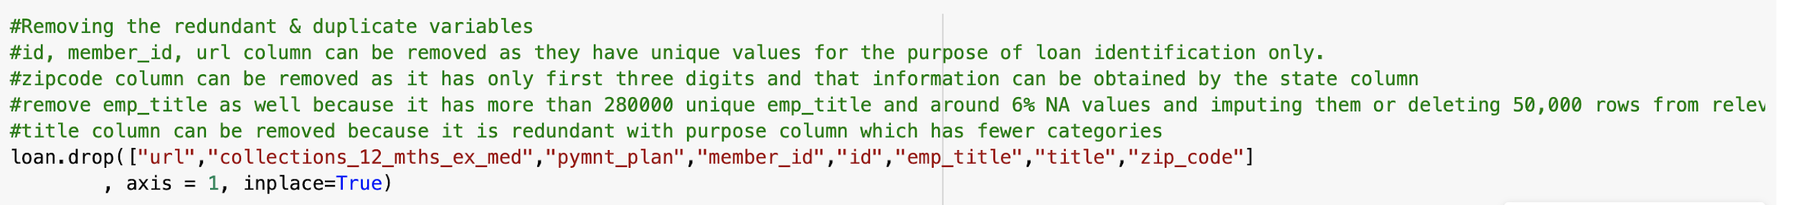
Remove the redundant & duplicate variables

Slide 11
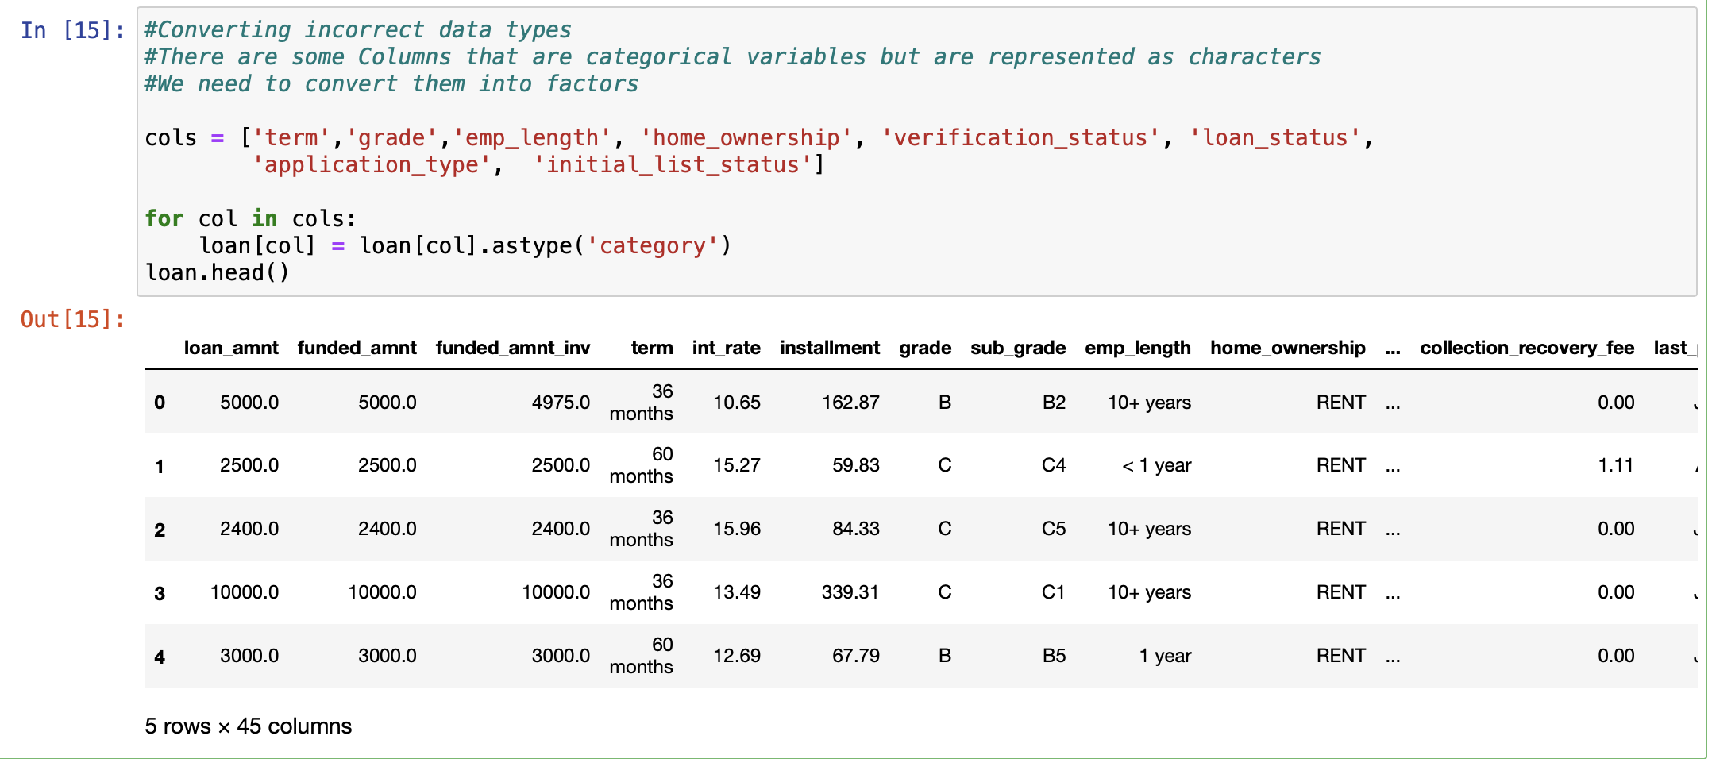
Converting Data type

Slide 12
3. Data analysis and visualization

Slide 13
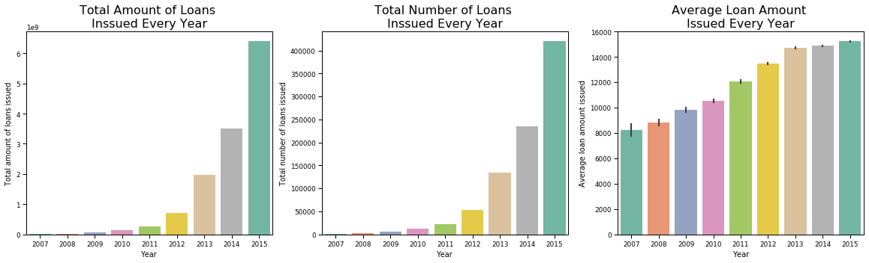
General Analysis
From 2007 to 2015, the total number, total amount, and average amount of loans increased continuously.
Notes:
time trend of ,

Slide 14
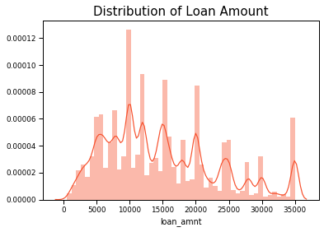
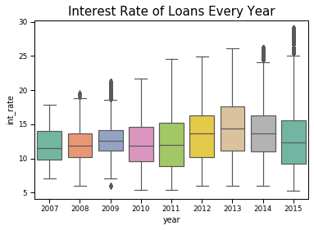
General Analysis
Most of the loans were issued in the range of 10,000 to 20,000USD
The loan issued in 2013 has the highest interest rate

Slide 15
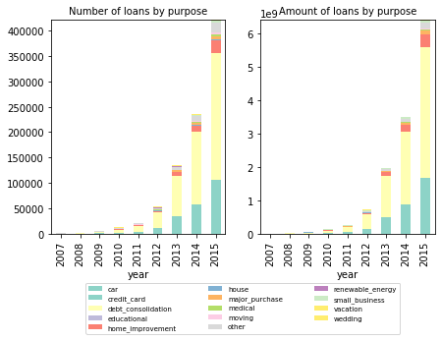
Loan Usage Pattern
Almost 3/4ths of loans are used to consolidate or refinance other debt.
Reason: P2P interest rate is more appealing -- a high-quality borrower can be eligible for interest rate below 10%, which is far lower than the 14% rate for a credit card balance transfer. (refer to the interest rate graph in last page)

Slide 16
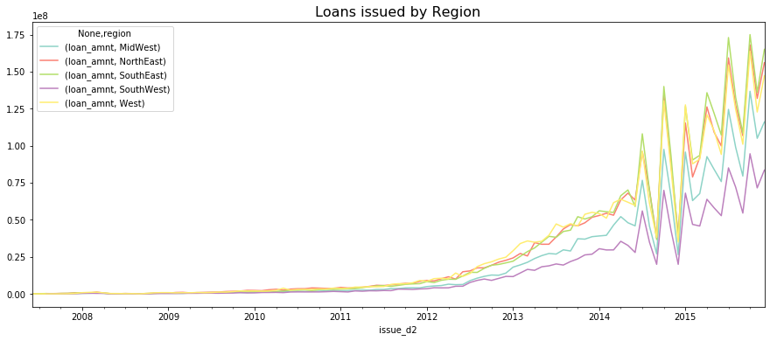
Region Analysis
SouthEast , West, and NorthEast are regions that had the highest amount of loans issued.

Slide 17
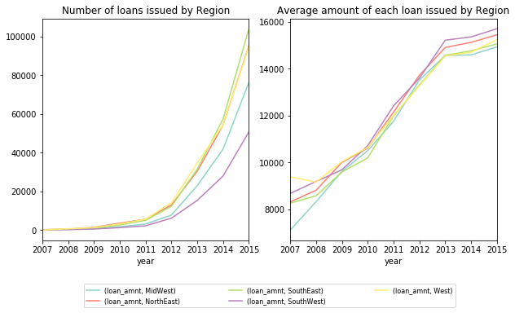
Region Analysis
The reason for Southeast and West region: large number of loan
The reason for Northeast: large number of loan & high average amount of each loan

Slide 18
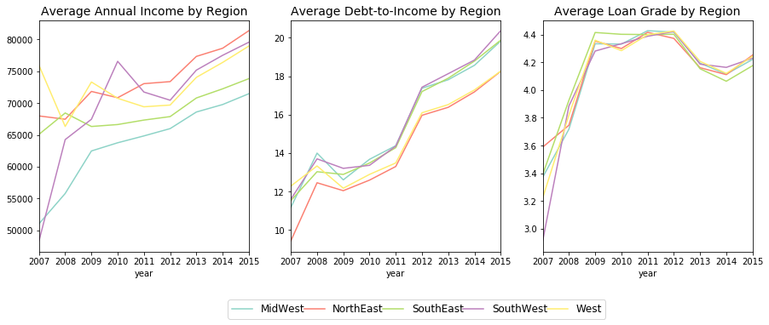
Region Analysis
Northeast people tend to borrow larger amount of money: since they have higher-level income, lower repayment pressure (debt-to-income ratio), and higher average loan grade.
Southeast people have low average income: so they have higher repayment pressure (debt-to-income ratio) and lower average loan grade.

Slide 19
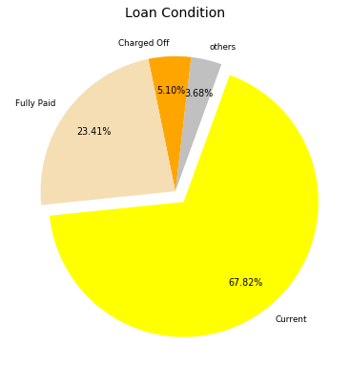
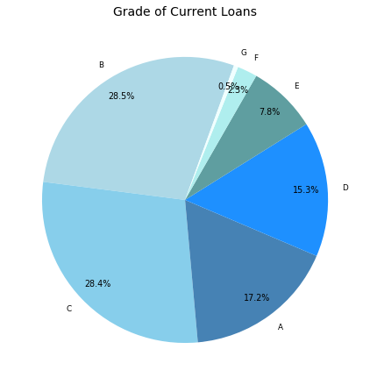
Risk Analysis
1/3 loans are completed, fully paid or charged off.
2/3 loans are current loans, will be paid or charged off in the future.
Grade A to C loans consist ¾ of current loans

Slide 20
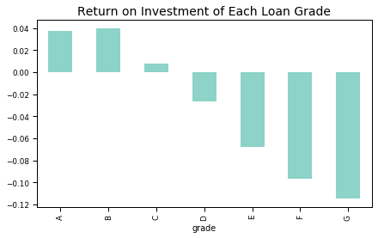
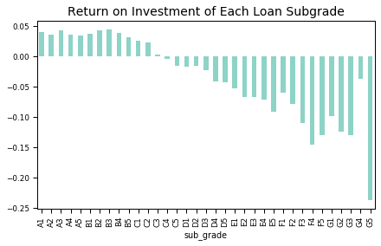
Risk Analysis
ROI on loans of B grade is the highest
ROI on loans lower than C4 grade is negative
Notes:
Interest received to date 利息收入
Late fees received to date 延期费收入
Principal received to date 本金收入

Slide 21
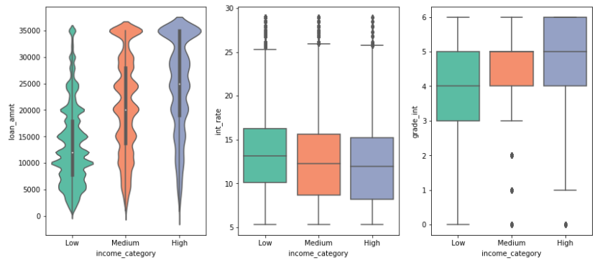
Risk Analysis
Borrowers of high income took higher loan amounts than people from low and medium income level.
Borrowers with a lower income had on average highest interest rates than others.

Slide 22
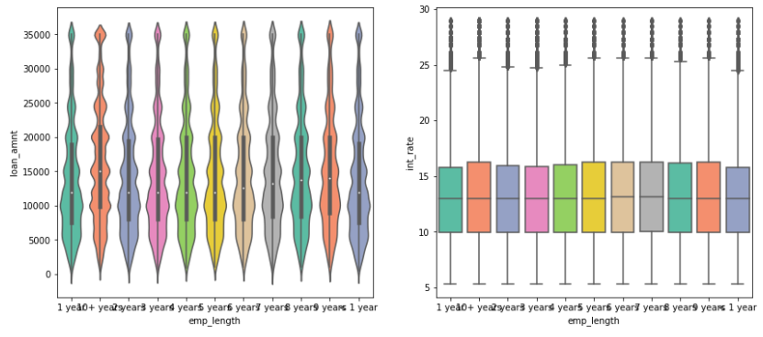
Risk Analysis
Length of employment has no obvious influence on the interest rate or amount of loan

Slide 23
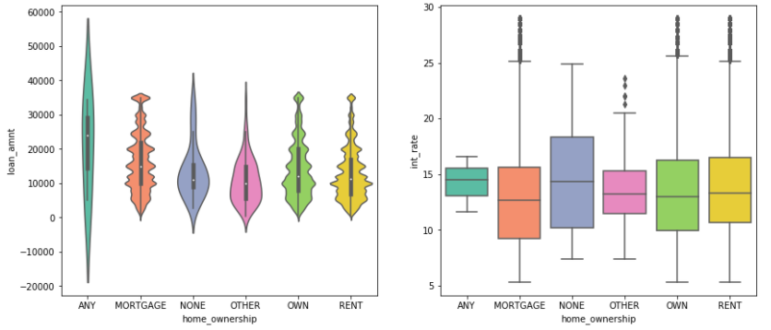
Risk Analysis
Among all types of home ownership, those with mortgaged house have larger amount and lower interest rate that others, while those with “none” house have larger rate and lower amount.

Slide 24
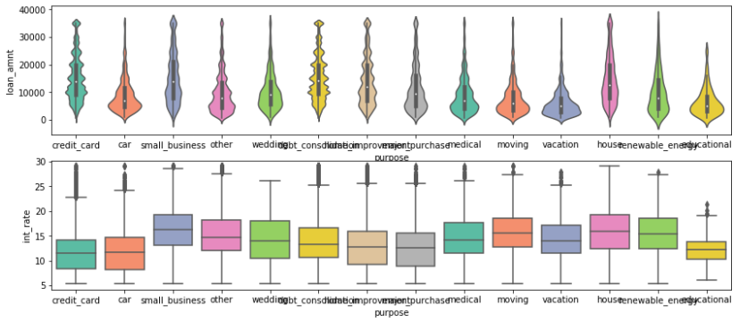
Risk Analysis
High rate: small business, wedding, house purchasing; low rate: credit card, car, and eductaion.
Low amount: car, wedding, medical, moving, vacation and education; high amount: small business, house

Slide 25
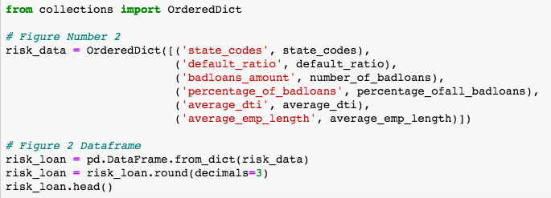
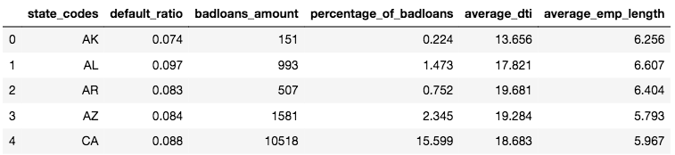
Risk Analysis
Analyze risk condition(default ratio, badloans_amouny, percentage of badloans) of each state

Slide 26
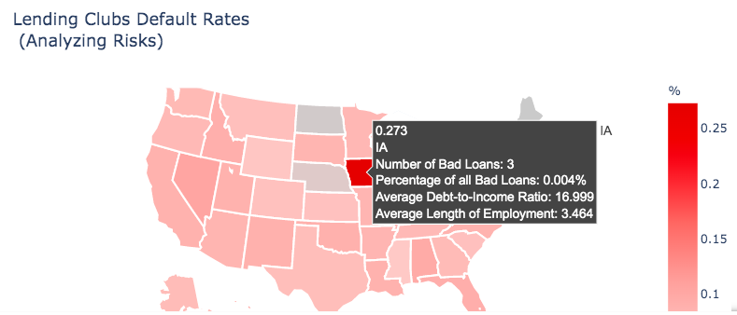
Shown in map

Slide 27
4. Data Prediction Model
Simple Linear Regression

Slide 28

Import Package

Slide 29
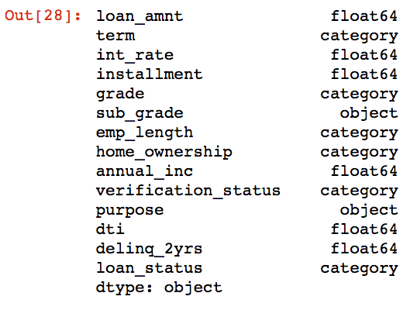
Correlation

Slide 30
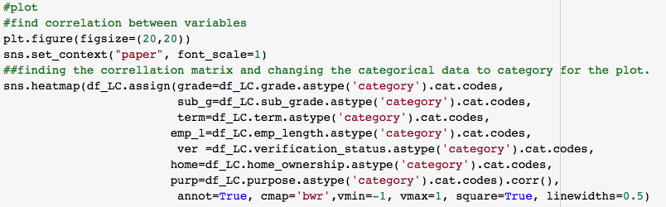
Correlation

Slide 31
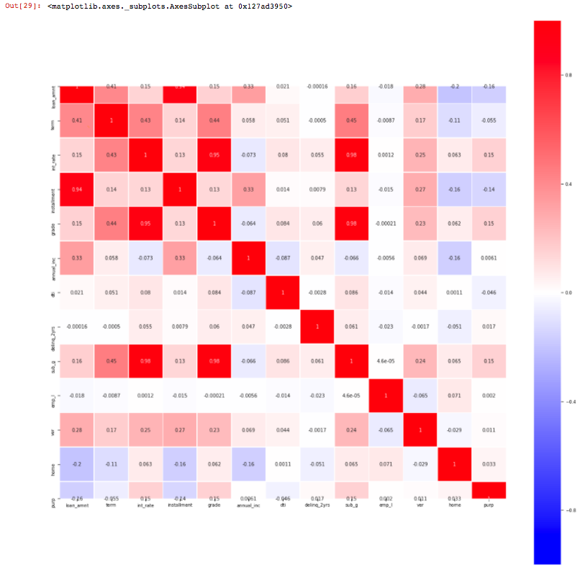
term
int_rate
grade
Conclusion:
Interest rate is highly correlated to grade (subgrade), and it is also correlated to term.
sub_grade
Linear Regression
int_rate

Slide 32


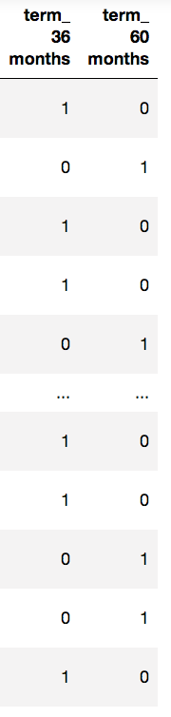
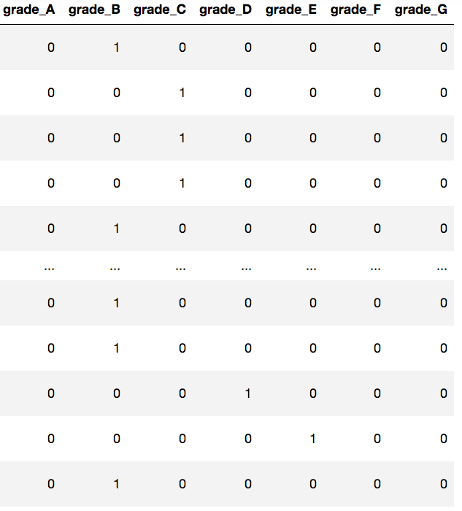
Regression - Convert dummy variable

Slide 33
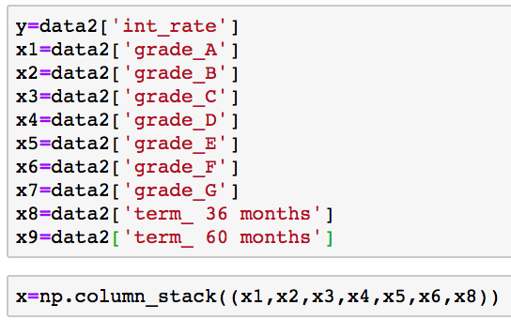
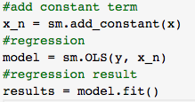

Regression - Model
Select variables
Linear Regression Model: OLS

Slide 34
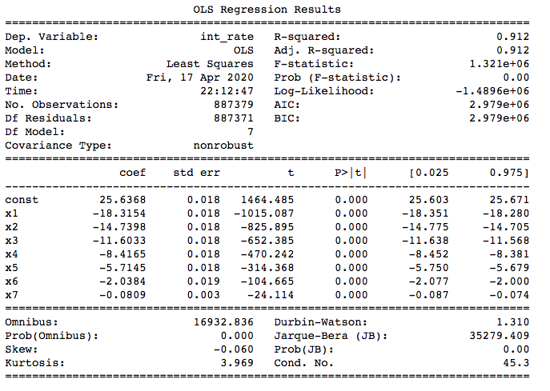
Regression - Result
Conclusion:
All of them are statistically significant.
R-squared: 0.912
Valid model: Prediction

Slide 35
5. Business Impact

Slide 36
Total demand is increasing with the help of appealing interest rate. Largely for consolidate debt usage.
People in higher income level regions tend to loan more.
Loans with mortgaged house as home ownership type have larger amount and lower interest rate.
Maintain the lower interest rate
Focus more on the customers who have a consolidate debt demand
Cooperate with real estate companies and provide tailored loan product to relevant customers.
Distribute marketing resources to the regions according to its income level.

Slide 37
Thank you!
Ruixian Yang
Zhongyu Hong
Yichen Dong
Yu Lu
Mengdie Ji
Do you have any questions?

