Slide 1
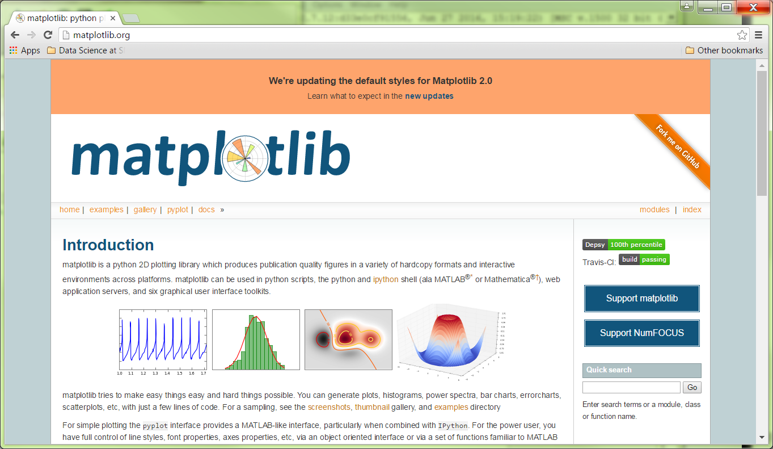
http://matplotlib.org/

Slide 2
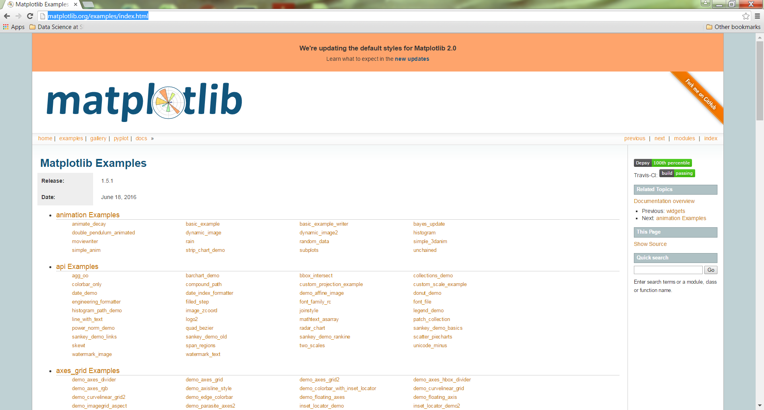
http://matplotlib.org/examples/index.html

Slide 3
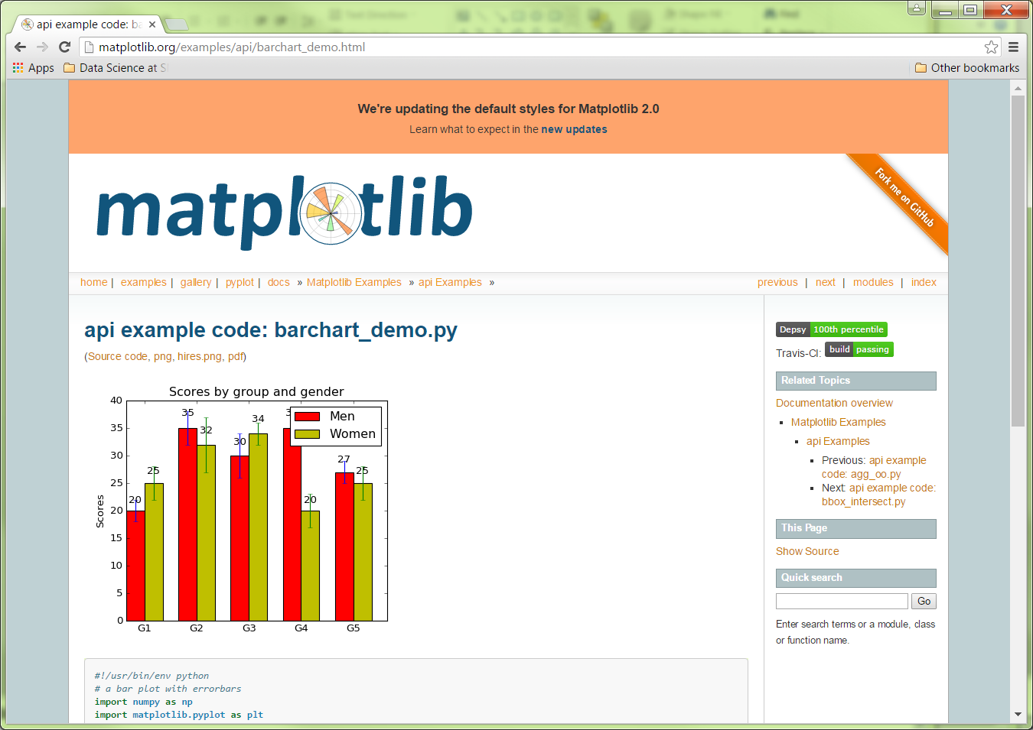
http://matplotlib.org/examples/api/barchart_demo.html

Slide 4
Barchart Example Code
>>> #!/usr/bin/env python
# a bar plot with errorbars
import numpy as np
import matplotlib.pyplot as plt
N = 5
menMeans = (20, 35, 30, 35, 27)
menStd = (2, 3, 4, 1, 2)
ind = np.arange(N) # the x locations for the groups
width = 0.35 # the width of the bars
fig, ax = plt.subplots()
rects1 = ax.bar(ind, menMeans, width, color='r', yerr=menStd)
womenMeans = (25, 32, 34, 20, 25)
womenStd = (3, 5, 2, 3, 3)
rects2 = ax.bar(ind + width, womenMeans, width, color='y', yerr=womenStd)
# add some text for labels, title and axes ticks
ax.set_ylabel('Scores')
ax.set_title('Scores by group and gender')
ax.set_xticks(ind + width)
ax.set_xticklabels(('G1', 'G2', 'G3', 'G4', 'G5'))
ax.legend((rects1[0], rects2[0]), ('Men', 'Women'))
def autolabel(rects):
# attach some text labels
for rect in rects:
height = rect.get_height()
ax.text(rect.get_x() + rect.get_width()/2., 1.05*height,
'%d' % int(height),
ha='center', va='bottom')
autolabel(rects1)
autolabel(rects2)
plt.show()

Slide 5
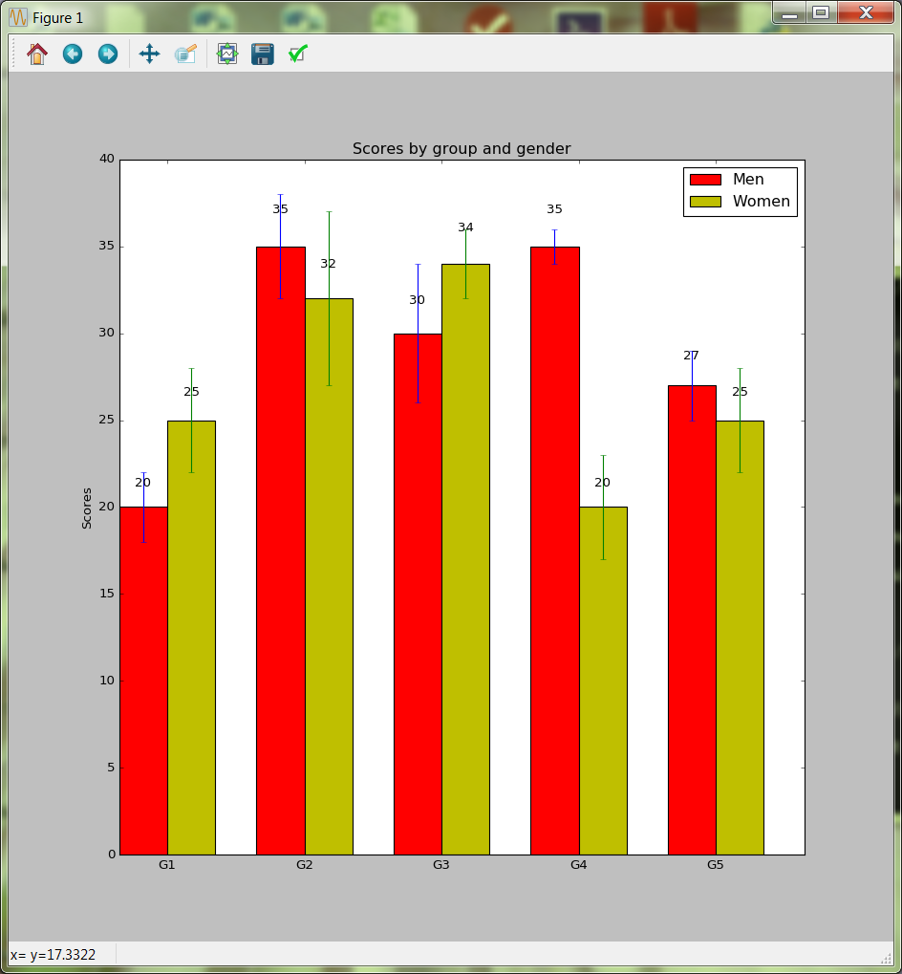
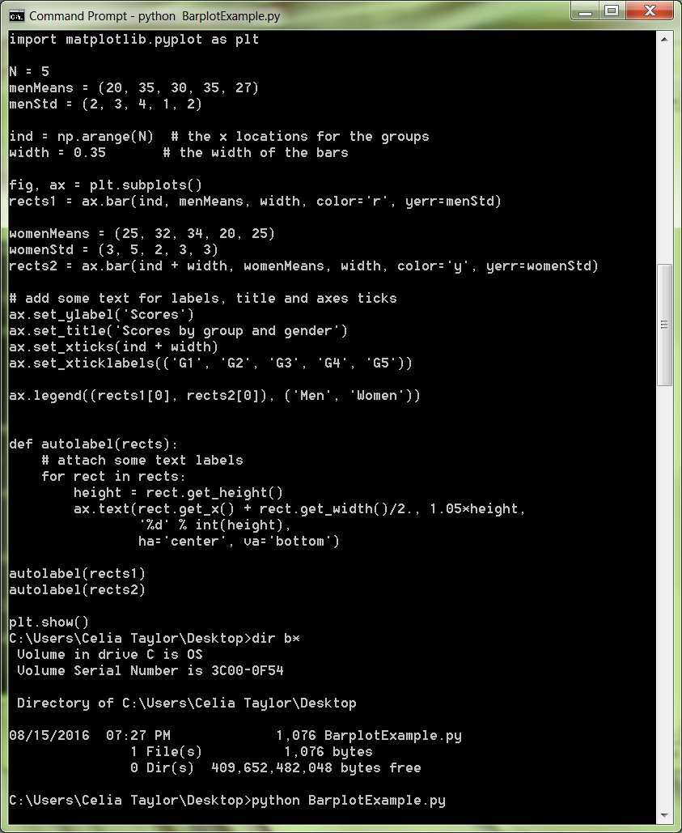
Execute .py file at command prompt

