Slide 1
Implementing “Just Culture” Challenges
Celine Del Mundo
Bellevue University | CSD 380
September 29, 2024

Slide 2
Breaking Silos
DevOps aim to bridge gaps between development and operations, but sometimes there are silos that persist.
Having Silos can make a difficult just culture when both teams need to share responsibility and accountability

Slide 3
Defining Roles and Responsibilities
Complex workflows and multiple stakeholders can be challenging to defining roles and responsibilities.
It is crucial in Just Culture that expectations are clear and proper communication is accomplished.

Slide 4
Cultural Transformation
Just culture requires a deep-seated cultural shift
When organizations must change established norms and practices, this will be quite a challenge

Slide 5
Scalability
As the organization grows so does the team. DevOps practices and Just Culture must scale accordingly for the organization
Established teams and multiple sites now must shift.

Slide 6
Addressing Fear and Blame
Fear and blame can still exist in the DevOps culture, especially if its not being addressed proactively.
Leaders need to create a safe space where teams are comfortable sharing knowledge and learning failures

Slide 7
Measuring Success
Leaders must focus on outcome rather than metrics
Questions that might appear:
Have we improved collaboration?
Did we reduce errors?
Did we increase customer satisfaction?
There isn’t a clear sign that Just Culture was successful, it is a gradual process

Slide 8
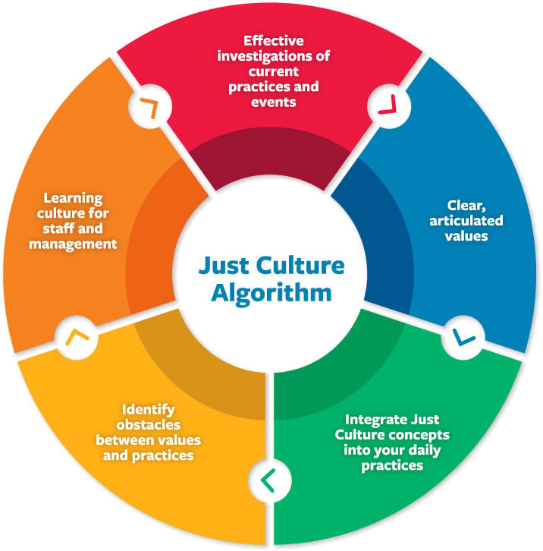
Just/accountable culture. At a Glance - CPS Services. (n.d.). https://www.centerforpatientsafety.org/just-accountable-culture

Slide 9
Work Cited
Page, A. H. (n.d.). PSNet. Making Just Culture a Reality: One Organization’s Approach. https://psnet.ahrq.gov/perspective/making-just-culture-reality-one-organizations-approach
Shah, H. (n.d.). How to establish a devops culture: 7 tips. The Enterprisers Project. https://enterprisersproject.com/article/2022/11/how-establish-devops-culture
3 steps to implementing a successful DevOps Culture. Pega. (2020, December 14). https://www.pega.com/insights/articles/3-steps-implementing-successful-devops-culture

