Slide 1

The Technology Value Stream
Del Mundo, Celine
Bellevue University CSD 380

Slide 2

Value Stream
It encompasses the activities involved in software development, quality assurance and operations.
Key Components:
Product Management
Development
Quality Assurance
IT Operations
Information Security

Slide 3
Value Stream Best Practices
Focus on Customer Values: Ensure that the process aligns with delivering value to the customer
Measure and Monitor: Evaluating value stream performance to make correct decisions
Identify and Remove Waste: Continuously identify and remove waste and bottlenecks
Continuous Improvement: Have a culture of continuous improvement.

Slide 4
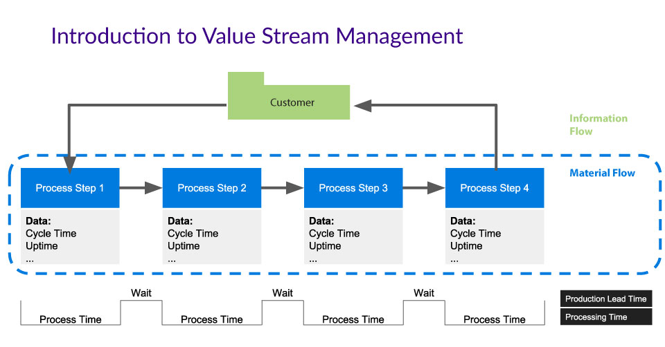

Slide 5

Lead Time
It is the measurement of the time elapsed between the moment a change request is initiated to deployment to production.
Best Practices:
Measuring and tracking lead time to identify areas of improvement
Use automation to reduce delivery times and improve code quality

Slide 6

Processing Time
The duration it takes for when a team starts a specific process to the completion of work.
Best Practices:
Continuous Integration and Continuous Delivery
Feedback Loop
Collaboration and Communication

Slide 7
The Common Scenario
When working with a large organization that means that the system is monumental as well.
Teams will find themselves where the deployment time requires months.
Having long lead times could lead to discovering that nothing works in the end of the project. Developers would have to go back and fix it which could require days or weeks.

Slide 8
Our DevOps Ideal
DevOps want a fast, efficient, and reliable production environment.
To achieve this, they must constantly check small code changes and have exploratory testing.
Using this method will have the deployment lead time be completed in minutes. The worst outcome would be having a lead time of hours.

Slide 9
Citations
Lead time and how to measure it in devops: Devops metrics. Software.com. (n.d.). https://www.software.com/devops-guides/lead-time
Hall, T. (n.d.). DevOps Best Practices. Atlassian. https://www.atlassian.com/devops/what-is-devops/devops-best-practices
Kim, G., Debois, P., Willis, J., Humble, J., Forsgren, N., & Allspaw, J. (2021). The devops handbook: How to create world-class agility, reliability, & Security in Technology Organizations. IT Revolution Press, LLC.
How to use value stream mapping in DevOps. How to Use Value Stream Mapping in DevOps | Lucidchart Blog. (2018, December 21). https://www.lucidchart.com/blog/value-stream-mapping-for-devops
https://www.cloudbees.com/blog/value-stream-management-software-delivery-visibility-and-insight
Atlassian. (n.d.-a). Value stream mapping. https://www.atlassian.com/continuous-delivery/principles/value-stream-mapping

