Slide 1

Intro to Git!
Christine Stawitz
6/22/2016

Slide 2
What is version control?
Source code management or version control
Generally: “management of changes to documents, computer programs, large web sites, and other collections of information”
Specifically: refers to a way of managing, tracking, and modifying changes to a piece of computer code across a group of individuals
Usually includes management tools: some kind of hierarchy and workflow and a centralized interface where folks can file bugs, track changes, and “approve” changes

Slide 3
OK why is GitHub so cool?
Unlike traditional version control, Git does not require you to “check out” code
Traditionally – just one version of each file and different users take “ownership” of it to modify stuff
Git instead it tracks snapshots at every point
Pros: No need to check out, multiple people can simultaneously edit the same file, and you can back out changes that occurred many version ago
Cons: More likelihood of getting merge conflicts (which are ugly)
AAHHHH!
1
2
3
1+3
Time

Slide 4

The basics
Handling local vs. server code; pulls, commits, and pushes

Slide 5
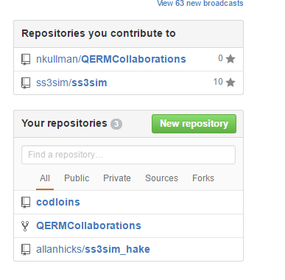
Creating a repository
Default, free repositories are public
Free private repositories for students
https://education.github.com/pack/join

Slide 6

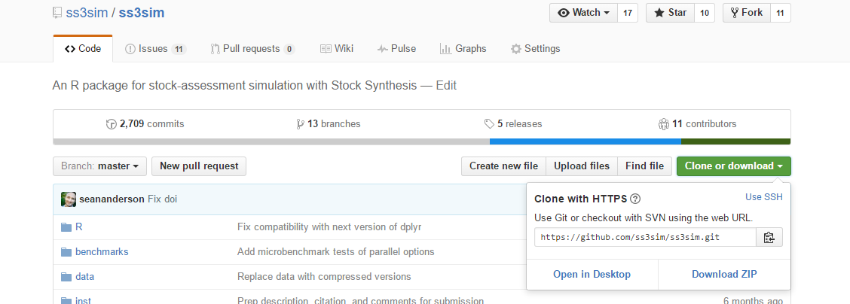
“Cloning”
Creates a “clone” of a repository on your local machine
git clone <link>

Slide 7
Local vs. server code
Computer folder is now a “snapshot” of code
To update the code on your machine, you “pull”
To update the code on the server with the code on your machine, you “push”
If you mess up something locally, just delete the folder and re-clone!

Slide 8
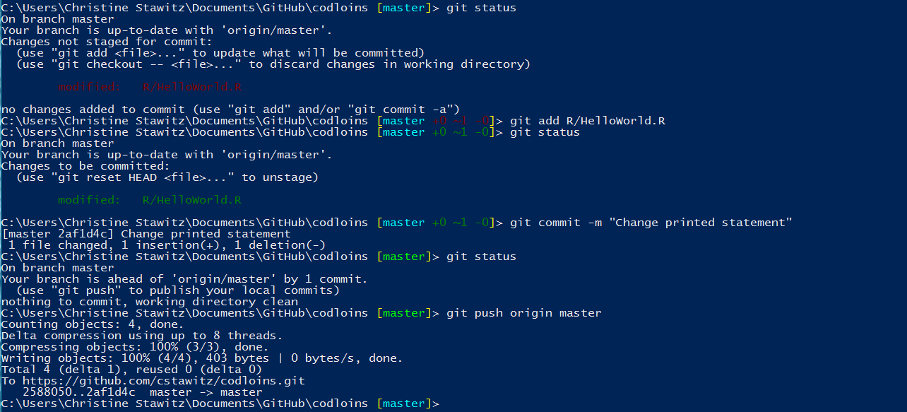
Making and committing changes
Add an .R file to your local repository
OK! You now have local changes and you want to update the server version
Use “git status” to see which files need to be added
Notes:
Add some files!

Slide 9
Making and committing changes
To add a file to tracking, or “stage”, use “git add <filename>”
To commit changes, use “git commit –m “”<Message detailing what you changed>”
Notes:
Add some files!

Slide 10
Making and committing changes
To push to the remote repository, “git push origin master”
Notes:
Add some files!

Slide 11
Skipping staging
If “git add” seems like a useless step, you can skip it!

Slide 12
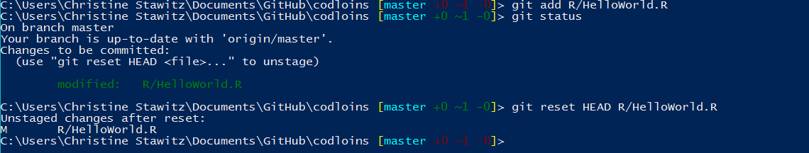

What if you mess up?
In the “add” phase – git reset HEAD <filename>

Slide 13
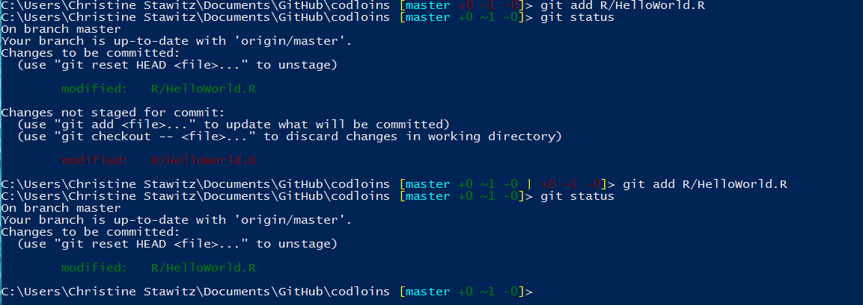
What if you mess up?
OR “git add” again if you changed something

Slide 14
What if you mess up?
At the commit stage
Use git commit --amend
$ git commit -m 'initial commit'
$ git add forgotten_file
$ git commit --amend

Slide 15
What if you mess up?
Reverting to previous version
$ git checkout –- R/HelloWorld.R

Slide 16

“git log”
Default shows all changes
git log –p shows diff
Git log –S<text> searches all edits for “text”
Git log –grep “” searches commits for “”

Slide 17
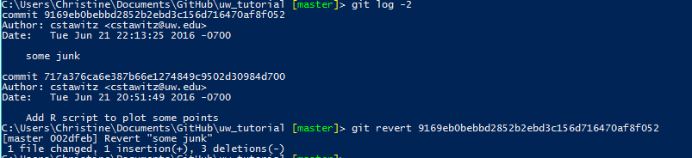
Undoing a commit
Git log shows you the unique hash value corresponding to each commit
If you want to undo one commit, run “git revert <hash>”

Slide 18
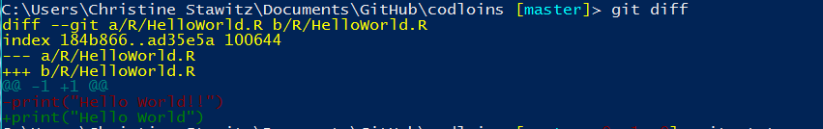
“git diff” is also helpful
Shows you exactly which lines changed

Slide 19
Git stash
“git stash” allows you to save changes in your local working directory without committing them
Useful if you want to switch to a different branch and work on something else, but your code is in a bit of a messy state

Slide 20
Wrapping up basics
Clone -> Move/create/edit/delete files -> git add -> git commit -> git push origin master
“git pull” instead of clone if it is an exiting repository
Important note: “commit” is key to take advantage of version tracking. Without “commit”, you can lose your changes!
“push” makes your changes available on different computers

Slide 21

Advanced stuff!
Documentation, .Gitignore files, skipping staging

Slide 22
Documentation
The sweet documentation you see on git repository homepages is created in Markdown
Git creates README.Rmd when you create a repository
Just edit that file and push the changes to create documentation
Or edit the file on the git website
If you want to get fancier (math, citations, figures) use Pandoc (http://pandoc.org/)

Slide 23
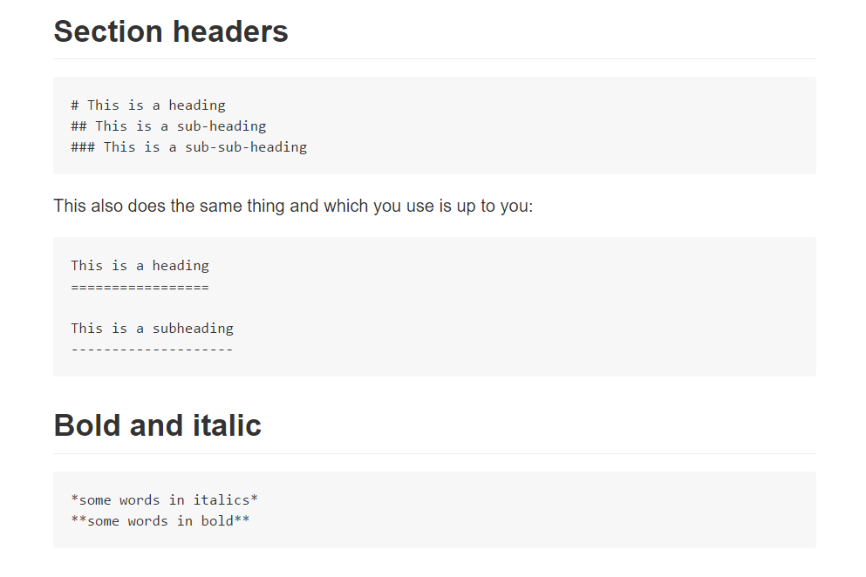
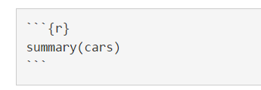
Markdown syntax
Code chunks

Slide 24
Git will auto-track everything in the directory!
Sometimes this is not optimal
Figures
Any output (.csv, .log)
To stop tracking certain types of files, a .gitignore file is useful
Tells git to ignore filenames matching any regular expression
..(you can also move or delete the file)

Slide 25

Creating a .gitignore file
On Windows:
create my.txt in your working directory
Rename it in the command line using “ren”
Edit in a standard .txt editor
On Mac terminal in your working directory:
touch .gitignore
defaults write com.apple.finder AppleShowAllFiles YES.
Edit in standard .txt editor

Slide 26
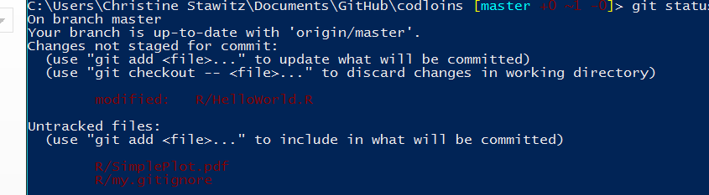
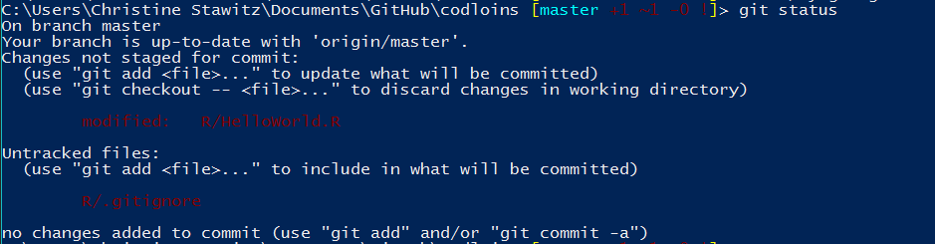
Voila!
After creating .gitignore:

Slide 27

Collaboration
Organizations, workflows, branching, pull requests

Slide 28
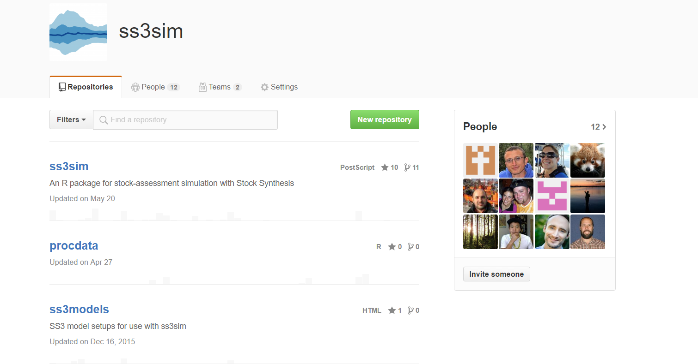
Organizations
Allow changes in permissions
Pull only, pull and push, pull, push, administrative
Multiple repositories for different things
i.e. package vs individual paper
Teams

Slide 29

Tools for collaboration
Once you have more than 2 or 3 people collaborating, unlimited edits in the master branch can cause merge conflicts
Merge conflicts are THE WORST
Avoiding them with a workflow is always faster than fixing them after the fact
Luckily, branches, forks and pull requests will save you!

Slide 30

Branches
So far, we have only talked about doing things in the ”master” branch
When collaborating, the master branch should be a sacred space that always works!
If it stops working because of your change, you have screwed your collaborators.
So create your own branch when you are working on a piece of code
Only check in to master when you have verified it works and doesn’t conflict with someone else’s changes.

Slide 31
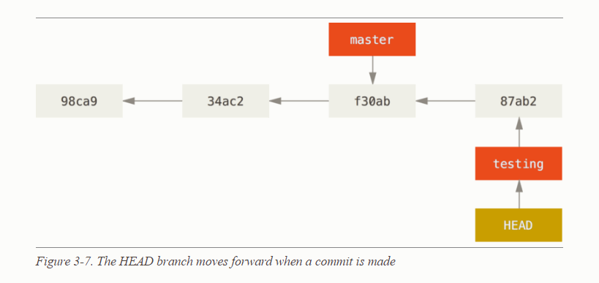
Making a branch
To do this, just do “git branch <branchname>”
This command creates a branch but doesn’t switch to it
To create and switch to a branch, or (without -b) just switch to an existing branch use “git checkout –b <branchname>”
Your working directory is now operating in that branch

Slide 32
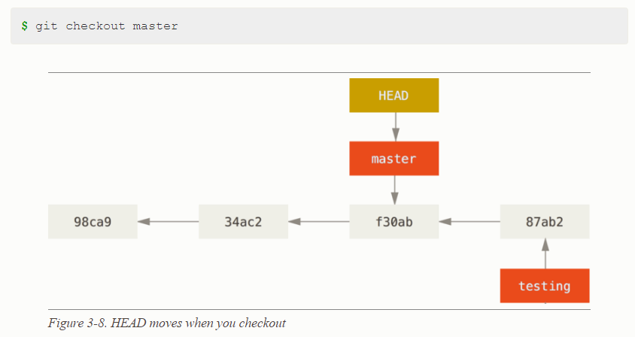
Switching between branches
Switching between branches changes the files in your local working directory, but branch changes are preserved on the server

Slide 33
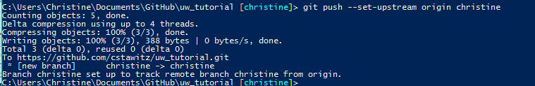
Sharing the branch with others
Creating and checking out a branch just creates it locally
To let others collaborate on it, you need to run “git push --set-upstream origin <branchname>”

Slide 34


OK, so how do you integrate changes?
Fetch and rebase the master branch with yours
This pulls down anyone else’s changes that may have occurred while you were working in your branch
git fetch: pulls down changes to local without merging (pull merges)
git rebase origin: rewinds master, then puts your changes on top, then fast-forwards master
Test your code with the changes from master before merging

Slide 35
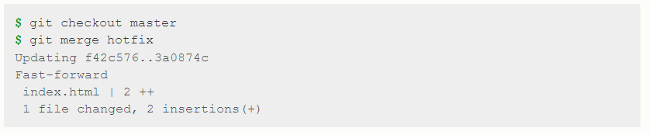
Integrating changes, continued
Now merge!

Slide 36

Forks
A fork is a copy of an existing Git repository
Different from branches as branches are w/in a repository
Theory behind forks is making a copy of a repository to “play” around with
Other repository members can’t see what you do, unlike in a branch
You might want to fork a repository, rather than branch it, if
You want to make specific code modifications to a repository you’re not an author of
A project you are involved with is diverging into multiple projects
You might want to merge a fork if your changes become useful to others

Slide 37
Getting fancier with merges
At some point in a collaboration size (i.e., large working group), freely merging can cause problems
At this point, having an administrator and pull requests becomes super helpful
A pull request is a formal documentation of merging your changes into the master branch or fork
Other collaborators can see your request and approve or disapprove it
Git auto-checks if there are likely to be merge conflicts

Slide 38
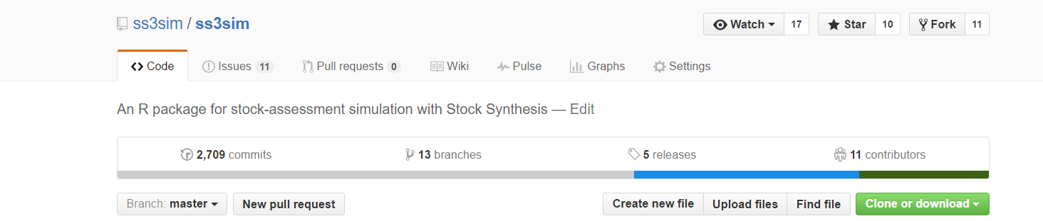
Creating a pull request

Slide 39
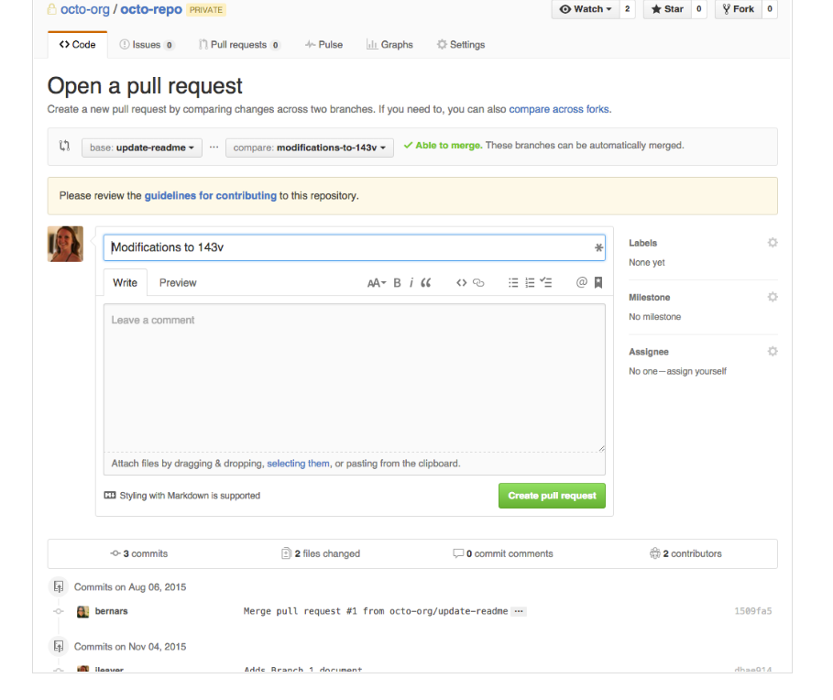
Creating a pull request
Write in some informative text!

Slide 40
Creating a pull request
Write in some informative text!
Git will tell you if it can be auto-merged, and these drop downs allow you do to a diff!

Slide 41
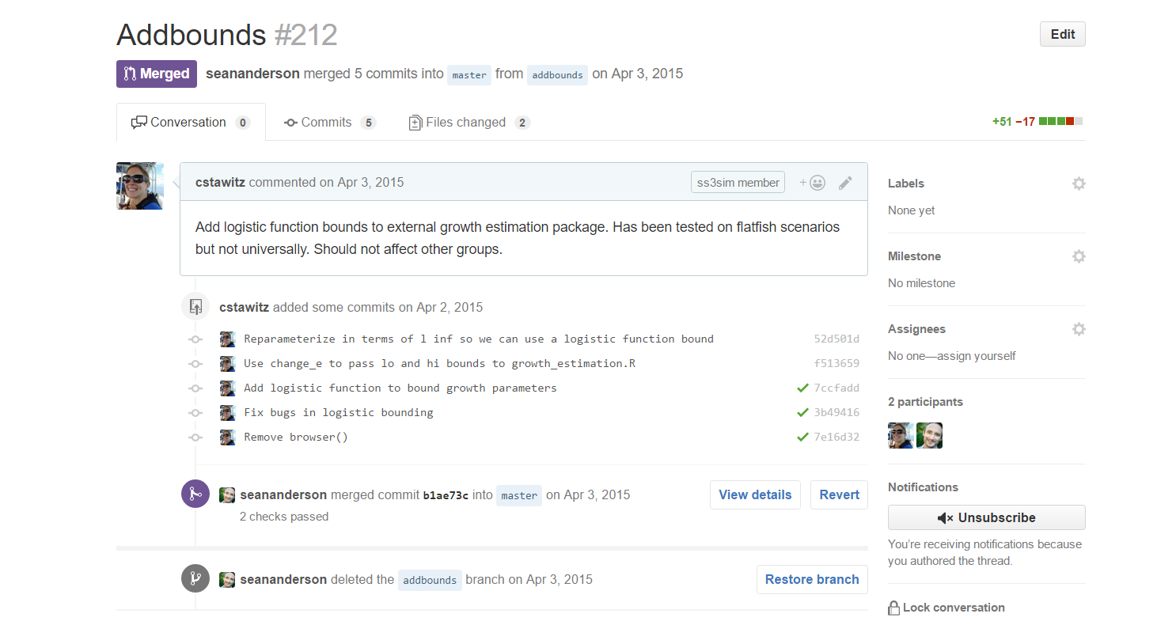

Slide 42
Issues
Method to track to-dos or bugs
You can assign to yourself or others
Create deadlines
Close when the issues are fixed!

Slide 43
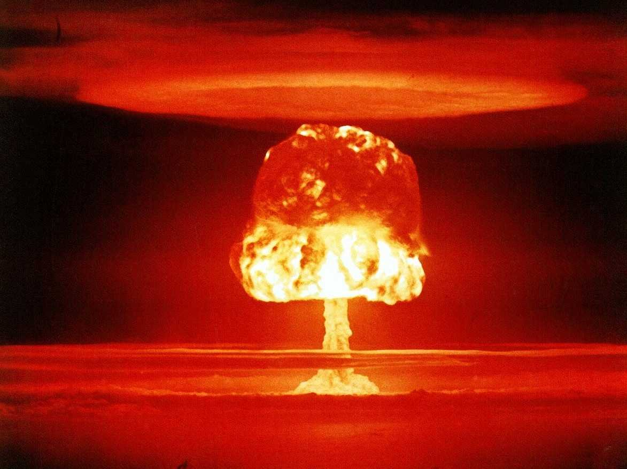
Merge conflicts
The only thing in Git that is hard
If you can bear it, you should probably just move a change out then re-copy it in rather than try to resolve conflicts
If you HAVE TO you can try to resolve

Slide 44
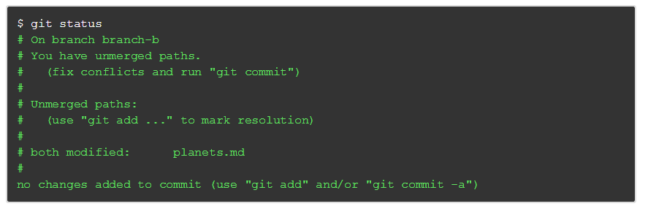
More merge conflicts
If a change you are trying to merge in directly conflicts with someone else’s (usually happens if you don’t fetch or pull)

Slide 45
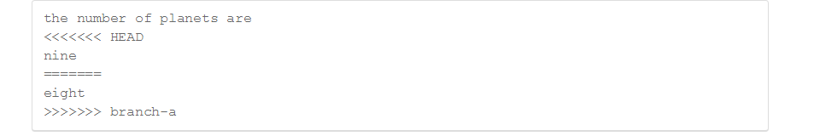
More merge conflicts
Git will create a local file which shows the conflict
Theoretically, you just fix the file and commit again, but it is rarely that easy

Slide 46
Being an administrator
Protect branches
Provide issue and pull request templates
Enable auto-checks before merging
Create a CONTRIBUTING.md file that defines a workflow and other procedures

Slide 47
References
Ebook tutorial! https://git-scm.com/
Useful .gitignore files https://github.com/github/gitignore

