Slide 1
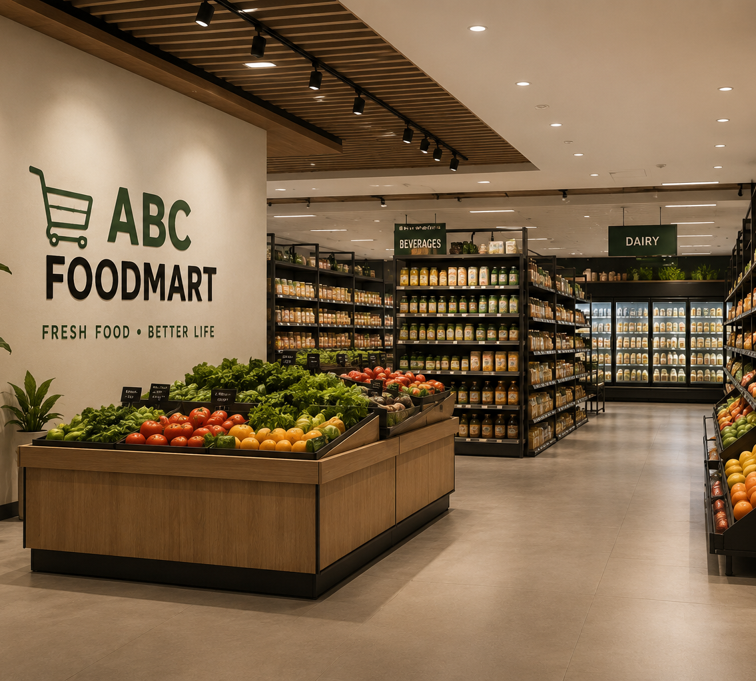
ABC FOODMART
Relational Database & Dashboard System
APAN 5310 · SQL & Relational Databases · Final Presentation
Group 4: Xiangzhou Tan, Xilin Wang, Guyi Jia, Cloris He
PostgreSQL
Python ETL
Metabase

Slide 2
1. Client Scenario: Why ABC Foodmart Needs a New System
Consulting problem definition — business growth has outpaced the spreadsheet-and-binder workflow.
SITUATION
COMPLICATION
OUR RESPONSE
ABC Foodmart is expanding from two Queens locations to three new Brooklyn stores. Staffing, inventory, purchasing, sales, and accounting data must now scale across five locations.
Operational information is fragmented across spreadsheets and paper records. Decisions are slow, cross-store comparisons are difficult, and inconsistent updates increase the risk of errors.
Build one normalized PostgreSQL database, automate data preparation with Python, and expose role-appropriate insights through SQL and Metabase dashboards.
01
Faster decisions
02
Reliable reporting
03
Scalable control
CLIENT
DEMAND
inventory, purchasing, staffing
single source of truth
five stores + future growth

Slide 3
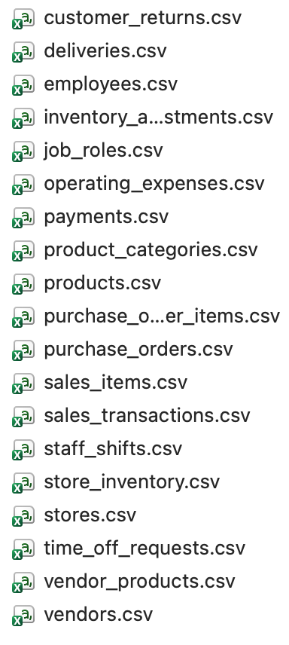
2. Data Structure – “Original Data”
Because no usable historical source file was provided, we modeled representative raw records the new system would receive.
VALIDATION SUMMARY
DATA STAGING
Authoritative final PostgreSQL row counts
-----------------------------
stores = 5
job_roles = 6
employees = 80
staff_shifts = 3627
time_off_requests = 80
product_categories = 8
products = 48
store_inventory = 126
inventory_adjustments = 128381
vendors = 10
vendor_products = 93
purchase_orders = 1240
purchase_order_items = 4943
deliveries = 1210
sales_transactions = 36000
sales_items = 122906
customer_returns = 720
payments = 37333
operating_expenses = 119
Dataset note
---------------------------
The package contains exactly 19 CSV files. The staged inventory_adjustments.csv contains 5,475 non-sale adjustments. During PostgreSQL loading, the validated sales-item trigger adds 122,906 sale adjustments, producing the authoritative loaded count of 128,381.
DATA GENERATE
ABC Foodmart did not provide us with a complete historical dataset, so we treated this as the design of a new operational database rather than a traditional data migration project. We first defined what data each business process should generate, and then created synthetic data for stores, employees, products, inventory, purchases, deliveries, sales, returns, and expenses.

Slide 4
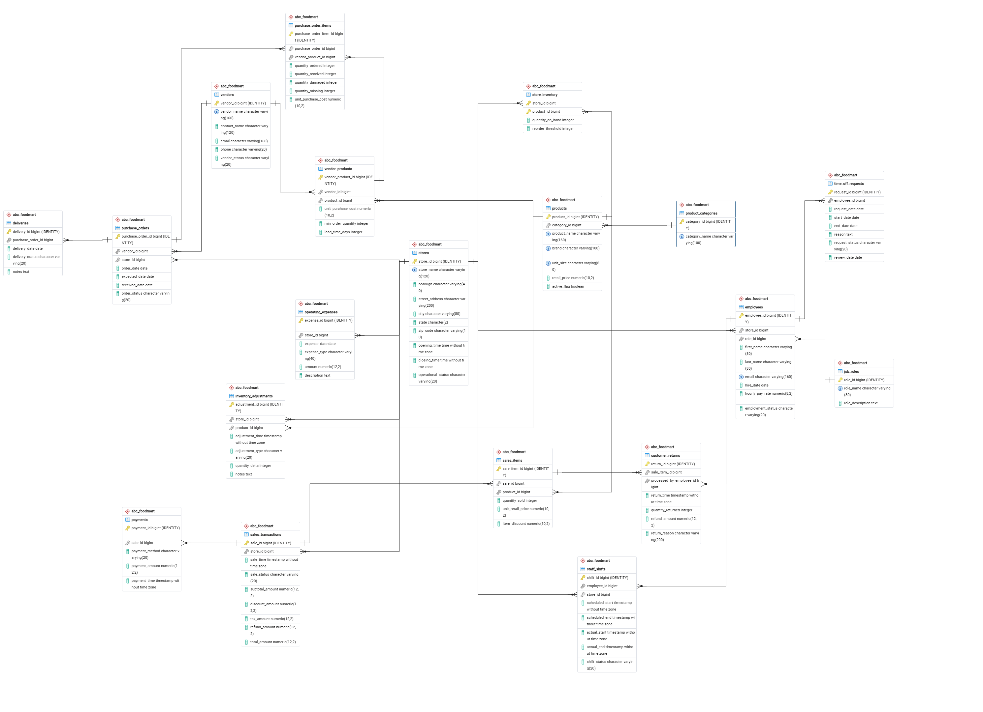
3. Database Design
19 Tables Organized Around Five Business Domains: The ER model turns operational events into connected entities and relationships
ER DIAGRAM
MIND MAP

Slide 5
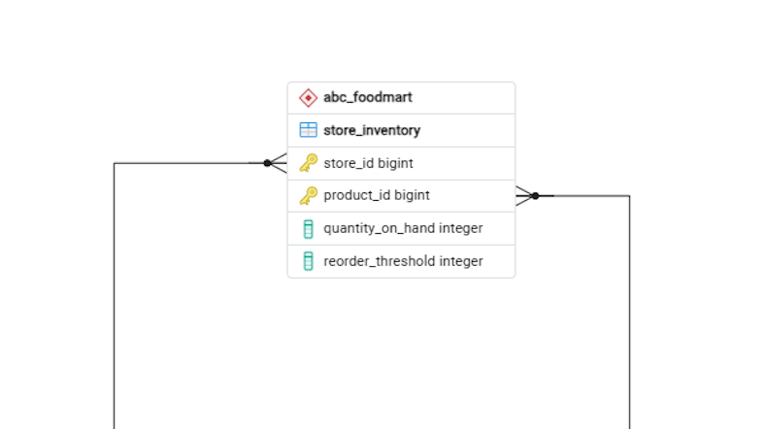
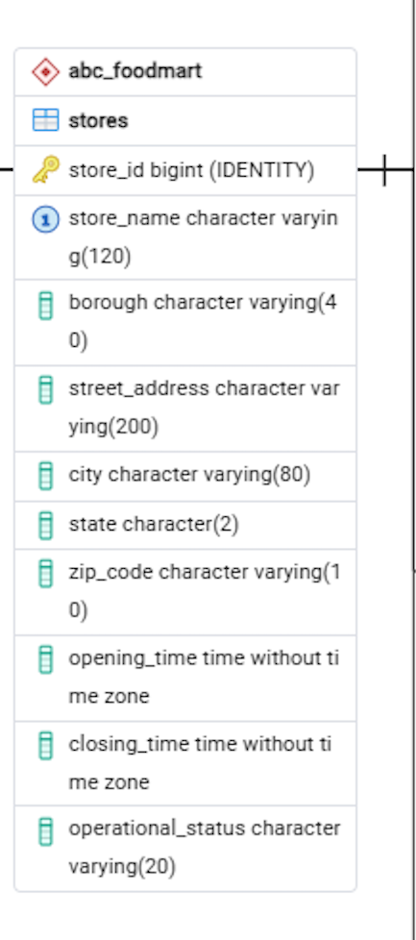
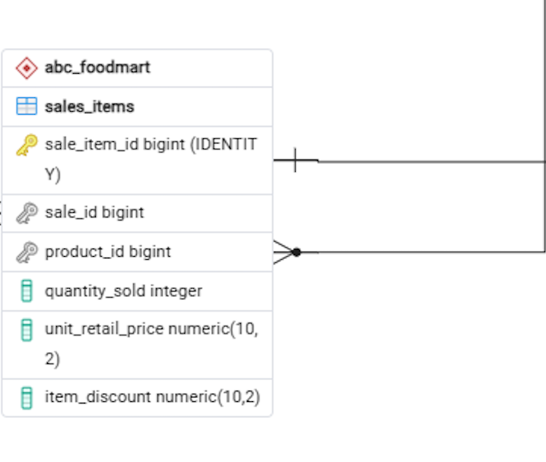
Sample Schema: SQL Demo
Demo example
CREATE TABLE stores (
store_id BIGINT GENERATED ALWAYS AS IDENTITY PRIMARY KEY,
store_name VARCHAR(120) NOT NULL UNIQUE,
borough VARCHAR(40) NOT NULL CHECK (borough IN ('Queens', 'Brooklyn')),
street_address VARCHAR(200) NOT NULL,
city VARCHAR(80) NOT NULL DEFAULT 'New York',
state CHAR(2) NOT NULL DEFAULT 'NY',
zip_code VARCHAR(10) NOT NULL,
opening_time TIME NOT NULL,
closing_time TIME NOT NULL,
operational_status VARCHAR(20) NOT NULL DEFAULT 'active'
CHECK (operational_status IN ('planned', 'active', 'temporarily_closed', 'closed')),
CHECK (opening_time < closing_time)
);
CREATE TABLE store_inventory (
store_id BIGINT NOT NULL REFERENCES stores(store_id),
product_id BIGINT NOT NULL REFERENCES products(product_id),
quantity_on_hand INTEGER NOT NULL DEFAULT 0 CHECK (quantity_on_hand >= 0),
reorder_threshold INTEGER NOT NULL DEFAULT 0 CHECK (reorder_threshold >= 0),
PRIMARY KEY (store_id, product_id)
);
CREATE TABLE sales_items (
sale_item_id BIGINT GENERATED ALWAYS AS IDENTITY PRIMARY KEY,
sale_id BIGINT NOT NULL REFERENCES sales_transactions(sale_id) ON DELETE CASCADE,
product_id BIGINT NOT NULL REFERENCES products(product_id),
quantity_sold INTEGER NOT NULL CHECK (quantity_sold > 0),
unit_retail_price NUMERIC(10,2) NOT NULL CHECK (unit_retail_price >= 0),
item_discount NUMERIC(10,2) NOT NULL DEFAULT 0 CHECK (item_discount >= 0),
UNIQUE (sale_id, product_id),
CHECK (item_discount <= quantity_sold * unit_retail_price)
);
CREATE TRIGGER trg_reduce_inventory_after_sale
AFTER INSERT ON sales_items
FOR EACH ROW EXECUTE FUNCTION reduce_inventory_after_sale();

Slide 6
Sample Data: SQL Demo
Demo example
WHY THIS MATTERS？
SELECT s.store_name,
p.product_name,
i.quantity_on_hand,
i.reorder_threshold
FROM store_inventory i
JOIN stores s
ON s.store_id = i.store_id
JOIN products p
ON p.product_id = i.product_id
WHERE i.quantity_on_hand <= i.reorder_threshold
ORDER BY s.store_name, i.quantity_on_hand;
01
Operational
joins inventory, store, and product context
02
Actionable
returns only items requiring replenishment attention
03
Reusable
same query powers analyst workflows and dashboard cards
RESULT
Flushing | Whole Milk | 7 on hand | threshold 10

Slide 7
4. Design Choices: Normalized, Connected, Enforced
We designed for maintainability first — then let SQL joins reconstruct the business view when needed.
01
02
03
3NF NORMALIZATION
ASSOCIATIVE TABLES
INTEGRITY RULES
Separate stores, employees, categories, vendors, orders, transactions, and expenses so each fact is stored once and update anomalies are minimized.
Bridge many-to-many relationships such as vendor–product and sale–product. This preserves flexibility without duplicating descriptive attributes.
Primary keys, foreign keys, CHECK constraints, and NOT NULL rules protect valid references and reduce bad operational states.
DESIGN PRINCIPLE
One business fact → one authoritative place to store it.

Slide 8
5. Data Pipeline & ETL: Python → Validation → PostgreSQL
The pipeline generates reproducible test data, standardizes it, validates relationships, and loads tables in dependency order.
01
02
03
04
05
GENERATE
STAGE
CLEAN
VALIDATE
LOAD
Synthetic but operationally realistic records
Write one CSV per table for review
Standardize types, columns, dates, missing values
Check uniqueness, references, ranges
Bulk insert to PostgreSQL and reset sequences
→
→
→
→
NOTE
Fixed random seed 5310 · transaction-safe load · final row-count checks · rollback on failure

Slide 9
6. Analytical Procedures: Customer Needs → SQL Questions
The database is useful because it converts management questions into repeatable, auditable analytical queries.
BUSINESS QUESTION
ANALYTICAL OUTPUT
RELATIONAL PATH
Stock risk
Which products are at risk of going out of stock?
store_inventory + products + stores
Overstock
Which items have high inventory but weak sales?
store_inventory + sales_items + sales_transactions
Product performance
Which products/categories sell best by store?
sales_transactions + sales_items + products + product_categories
Return Analysis
Which products and product categories have a high return rate?
customer_returns + sales_items + products + product_categories
Store profitability
Which stores underperform after operating costs?
sales_transactions + operating_expenses + staff_shifts + employees + stores
Staffing
Which stores have frequent lateness, absences, or staffing gaps?
staff_shifts + employees + time_off_requests + stores
ANALYST ACCESS
raw SQL · Python/R connector · detailed drill-down
MANAGER ACCESS
Metabase dashboards · filters · KPI overview

Slide 10
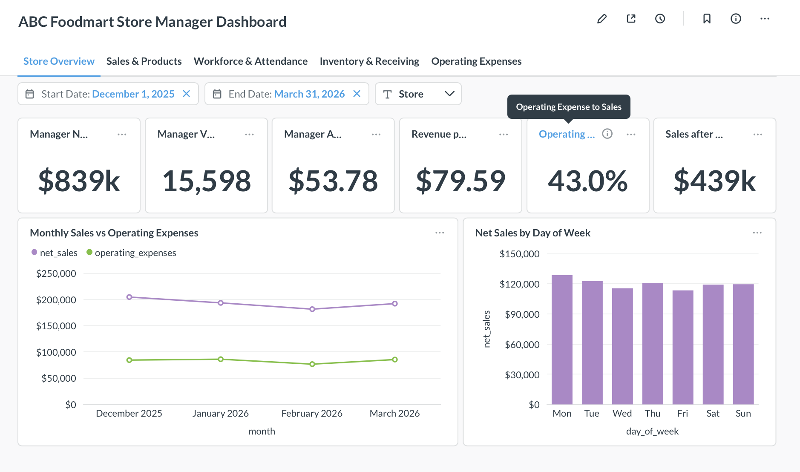
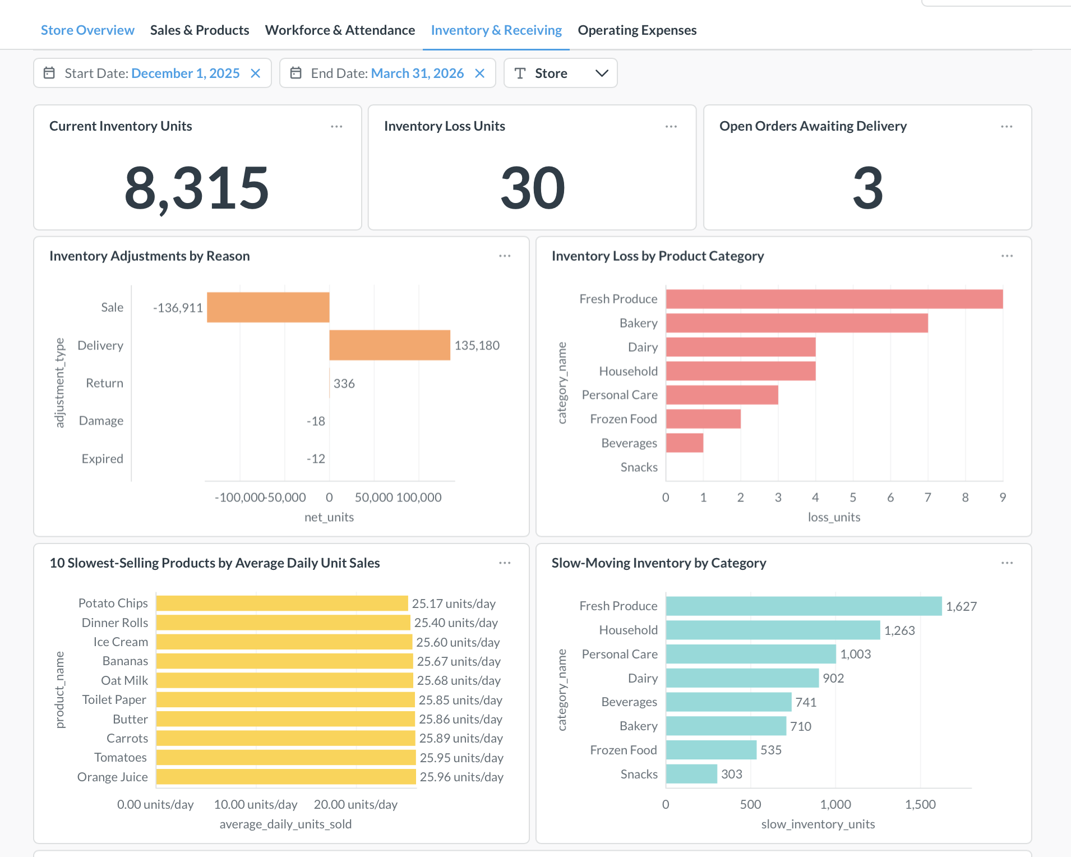
7. Metabase Demo: Management View
http://82.157.4.243:3000
DEMO FLOW
Filter store → inspect low-stock items → drill into product/vendor details → return to executive KPIs

