Slide 1
BLUESTOCK FINTECH • CAPSTONE PROJECT
Mutual Fund Performance Analysis
An end-to-end data pipeline, dashboard and advanced analytics suite
for mutual fund investment behaviour, performance and risk
Prepared by Celin Treesa Joseph
Data Analyst Intern, Bluestock Fintech
celintreesa700@gmail.com | June 2026

Slide 2


PROJECT BRIEF
Problem & Objective
The Problem
Project Objectives
Bluestock Fintech needed a unified view of how 5,000 investors across India engage with mutual funds — where they invest, how much, through which transaction types, and how those funds actually perform on a risk-adjusted basis. Raw data existed only as 10 disconnected CSV exports with no cleaning, modelling, or visualisation layer, making it impossible to answer these questions quickly or reliably.
Build a Python ETL pipeline to clean and unify 10 structured datasets
Conduct exploratory analysis of investment behaviour, geography and demographics
Compute risk-adjusted performance metrics: CAGR, Sharpe, Sortino, Drawdown
Deliver VaR / CVaR, cohort, SIP continuity and HHI concentration analysis
Build a rule-based Fund Recommendation Engine
Design a 4-page interactive Power BI dashboard for stakeholders
Bluestock Fintech | Mutual Fund Performance Analysis | June 2026
2

Slide 3


DATA FOUNDATION
Data Sources
10
32,778
5,000
2023-25
Key Columns Used
amfi_code, nav, transaction_date, amount_inr,
state, age_group, investor_id, transaction_type
Structured CSV
datasets
Investor
transactions
Unique
investors
Date range
covered
10 Primary Datasets
Pipeline Snapshot
01 fund_master.csv — Fund master reference data
02 nav_history.csv — Daily NAV per fund and date
03 aum_by_fund_house.csv — AUM by fund house
04 monthly_sip_inflows.csv — Monthly SIP inflows
05 category_inflows.csv — Category-level inflows
06 industry_folio_count.csv — Industry folio counts
07 scheme_performance.csv — CAGR, Sharpe, drawdown
08 investor_transactions.csv — Transaction records
09 portfolio_holdings.csv — Portfolio holdings
10 benchmark_indices.csv — Benchmark index data
Update Frequency
Batch — provided as static CSVs
Data Quality Fixes
Forward-fill on NAV series; flag-based imputation for missing amounts
Dedup Key
investor_id + transaction_date composite key
Bluestock Fintech | Mutual Fund Performance Analysis | June 2026
3

Slide 4




SYSTEM DESIGN
Pipeline Architecture
10 Raw CSVs
Python ETL
(Pandas / NumPy)
Processed
Datasets
Power BI Dashboard
+ Python Analytics
NAV history, transactions,
AUM, SIP, holdings,
benchmarks, scorecards
Date parsing
Duplicate removal
Missing-value handling
Feature engineering
Clean, analysis-ready
CSVs exported to
/data/processed/
4-page interactive
dashboard
VaR, Sharpe, Cohort,
Recommender
ETL Transformation Steps
1. Load all 10 CSVs into Pandas DataFrames
2. Parse transaction_date & nav_date to datetime
3. Drop duplicates on investor_id + transaction_date
4. Forward-fill NAV series; flag null amount_inr
5. Engineer year/month, age bins, category flags
6. Export cleaned CSVs to /data/processed/
Bluestock Fintech | Mutual Fund Performance Analysis | June 2026
4

Slide 5




EXPLORATORY DATA ANALYSIS
EDA Highlights — Investment Overview
Investment Share by Transaction Type
₹4 Bn
5,000
32,778
Total Investment
Amount (INR)
Total
Investors
Total
Transactions
What the Data Shows
Lumpsum investments contribute the highest share of total investment value, while SIP contributes the smallest share.
SIP transactions remain the most frequent by count, reflecting strong adoption of systematic investing.
Redemptions account for a substantial middle share of activity, indicating active portfolio churn.
Bluestock Fintech | Mutual Fund Performance Analysis | June 2026
5

Slide 6

EXPLORATORY DATA ANALYSIS
EDA Highlights — Geography & Trends
Top Investing States (Sum of Amount, ₹ Bn)
Investment Volume by Year (₹ Bn)
Punjab, Tamil Nadu and Madhya Pradesh lead in transaction volume, highlighting regional concentration that can guide targeted outreach. 2024 recorded notably higher activity than 2025, suggesting either a 2024 peak or incomplete 2025 data capture.
Bluestock Fintech | Mutual Fund Performance Analysis | June 2026
6

Slide 7




PERFORMANCE ANALYSIS
Performance Metrics — Core Indicators
CAGR Analysis
Sharpe Ratio
Sortino Ratio
Compound Annual Growth Rate computed per fund to gauge long-term return.
Risk-adjusted return relative to a benchmark rate; basis for fund ranking.
Downside-deviation-adjusted return, focusing on harmful volatility.
Maximum Drawdown
Risk Classification
Fund Recommendation System
Largest peak-to-trough decline observed for each fund.
Funds grouped into Low / Medium / High risk based on volatility.
Rule-based engine using Sharpe, CAGR and drawdown scores.
Bluestock Fintech | Mutual Fund Performance Analysis | June 2026
7

Slide 8

PERFORMANCE ANALYSIS
Performance Metrics — Advanced Analytics
Analysis | Description
Historical VaR & CVaR | Value at Risk and Conditional VaR computed at 95% confidence level
Rolling 90-Day Sharpe | Rolling Sharpe Ratio tracked over time; charted in Matplotlib
Investor Cohort Analysis | Investors grouped by join cohort; retention and activity tracked
SIP Continuity Analysis | SIP investors tracked for payment continuity and drop-off patterns
HHI Concentration | Herfindahl-Hirschman Index used to measure fund concentration
Fund Recommendation Engine | Rule-based system recommending funds by risk profile and score
Why It Matters
Goes beyond raw returns to surface risk-adjusted fund quality.
Identifies investors at risk of dropping SIP contributions.
Flags concentration risk across the fund universe via HHI.
Feeds a rule-based recommender for personalised fund matching.
Bluestock Fintech | Mutual Fund Performance Analysis | June 2026
8

Slide 9
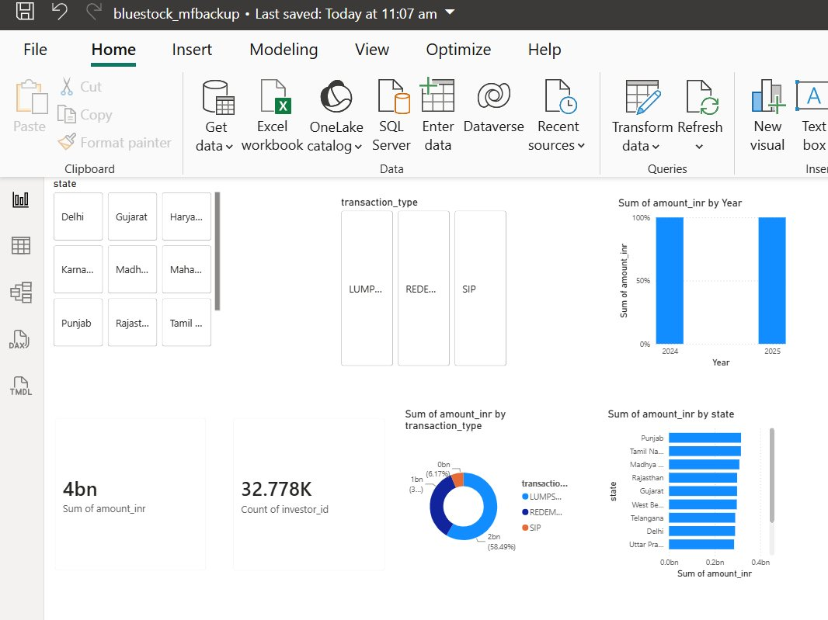
DASHBOARD OVERVIEW
Power BI — Industry & Investor Analytics
Page Highlights
Total Investment KPI: ₹4 Bn
Investor Count: 32.778K transactions
State, transaction type and year slicers drive every visual
Donut chart breaks down investment by Lumpsum / Redemption / SIP
State-wise bar ranks Punjab, Tamil Nadu, MP at the top
Bluestock Fintech | Mutual Fund Performance Analysis | June 2026
9

Slide 10
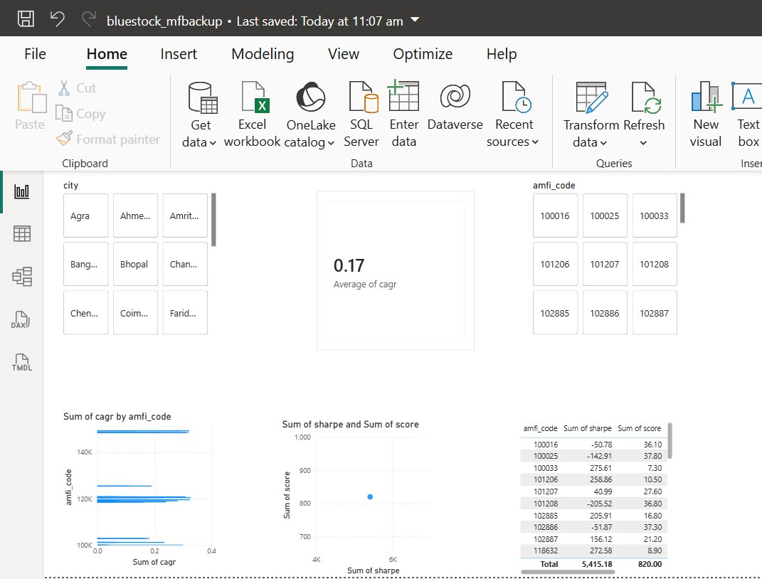
DASHBOARD OVERVIEW
Power BI — Fund Performance
Page Highlights
Average CAGR across funds: 0.17 (17%)
City and AMFI fund code slicers for granular drill-down
CAGR by amfi_code chart compares fund growth rates
Sharpe vs Score scatter highlights risk-adjusted leaders
Detail table lists Sharpe and Score totals per fund
Bluestock Fintech | Mutual Fund Performance Analysis | June 2026
10

Slide 11


CONCLUSIONS
Key Findings & Recommendations
Key Findings
Recommendations
Lumpsum dominates investment value; SIP dominates transaction frequency.
Punjab, Tamil Nadu and Madhya Pradesh are the top three investing states.
2024 transaction volume exceeded 2025, pointing to a possible activity peak or incomplete 2025 capture.
Risk-adjusted metrics (Sharpe, Sortino, drawdown) reveal meaningful variation across Low / Medium / High risk funds.
SIP investors show more stable, long-term participation per cohort analysis.
Continue SIP investments for consistency and stable long-term outcomes.
Diversify across risk grades using the fund scorecard.
Prefer Sharpe Ratio over raw CAGR for fund selection.
Monitor maximum drawdown before investing in high-CAGR funds.
Add live NAV ingestion and a scheduled Power BI refresh.
Extend the recommender with a Scikit-learn model for quartile predictions.
Bluestock Fintech | Mutual Fund Performance Analysis | June 2026
11

Slide 12
Thank You
Questions & discussion welcome
Celin Treesa Joseph
Data Analyst Intern, Bluestock Fintech
celintreesa700@gmail.com
linkedin.com/in/celin-treesa-joseph-907978354 | github.com/celintreesa

