Slide 1

PHP Object Oriented Programming (OOP)
Dr. Charles Severance
www.wa4e.com
http://www.wa4e.com/code/objects.zip

Slide 2
PHP => Object Oriented
With PHP 5, an object oriented approach is the preferred pattern.
Libraries are evolving toward OOP.

Slide 3
Object Oriented Programming (OOP)
Object-oriented programming (OOP) is a programming paradigm that represents concepts as "objects" that have data fields (attributes that describe the object) and associated procedures known as methods. Objects, which are usually instances of classes, are used to interact with one another to design applications and computer programs.
http://en.wikipedia.org/wiki/Object-oriented_programming

Slide 4
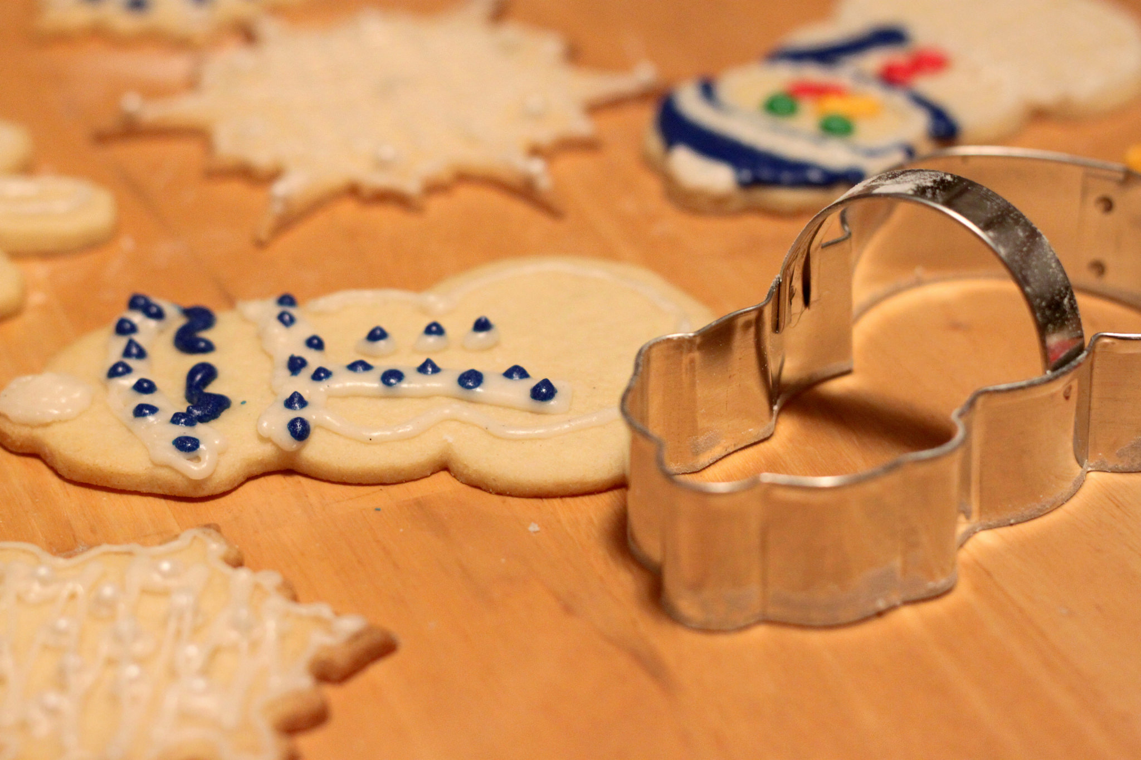
Definitions
Class - a template - Dog
Method - A defined capability of a class - bark()
Object or Instance - A particular instance of a class - Lassie
Image CC-By 2.0: https://www.flickr.com/photos/dinnerseries/23570475099

Slide 5
Terminology: Class
Defines the abstract characteristics of a thing (object), including the thing’s characteristics (its attributes, fields, or properties) and the thing’s behaviors (the things it can do, or methods, operations, or features). One might say that a class is a blueprint or factory that describes the nature of something. For example, the class Dog would consist of traits shared by all dogs, such as breed and fur color (characteristics), and the ability to bark and sit (behaviors).

Slide 6
Terminology: Instance
One can have an instance of a class or a particular object. The instance is the actual object created at runtime. In programmer jargon, the Lassie object is an instance of the Dog class. The set of values of the attributes of a particular object is called its state. The object consists of state and the behavior that is defined in the object’s class.
Object and Instance are often used interchangeably.

Slide 7
Terminology: Method
An object’s abilities. In language, methods are verbs. Lassie, being a Dog, has the ability to bark. So bark() is one of Lassie’s methods. She may have other methods as well, for example sit() or eat() or walk() or save_timmy(). Within the program, using a method usually affects only one particular object; all Dogs can bark, but you need only one particular dog to do the barking.
Method and Message are often used interchangeably.

Slide 8
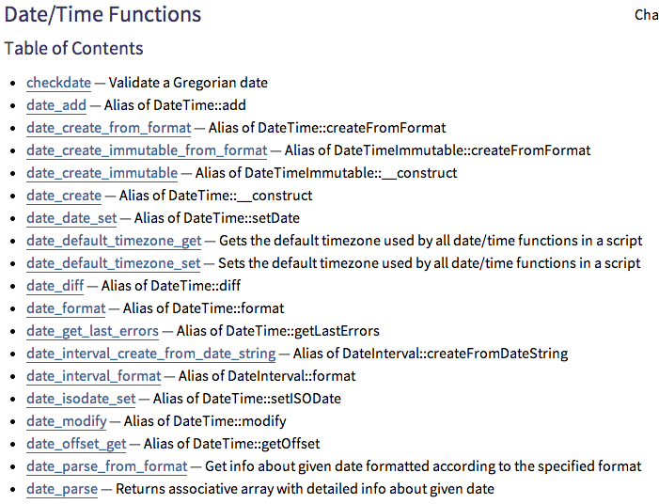
Non-OOP
http://php.net/manual/en/ref.datetime.php

Slide 9
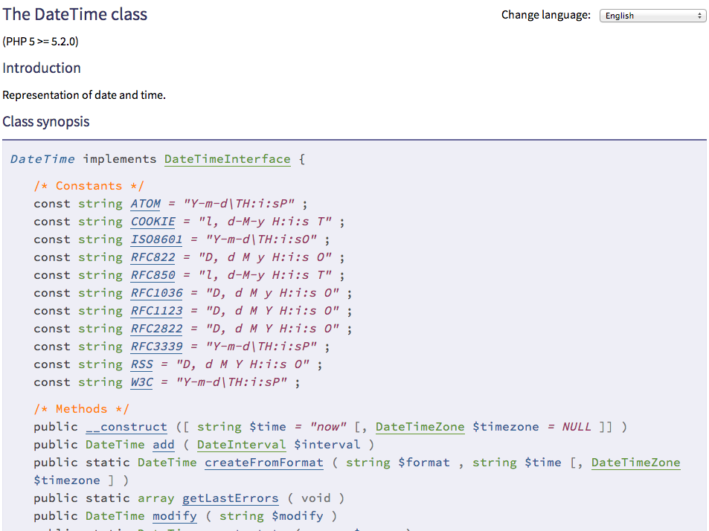
OOP
http://www.php.net/manual/en/class.datetime.php

Slide 10
<?php
date_default_timezone_set('America/New_York');
$nextWeek = time() + (7 * 24 * 60 * 60);
echo 'Now: '. date('Y-m-d') ."\n";
echo 'Next Week: '. date('Y-m-d', $nextWeek) ."\n";
echo("=====\n");
$now = new DateTime();
$nextWeek = new DateTime('today +1 week');
echo 'Now: '. $now->format('Y-m-d') ."\n";
echo 'Next Week: '. $nextWeek->format('Y-m-d') ."\n";
Now: 2013-09-25
Next Week: 2013-10-02
=====
Now: 2013-09-25
Next Week: 2013-10-02
date.php

Slide 11
Making a Class / Objects

Slide 12
nonobj.php
<?php
$chuck = array("fullname" => "Chuck Severance",
'room' => '4429NQ');
$colleen = array("familyname" => "van Lent",
'givenname' => 'Colleen', 'room' => '3439NQ');
function get_person_name($person) {
if ( isset($person['fullname']) ) return $person['fullname'];
if ( isset($person['familyname']) && isset($person['givenname']) ) {
return $person['givenname'] . ' ' . $person['familyname'] ;
}
return false;
}
print get_person_name($chuck) . "\n";
print get_person_name($colleen) . "\n";
Chuck Severance
Colleen van Lent

Slide 13
<?php
class Person {
public $fullname = false;
public $givenname = false;
public $familyname = false;
public $room = false;
function get_name() {
if ( $this->fullname !== false ) return $this->fullname;
if ( $this->familyname !== false && $this->givenname !== false ) {
return $this->givenname . ' ' . $this->familyname;
}
return false;
}
}
$chuck = new Person();
$chuck->fullname = "Chuck Severance";
$chuck->room = "4429NQ";
$colleen = new Person();
$colleen->familyname = 'van Lent';
$colleen->givenname = 'Colleen';
$colleen->room = '3439NQ';
print $chuck->get_name() . "\n";
print $colleen->get_name() . "\n";
withobj.php
Chuck Severance
Colleen van Lent

Slide 14
Reading Documentation

Slide 15
Two New Operators
Access “static item” in a class
    echo DateTime::RFC822."\n";
Access item in an object
    echo $z->format('Y-m-d')."\n";

Slide 16
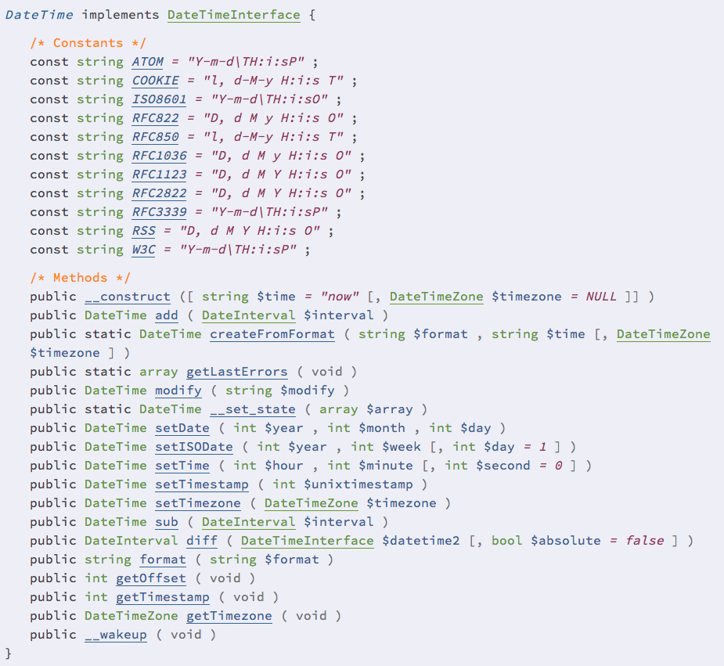
echo DateTime::RFC822."\n";
D, d M y H:i:s O

Slide 17
$x = new DateTime();
$y = new DateTime('now');
$z = new DateTime('2012-01-31');

Slide 18
$x = new DateTime('1999-04-31');
$oops = DateTime::getLastErrors();
print_r($oops);
Array
(
[warning_count] => 1
[warnings] => Array
(
[11] => The parsed date was invalid
)
[error_count] => 0
[errors] => Array
(
)
)

Slide 19
$z = new DateTime('2012-01-31');
echo $z->format('Y-m-d')."\n";
2012-01-31

Slide 20
http://php.net/manual/en/language.oop5.magic.php

Slide 21
Object Life Cycle
http://en.wikipedia.org/wiki/Constructor_(computer_science)

Slide 22
Object Life Cycle
Objects are created, used and discarded.
We have special blocks of code (methods) that get called
    - At the moment of creation (constructor)
    - At the moment of destruction (destructor)
Constructors are used a lot.
Destructors are seldom used.

Slide 23
Constructor
The primary purpose of the constructor is to set up some instance variables to have the proper initial values when the object is created.

Slide 24
party.php
class PartyAnimal {
function __construct() {
echo("Constructed\n");
}
function something() {
echo("Something\n");
}
function __destruct() {
echo("Destructed\n");
}
}
echo("--One\n");
$x = new PartyAnimal();
echo("--Two\n");
$y = new PartyAnimal();
echo("--Three\n");
$x->something();
echo("--The End?\n");
--One
Constructed
--Two
Constructed
--Three
Something
--The End?
Destructed
Destructed

Slide 25
Many Instances
We can create lots of objects - the class is the template for the object.
We can store each distinct object in its own variable.
We call this having multiple instances of the same class.
Each instance has its own copy of the instance variables.

Slide 26
class Hello {
protected $lang; // Only accessible in the class
function __construct($lang) {
$this->lang = $lang;
}
function greet() {
if ( $this->lang == 'fr' ) return 'Bonjour';
if ( $this->lang == 'es' ) return 'Hola';
return 'Hello';
}
}
$hi = new Hello('es');
echo $hi->greet()."\n";
Hola
hello.php

Slide 27
Definitions
Class - a template - Dog
Method or Message - A defined capability of a class - bark()
Object or Instance - A particular instance of a class - Lassie
Constructor - A method which is called when the instance / object is created

Slide 28
Inheritance
http://www.php.net/manual/en/language.oop5.inheritance.php

Slide 29
Inheritance
When we make a new class we can reuse an existing class and inherit all the capabilities of an existing class and then add our own little bit to make our new class
Another form of store and reuse
Write once - reuse many times
The new class (child) has all the capabilities of the old class (parent) - and then some more

Slide 30
Terminology: Inheritance
“Subclasses” are more specialized versions of a class, which inherit attributes and behaviors from their parent classes, and can introduce their own.
http://en.wikipedia.org/wiki/Object-oriented_programming

Slide 31
goodbye.php
class Hello {
protected $lang;
function __construct($lang) { ... }
function greet() { ... }
}
class Social extends Hello {
function bye() {
if ( $this->lang == 'fr' ) return 'Au revoir';
if ( $this->lang == 'es' ) return 'Adios';
return 'goodbye';
}
}
$hi = new Social('es');
echo $hi->greet()."\n";
echo $hi->bye()."\n";
Hola
Adios

Slide 32
Definitions
Class - a template - Dog
Method or Message - A defined capability of a class - bark()
Object or Instance - A particular instance of a class - Lassie
Constructor - A method which is called when the instance / object is created
Inheritance - the ability to take a class and extend it to make a new class

Slide 33
Visibility
Class member variables also have scope.
  Public – can be accessed outside the class, inside the class, and in derived classes
  Protected – can be accessed inside the class, and in derived classes
  Private – can only be accessed inside the class (i.e. private variables are not visible in derived classes)
http://www.php.net/manual/en/language.oop5.visibility.php

Slide 34
visibility.php
class MyClass
{
public $pub = 'Public';
protected $pro = 'Protected';
private $priv = 'Private';
function printHello()
{
echo $this->pub."\n";
echo $this->pro."\n";
echo $this->priv."\n";
}
}
$obj = new MyClass();
echo $obj->pub."\n"; // Works
echo $obj->pro."\n"; // Fatal Error
echo $obj->priv."\n"; // Fatal Error
$obj->printHello(); // Shows Public, Protected and Private
Public
Public
Protected
Private

Slide 35
class MyClass2 extends MyClass
{
function printHello()
{
echo $this->pub."\n";
echo $this->pro."\n";
echo $this->priv."\n"; // Undefined
}
}
echo("--- MyClass2 ---\n");
$obj2 = new MyClass2();
echo $obj2->pub."\n"; // Works
$obj2->printHello(); // Shows Public, Protected, Undefined
--- MyClass2 ---
Public
Public
Protected
(false)

Slide 36
Building an Object from Scratch
Sometimes a developer will prefer to make an object with public key-value pairs rather than an array.
Use where appropriate…

Slide 37
scratch.php
$player = new stdClass();
$player->name = "Chuck";
$player->score = 0;
$player->score++;
print_r($player);
class Player {
public $name = "Sally";
public $score = 0;
}
$p2 = new Player();
$p2->score++;
print_r($p2);
stdClass Object
(
[name] => Chuck
[score] => 1
)
Player Object
(
[name] => Sally
[score] => 1
)

Slide 38
Summary
Object Oriented programming is a very structured approach to code reuse.
There is a trend away from global function names and toward OO.
We can group data and functionality together and create many independent instances of a class.

Slide 39

Acknowledgements / Contributions
These slides are Copyright 2010- Charles R. Severance (www.dr-chuck.com) as part of www.wa4e.com and made available under a Creative Commons Attribution 4.0 License. Please maintain this last slide in all copies of the document to comply with the attribution requirements of the license. If you make a change, feel free to add your name and organization to the list of contributors on this page as you republish the materials.
Initial Development: Charles Severance, University of Michigan School of Information
Insert new Contributors and Translators here including names and dates
Continue new Contributors and Translators here
Notes:
Note from Chuck. Please retain and maintain this page as you remix and republish these materials. Please add any of your own improvements or contributions.

Slide 40
Additional Source Information
Snowman Cookie Cutter" by Didriks is licensed under CC BY
https://www.flickr.com/photos/dinnerseries/23570475099
Photo from the television program Lassie. Lassie watches as Jeff (Tommy Rettig) works on his bike is Public Domain
https://en.wikipedia.org/wiki/Lassie#/media/File:Lassie_and_Tommy_Rettig_1956.JPG

