Slide 1
Day 3-Like Problem Learning objectives
First semester: learning to formalize the problem
“Stub” report: Breaking the ‘problem’ down into different levels (Motivating, Computational, Specific Approach vs Specific Implementation)
Tenets of good citizenry (Useful README and readable Code)
Pseudocode as a tool to develop the algorithm for YOU/layman reader (short intuitive English explanations of major steps)
This semester: better coding and better reporting
Considering assumptions and limitations of computational problem
Interpreting and communicating results
Computational considerations: Parameterizing, stubbing, subsetting problem
Pseudocode as a tool to communicate algorithm to OTHERS/fellow programmers (formal generalizations, closer to math)

Slide 2
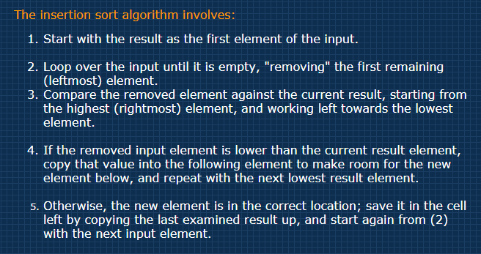
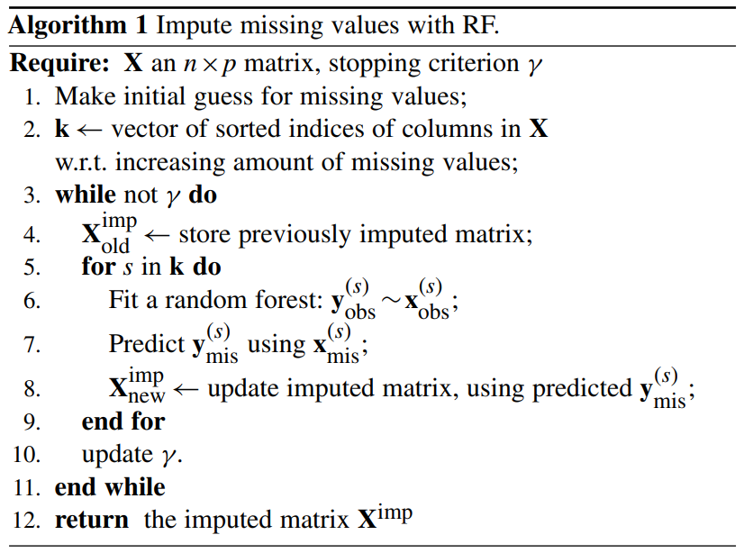
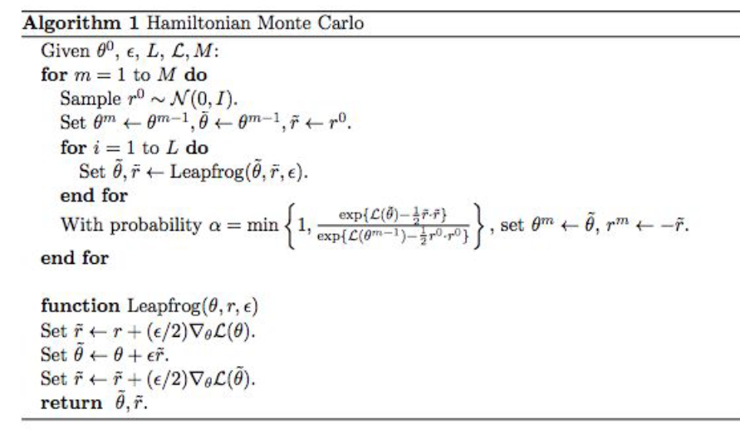
English
Math
This semester, be more here

Slide 3
Semester 2: Solve 2015 Prelim
Module 1: design algorithm and submit assignment plan
Submit Stub report (see examples) + Pseudocode
Submit detailed plan to break problem into two implementation pieces with clear standalone input/output
Module 2: Implementation Piece #1
README, code
Module 3: Implementation Piece #2
README, code
Full version of the Report (background, methods, results, discussion, conclusions)
Module 4: none

Slide 4
Feedback format this semester
Unlike last year where all feedback was done via email, this year we would like each of you to attend a 1 hour zoom call with the three graders to receive your feedback in real time.
Generally the day of the appointments will a few days after you hand in your assignment, though I am finalizing dates with the other graders currently. I will get back to you.
This year the assignment is less prescribed so we really look forward to you using your creativity to solve the problem.

Slide 5
Takehome Message
Trying to teach you to work out procedure in abstract FIRST before you even THINK about coding and data structures (use pseudocode to your advantage!!!)
Getting the logic correct is the most important thing – do it the simple way first if you must, then think about optimizations but try to always be considering how you can optimize things
Think about minimal data structures you need (optimize space)
Think about whether you can memoize certain operations (optimize time)
Think about assumptions you have to make in order to catch boundary cases
Any optimizations become discussion points in the report

