Slide 1
Predicting type II diabetes risk
Christine Lloyd

Slide 2
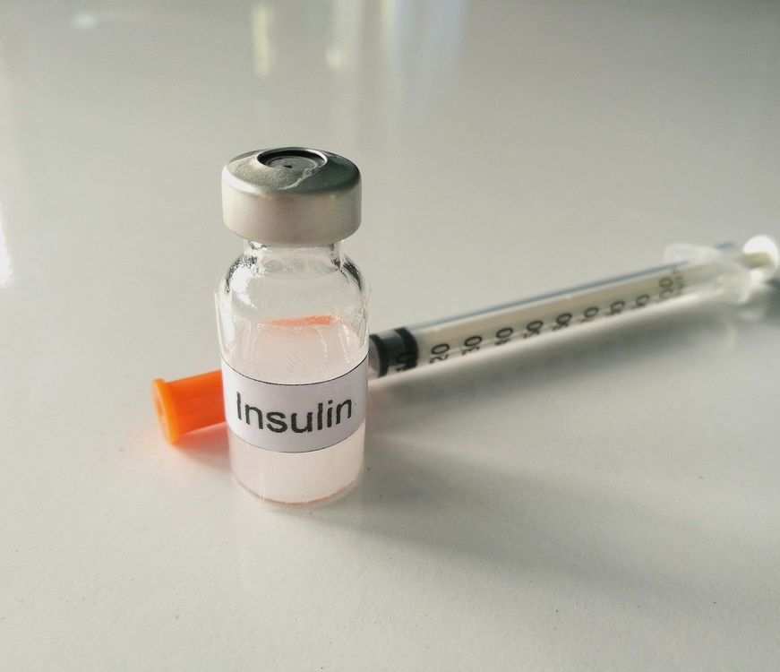
Diabetes costs $327 B/year in the USA
1 out of every 7 dollars of healthcare spending
34 M Americans have diabetes
88M Americans have prediabetes

Slide 3

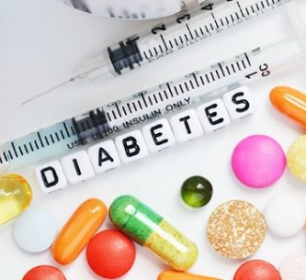
Save money and lives by finding prediabetic patients
Diabetes care: ~$10k/year/patient
A1C: ~$35/test
PCP counseling: <$100/visit

Slide 4
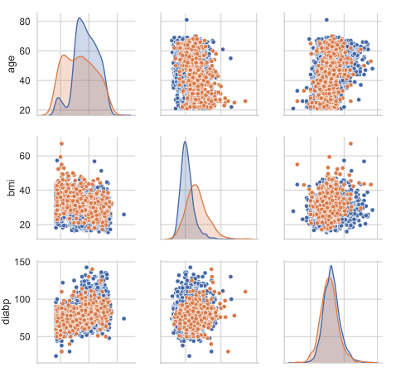

A model can help where simple cutoffs can’t

Slide 5
Next steps:
More thorough cost-benefit analysis
Display actual diabetes risk given a score and relative risk compared to the population
Discuss appropriateness and legal ramifications of tree-based models

Slide 6
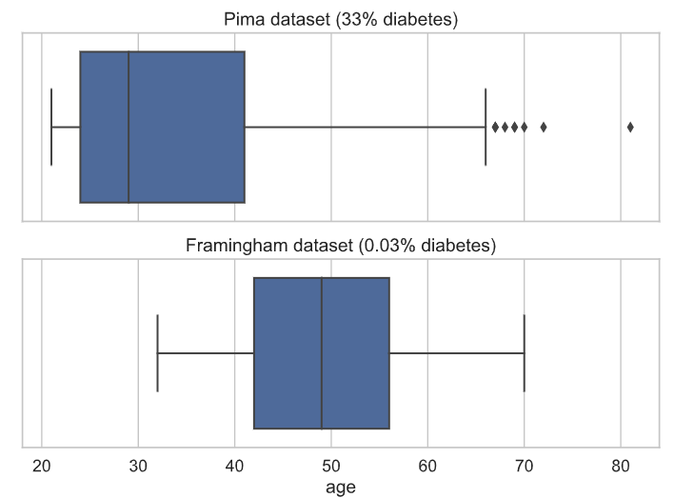

Slide 7
