Slide 1
Building a sweater pattern matcher
Christine Lloyd

Slide 2
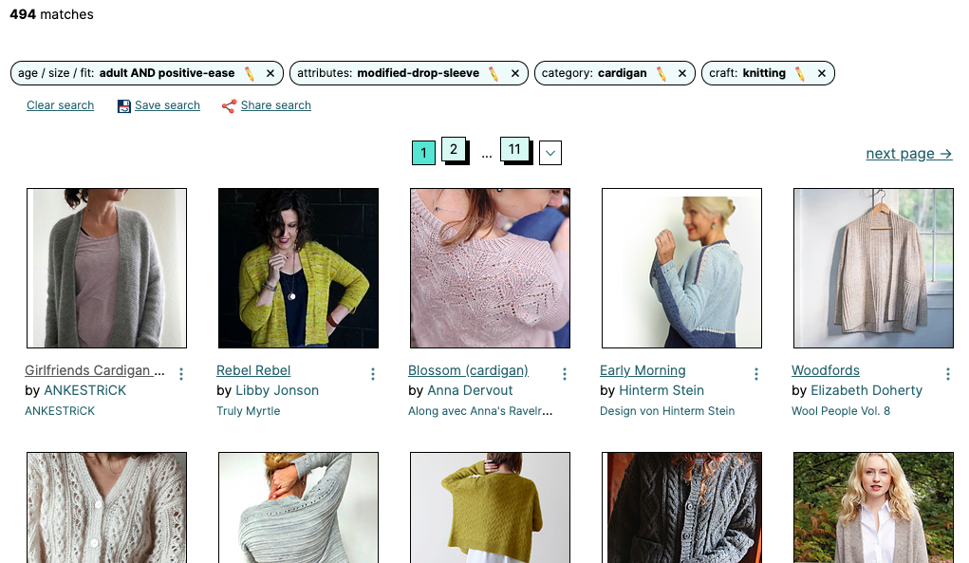
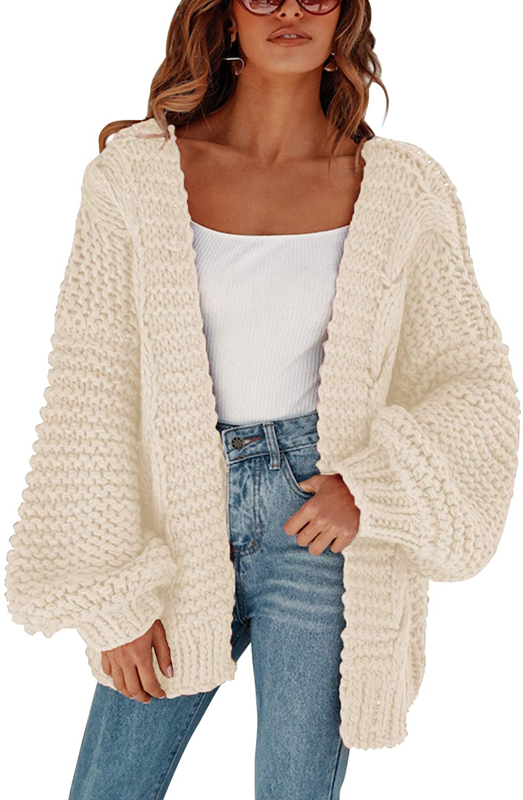
Which pattern is the best fit?

Slide 3
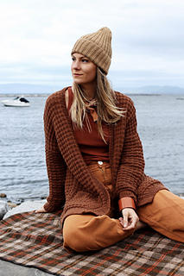
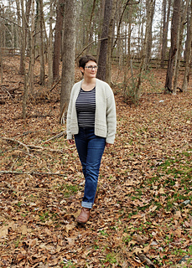
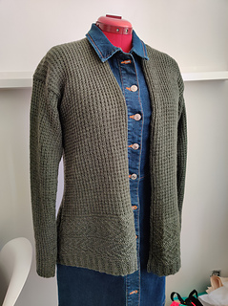
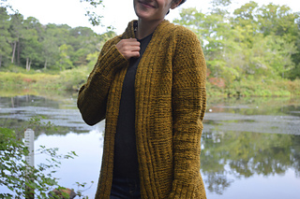
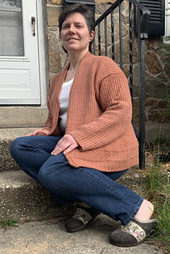
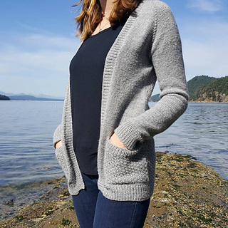
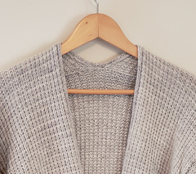
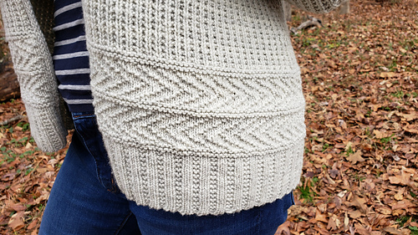
Human clustering of sweaters

Slide 4
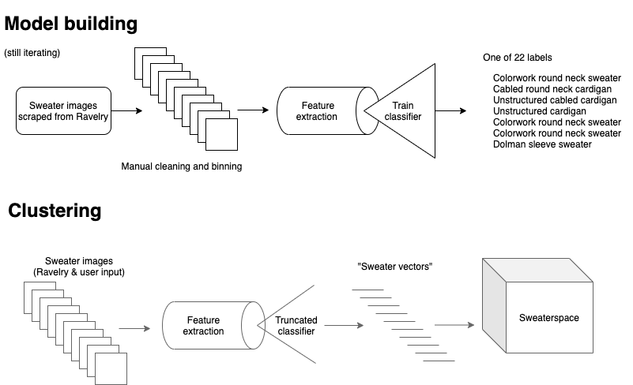
Looking for eigensweaters

Slide 5
Looking for eigensweaters
projects/library/alden-2
projects/library/mabrey-sweater
…

Slide 6
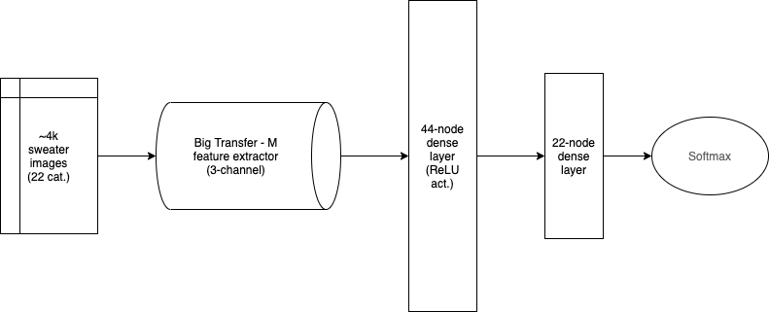
Neural net architecture
Removed for final vector calculation
Pre-trained
feature extraction
Sweater
recognition

Slide 7
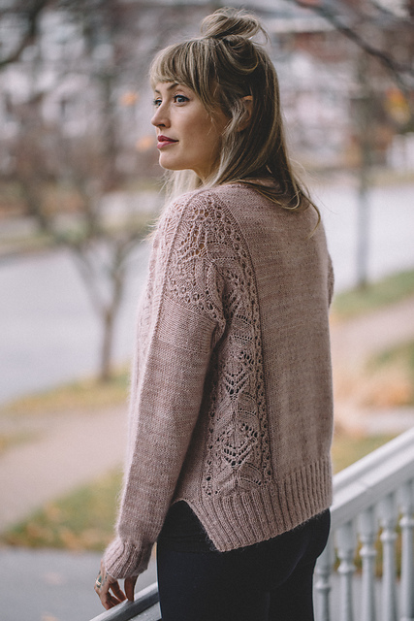
Performance and room for improvement
Neural net accuracy of ~65% on classification
Single pass feature extraction and iterate on those vectors
Use classification mistakes to inform iterations
Engineer training data to be as balanced as possible
Image processing currently slow
Use more lightweight feature extractor
Serve saved model on TensorFlow.js or TensorFlow Lite
5-10 minutes, various results

Slide 8
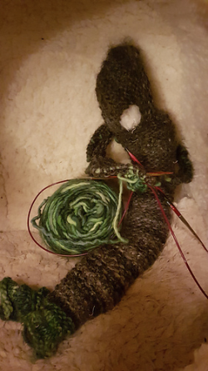
Model expansion
Relatively limited set of Ravelry sweaters (~400 of 140k)
Experiment with training algorithm to recognize “good” sweater photos
Work with Ravelry to ingest photos more effectively
Using Ravelry community to crowdsource image classification
Classify by shape
Separate classification for colorwork and decorative stitching presence/absence
SkyKnit had huge community buy-in
SkyKnit-generated pattern

