Slide 1


Slide 2

Proof-of-Deposit: A game-changing innovation
Taps into the most important userbase:
Those that cannot or do not want to take risk with their money
e.g. the Unbanked, regulated custodians, etc
Amplifies demand for CELO and stablecoins
A new tool for central banks: monetary policy with configurable discretion

Slide 3
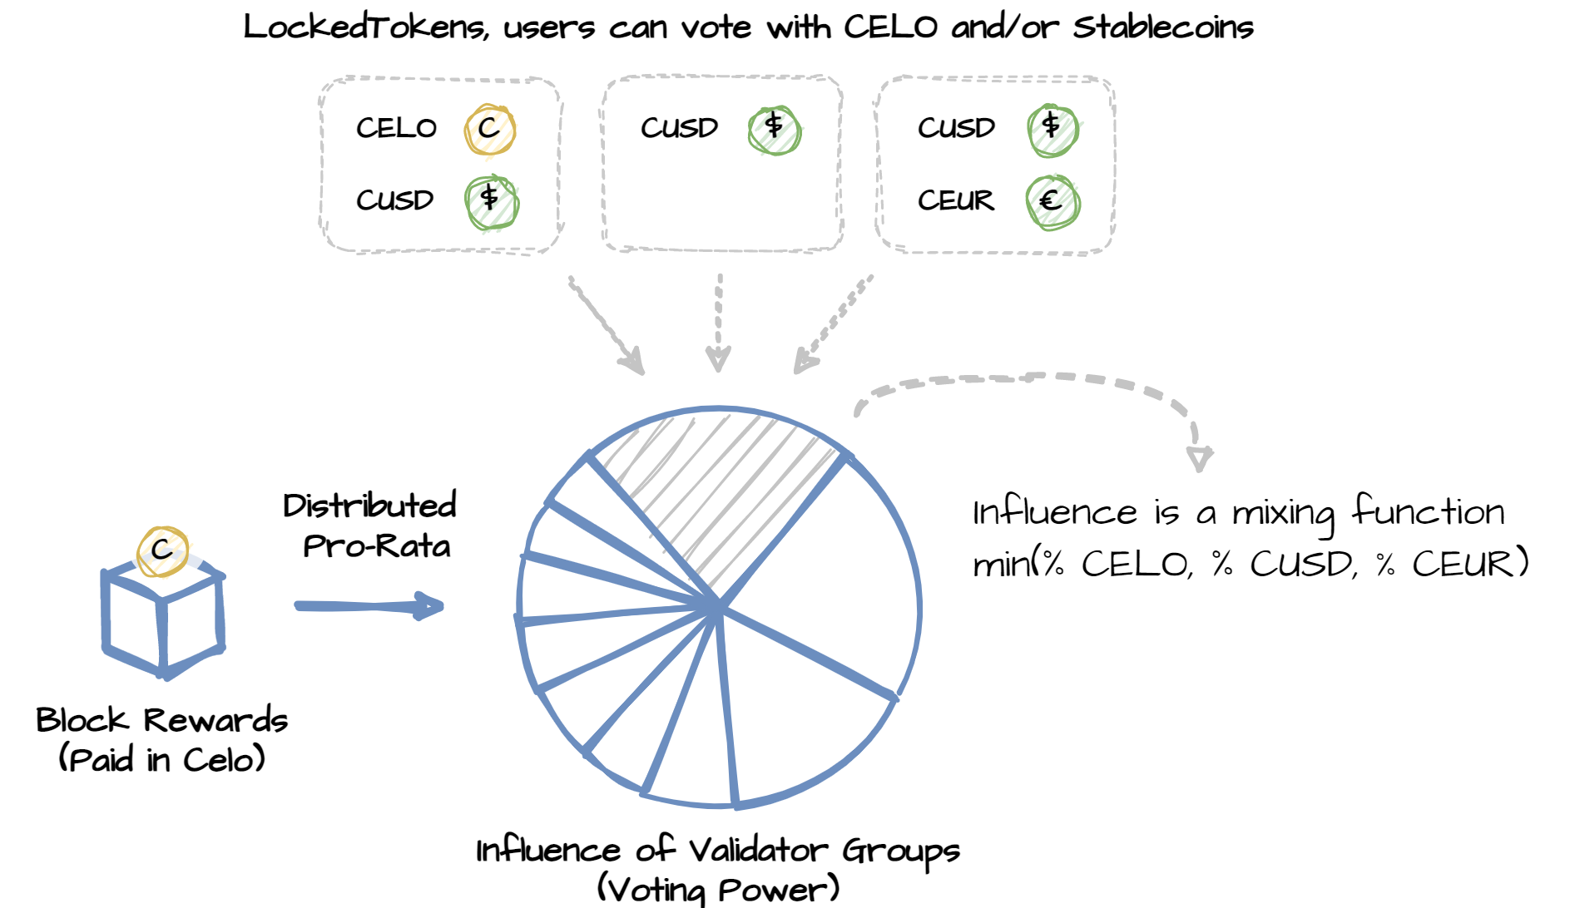
Proof-of-Deposit: The core idea

Slide 4
Demonstration Time!
https://hackathon.cambridgecryptographic.com/
We implemented the following:
Modified LockedGold → LockedToken (compatible with any ERC20)
Modified Election → Compatible with multiple LockedToken

