Slide 1
编译原理Project weird-o-compiler
殷叶航 3150104531 周洋 3150104024

Slide 2
What is WOC? (weird -0-compiler) What it supports?
A C-like compiler with weird restrictions
Supports:
functions, nested functions
all loop kinds of C, break & continue
branching (if & else)
label and goto
variable
all logical and numerical operations of C
Not supports:
No MACRO
No struct
No pointers
No dynamic strong types (but have built-in types)

Slide 3

What is in WOC?
Scanner written in Lex ------------------------
token error detection
Parser written in Yacc --------------------------
Abstract syntax tree generator --------------
syntax error detection and recovery
Activation Record ------------------------------
IR Tree translator -------------------------------
semantic error detection
IR Tree interpreter -----------------------------

Slide 4
Features of WOC (1/5) Branching and Combination priority
test case: if.woc
function main(argc, argv) {
if(argv[0]) {
print(argv[0]);
}
if(argc > 2) {
print(argc);
print(3.14159265358979);
}
else {
print("hello");
}
return argc;
}
https://celphi-misc.github.io/woc-visualization/

Slide 5
Features of WOC (2/5) loops, break and continue
test case: iter.woc
var n = 10;
function main(argc, argv) {
for(var i = 0; i < n; i++) {
print(i);
} // for loop
var j = n - 1; while(j) {
print(j);
j--;
} // while loop
do {
print(j);
j++;
} while(j < n); // do-while loop
loop:
print(j);
j--;
if(j > 0) goto loop; // goto & label
return argv[argc - 1];
}
https://celphi-misc.github.io/woc-visualization/

Slide 6
Features of WOC (2/5) loops, break and continue
test case: simple_break.woc
function main(argc, argv) {
var i = 1;
while (i < 1000){
i <<= 1;
if(i % 3 == 0) continue;
if(i < 0) break;
}
}
https://celphi-misc.github.io/woc-visualization/

Slide 7
Features of WOC (3/5) Functions and Nested funtions
test case: nested.woc
function main(argc, argv) {
function max(a, b) {
return a > b ? a : b;
}
return max(1, max(2, 3));
}
https://celphi-misc.github.io/woc-visualization/

Slide 8
Features of WOC (4/5) General test case with common operations
test case: test.woc
var __var = 3;
var val = __var;
function foo() {
var bar = val << 2;
__var += val * bar > 0 ? __var : val >> __var;
return bar + __var;
}
function main(argc, argv)
{
var a = "hello world";
function hello(para1, para2) { return null; }
if(a == "hello") {
for(var i = 0; i < 10; i++)
{
print(a);
}
} else if(a[0] == 'h')
{
print(a);
} else {
print("foo");
}
return 0;
}
https://celphi-misc.github.io/woc-visualization/

Slide 9
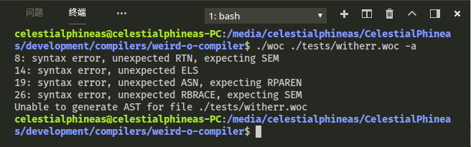
Features of WOC (5/5) Error check
test case: test.woc
var __var = 3;
var val = __var;
function foo() {
var bar = val << 2;
__var += val * bar > 0 ? __var : val >> __var // Semicolon
return bar + __var; // missed
}
function main(argc, argv)
{
var a = "hello world";
else print(4); // Mismatched else statement
function hello(para1, para2) { return null; }
if(a == "hello") {
for(var i = 0; i < 10; i++)
{
print(1 + 1 = 3); // Non-left-value
}
} else if(a[0] == 'h')
{
print(a);
} else {
print("foo") // Yet another semicolon missed
}
return 0;
}

Slide 10
References Outcomes
https://github.com/soshimozi/Compiler
ANSI C grammar, Lex specification
C-- Language Specification
The syntax of C in Backus-Naur Form
Flex & Bison
Project: https://github.com/celphi-misc/weird-o-compiler
Visualization：https://celphi-misc.github.io/woc-visualization/

Slide 11
Thank You! weird-o-compiler
殷叶航 3150104531 周洋 3150104024

Slide 12
Appendix You may ask …
How do we implement Activation Record?
Answer: A Skip-Tree-like data structure

Slide 13
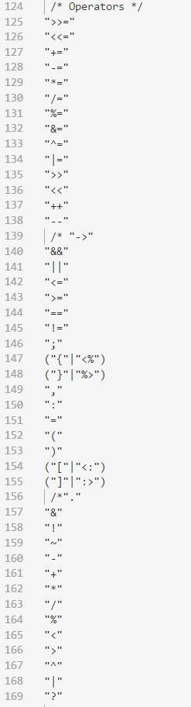
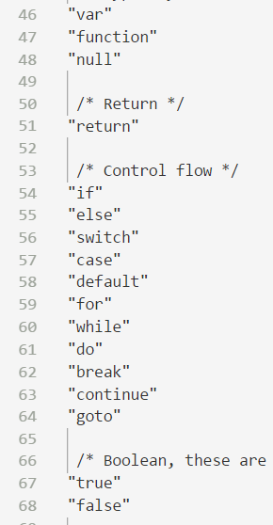
Appendix You may ask …
How many keyword and operators
are concerned?
Answer: here the list

