Slide 1
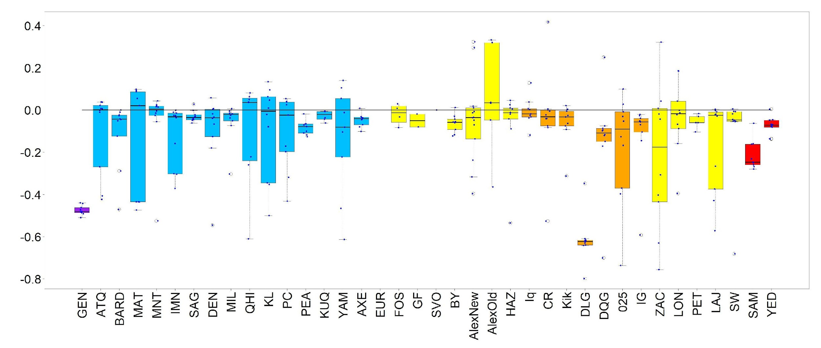
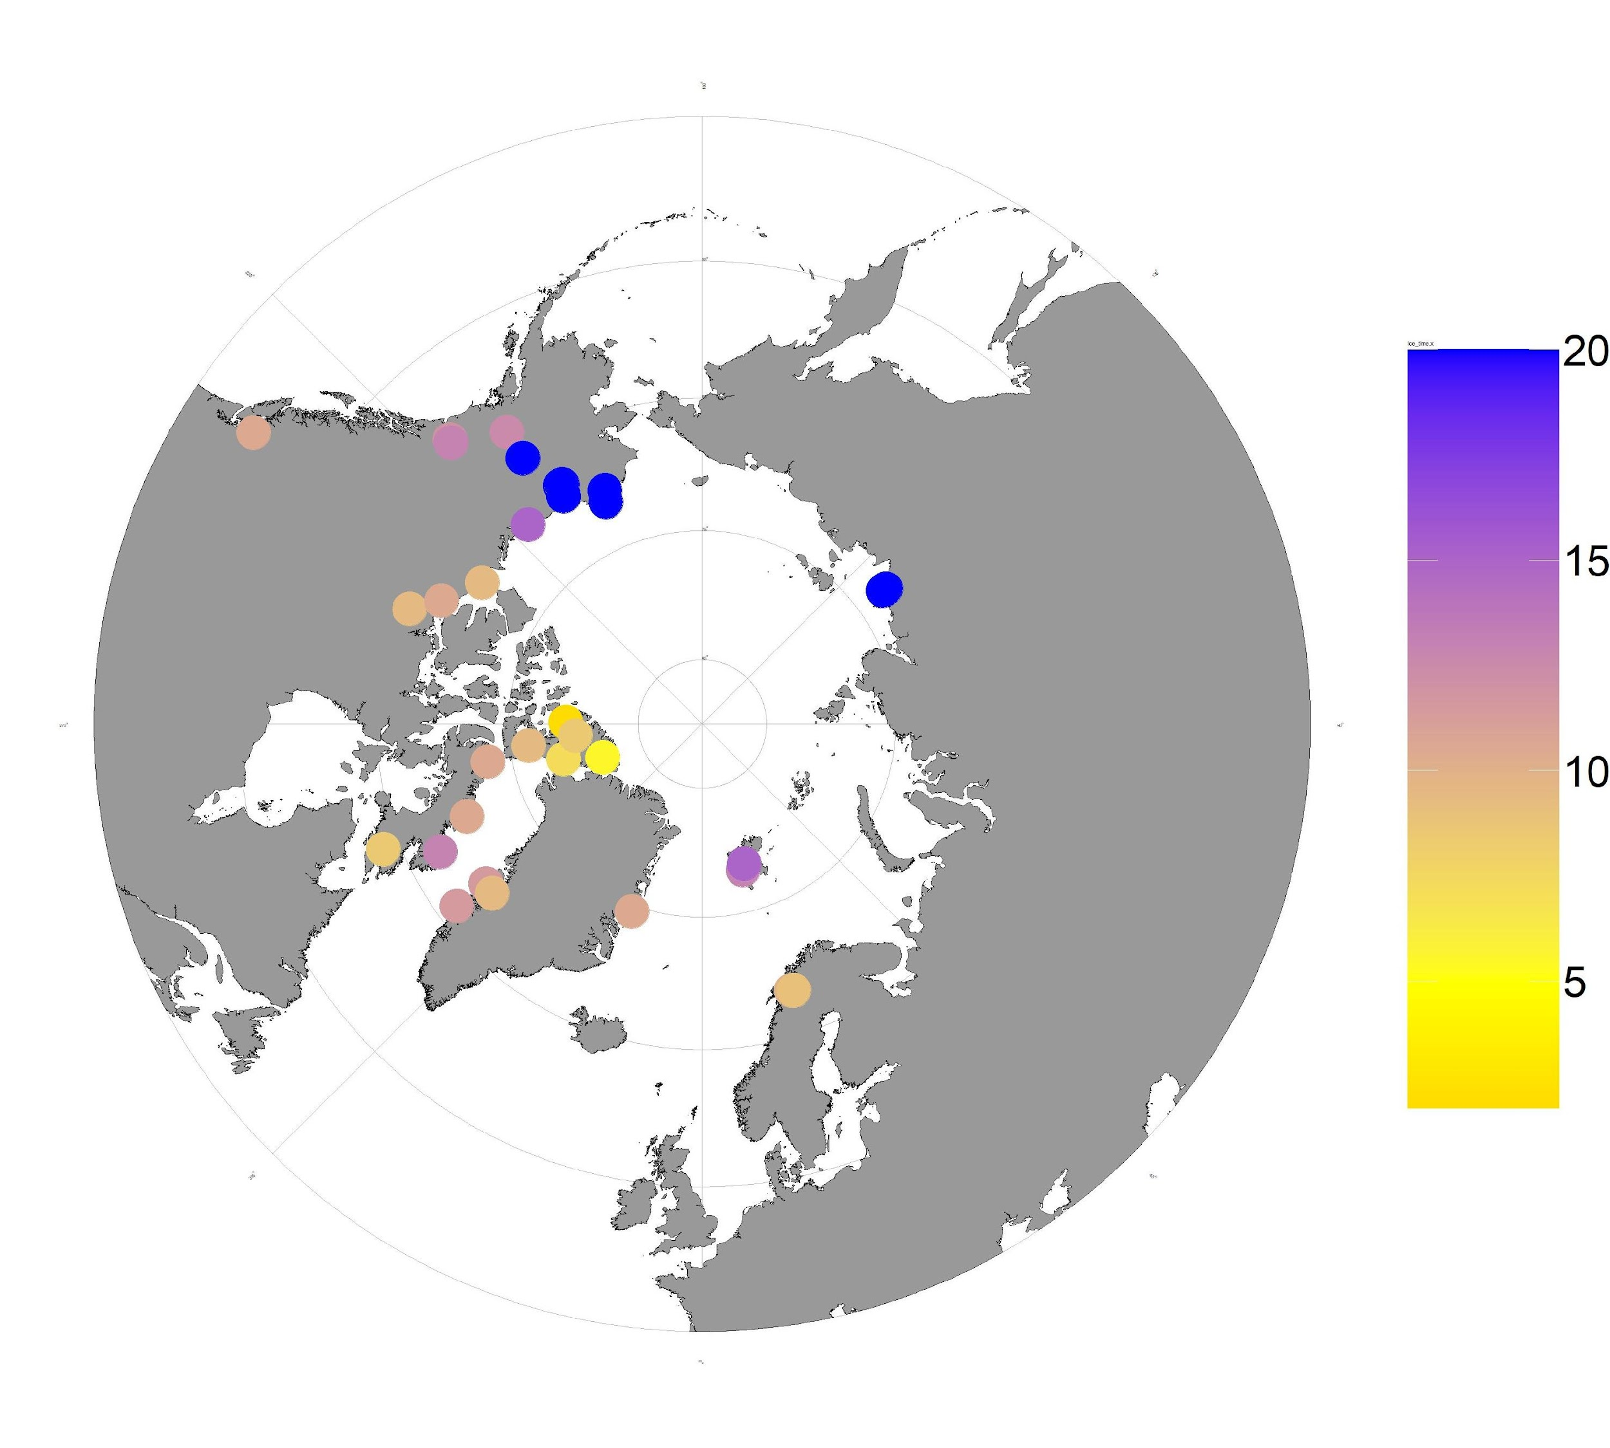
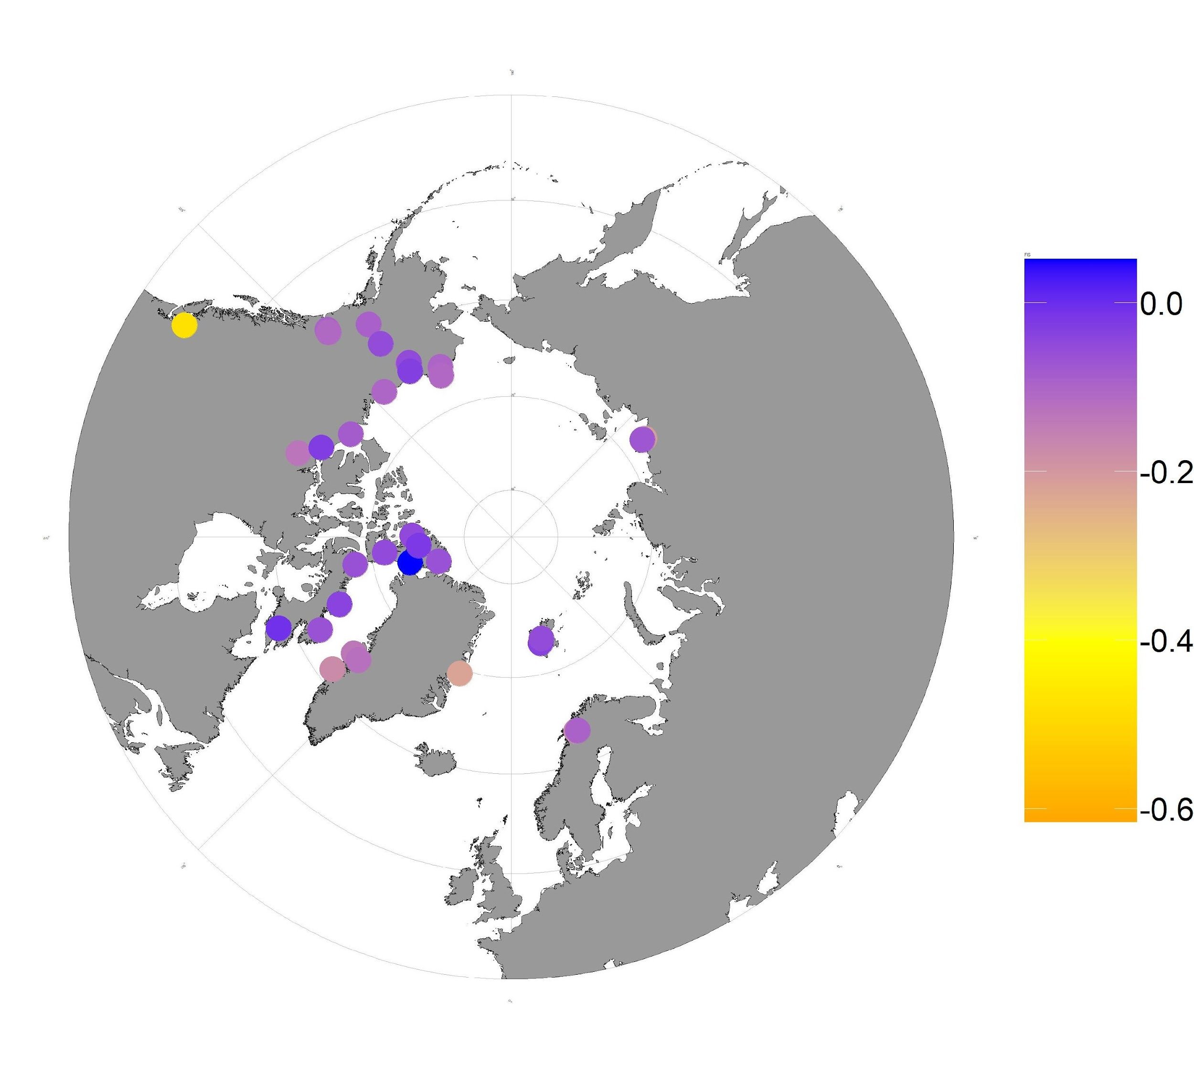
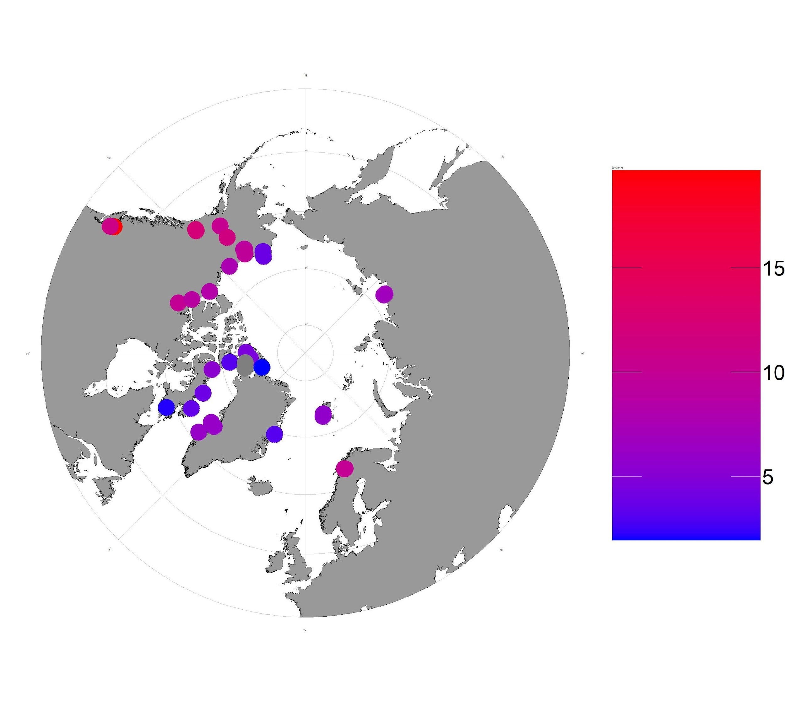

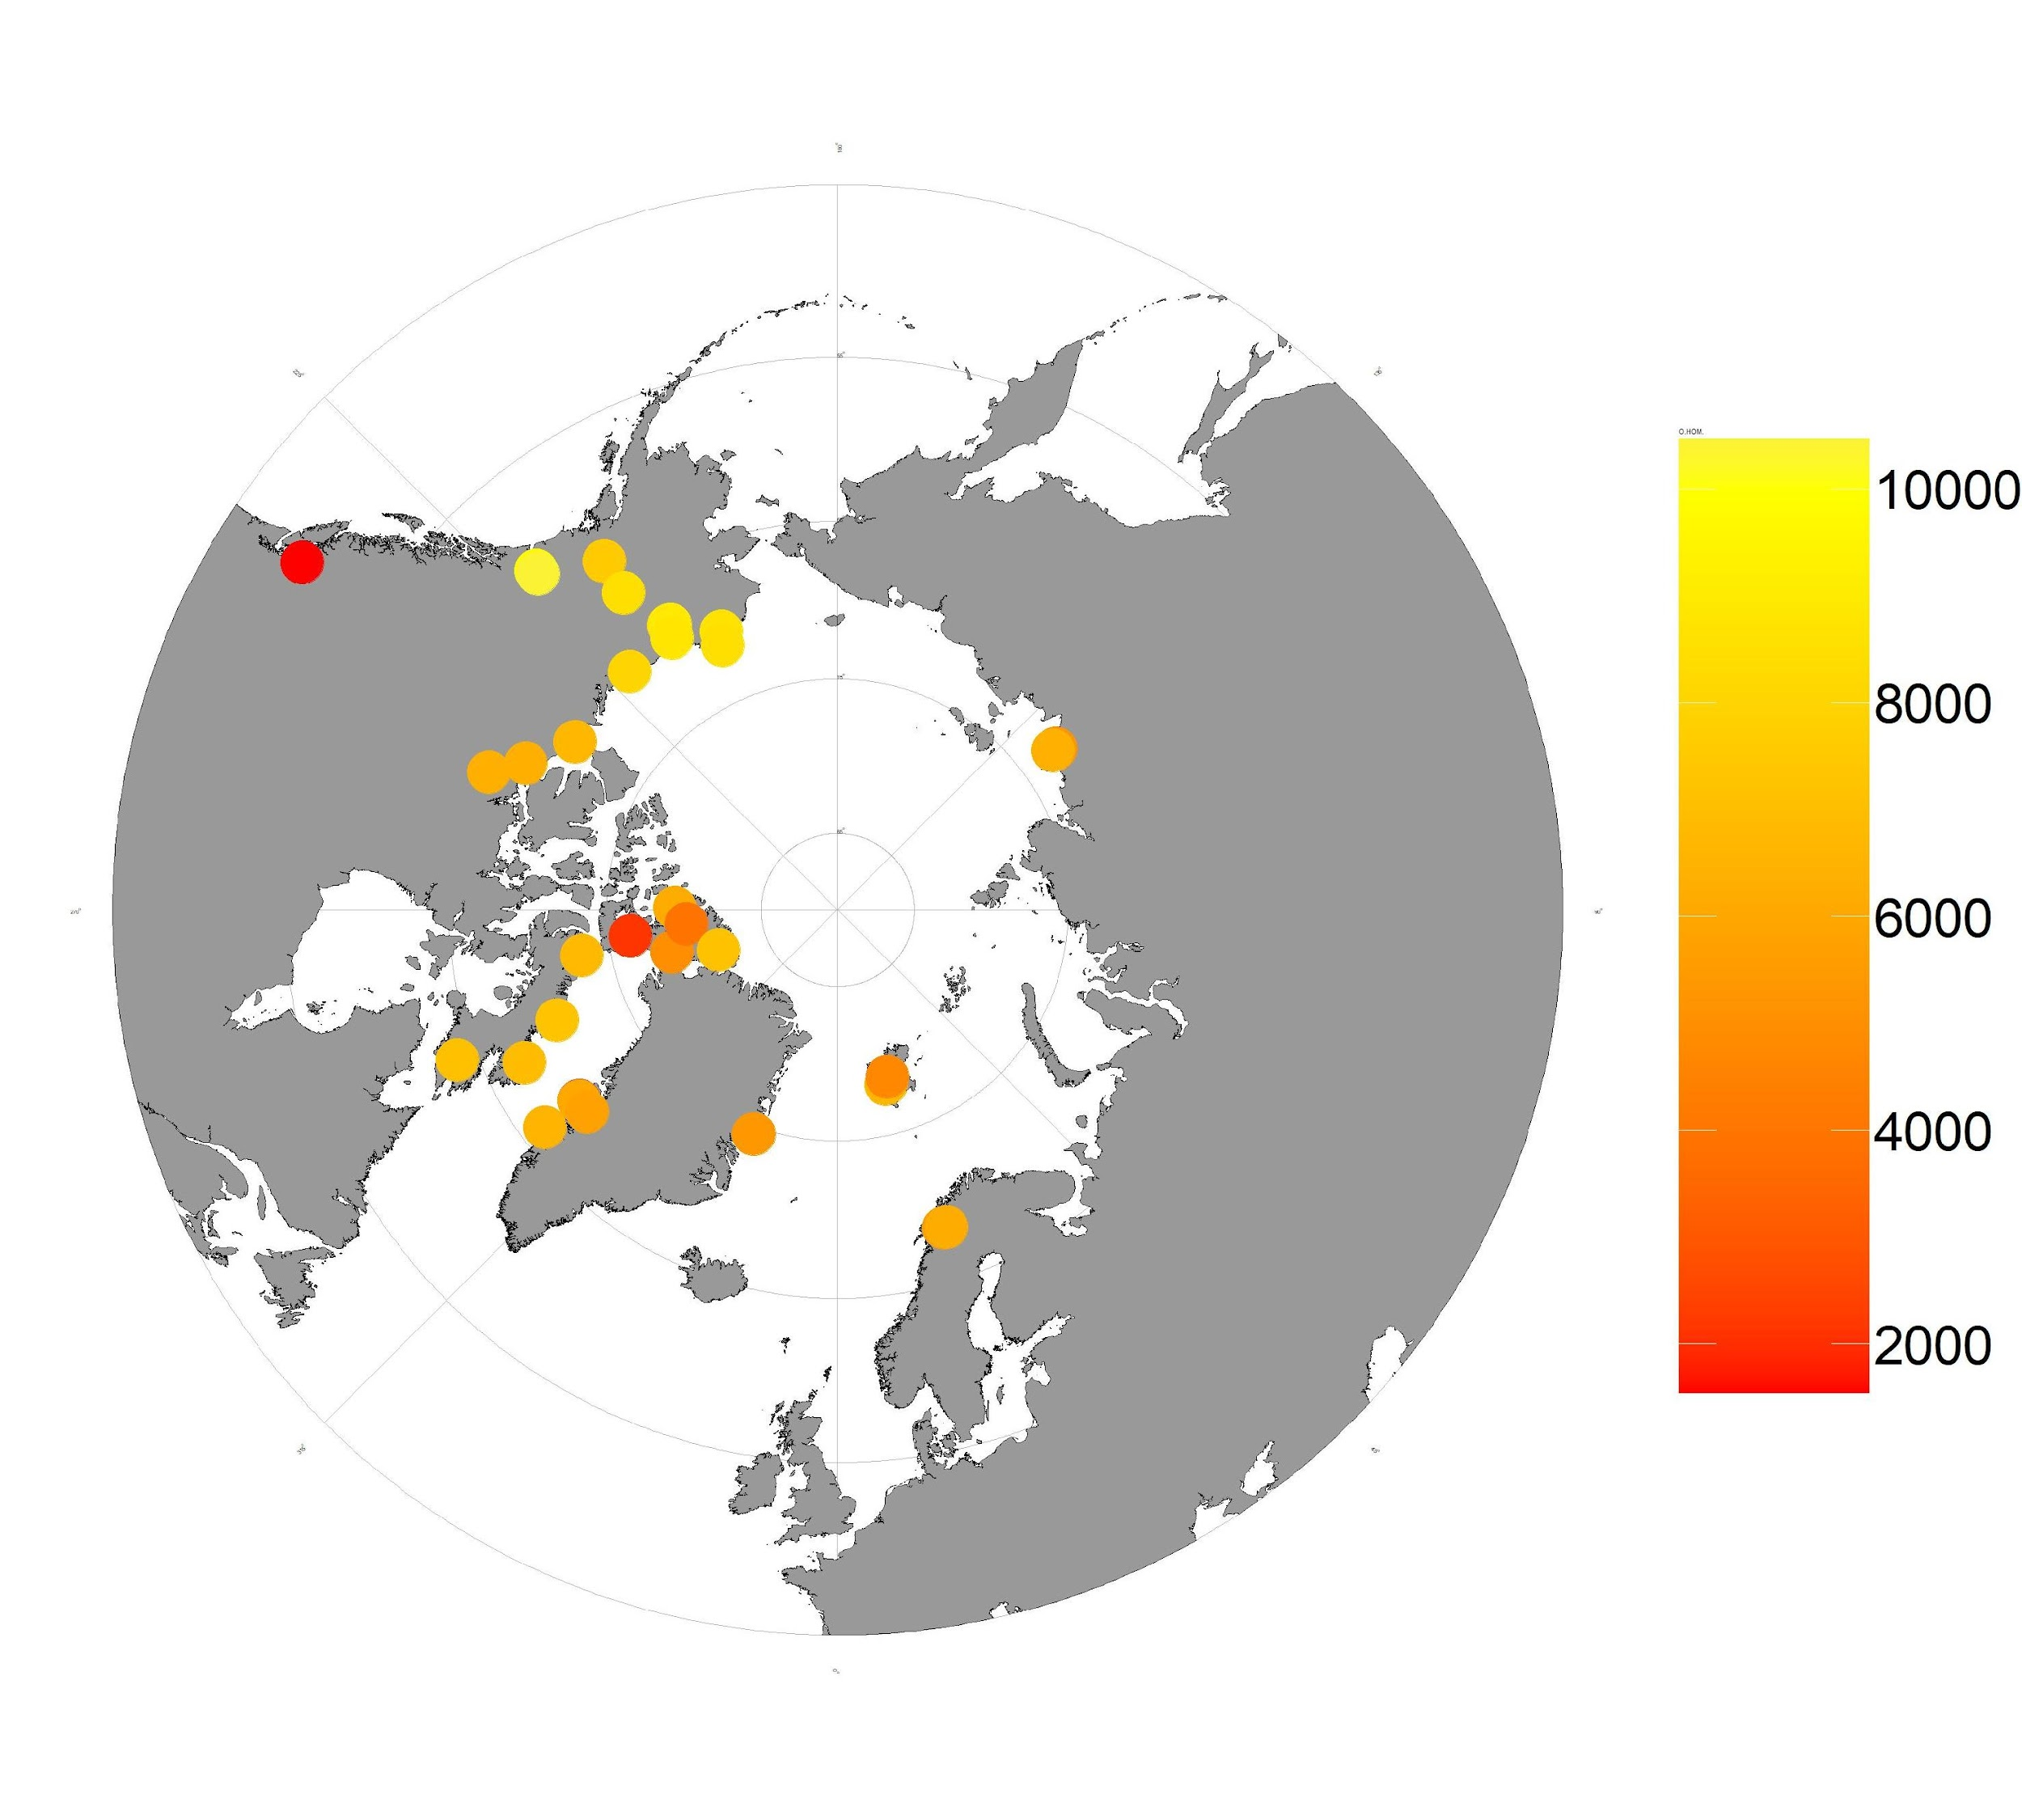
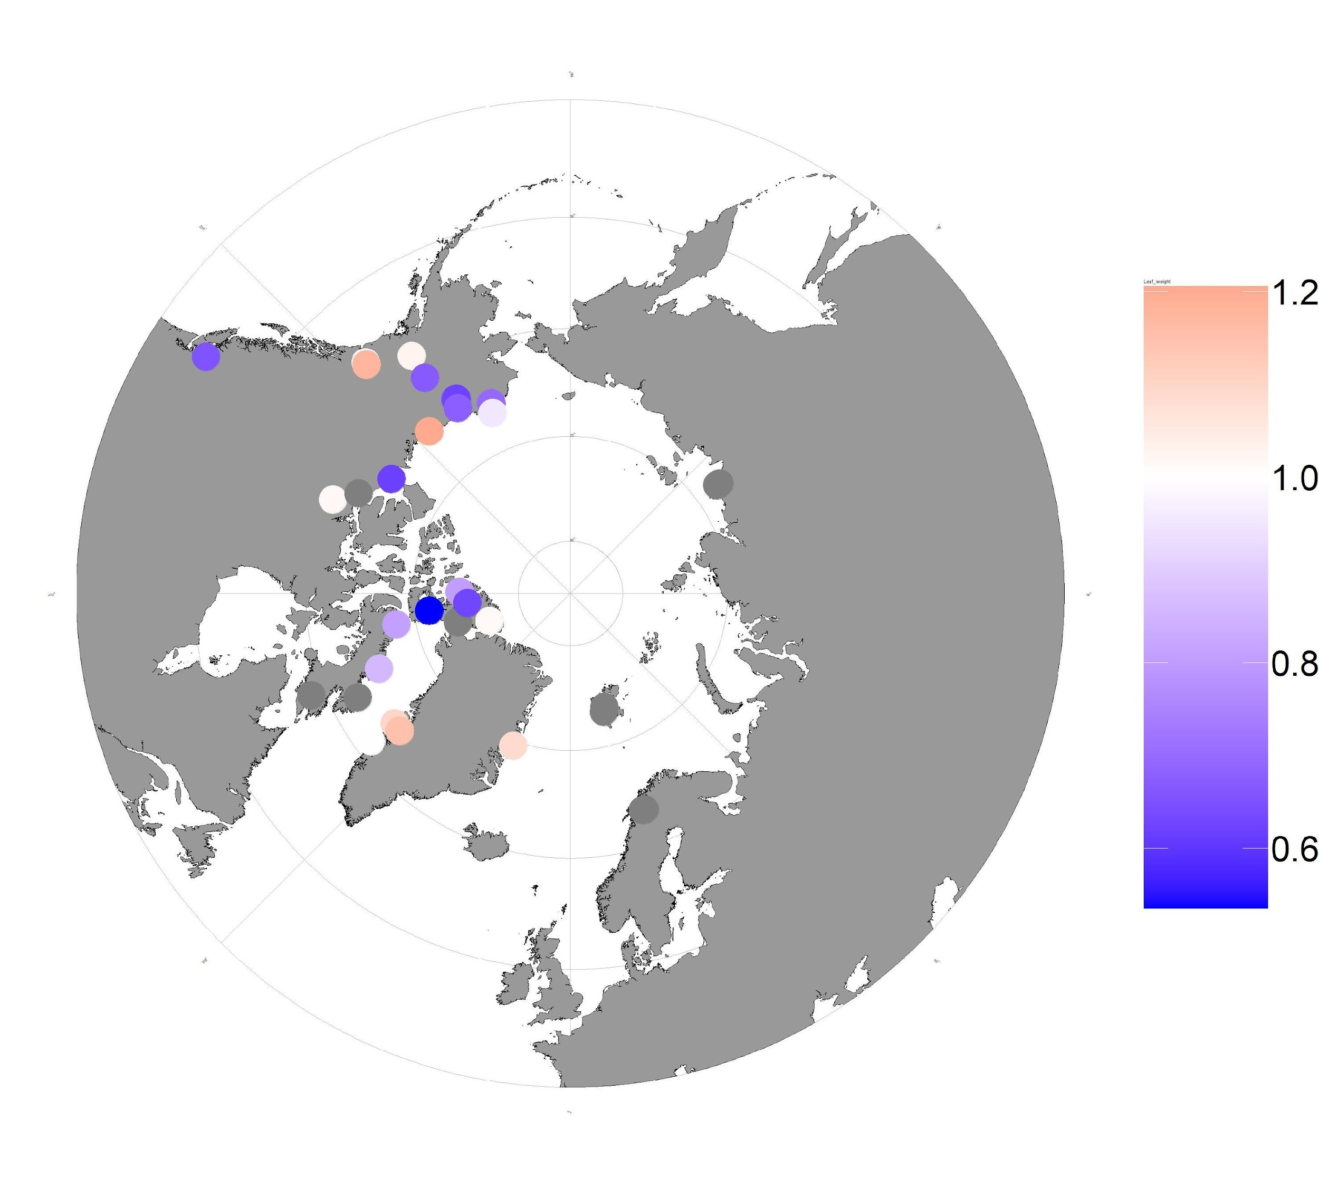
Alaska/Yukon
Ellesmere
Greenland
Europe
Russia
Gentian Peak
C. tetragona spp. saximontana
Disko (DLG)
A. Dates of Glacial Retreat (kyrs before present)
B. Inbreeding Coefficient
C. Summer Temperature
D. Summer Precipitation
D. Observed Homozygosity
D. Leaf Weights (mg)
Notes:
Popstats

Slide 2
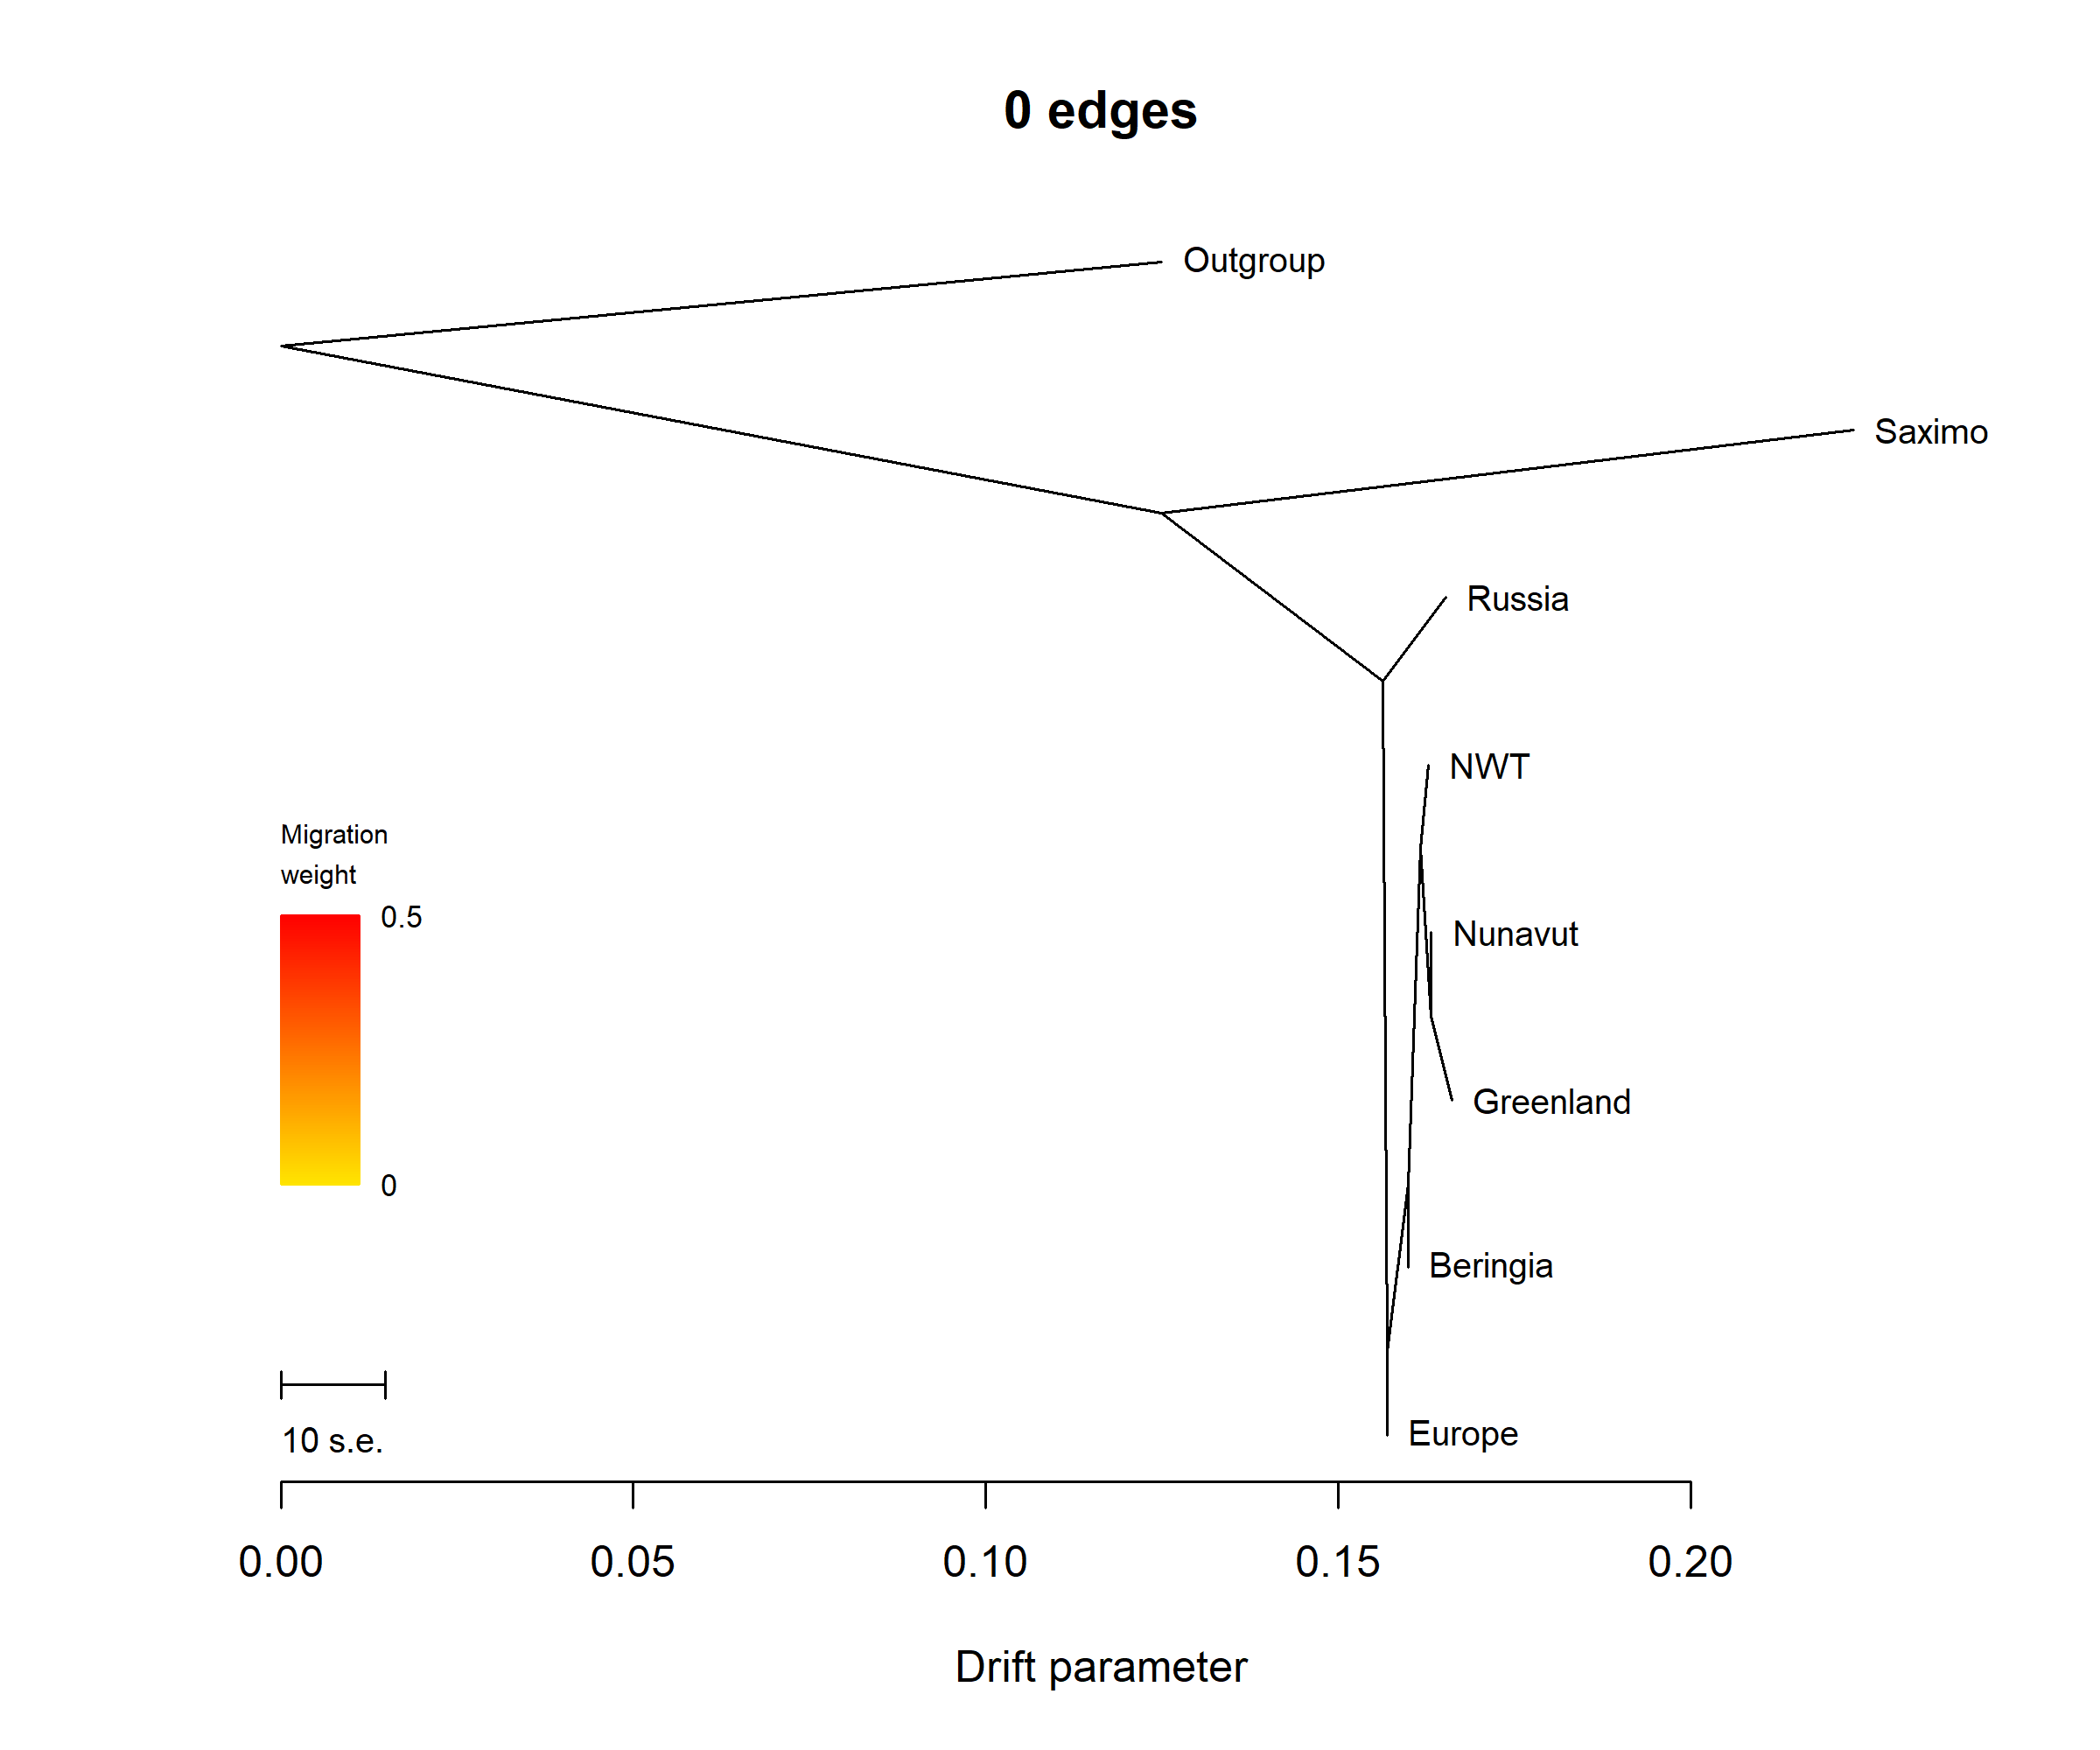
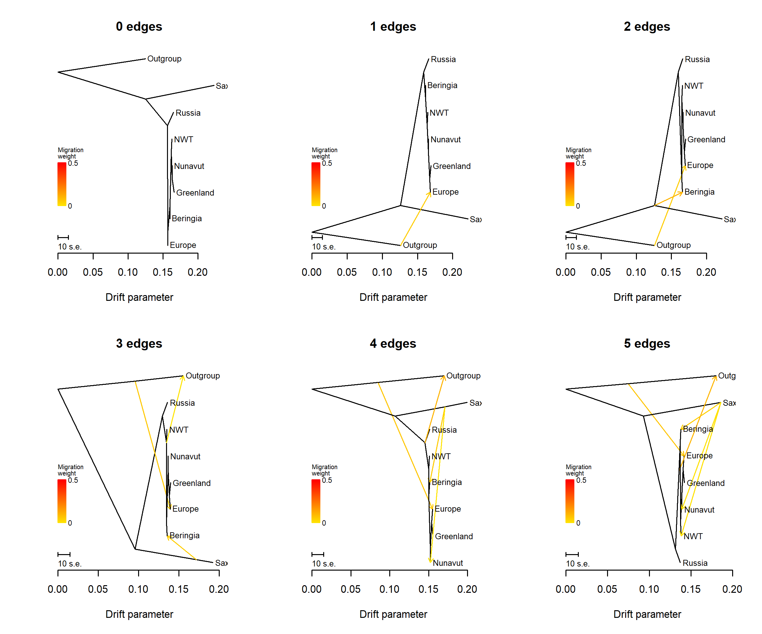
Notes:
Treemix

Slide 3
P1 = Historic
P2 = Present
P3 =Alaska
Outgroup
B
B
A
A
No Gene Flow - P1 and P2 share derived allele B
A
B
B
A
P2 and P3 share derived allele B implying gene flow
B
A
B
A
P1 and P3 share derived allele B implying gene flow
Notes:
ABBA BABA

Slide 4
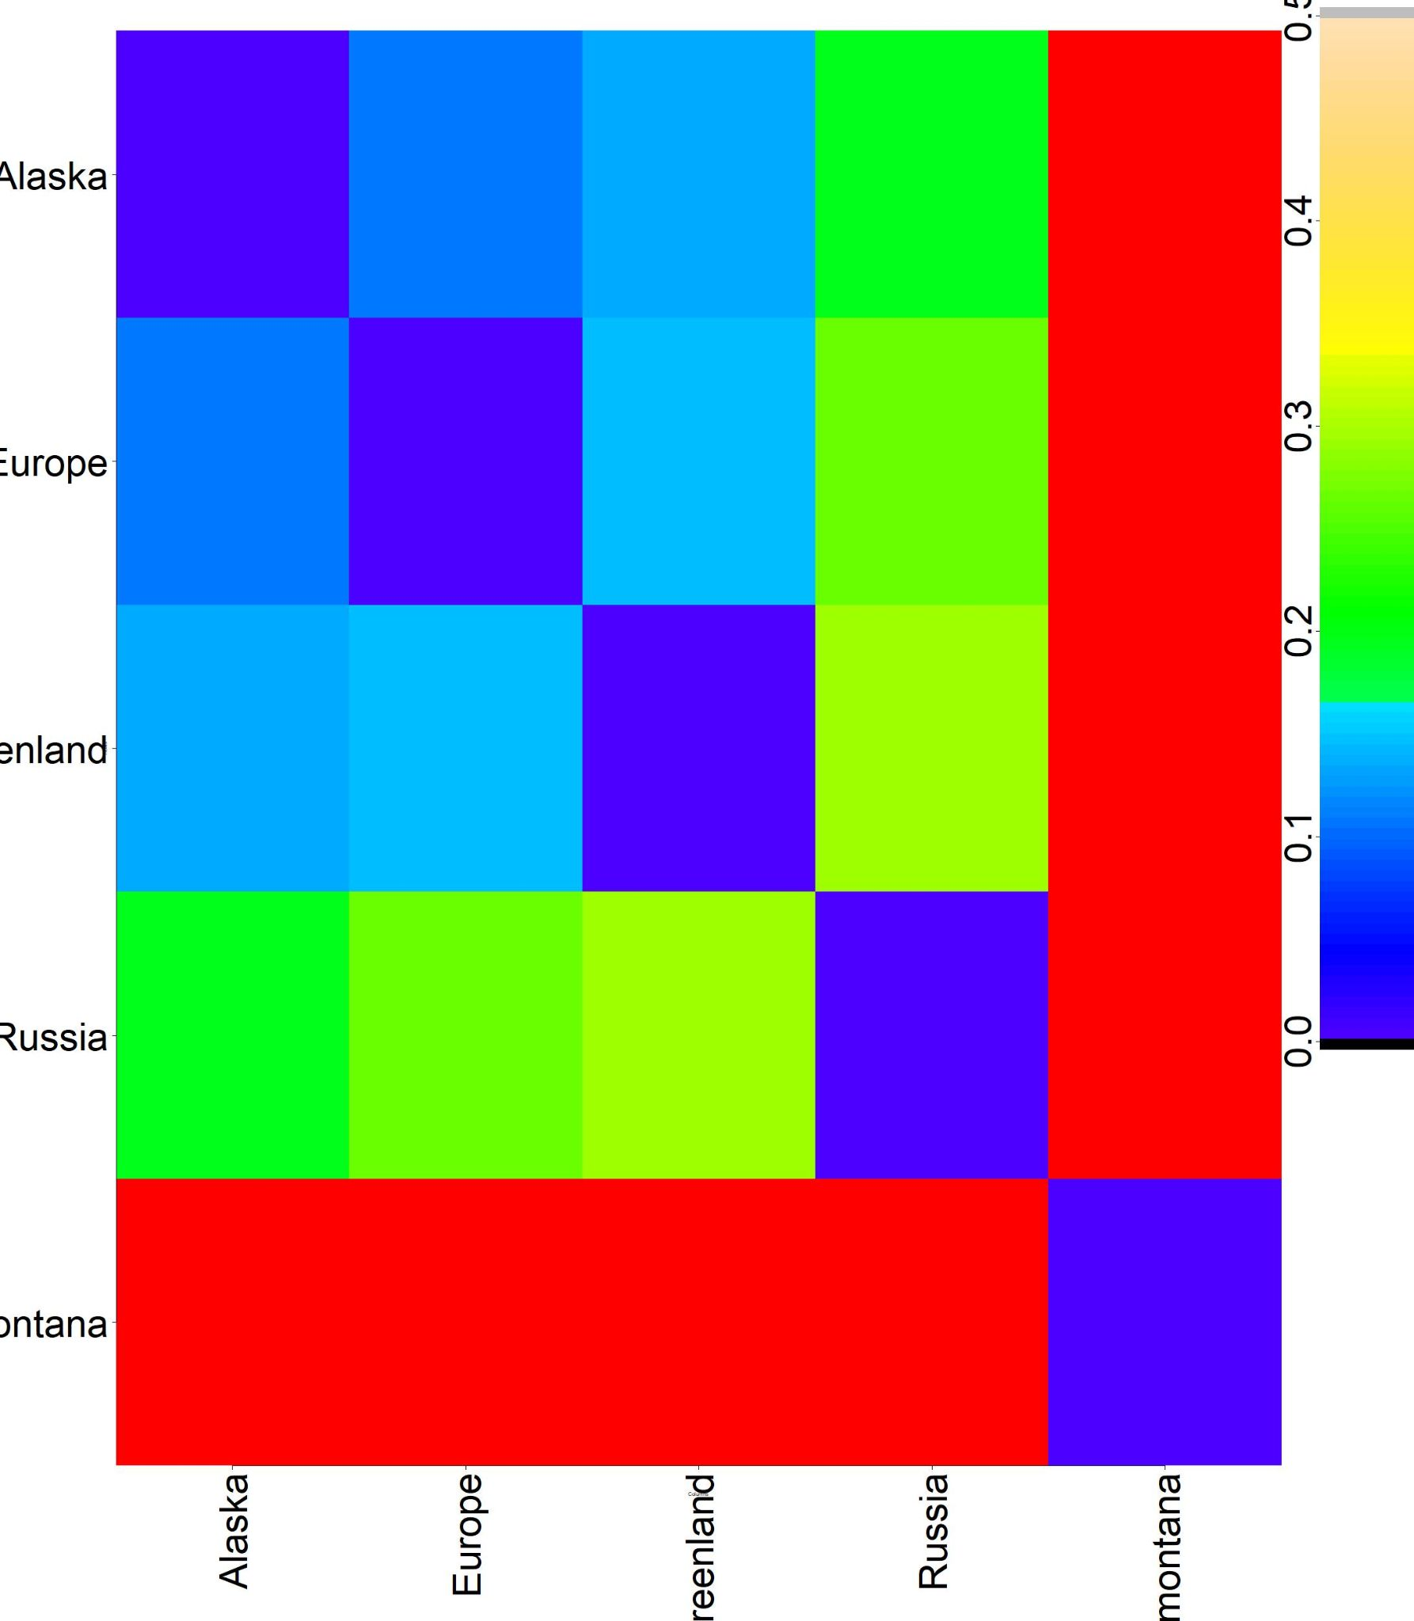
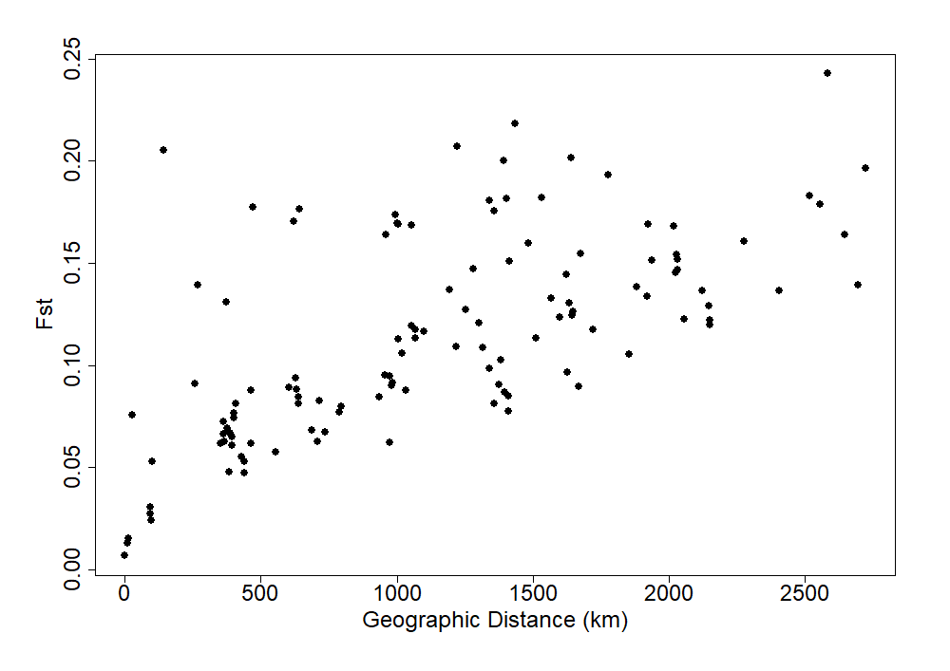
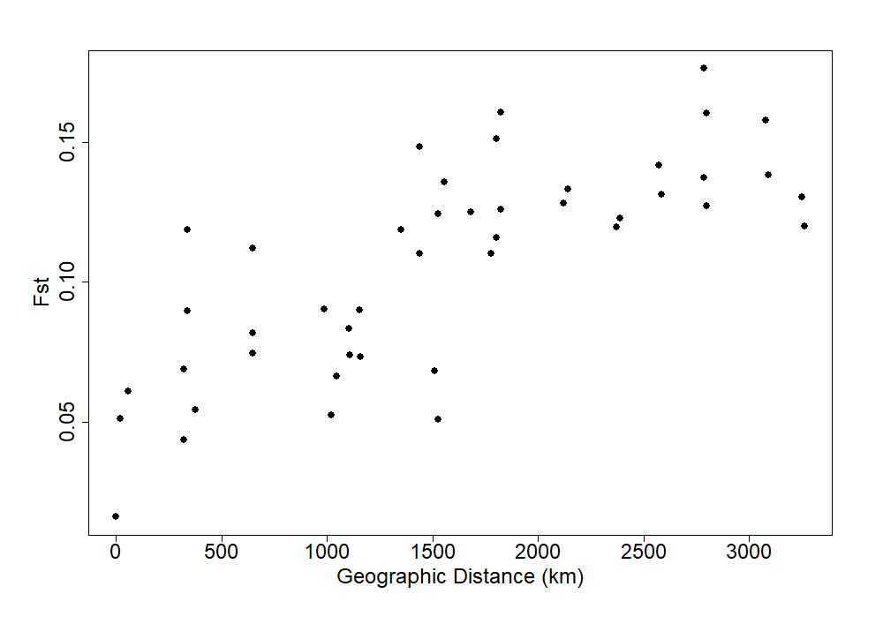
A.
Alaska
Europe
Greenland
Russia
Saximontana
Greenland
Saximontana
B. Alaska
C. Europe
Notes:
Admixture Fst and Mantel test

Slide 5
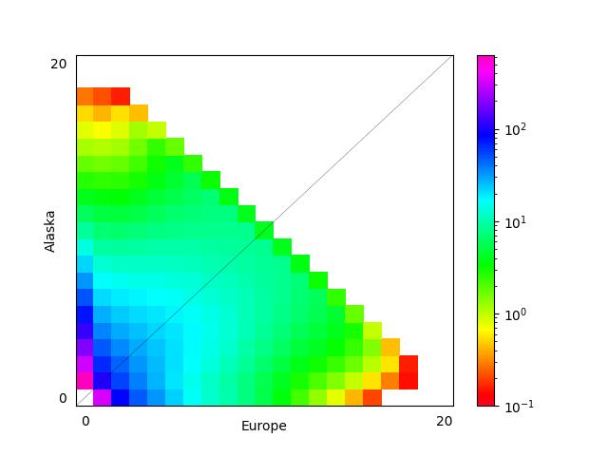
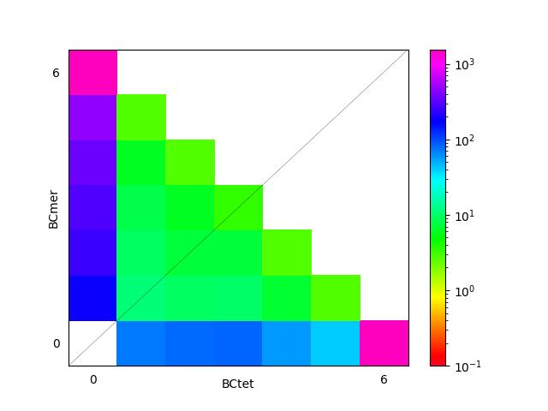
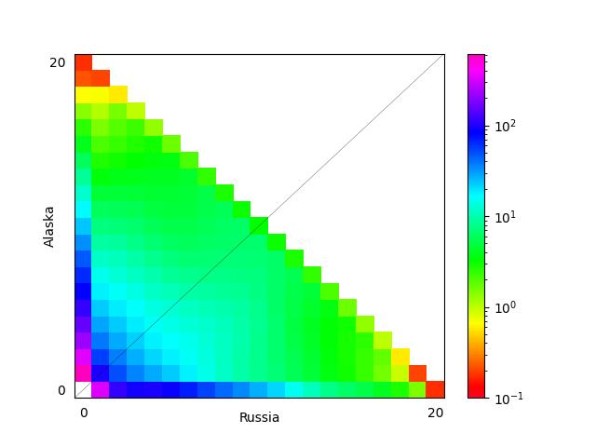
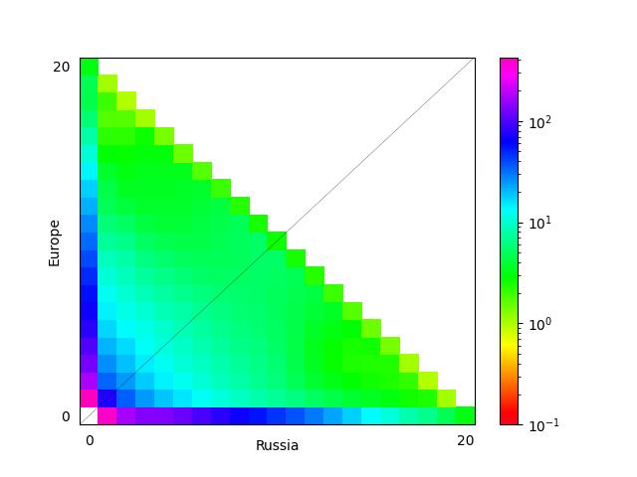
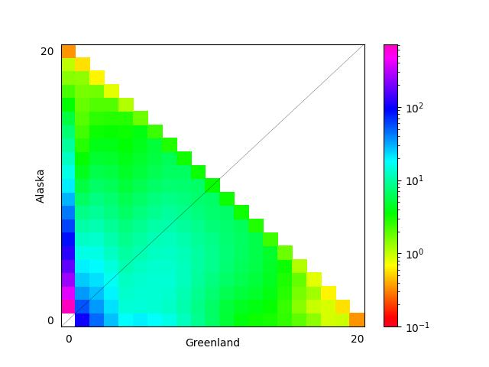
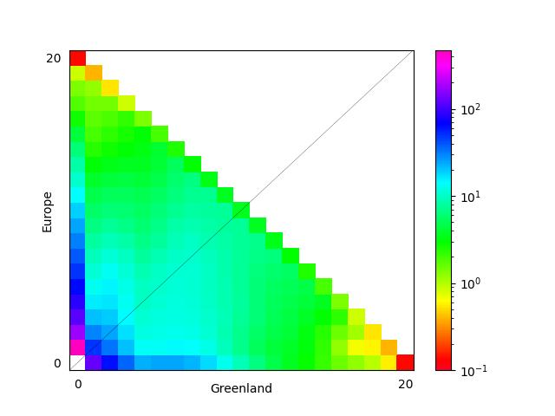
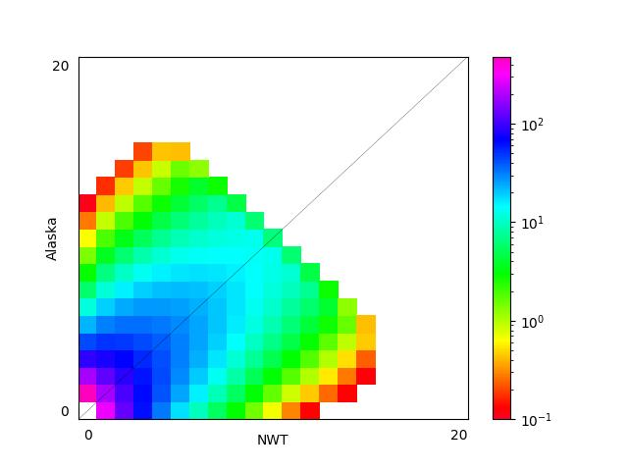
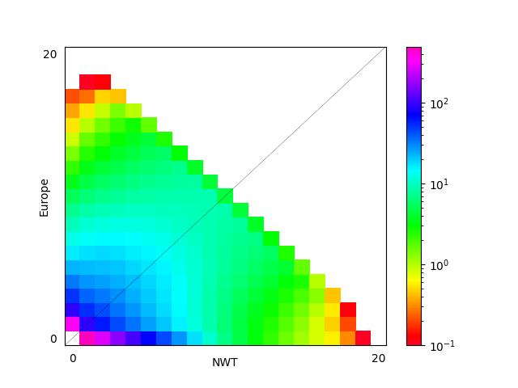
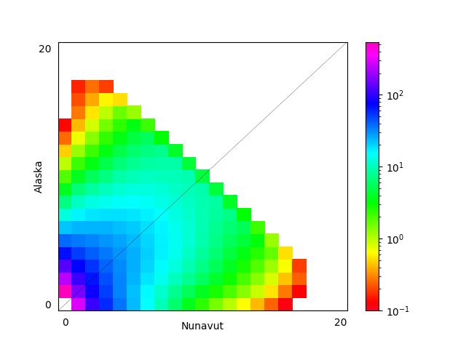
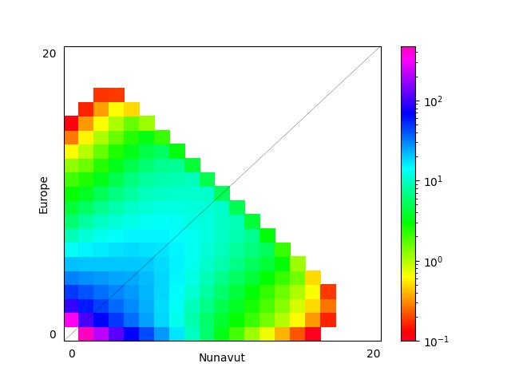
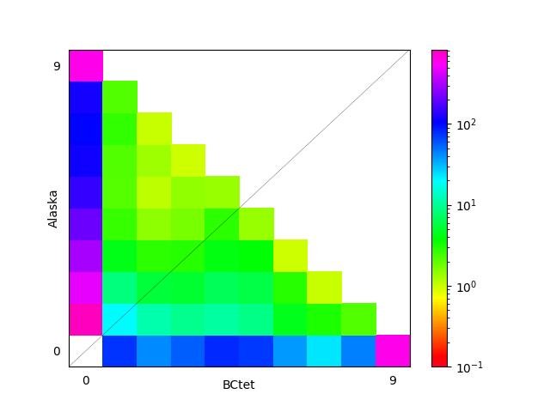
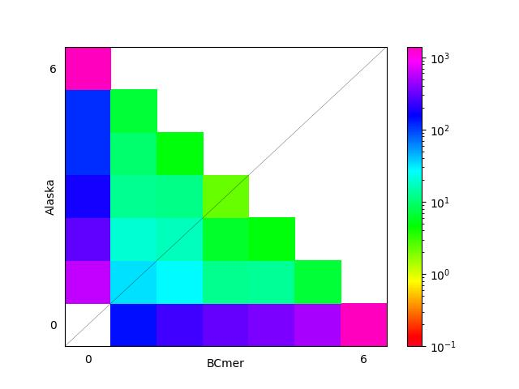
Notes:
Fig 3: Site Frequency Spectra (SFS) (A) 1D SFS(B) 2D SFS.

Slide 6
