Slide 1
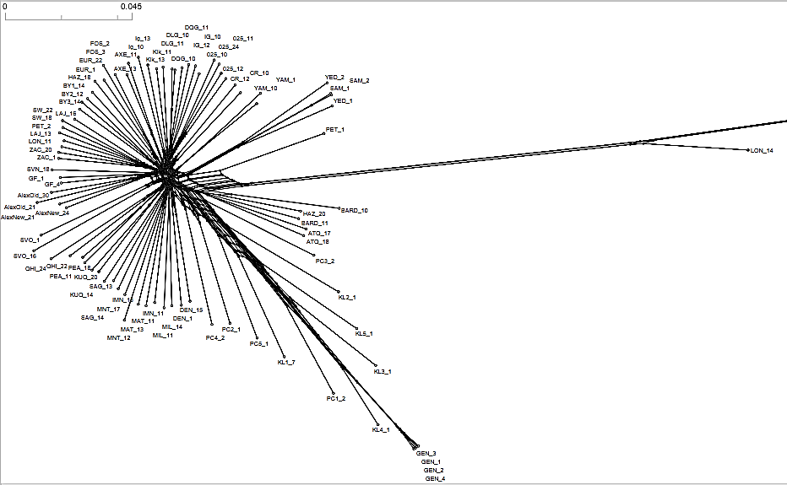
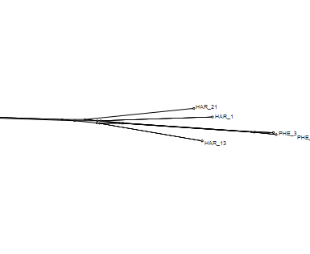
E.
Disko
Baffin
Europe
Russia
Outgroup
Ellesmere
NWT
Outgroup
C. mertensiana
Kluane
Alaska/Yukon
Gentian Peak
(ssp. saximontana)

Slide 2
E.
Disko
Baffin
Europe
Russia
Outgroup
Ellesmere
NWT
Outgroup
C. mertensiana
Kluane
Alaska/Yukon
Gentian Peak
(ssp. saximontana)

Slide 3
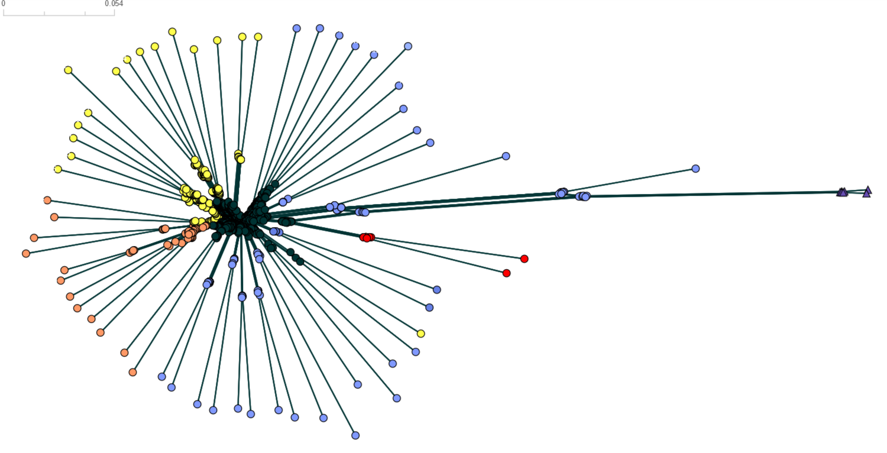
Ellesmere
Alaska
Europe
Kluane Lake hybrids
Subspecies saximontana
Baffin
Russia
Greenland
Alaska
NWT

