Slide 1
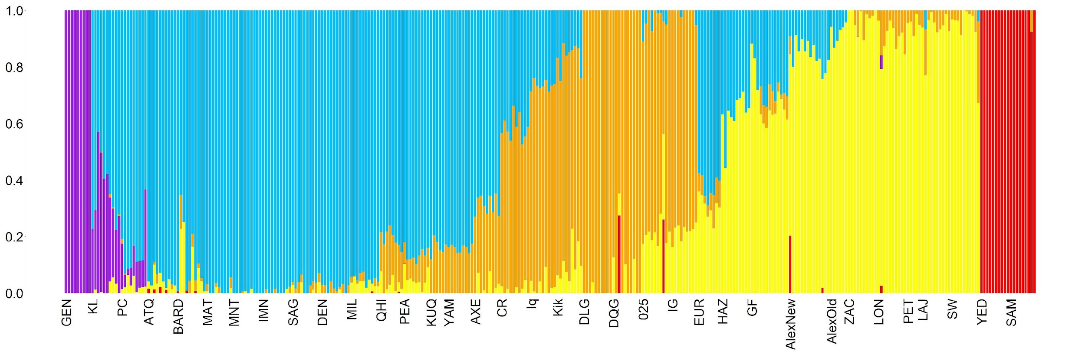
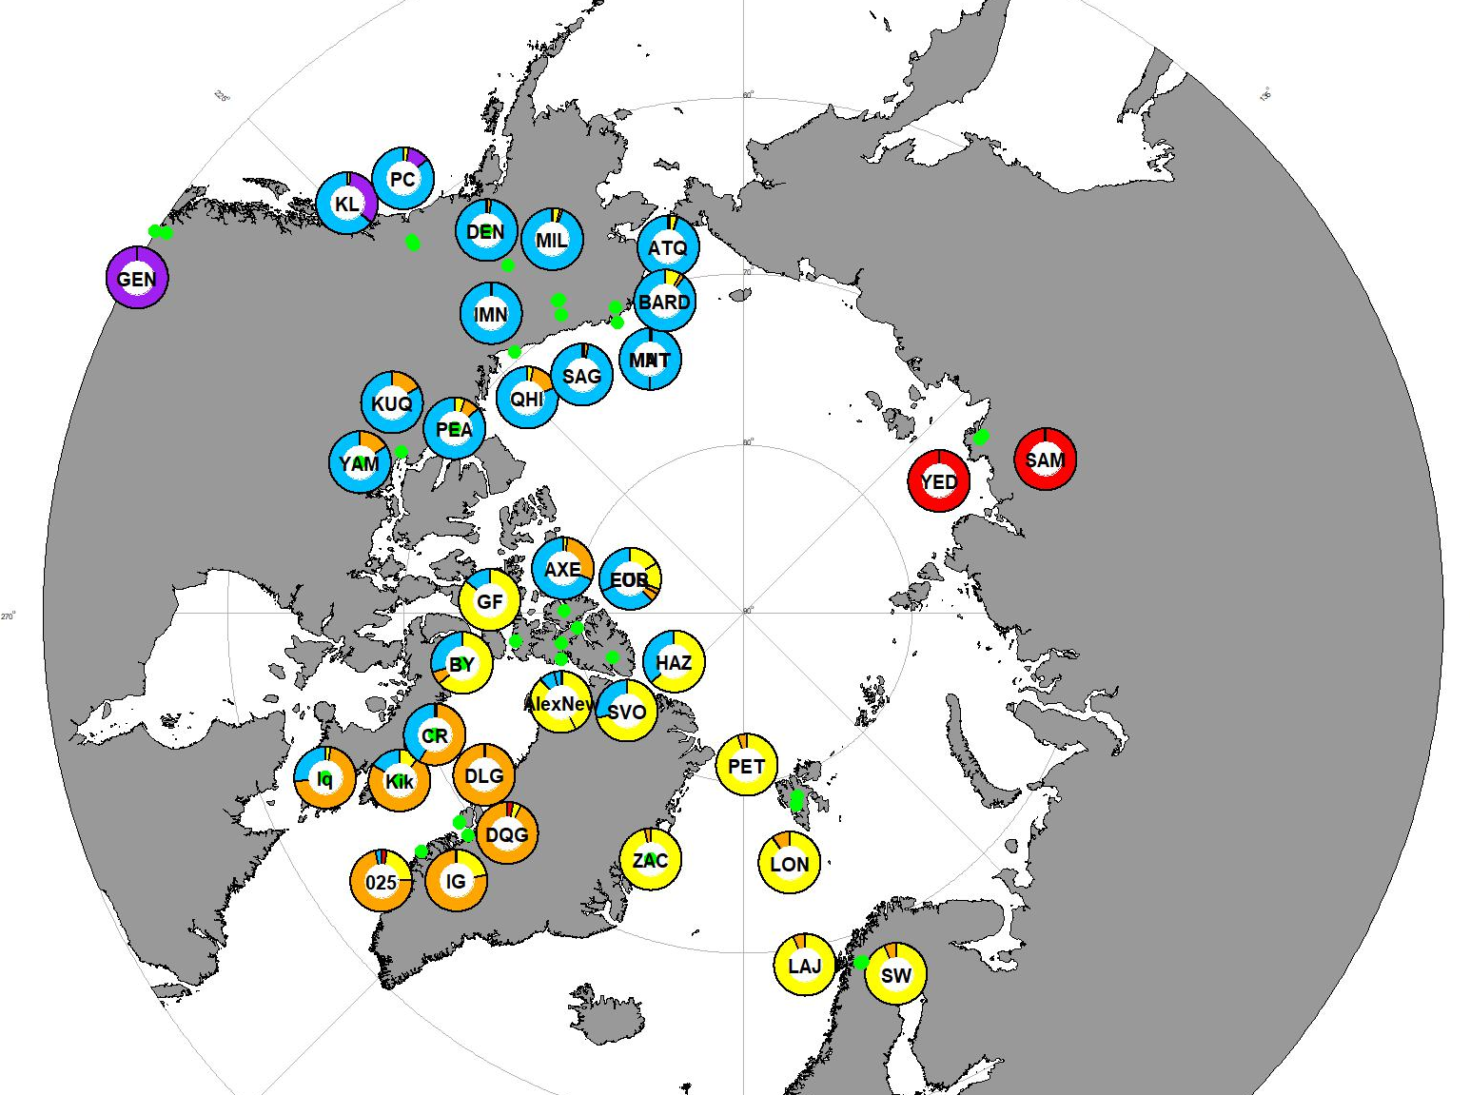
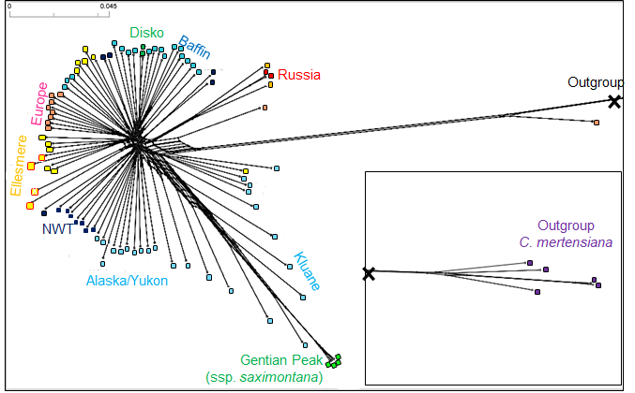
A.
Ssp. saximontana
ADMIXTURE proportion
BC
Kluane
Alaska/Yukon
NWT
Greenland/Baffin
Ellesmere
Europe
Russia
B.
Kluane
Beringia
BC
Alaska
NWT
Russia
Ellesmere
Baffin
Svalbard
Greenland
C.
Sweden

Slide 2
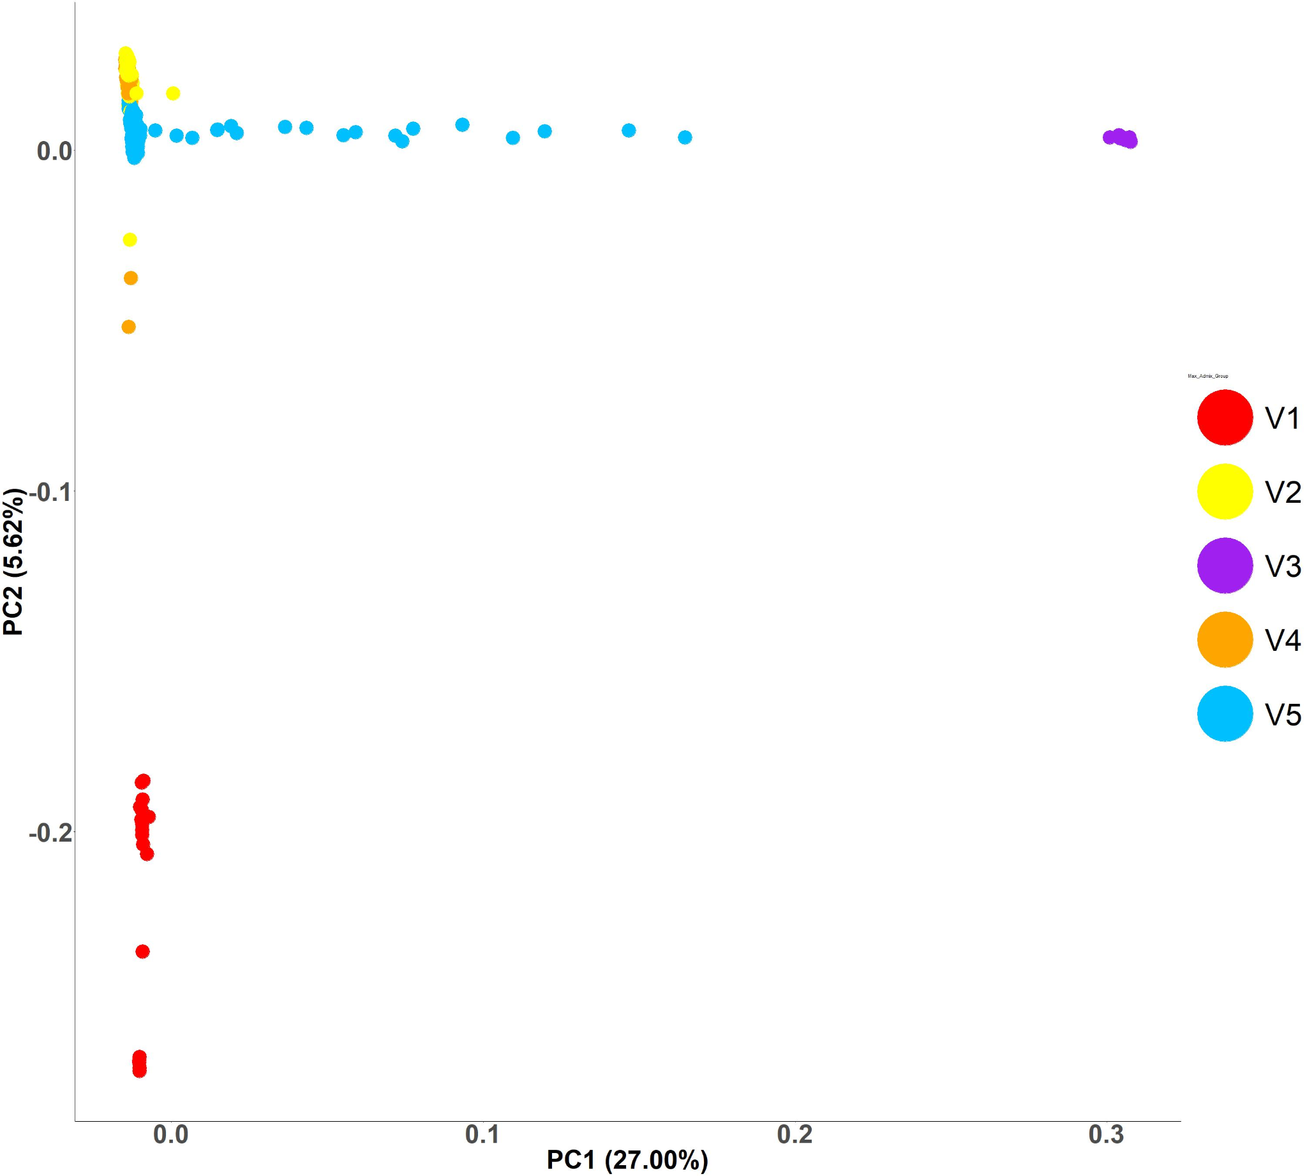
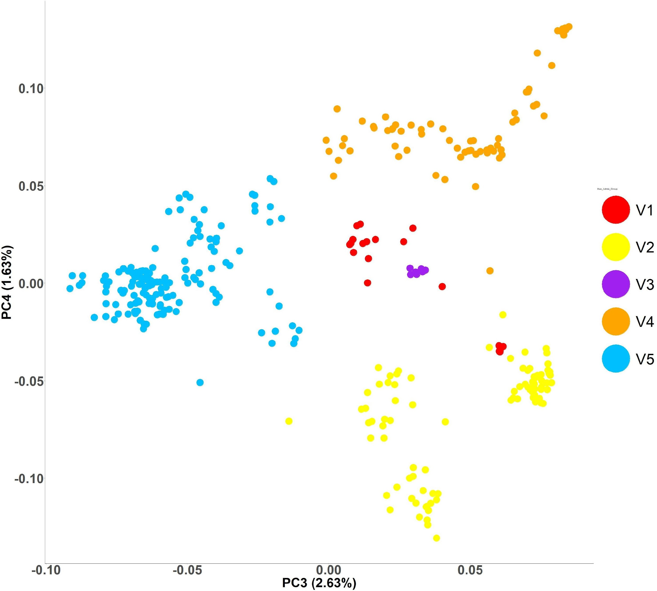
A.
Europe
Kluane Lake hybrids
Alaska
spp. saximontana
Russia
Europe
Russia
spp. saximontana
Greenland
Alaska
B.
Russia
Europe
spp. saximontana
Greenland
Greenland
Alaska
Russia
Alaska
spp. saximontana
Europe
Notes:
PCA

Slide 3
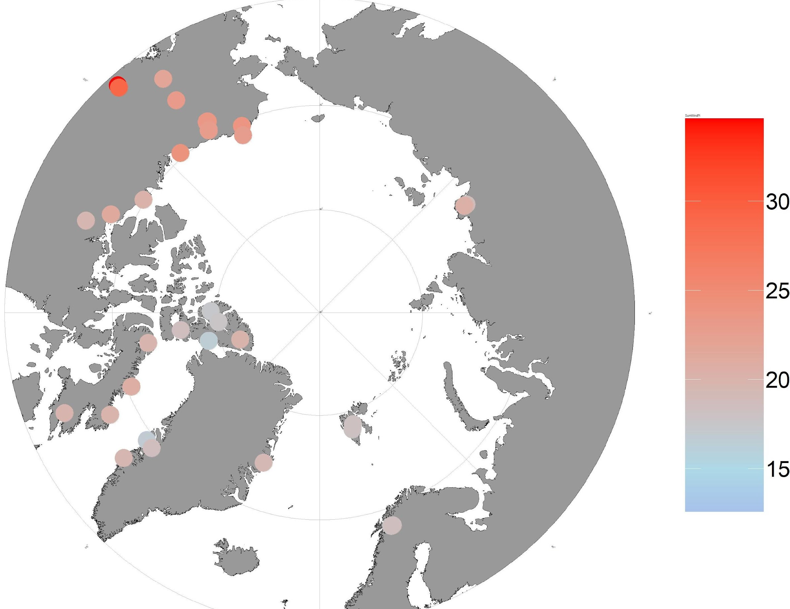
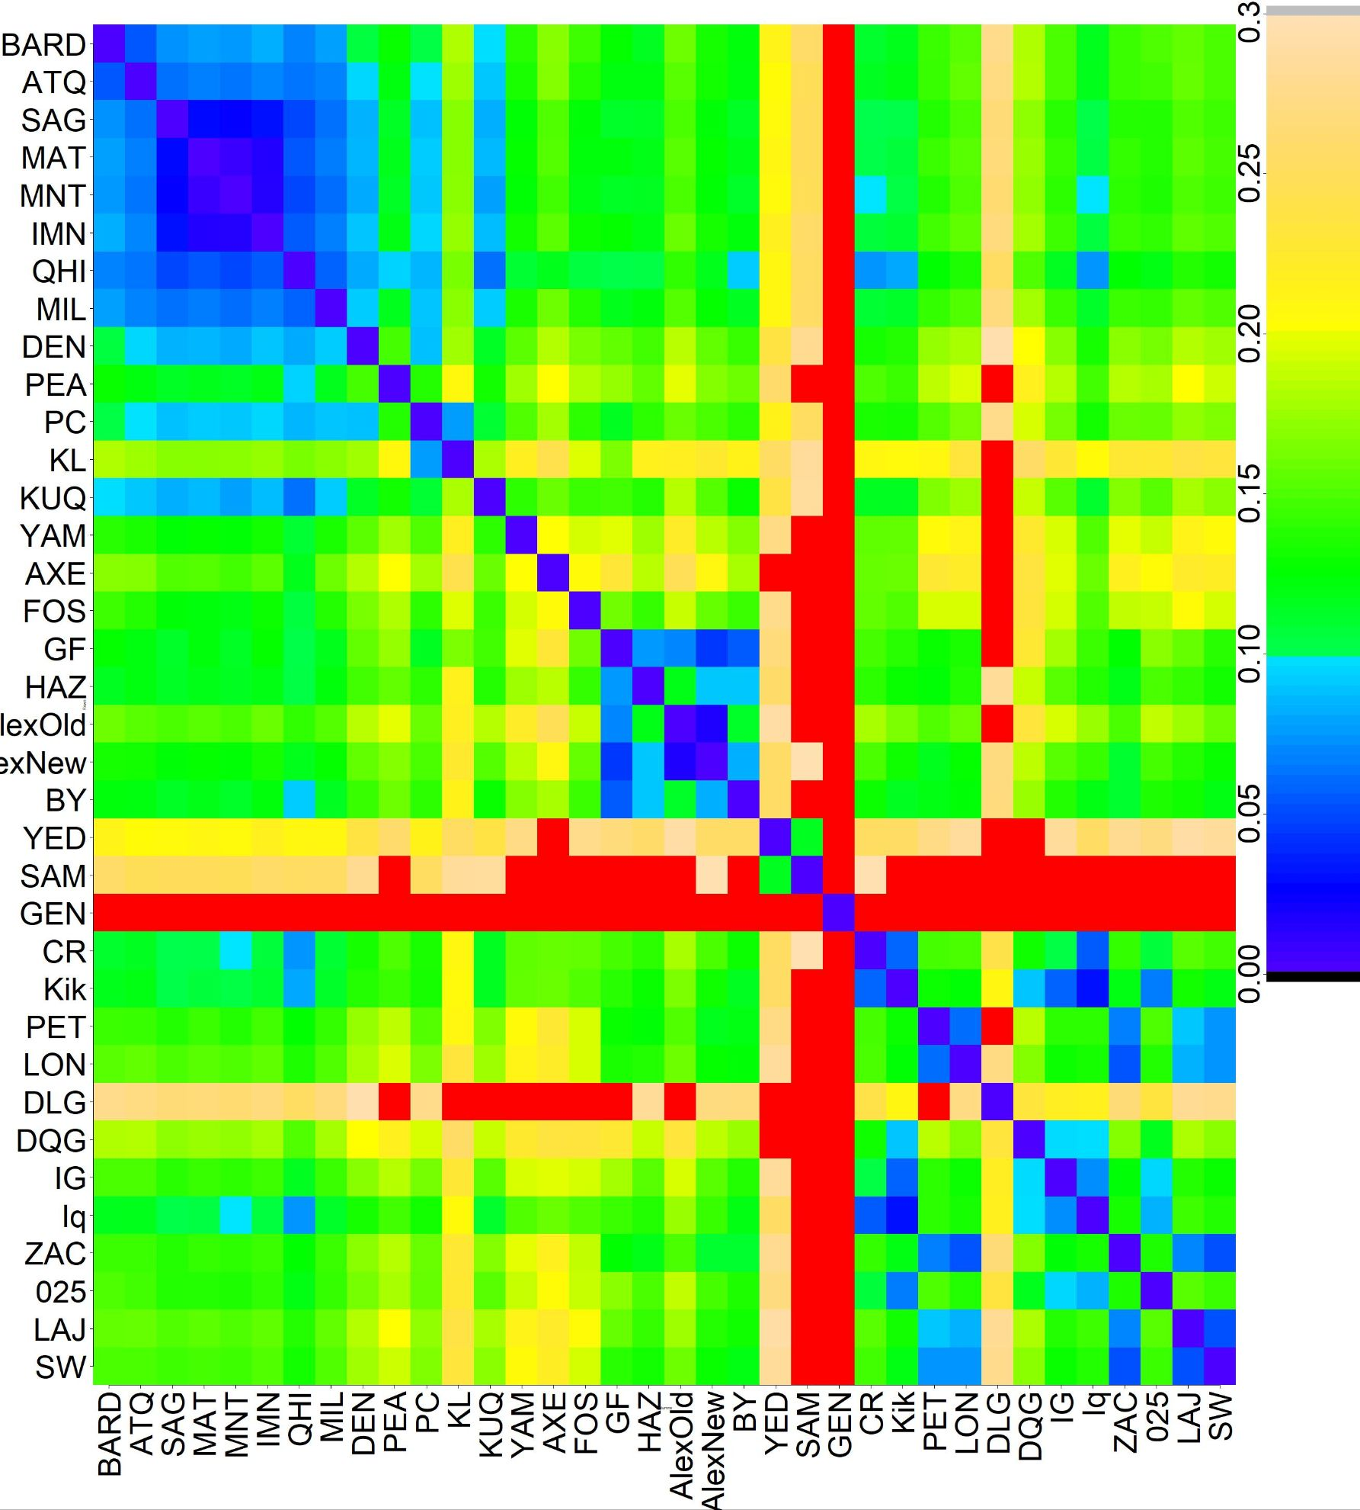

A.
Nucleotide diversity
B.
Baffin
Greenland/Europe
NWT
Ellesmere
BC
Alaska/Yukon
Russia
Disko
Svalbard

Slide 4
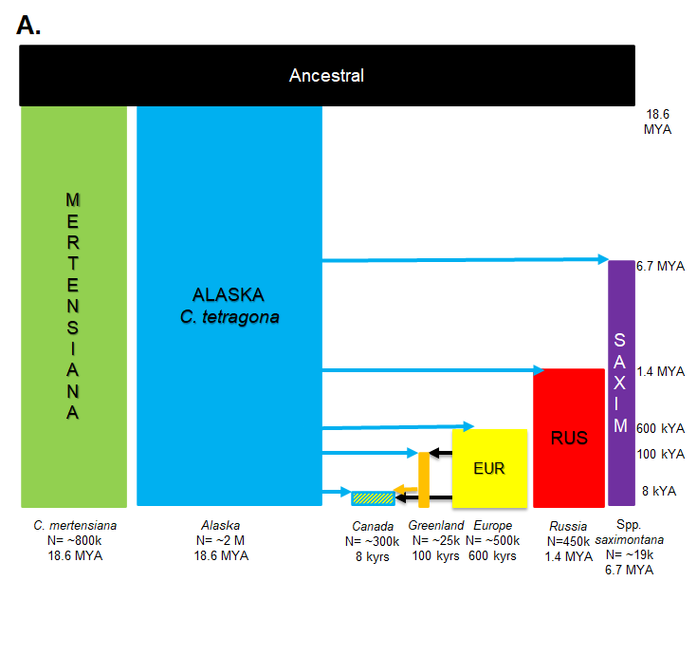
Notes:
Fig 3: Demography figures (see Table XX for model details). (A) Model diagram showing longer time scales from 18.6MYA. (B) .

Slide 5
