Slide 1
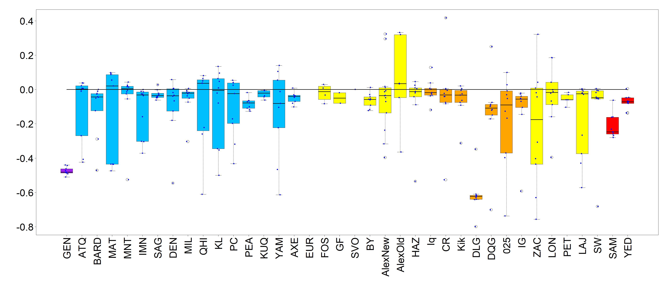
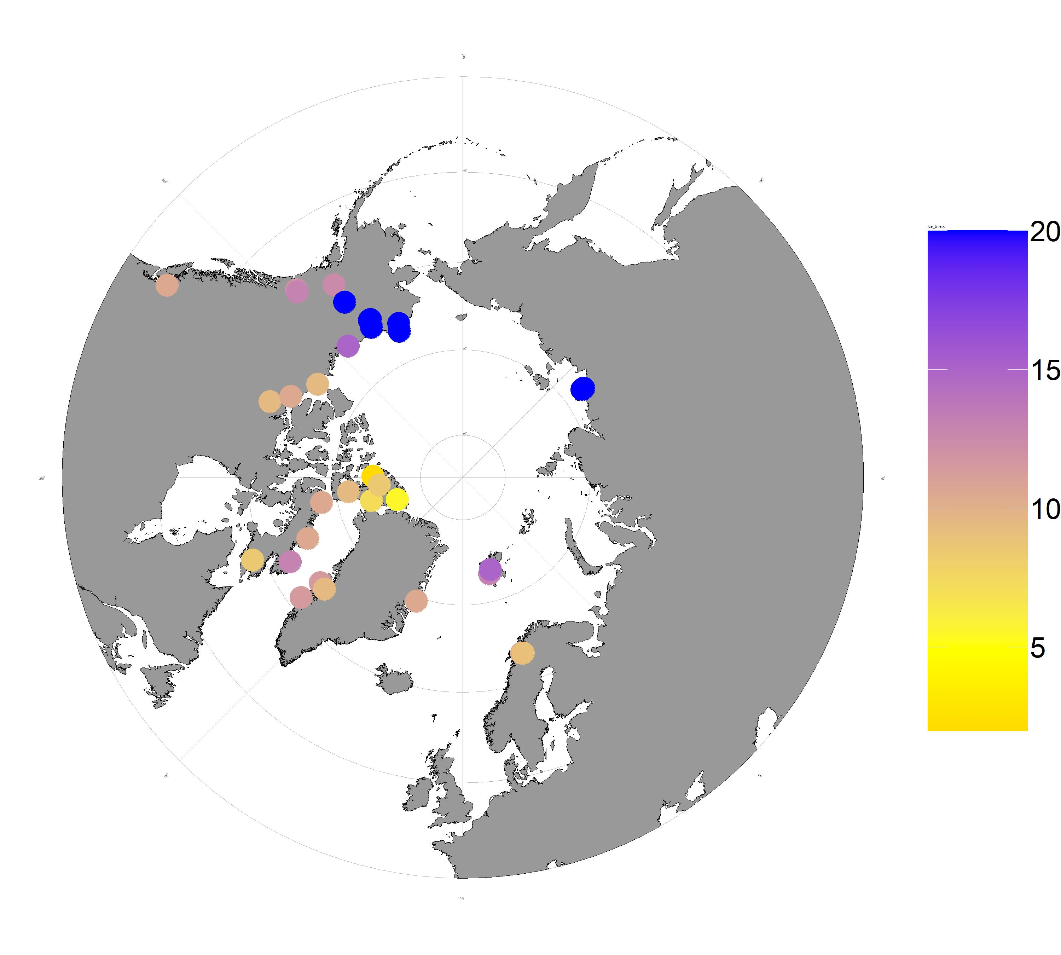
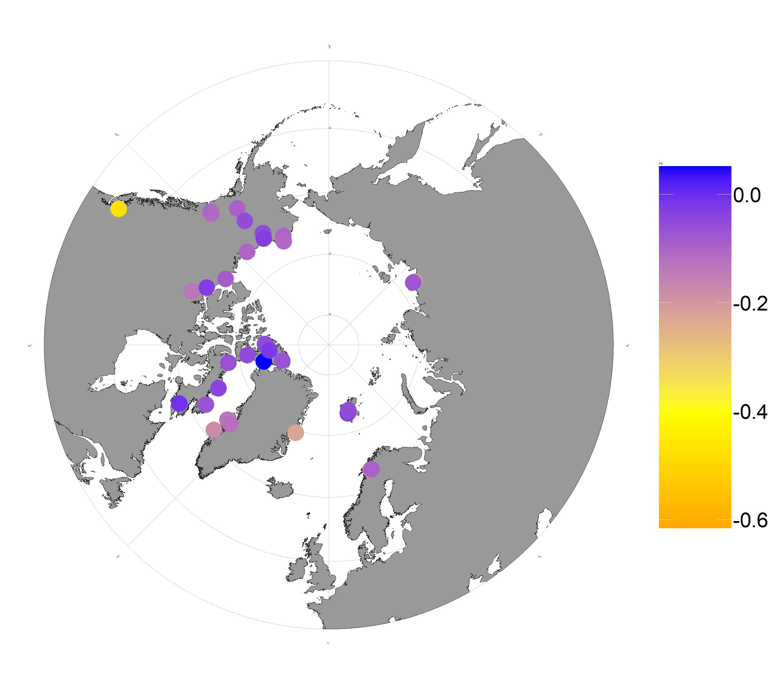
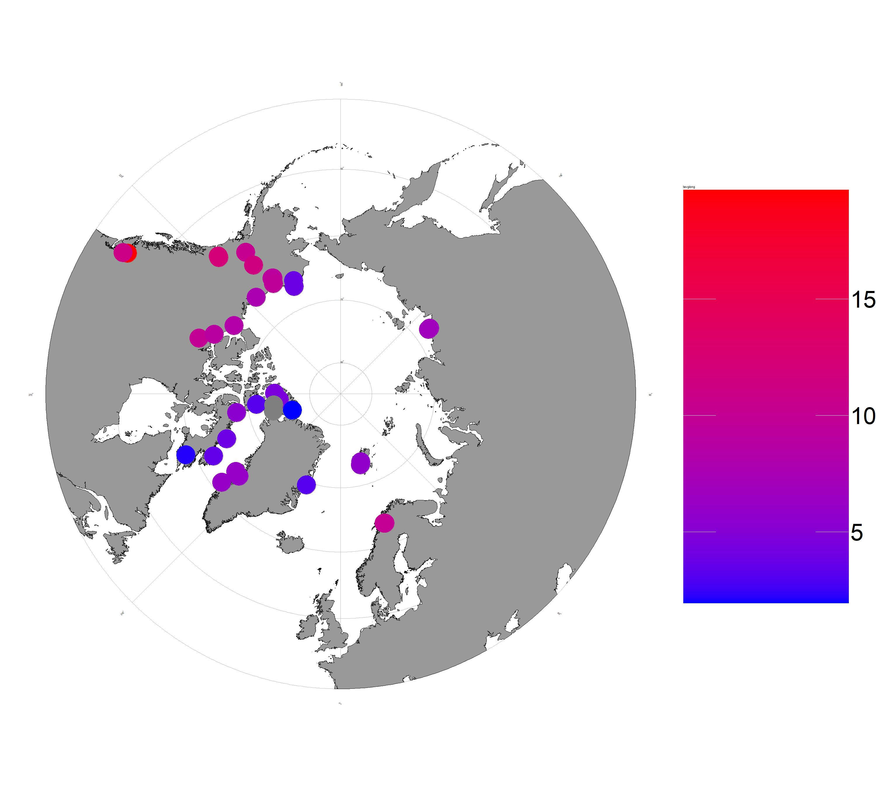

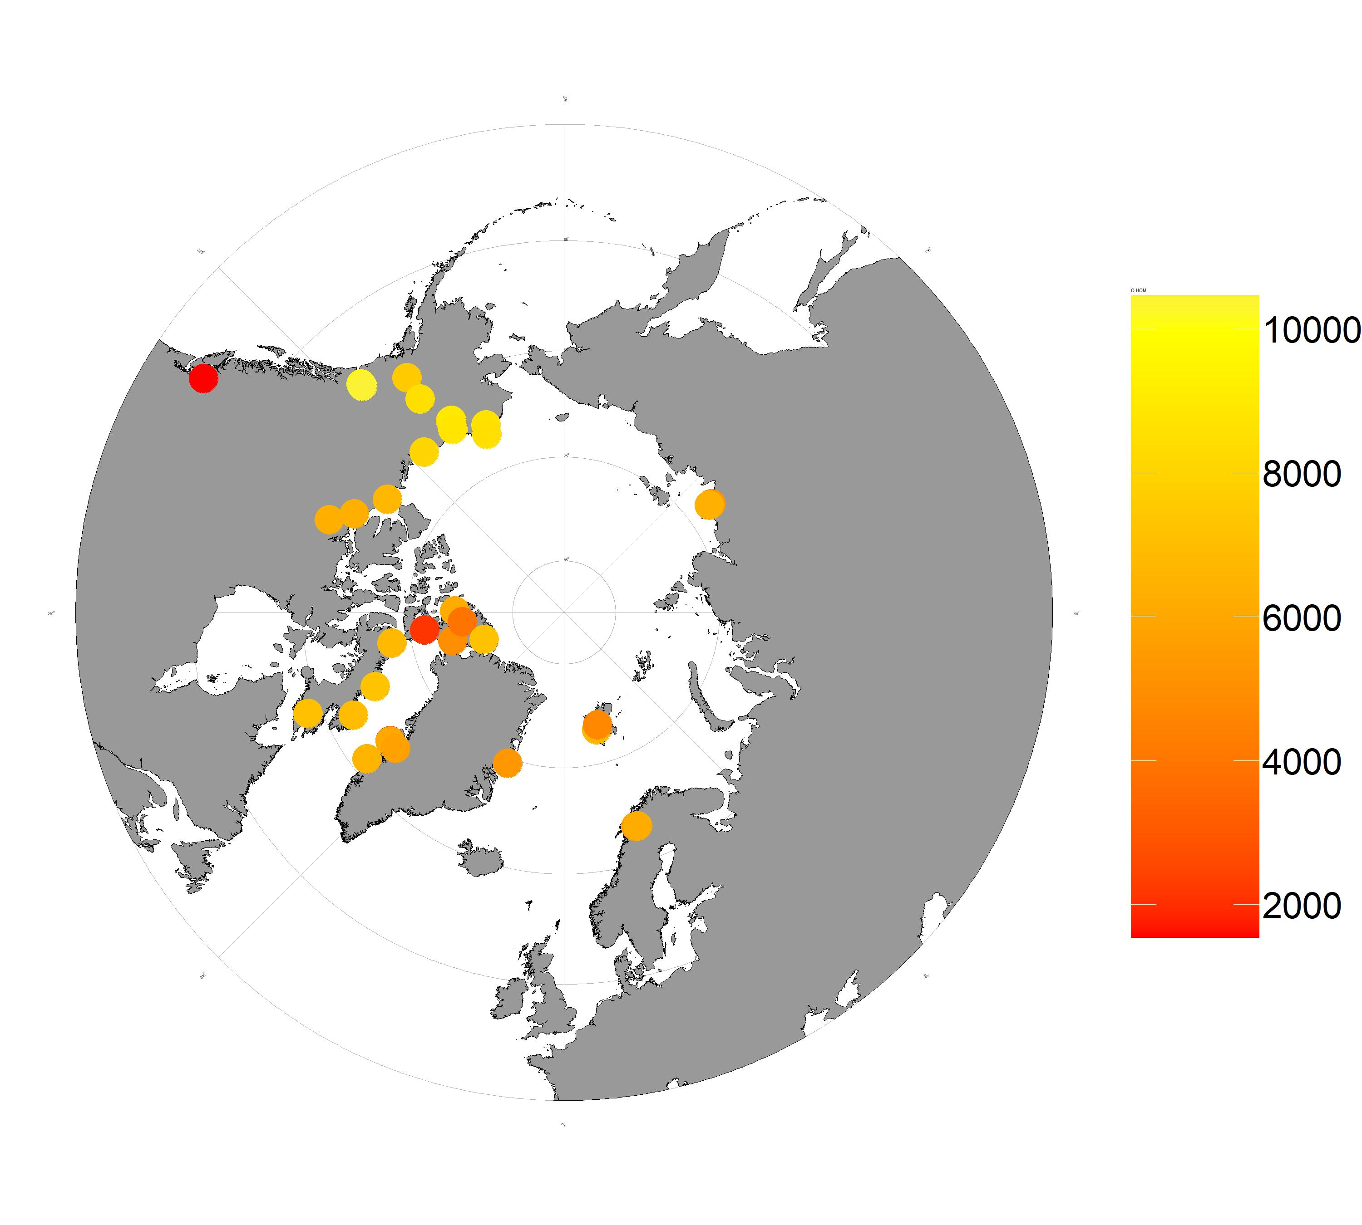
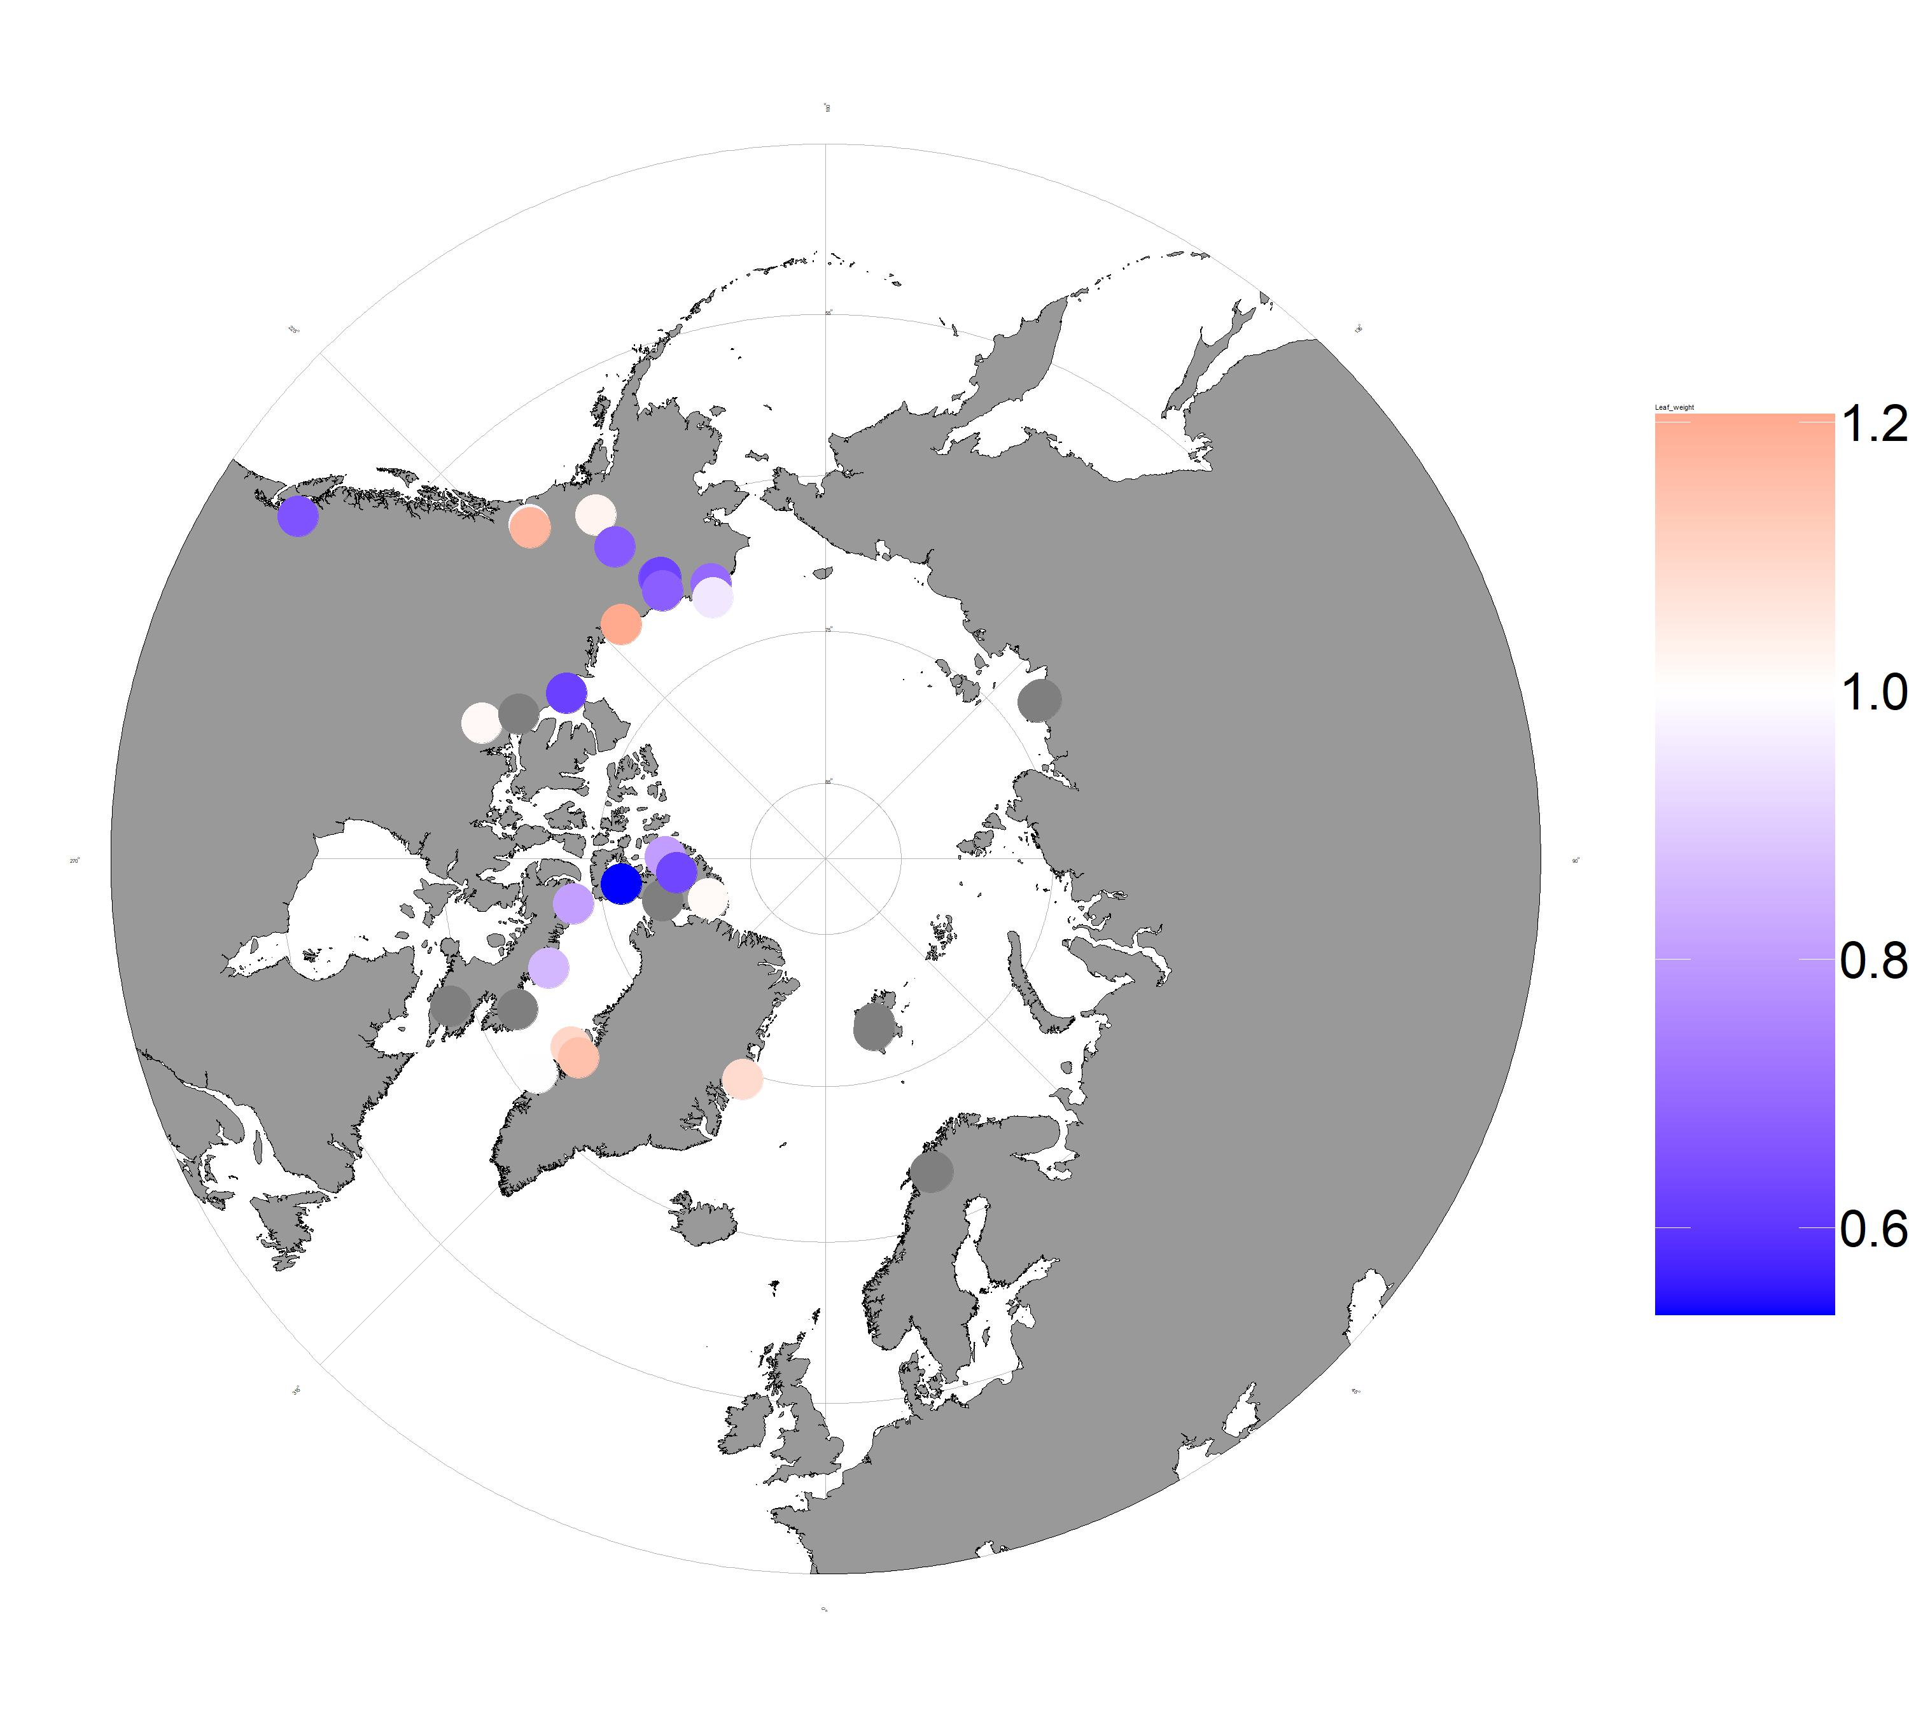
Alaska/Yukon
Ellesmere
Greenland
Europe
Russia
Gentian Peak
C. tetragona spp. saximontana
Disko (DLG)
A. Dates of Glacial Retreat (kyrs before present)
B. Inbreeding Coefficient
C. Summer Temperature
D. Summer Precipitation
D. Observed Homozygosity
D. Leaf Weights (mg)
Notes:
Popstats

Slide 2
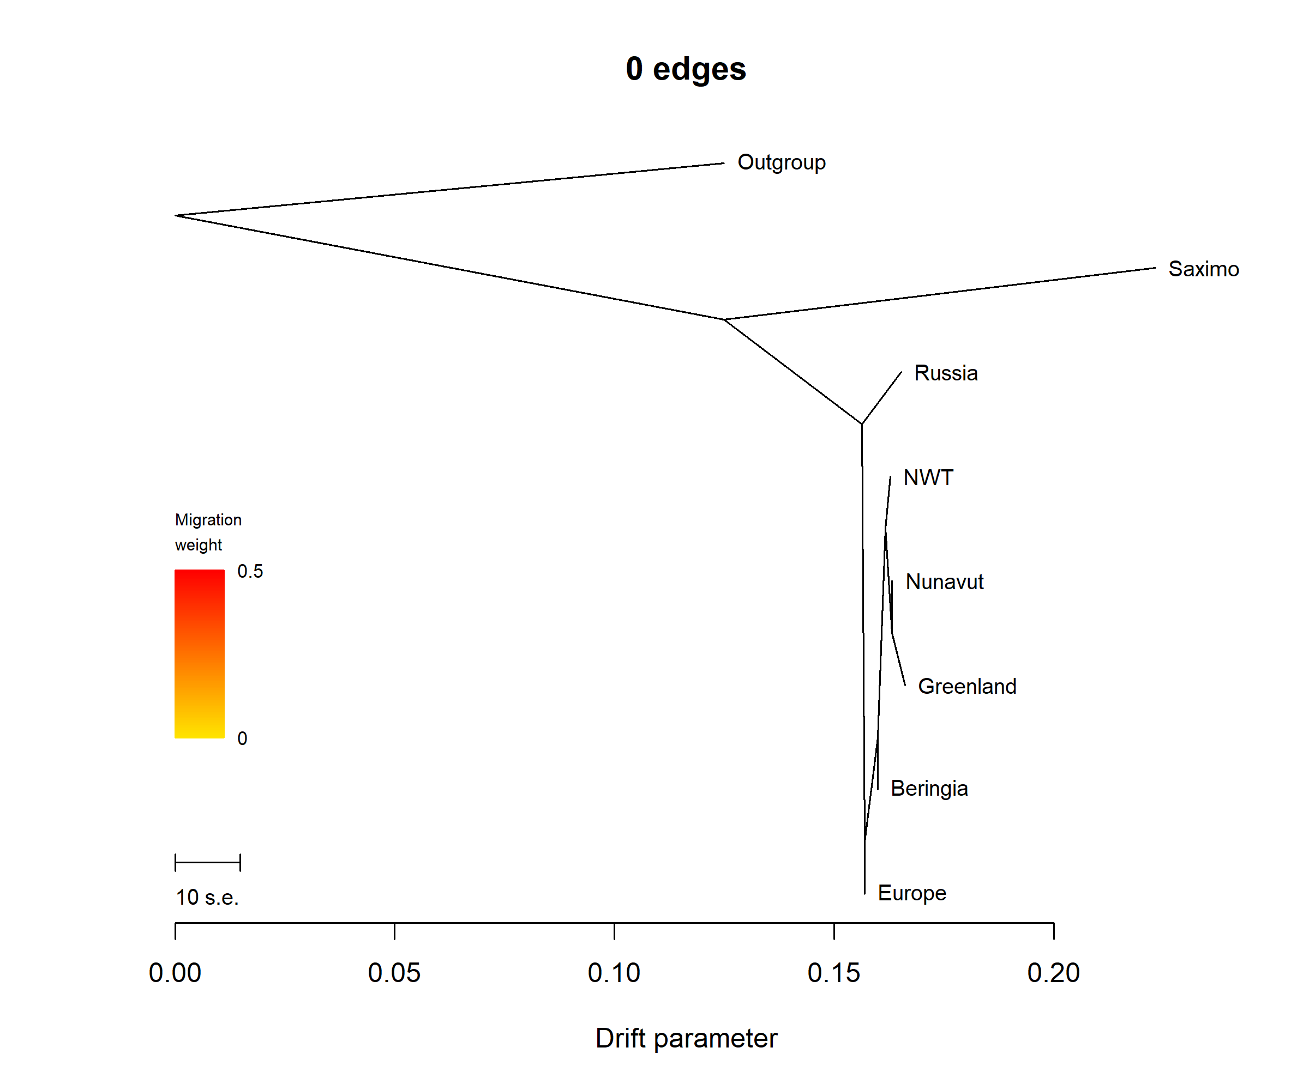
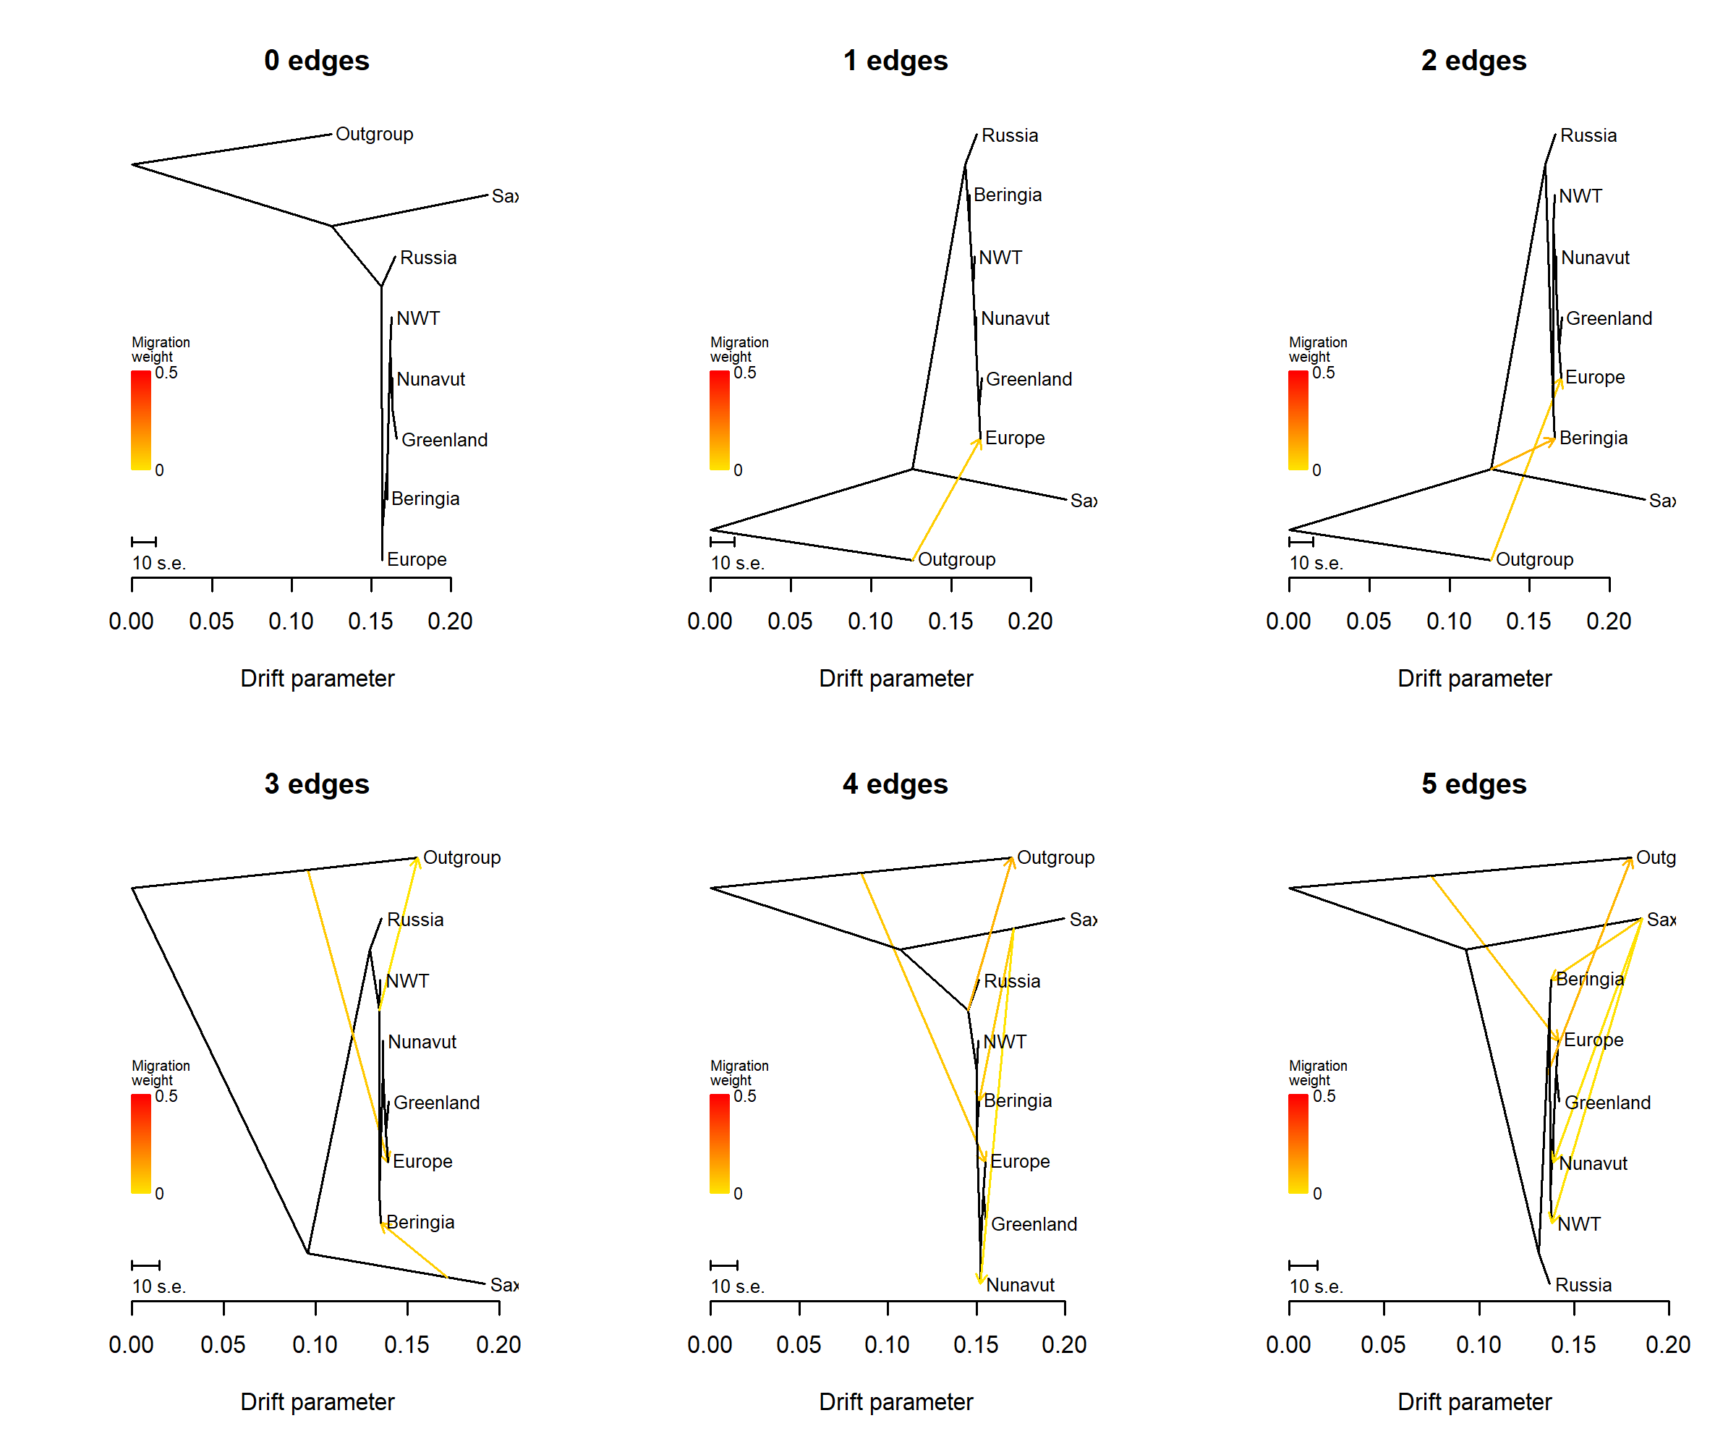
Notes:
Treemix

Slide 3
P1 = Ancient
P2 = Present
P3
Outgroup
B
B
A
A
No Gene Flow - P1 and P2 share derived allele B
A
B
B
A
P2 and P3 share derived allele B implying gene flow
B
A
B
A
P1 and P3 share derived allele B implying gene flow
Notes:
ABBA BABA

Slide 4
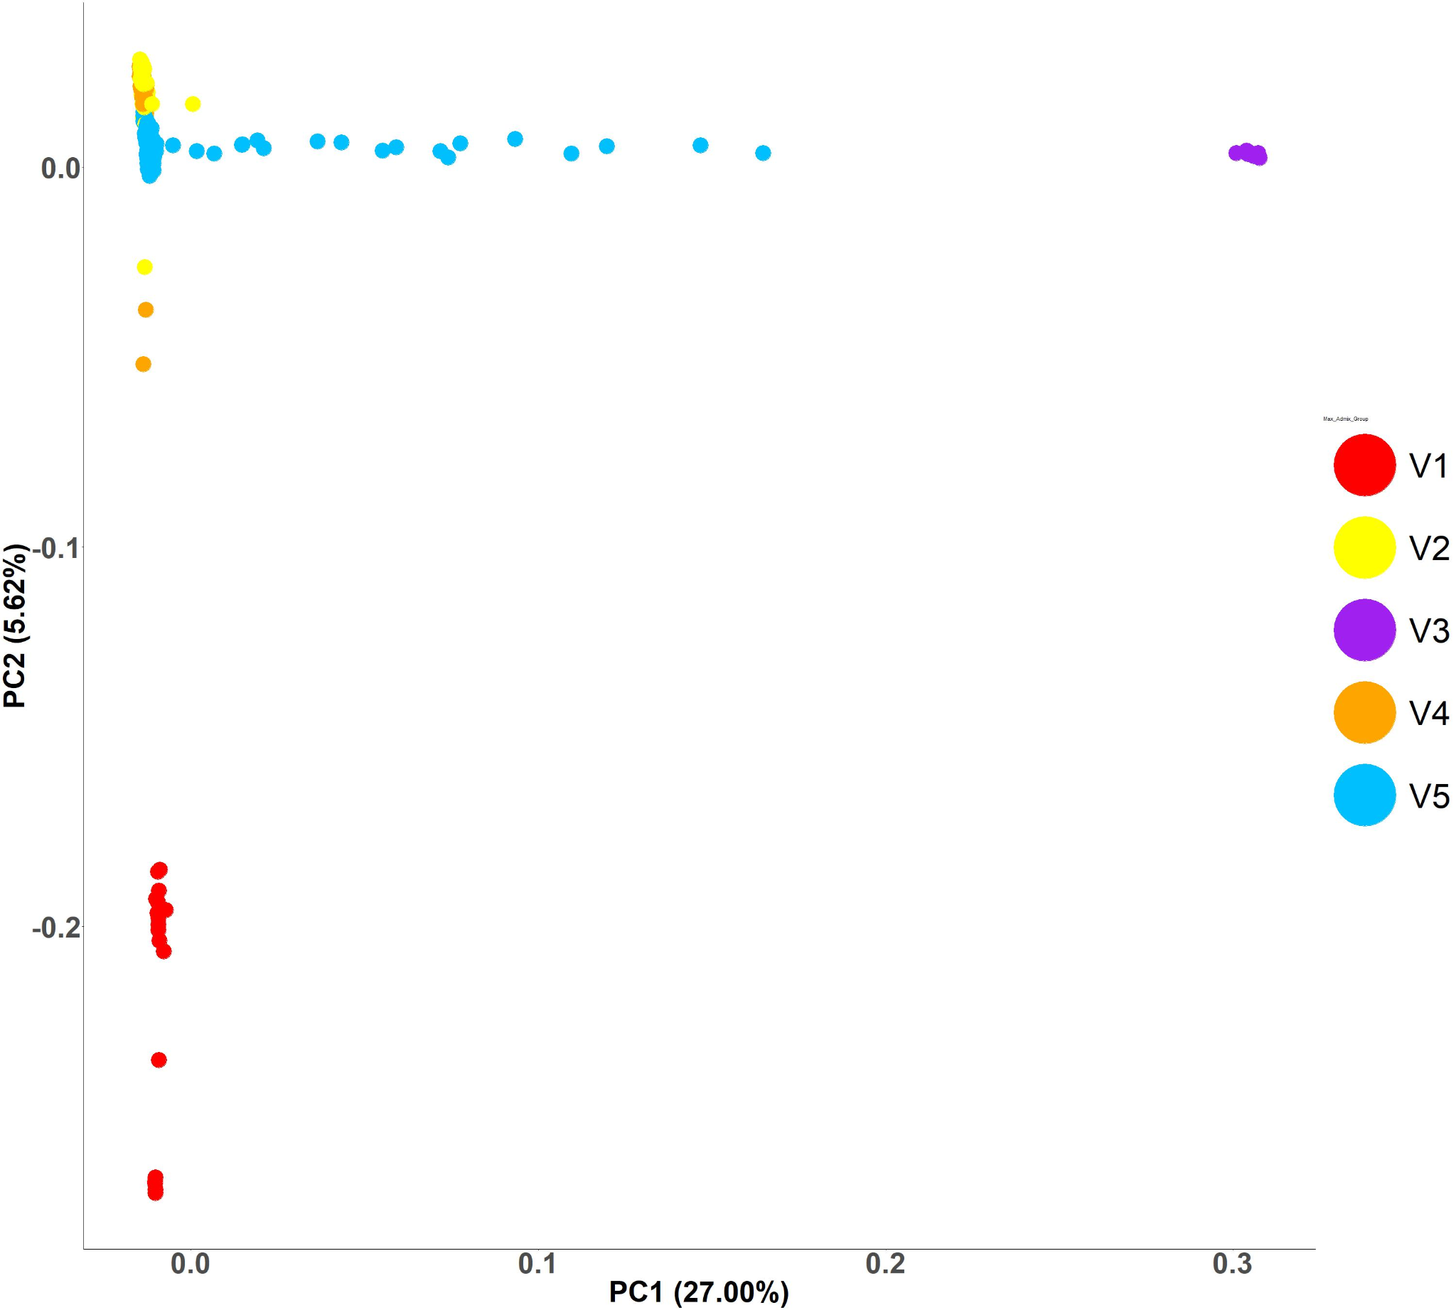
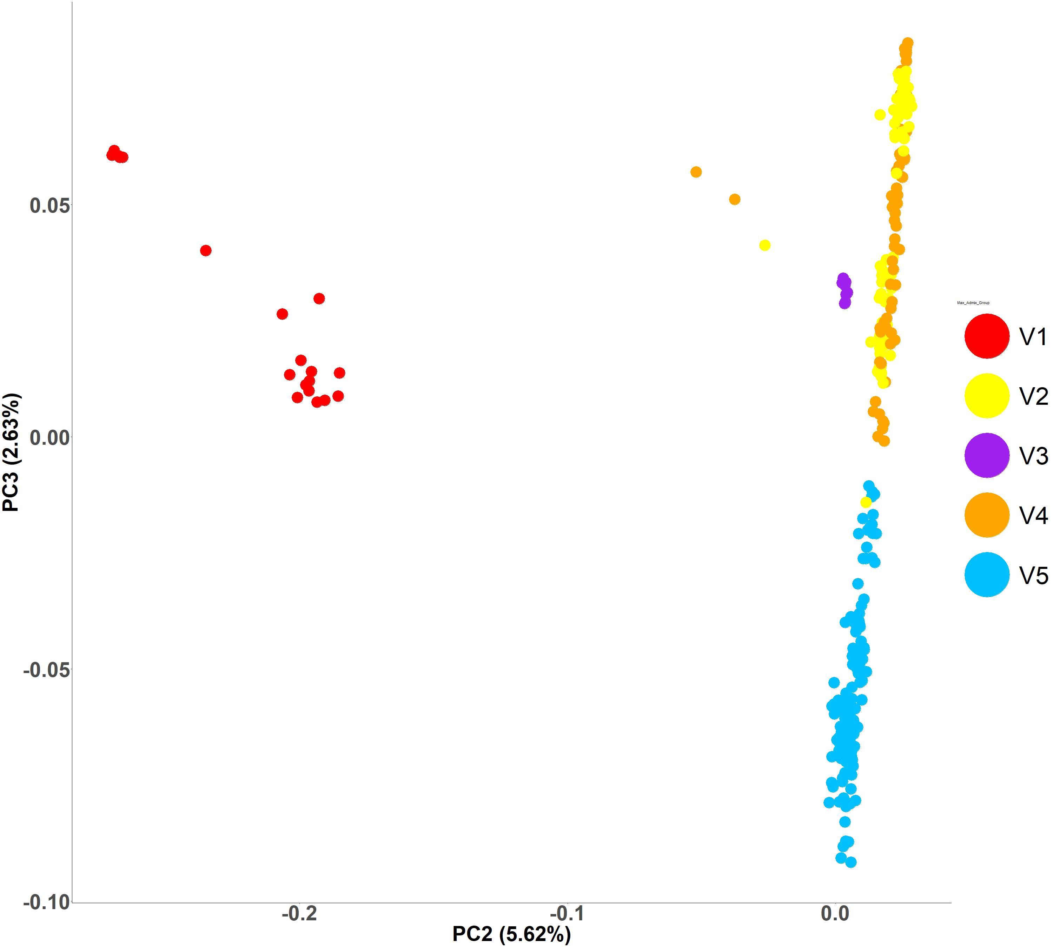
A.
Europe
Kluane Lake hybrids
Alaska
spp. saximontana
Russia
Europe
Russia
spp. saximontana
Greenland
Alaska
B.
Europe/Greenland
Russia
spp. saximontana
Russia
Europe
spp. saximontana
Alaska/Yukon
Greenland
Alaska
Notes:
PCA

Slide 5
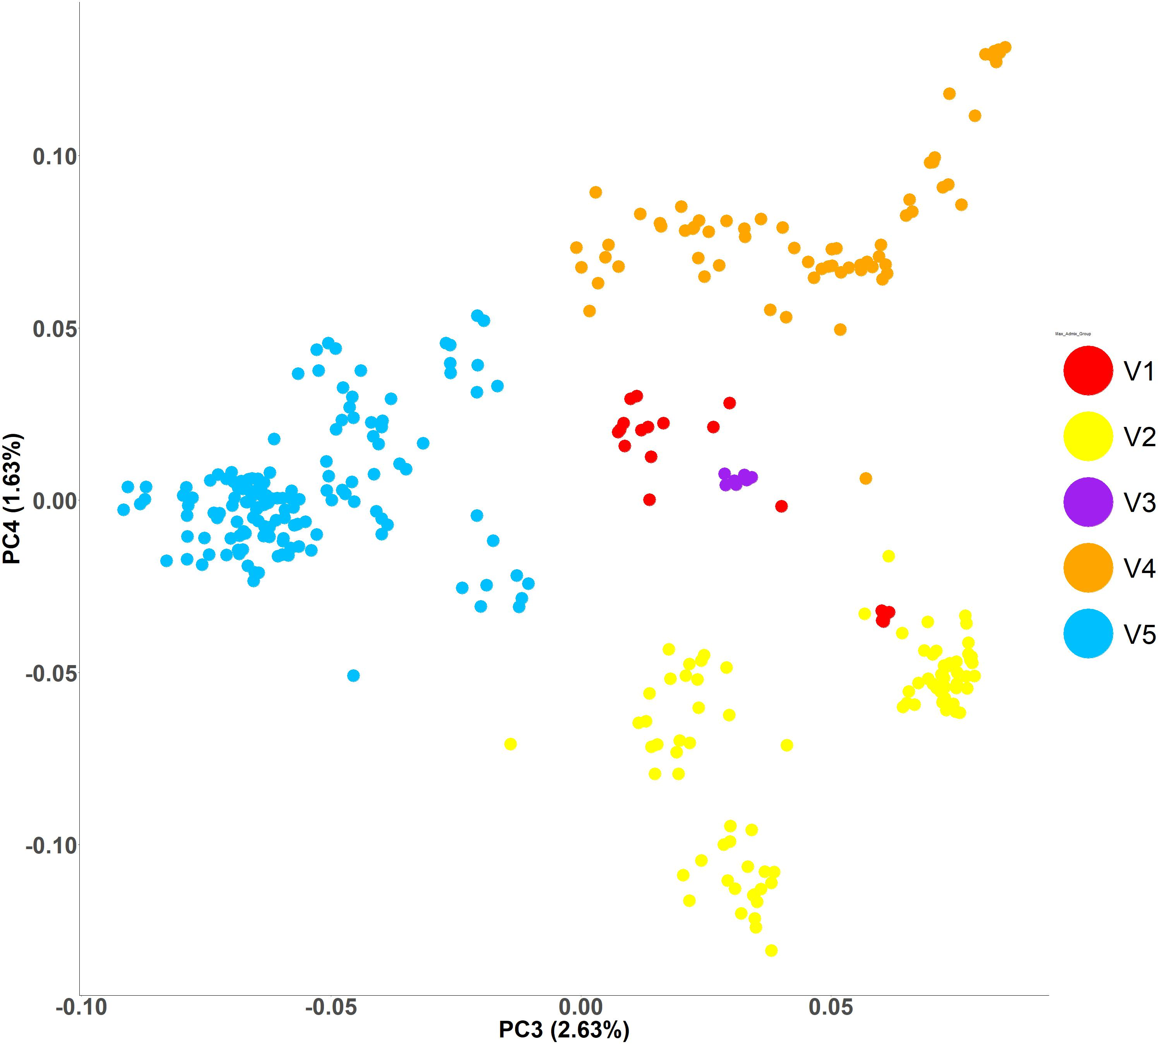
C.
Russia
Europe
spp. saximontana
Greenland
Greenland
Alaska
Russia
Alaska
spp. saximontana
Europe
.
Notes:
PCA

Slide 6
Notes:
Admixture Fst and Mantel test

