Slide 1
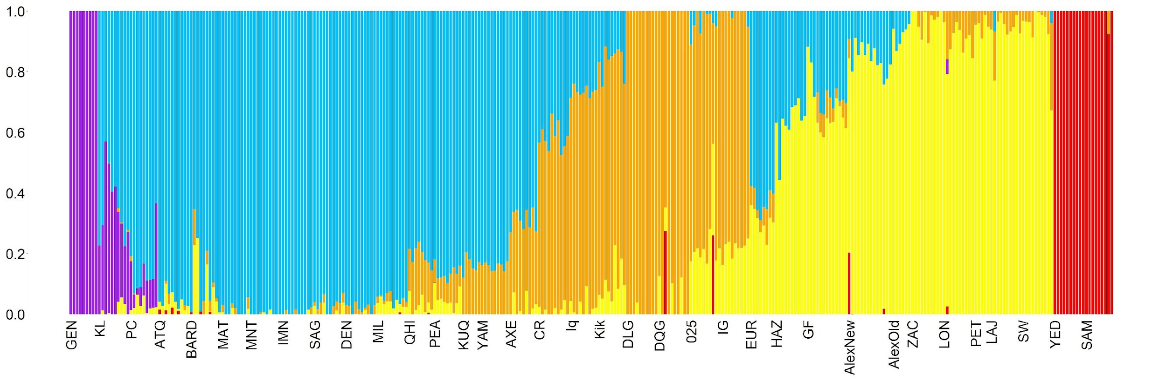
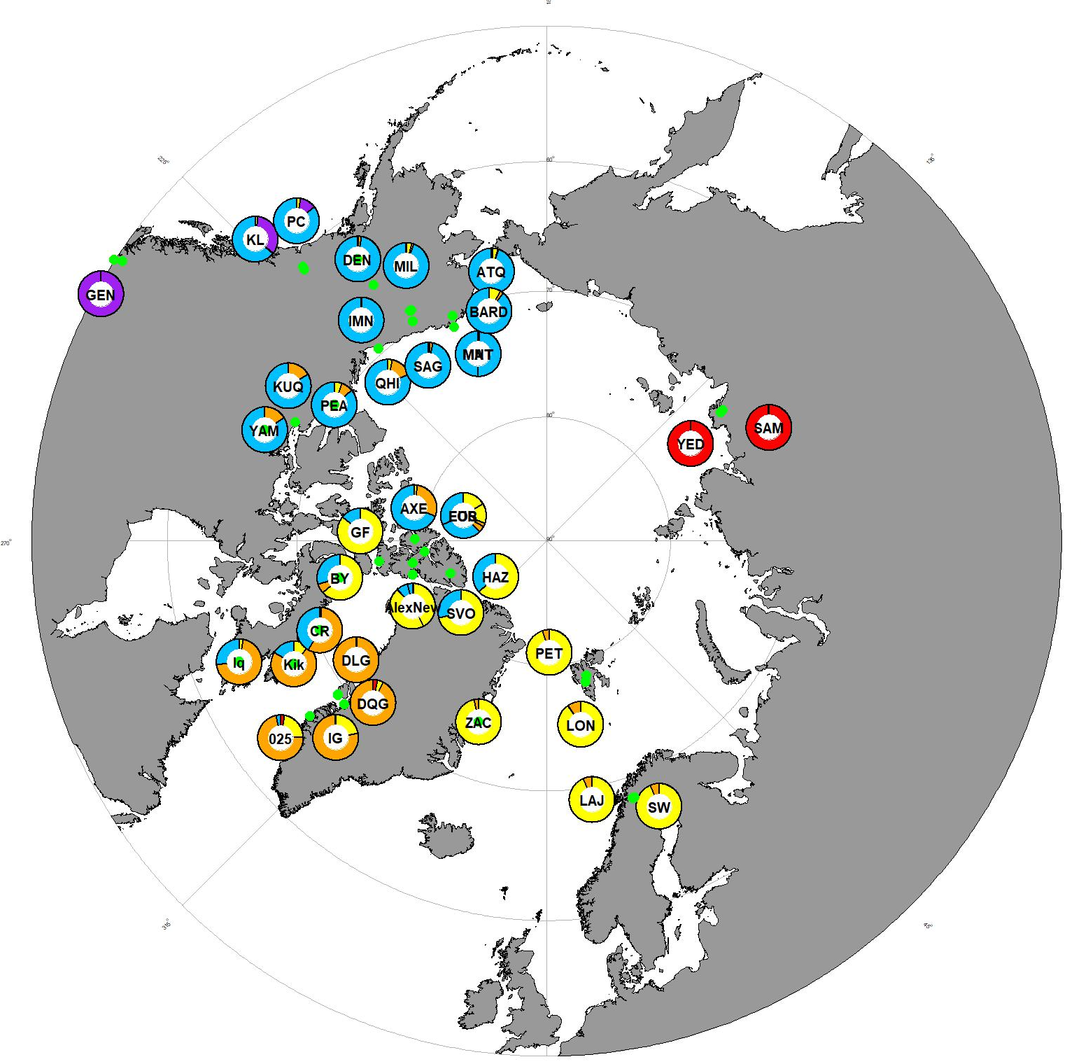
A.
Ssp. saximontana
ADMIXTURE proportion
BC
Kluane
Alaska/Yukon
NWT
Greenland/Baffin
Ellesmere
Europe
Russia
B.
Kluane
Beringia
BC
Alaska
NWT
Russia
Ellesmere
Baffin
Svalbard
Greenland
Sweden

Slide 2
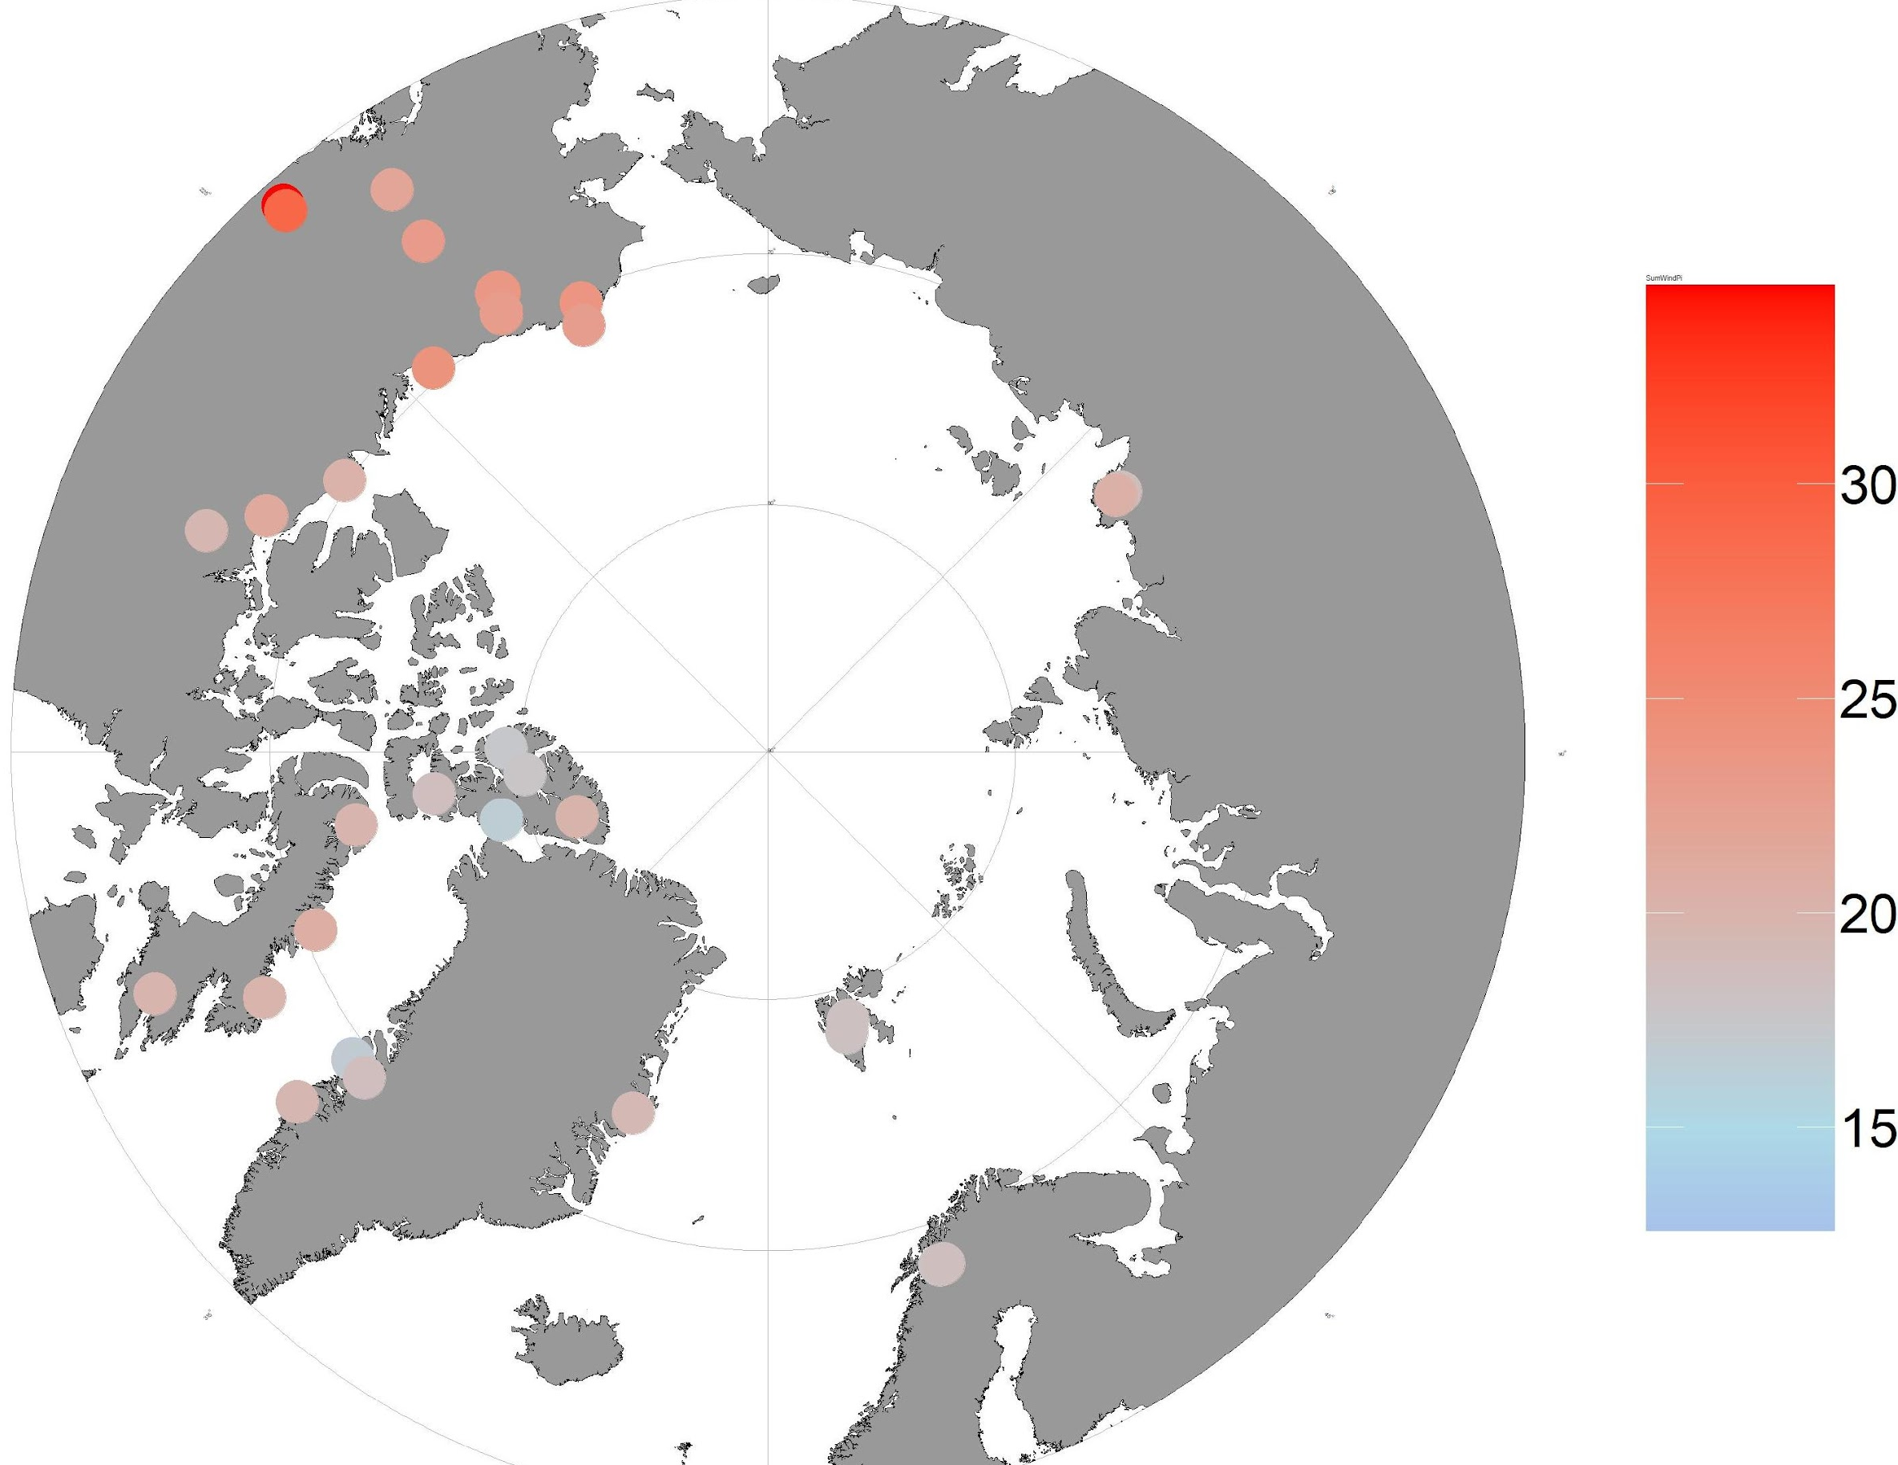
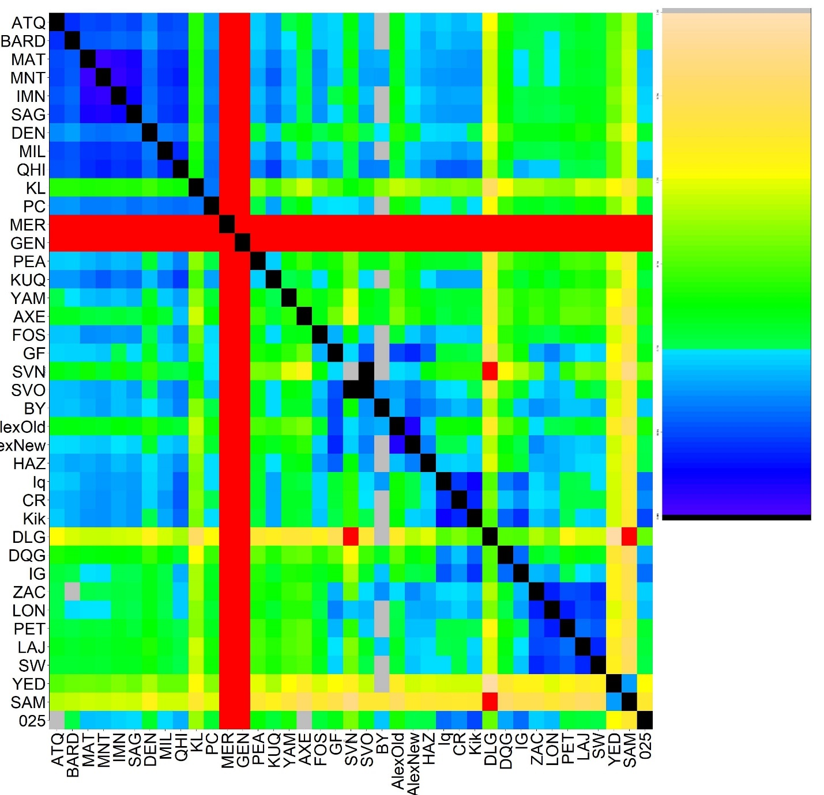

A.
Nucleotide diversity
B.
0.3
0.2
0.1
0.0
Alaska/Yukon
NWT
Ellesmere
Baffin
Disko
Europe
Russia
BC

Slide 3
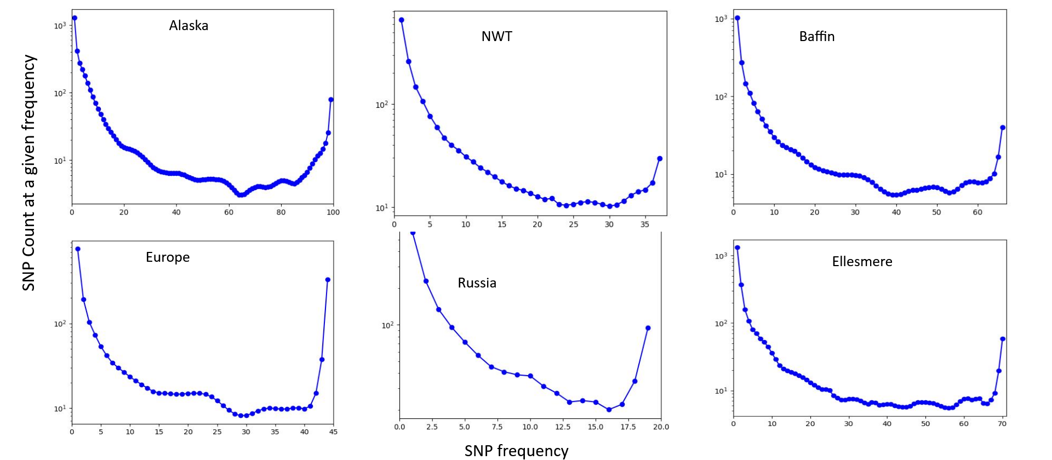
A.
B.
Ancestral
M
E
R
T
E
N
S
I
A
N
A
ALASKA
C. tetragona
SAXIM
EUR
RUS
C. mertensiana
N= ~800k
18.6 MYA
Alaska
N= ~2 M
18.6 MYA
Europe
N= ~500k
600 kyrs
Russia
N=450k 1.4 MYA
Spp.
saximontana
N= ~19k
6.7 MYA
C.
ALASKA
EUROPE
Alaska
N= ~2 M
18.6 MYA
Canada
N= ~300k
8 kyrs
Greenland
N= ~25k
100 kyrs
Europe
N= ~500k
600 kyrs
Notes:
Fig 3: Demography figures. (A) 1D Site Frequency Spectra. (B) 2D Site Frequency Spectra. (C) Dadi Model Diagram. Ancestral population split with asymmetric migration. See Table XX for parameters.( D) Model fits.

Slide 4
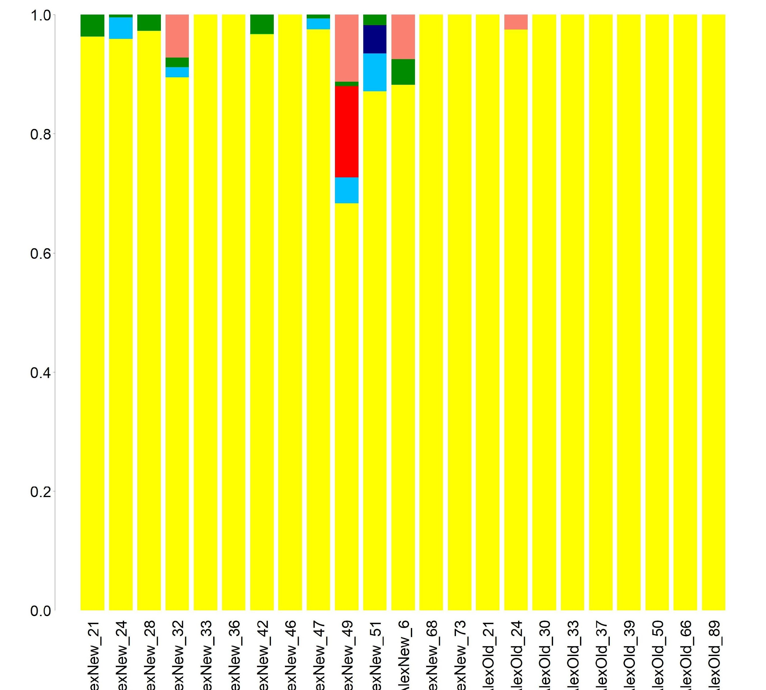
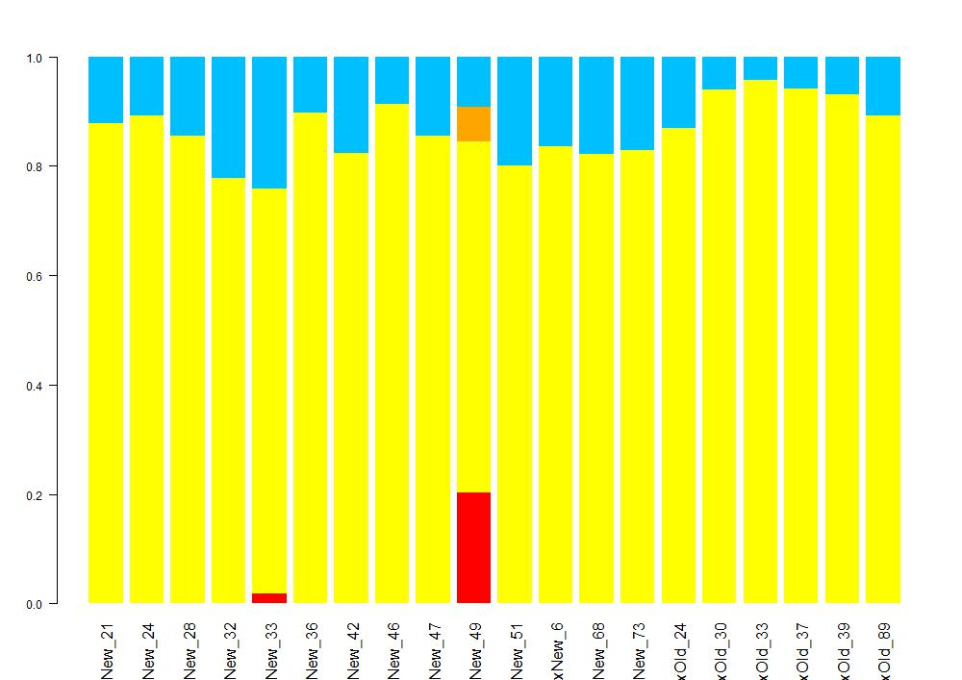
A.
ADMIXTURE proportion
Present day samples
Historic samples

