Slide 1

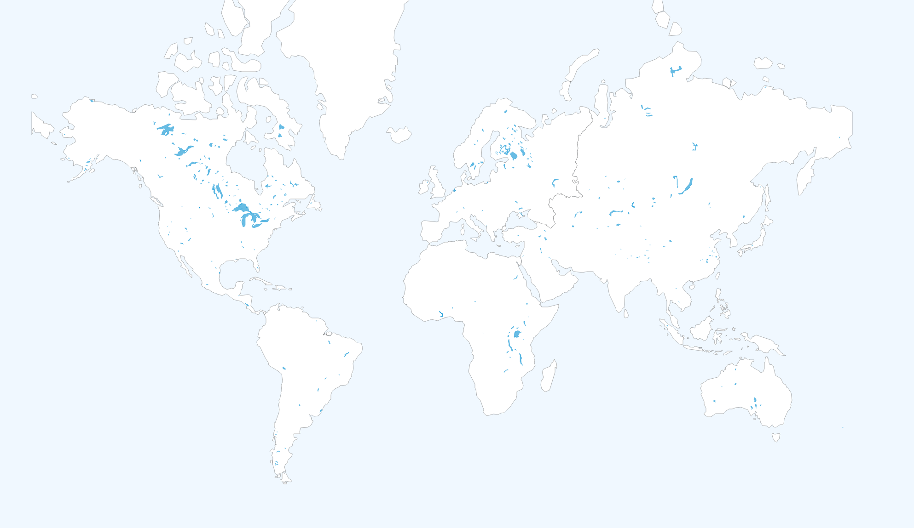
CoSWAT-GM
Home Datasets Scripts Outputs Calibration About
© Web Design: Celray James CHAWANDA

