Slide 1

CoSWAT-GM
Home Datasets Scripts Outputs Calibration About
There is a globe showing continents, catchments and performance and also mapped raster files in a slide show fashion,
Also show new contributions and who did it…
By how much did the model performance improve
A start button brings the map into view and destroys the fancy ‘screen saver’. Inactivity brings it up again after 2 minutes and start resumes
© Web Design: Celray James CHAWANDA

Slide 2
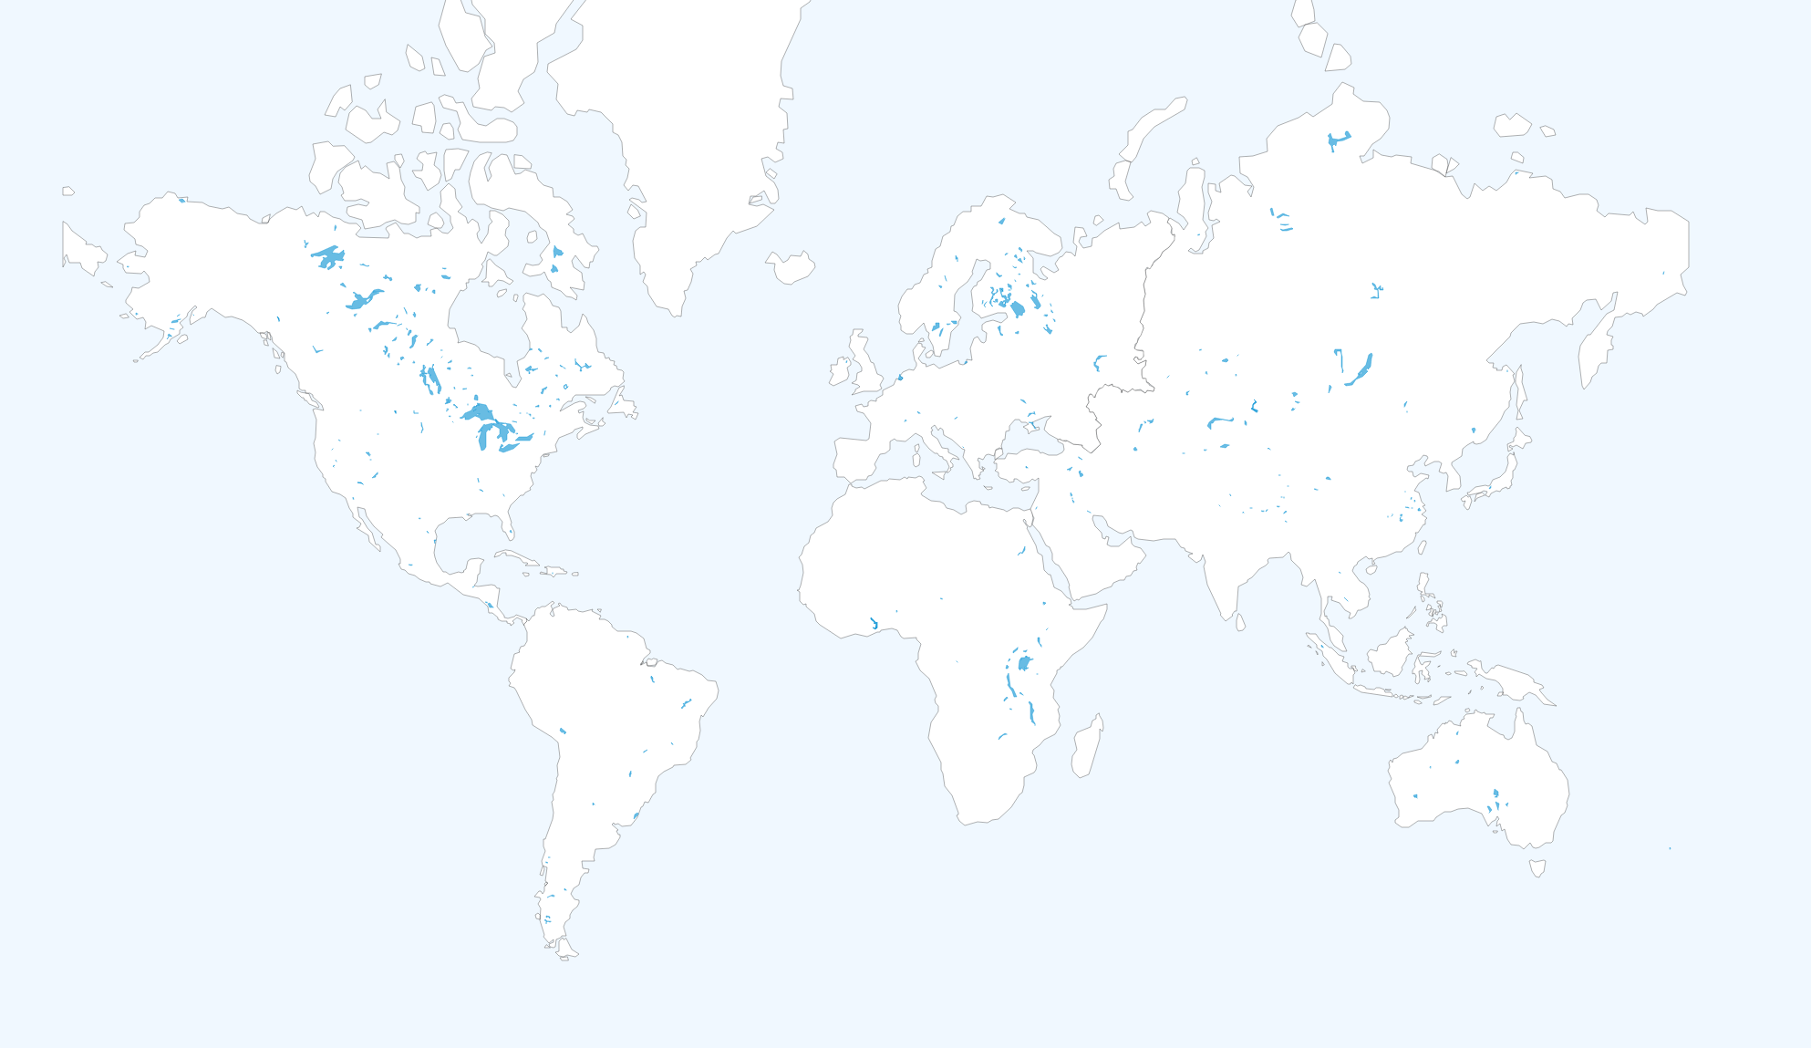
CoSWAT-GM
Home Datasets Scripts Outputs Calibration About
© Web Design: Celray James CHAWANDA

Slide 3
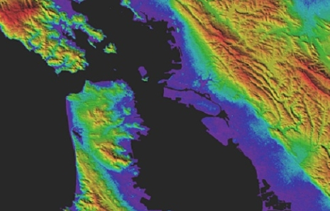
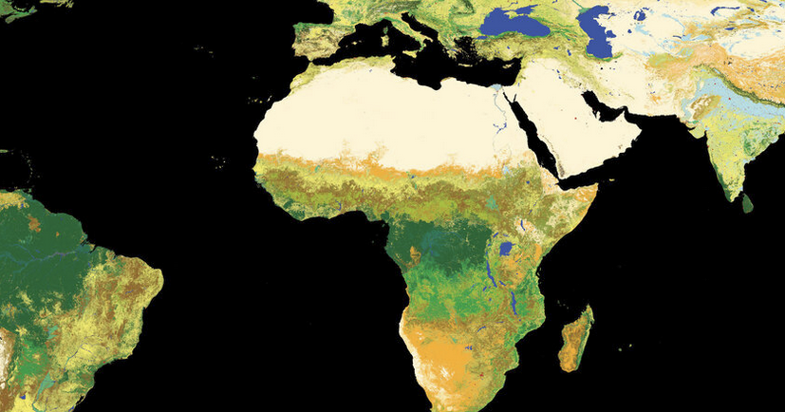
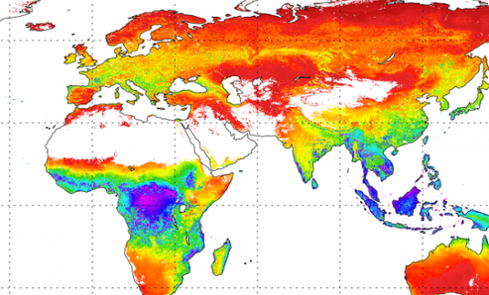
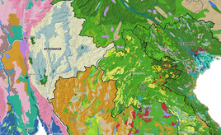
CoSWAT-GM
Home Datasets Scripts Outputs Calibration About
The Community SWAT+ Model v0.2.2 uses the following openly available datasets.
Input Data
Calibration Data
Aster GDEM
ESA Landuse Map
EWEMBI Weather Forcing
MODIS 16 ET Data
FAO Soil Map
© Web Design: Celray James CHAWANDA

Slide 4
CoSWAT-GM
Home Datasets Scripts Outputs Calibration About
The Community SWAT+ Model v0.2.2 uses the following openly available datasets.
Land use map from the European Space Agency.
ESA’s global land cover map, which is ten times sharper than any previous global satellite map, is now available to the public online from the GlobCover website. It is the highest resolution land cover map that has been completely validated ever released.
ASTER GDEM.
Version 3 of the Advanced Spaceborne Thermal Emission and Reflection Radiometer (ASTER) Global Digital Elevation Model (GDEM) is now available from NASA’s Land Processes Distributed Active Archive Center (LP DAAC). The ASTER GDEM covers land surfaces between 83°N and 83°S, and was produced through automated processing of 2.3 million scenes from the ASTER archive.
© Web Design: Celray James CHAWANDA

Slide 5
Close Button

