Slide 1

CoSWAT-GM
Home Datasets Scripts Outputs Calibration About
There is a globe showing continents, catchments and performance and also mapped raster files in a slide show fashion,
Also show new contributions and who did it…
By how much did the model performance improve
A start button brings the map into view and destroys the fancy ‘screen saver’. Inactivity brings it up again after 2 minutes and start resumes
© Web Design: Celray James CHAWANDA

Slide 2
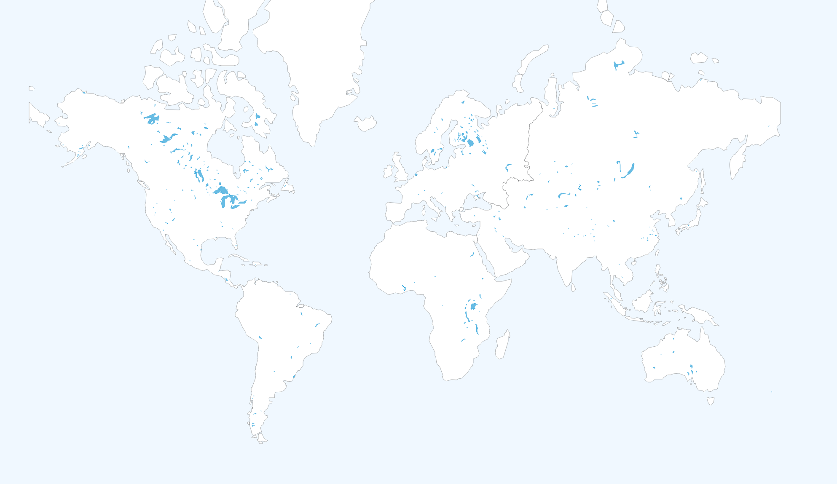
CoSWAT-GM
Home Datasets Scripts Outputs Calibration About
© Web Design: Celray James CHAWANDA

Slide 3
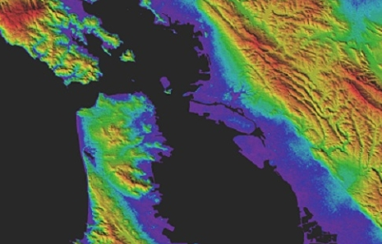
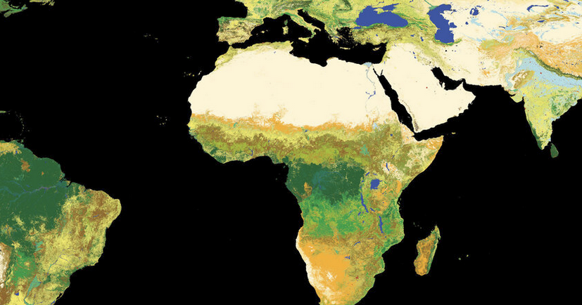
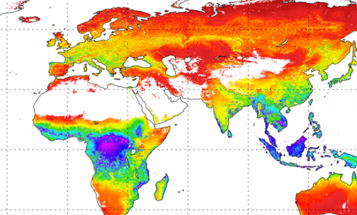
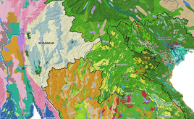
CoSWAT-GM
Home Datasets Scripts Outputs Calibration About
The Community SWAT+ Model v0.2.2 uses the following openly available datasets.
Input Data
Calibration Data
Aster GDEM
ESA Landuse Map
EWEMBI Weather Forcing
MODIS 16 ET Data
FAO Soil Map
© Web Design: Celray James CHAWANDA

Slide 4
CoSWAT-GM
Home Datasets Scripts Outputs Calibration About
The Community SWAT+ Model v0.2.2 uses the following openly available datasets.
Land use map from the European Space Agency.
ESA’s global land cover map, which is ten times sharper than any previous global satellite map, is now available to the public online from the GlobCover website. It is the highest resolution land cover map that has been completely validated ever released.
ASTER GDEM.
Version 3 of the Advanced Spaceborne Thermal Emission and Reflection Radiometer (ASTER) Global Digital Elevation Model (GDEM) is now available from NASA’s Land Processes Distributed Active Archive Center (LP DAAC). The ASTER GDEM covers land surfaces between 83°N and 83°S, and was produced through automated processing of 2.3 million scenes from the ASTER archive.
© Web Design: Celray James CHAWANDA

Slide 5
Close Button

Slide 6








Current Model Indices (Zoom to your Region)
Recent Contributors
FirstName LastName - Nile
FirstName LastName - Amazon
FirstName LastName - Amazon
FirstName LastName - Amazon
Extract Selection
Upload Parameters
Compare Performance

Slide 7
Recent Contributors
FirstName LastName - Nile
FirstName LastName - Amazon
FirstName LastName - Amazon
FirstName LastName - Amazon
Extract Selection
Upload Parameters
Compare Performance

Slide 8

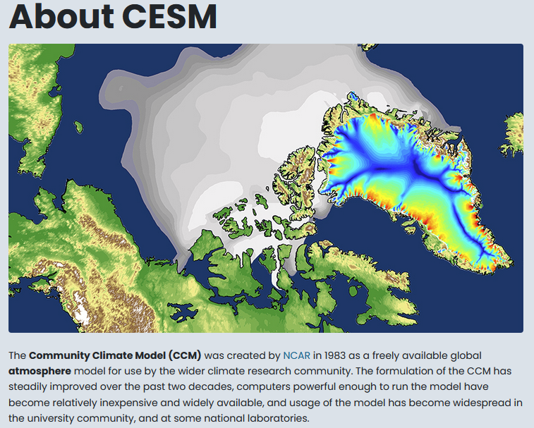
Mission & Vision
The primary goal of the Community Earth System Model (CESM) project is to develop a state-of-the-art climate model and to use it to perform the best possible science to understand climate variability and global change. We will strive to build a CESM community of users who are interested in participating in this project.
Earth System Modeling Challenge
Identify and model the physical, chemical, biological, and human components that govern the climate system; quantify the certainties and uncertainties in Earth-system feedbacks on timescales up to centuries and longer.
Reliable information on expected climate conditions and impacts is needed to better inform societal decisions. Climate variability and change is determined by the functioning of the Earth’s physical, chemical, biological, and human systems and the interactions among them. To further understand climate system behavior, it is critical to maintain CESM as a world-class, community-based, state-of-the science, and comprehensive Earth System Model.
This requirement depends on the translation of fundamental research on climate system processes into new and better parameterizations. It also necessitates the evaluation of model simulation behavior against process knowledge, observations and proxies from the distant past to the present.
Objectives
Enhance capability for Earth system modeling of the physical climate system coupled with chemistry, biogeochemistry, biology and human systems.
Improve model representation of Earth system processes through the incorporation of new components, parameterizations and dynamical cores.
Use existing and new observations to test Earth system models at a process level and quantify the relative importance of different feedbacks.
Enable CESM community to conduct competitive climate research on a full range of computing platforms, through specific software developments and by hosting visitors and training tutorials.
Provide relevant datasets to the greater climate research community, accompanied by the collective knowledge gained from our experience.
Contribute knowledge to national and international assessments (e.g. IPCC).

