Slide 1


Round 1: The Film Round
Starring:
Well-respected films with terrible sequels

Slide 2
Director’s Note
This round is all about good films which have infamously not so good sequels.
Each question will give a clue towards either the original film or the terrible sequel - all you have to do is write down the name of the flim
Either the name of the original, the name of the sequel or the name of the franchise is acceptable.

Slide 3
ACT 1
The Questions

Slide 4


X -> Y
Question :
X% -> Y%
Total “Badness”:
100

Slide 5
Question 1:
This film (sequel) was dedicated to the cast members John Belushi, Cab Calloway, and John Candy, who passed away since the release of the original film.
7.9 -> 4.9
92% -> 37%
Total “Badness”:
85

Slide 6
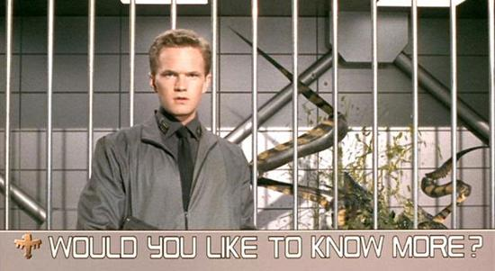
Question 2:
This 1999 science-fiction film (original) features scenes presented as futuristic military propoganda with the phrase: “Would you like to know more?”
7.2 -> 3.6
70% -> 12%
Total “Badness”:
94

Slide 7
Question 3: Winner of the 2005 golden raspberry award for worst sequel, a common criticism of this film was the absence of the main character from the original, who was played by Jim Carrey.
6.9 -> 22
68% ->16%
Total “Badness”:
99

Slide 8
Question 4:
Technically the 8th film in the horror franchise (confused cannon aside). The franchise was rebooted in 2007 and again in 2018, with the latest title released in 2021.
7.7 -> 4.0
89% -> 25%
Total “Badness”:
101

Slide 9
Question 5:
The Amazon Prime description of this film (sequel) is:
Omni Consumer Products are bent on creating Delta City to replace rotting Detroit. Since the inhabitants have no intention of leaving, the company employs a ruthless army to attack and harass them.
7.6 -> 4.1
84% -> 15%
Total “Badness”:
104

Slide 10
Question 6: Adapted from a novel by Bret Easten Ellis (original), IMDB describes the film as a “crime” movie, despite the possibility that the protagonist, Patrick Bateman, may have just imagined all of the killings that they had committed.
7.6 -> 3.8
85% -> 18%
Total “Badness”:
105

Slide 11
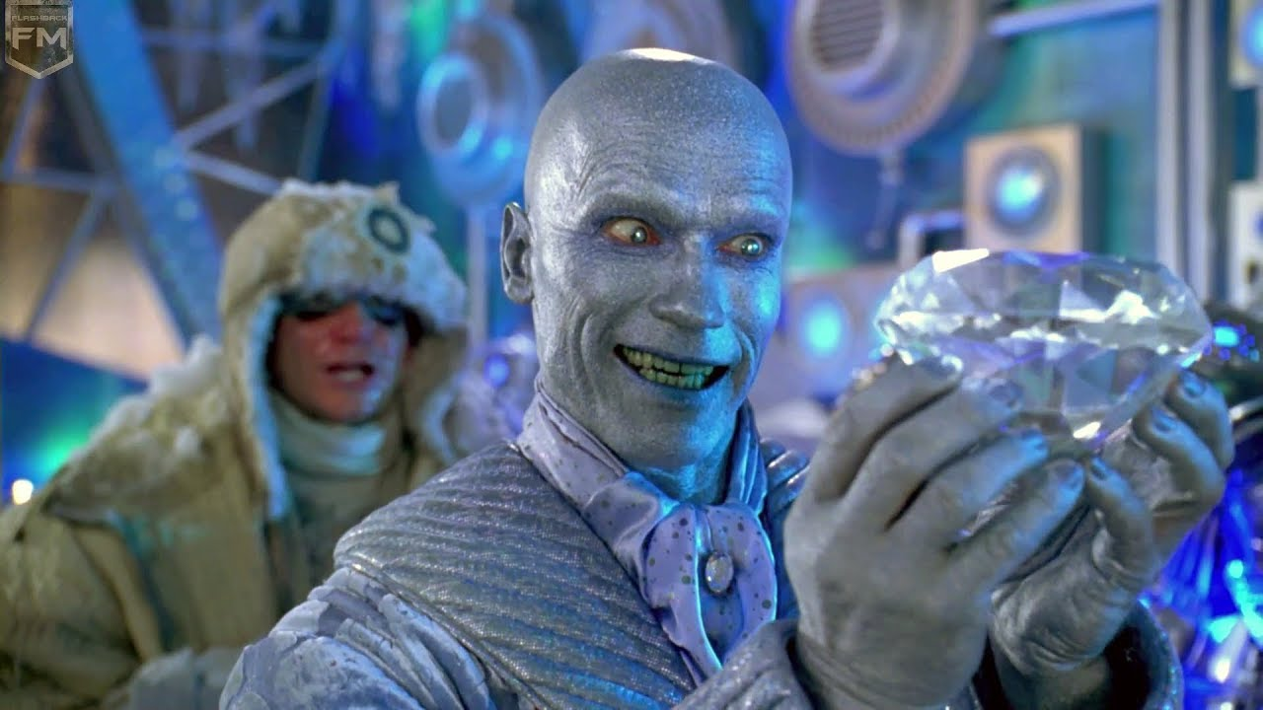
7.5 -> 3.8
Question 7:
84% -> 16%
Total “Badness”:
105

Slide 12
Question 8: The Washington Post described it as "More sluggish than a funeral barge, cheaper than a sale at Kmart, it's a nerd, it's a shame, it's <REDACTED>"
7.3 -> 3.7
86% -> 16%
Total “Badness”:
106

Slide 13
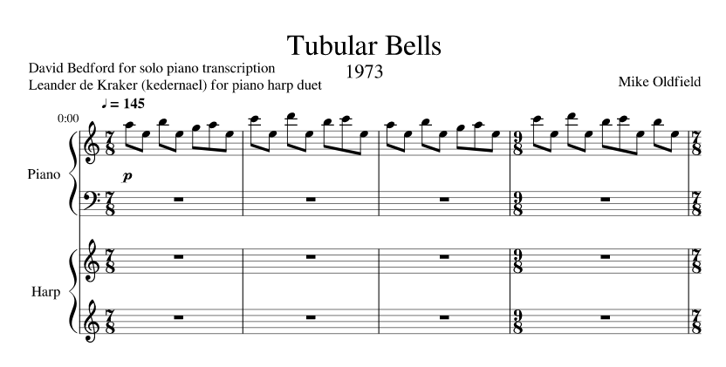
8.0 -> 3.8
Question 9:
87% -> 12%
Total “Badness”:
117

Slide 15
Question 10: This film (sequel) (in-)famously features a scene where Michael Caine & company electrocute a shark, causing it to leap out of the ocean and roar like a lion.
8.0 -> 3.0
90% -> 15%
Total “Badness”:
125

Slide 16
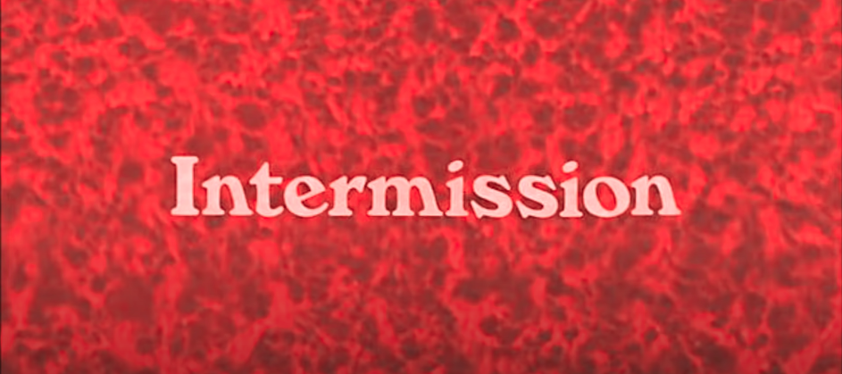

Slide 17
ACT 2
The Answers

Slide 18
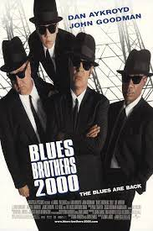
Question 1:
This film (sequel) was dedicated to the cast members John Belushi, Cab Calloway, and John Candy, who passed away since the release of the original film.
7.9 -> 4.9
92% -> 37%
Total “Badness”:
85

Slide 19
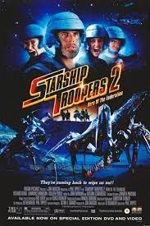
Question 2:
This 1999 science-fiction film (original) features scenes presented as futuristic military propoganda with the phrase: “Would you like to know more?”
7.2 -> 3.6
70% -> 12%
Total “Badness”:
94

Slide 20
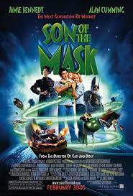
Question 3: Winner of the 2005 golden raspberry award for worst sequel, a common criticism of this film was the absence of the main character from the original, who was played by Jim Carrey.
6.9 -> 22
68% ->16%
Total “Badness”:
99

Slide 21
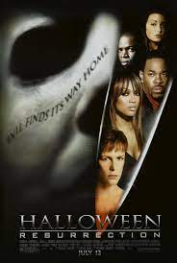
Question 4:
Technically the 8th film in the franchise (confused cannon aside). The franchise was rebooted in 2007 and again in 2018, with the latest title released in 2021.
7.7 -> 4.0
89% -> 25%
Total “Badness”:
101

Slide 22
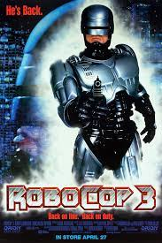
Question 5:
The Amazon Prime description of this film (sequel) is:
Omni Consumer Products are bent on creating Delta City to replace rotting Detroit. Since the inhabitants have no intention of leaving, the company employs a ruthless army to attack and harass them.
7.6 -> 4.1
84% -> 15%
Total “Badness”:
104

Slide 23
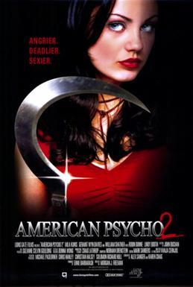
Question 6: Adapted from a novel by Bret Easten Ellis (original), IMDB describes the film as a “crime” movie, despite the possibility that the protagonist may have just imagined all of the killings that they had committed.
7.6 -> 3.8
85% -> 18%
Total “Badness”:
105

Slide 24
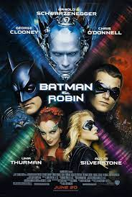
7.5 -> 3.8
Question 7:
84% -> 16%
Total “Badness”:
105

Slide 25
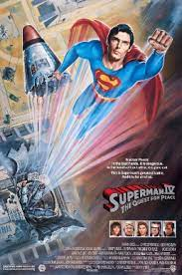
Question 8: The Washington Post described it as "More sluggish than a funeral barge, cheaper than a sale at Kmart, it's a nerd, it's a shame, it's <REDACTED>"
7.3 -> 3.7
86% -> 16%
Total “Badness”:
106

Slide 26

8.0 -> 3.8
Question 9:
87% -> 12%
Total “Badness”:
117

Slide 27
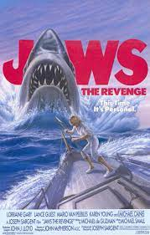
Question 10: This film (sequel) (in-)famously features a scene where Michael Caine & company electrocute a shark, causing it to leap out of the ocean and roar like a lion.
8.0 -> 3.0
90% -> 15%
Total “Badness”:
125

Slide 28
fin.
Bad sequels will return…

