Slide 1
The Media Round
Films and TV Shows In A World Locked Down

Slide 2
The Round
This round is all about tv shows and movies released (or meant to have been released) since the first UK lockdown on 26th March 2020.
The last question will have a time limit, so there will a couple of minutes after the first 9 questions to debate your previous answers.

Slide 3
Question 1
Like many films, Black Widow’s release was delayed and moved from 1st May 2020 to July 2021. Including this movie, in how many other MCU movies has Scarlett Johanson portrayed the titular Black Widow (inc post-credit scenes)?

Slide 4
Question 2
The 6th series of BBC’s Line of Duty was released on 21st March 2021. What does the acronym ‘OCG’ stand for that AC-12 uses throughout the show?

Slide 5
Question 3
‘Cruella’ was released in cinemas and Disney+ on May 28th 2021. Including this film, how many live-action films have been released in the 101 Dalmatians series.

Slide 6
Question 4
Name the Netflix series released in 2020 that caused sales of chess sets to increase by more that 1000%.

Slide 7
Question 5
Which of these films is not currently scheduled for a theatrical release (cinema) along with a simultaneous on-demand release?
Dune
The Addams Family 2
Minions: The Rise of Gru
Halloween Kills

Slide 8
Question 6
Sort these subscriptions services according to the price per month
(£7.99/month, £9.99/month, £11.99/month):
Netflix (standard)
Amazon Prime (standard)
Disney+
Youtube Premium
Spotify (standard)

Slide 9
Question 7
‘No Time To Die’ is currently scheduled for a September 2021 release after being delayed multiple times. But what number is the film in the official EON James Bond Series?

Slide 10
Question 8
On May 27th 2021, Lady Gaga, Justin Bieber and Cara Delevingne all appeared in a special episode of which TV series?

Slide 11
Question 9
Which film is random internet user Oliver A reviewing here: I thought the first Quiet Place movie was perfect and this one is even better. John Krasinski is now one of my all-time favorite directors. The movie makes you really feel for the family and you are tense through most of the movie. There are some scary jump scares but the movie, in general, isn't too scary
REDACTED

Slide 12
Question 10
EXTRA TIME

Slide 13
The Final Question – 10 Films
For the last question, you will have 3 minutes to write down 10 films starting from the film I give you (10 more) where each film’s title begins with the last letter of the film before’s title. (eagle, elephant, tiger, rabbit,...)
No repeats (eagle, eagle, eagle, eagle,...)
Can ignore the word ‘the’ (The Martian → Martian)
1 points for doing 5 films, 2 points for doing 10 films, 1 bonus point for having 10 films where the last film ends with the first letter of the film I give you.
Once you are done, hold your answer sheet in the air. Once two minutes are up, any team without their paper in the air gets no points.

Slide 14
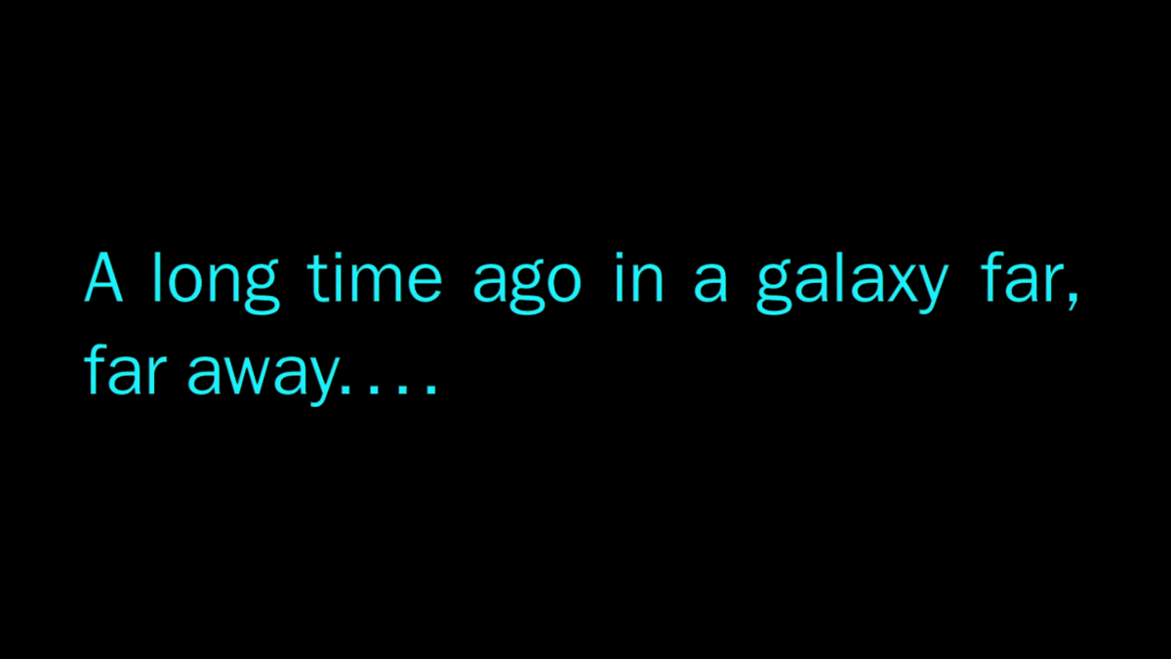

And the first film is...

Slide 15
Question 1
Like many films, Black Widow’s release was delayed and moved from 1st May 2020 to July 2021. Including this movie, in how many other MCU movies has Scarlett Johanson portrayed the titular Black Widow (inc post-credit scenes)?
9 - Iron Man 2 (2010), The Avengers (2012), Captain America: The Winter Soldier (2014), Avengers: Age of Ultron (2015), Captain America: Civil War (2016), Avengers: Infinity War (2018), Captain Marvel (2019), Avengers: Endgame (2019), Black Widow (2021).

Slide 16
Question 2
The 6th series of BBC’s Line of Duty was released on 21st March 2021. What does the acronym ‘OCG’ stand for that AC-12 uses throughout the show?
Organised Crime Group

Slide 17
Question 3
‘Cruella’ was released in cinemas and Disney+ on May 28th 2021. Including this film, how many live-action films have been released in the 101 Dalmatians series.
3

Slide 18
Question 4
Name the Netflix series released in 2020 that caused sales of chess sets to increase by more that 1000%.
The Queen’s Gambit

Slide 19
Question 5
Which of these films is not currently scheduled for a theatrical release (cinema) along with a simultaneous on-demand release?
Dune
The Addams Family 2
Minions: The Rise of Gru
Halloween Kills

Slide 20
Question 6
Sort these subscriptions services according to the price per month
(£7.99/month, £9.99/month, £11.99/month):
Netflix (standard) - £9.99/month
Amazon Prime (standard) - £7.99/month
Disney+ - £7.99/month
Youtube Premium - £11.99/month
Spotify (individual) - £9.99/month

Slide 21
Question 7
‘No Time To Die’ is currently scheduled for a September 2021 release after being delayed multiple times. But what number is the film in the official EON James Bond Series?
25

Slide 22
Question 8
On May 27th 2021, Lady Gaga, Justin Bieber and Cara Delevingne all appeared in a special episode of which TV series?
FRIENDS (The Reunion)

Slide 23
Question 9
Which film is random internet user Oliver A reviewing here: I thought the first Quiet Place movie was perfect and this one is even better. John Krasinski is now one of my all-time favorite directors. The movie makes you really feel for the family and you are tense through most of the movie. There are some scary jump scares but the movie, in general, isn't too scary.

