Slide 1
Round 4: General Knowledge
Put the things into the order we give you flavour

Slide 2
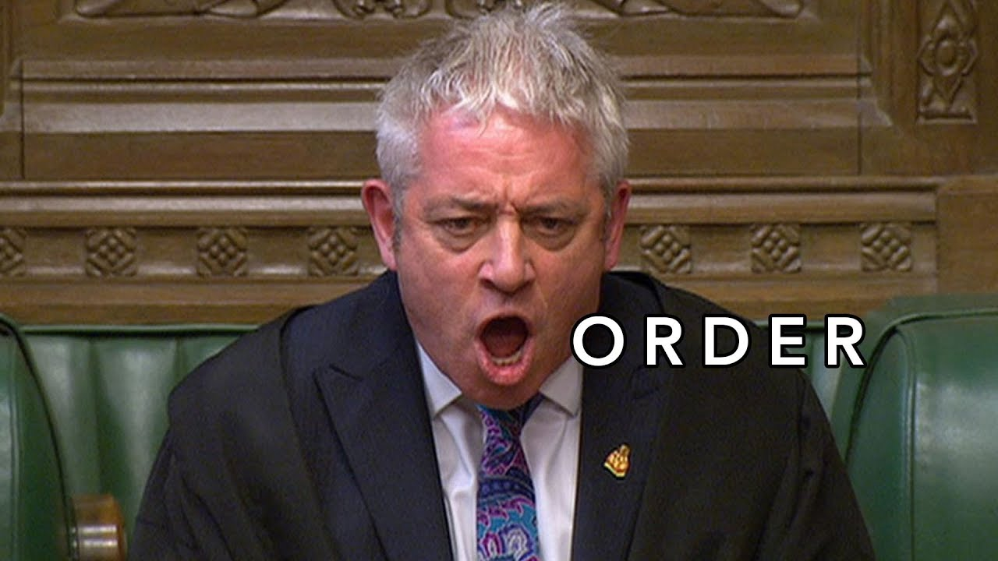
Round Notes:
For each question you will be given a small number of objects and a way to sort them
1 pt for sorting them all correctly

Slide 3
Question 1:
Sort the options below according to the following criteria:
Example criteria
a,b,c,d

Slide 4
Question 1:
Sort the options below according to the following criteria:
Distance from London closest first
Cardiff - Manchester - Plymouth

Slide 5
Question 2:
Sort the options below according to the following criteria:
List the following four wars in order starting with the earliest
Boer War, War of the Roses, American War of independence, Crimean War

Slide 6
Question 3:
Sort the options below according to the following criteria:
Deserts: put these in order of size, largest to smallest.
Arabian, Gobi, Sahara

Slide 7
Question 4:
Sort the options below according to the following criteria:
Atoms: put these in order according to mass, starting with the lightest
Plutonium, Potassium, Phosphorus, Palladium,

Slide 8
Question 5:
Sort the options below according to the following criteria:
Put these colours in the order you would come across streets of that colour when going round a (UK) monopoly board
Red, Orange, Yellow, Green, Dark Blue, Light Blue, Pink, Brown

Slide 9
Question 6:
Sort the options below according to the following criteria:
Put these Pokemon games into release order with the oldest first
Ruby, Yellow, Pearl, Black, Silver, X

Slide 10
Question 7:
Sort the options below according to the following criteria:
Put these things Rick Astley will never do in the order in which they appear in the song
desert you , say goodbye, give you up, hurt you, tell a lie, make you cry, let you down, run around

Slide 11
Question 8:
Sort the options below according to the following criteria:
Put these sports in order of how many players are in a standard team, smallest first
Football, netball, volleyball, curling, baseball

Slide 12
Question 8:
Sort the options below according to the following criteria:
Put these sports in order of how many players are in a standard team, smallest first
Football, netball, volleyball, curling, baseball

Slide 13
Question 9:
Sort the options below according to the following criteria:
Area of countries (land + water bodies) from smallest to largest
Sudan, Saudi Arabia, Spain, Sweden

Slide 14
Question 10:
Sort the options below according to the following criteria:
Applications by most number of downloads in 2021, lowest first
Facebook, Instagram, Telegram, Tik Tok, Whatsapp

Slide 15
The Final Set of Answers
Good luck

Slide 16
Question 1:
Sort the options below according to the following criteria:
Distance from London, closest first
Cardiff (155 miles) Manchester (199 miles) Plymouth (215 miles)

Slide 17
Question 2:
Sort the options below according to the following criteria:
List the following four wars in order starting with the earliest
War of the Roses (1455 - 1487), American War of Independence (1775 - 1783), Crimean (1853 - 1856) and Boer War (1899 - 1902)

Slide 18
Question 3:
Sort the options below according to the following criteria:
Deserts: put these in order of size, largest to smallest.
Sahara, Arabian, Gobi

Slide 19
Question 4:
Sort the options below according to the following criteria:
Atoms: put these in order according to mass, starting with the lightest
Phosphorus, Potassium, Palladium, Plutonium

Slide 20
Question 5:
Sort the options below according to the following criteria:
Put these colours in the order you would come across streets of that colour when going round a (UK) monopoly board
Brown, Light Blue, Pink, Orange, Red, Yellow, Green, Dark Blue

Slide 21
Question 6:
Sort the options below according to the following criteria:
Put these Pokemon games into release order with the oldest first
Yellow, Silver, Ruby, Pearl, Black, X

Slide 22
Question 7:
Sort the options below according to the following criteria:
Put these things Rick Astley will never do in the order in which they appear in the song
Give you up, let you down, run around, desert you, make you cry, say goodbye, tell a lie, hurt you

Slide 23
Question 8:
Sort the options below according to the following criteria:
Put these sports in order of how many players are in a standard team, smallest first
Curling (4), volleyball (6), netball (7), baseball (9), football (11)

Slide 24
Question 9:
Sort the options below according to the following criteria:
Area of countries (land + water bodies) from smallest to largest
Sweden, Spain, Sudan, Saudi Arabia,

Slide 25
Question 10:
Sort the options below according to the following criteria:
Applications by most number of downloads in 2021, lowest first
Telegram, Whatsapp, Facebook, Instagram, Tik Tok

