Slide 1
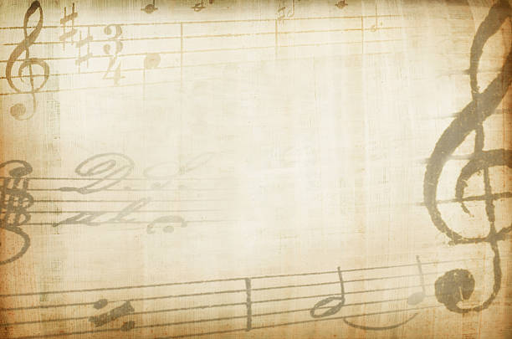


Round 3:
The Music Round
A terrible sequel to the last quiz…

Slide 2
Composers Notes:
For each question, I will give you a lyric from one of spotify’s top 100 most streamed songs of all time.
All you have to do is pick the correct title and artist from the options provided.
Except… as a call back to the quiz in September, I’ve translated each lyric with google translate about 20-100 times to “slightly” change the words

Slide 3
Movement 1: The Questions

Slide 4
Q1
It also pushed the magnet
My soul melts, as the Lord has spoken;

Slide 5
Q1
It also pushed the magnet
My soul melts, as the Lord has spoken;
Take me to church - Hozier
Shape of you - Ed Sheeran
Sad! - XXXTentacion
Havana - Camila Cabello et al.

Slide 6
Q2
I danced I danced! Such as
I have never seen your behaviour.
Thinking out loud - Ed Sheeran
Shallow - Lady Gaga et al.
Dance monkey - Tones & I
Leon on - Major Lazer et al.

Slide 7
Q3
Hello, everything is ready before we meet you.
Drink a lot with one slide, but exercise
Despacito - Luis Fonsi et al.
Closer - Chainsmokers et al.
Blinding lights - The Weeknd
One dance - Drake et al.

Slide 8
Q4
criticize your sister
angry with daughter
You can surprise your father
Perfect - Ed Sheeran
Heathens - Twenty One Pilots
Psycho - Post malone et al.
Bad guy - Billie Eilish

Slide 9
Q5
Sorry folks
It is raining
Believer - Imagine Dragons
Sweater weather - The Neighbourhood
Memories - Maroon 5
Uptown Funk - Mark Ronson et al.

Slide 10
Q6
My mother doesn't love you, she loves you.
I admit I wasn’t trying to make a mistake.
XO Tour Llif3 - Lil Uzi Vert
Love yourself - Justin Bieber
Circles - Post Malone
Someone you loved - Lewis Capaldi

Slide 11
Q7
Mother, mother, mother, mother, mother, mother, mother, mother, follow me
Baal is a devil to me.
Bohemian Rhapsody - Queen
Senorita - Shawn Mendes et al.
Demons - Imagine Dragons
We don’t talk anymore - Charlie Puth et al.

Slide 12
Q8
Try, try, try, try, try, try, try. Support and how and how and how and how and how and how and how and what to do? We move, we move, we move.
Two two two
Riptide - Vance Joy
Lose yourself - Eminem
Something just like this - Chainsmokers et al.
What do you mean - Justin Bieber

Slide 13
Q9
I started kissing her, what should I do?
I'm not smiling, I'm smiling
Lucid dreams - Juice World
Let her go - Passenger
Mr Brightside - The Killers
Too good at goodbyes - Sam Smith

Slide 14
Q10
That's it.
This is my beautiful wall

Slide 15
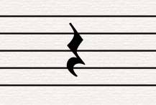

Slide 16
Movement 2: The Answers

Slide 17
Q1
It also pushed the magnet
My soul melts, as the Lord has spoken;
We push and pull like a magnet do
Although my heart is falling too
Shape of you - Ed Sheeran

Slide 18
Q2
I danced I danced! Such as
I have never seen your behaviour.
Dance for me, dance for me, dance for me, oh, oh, oh
I've never seen anybody do the things you do before
Dance monkey - Tones & I

Slide 19
Q3
Hello, everything is ready before we meet you.
Drink a lot with one slide, but exercise
Hey, I was doing just fine before I met you
I drink too much, and that's an issue, but I'm okay
Closer - Chainsmokers et al.

Slide 20
Q4
criticize your sister
angry with daughter
You can surprise your father
Make your mama sad type
Make your girlfriend mad tight
Might seduce your dad type
Bad guy - Billie Eilish

Slide 21
Q5
Sorry folks
It is raining
I was choking in the crowd
Building my rain up in the cloud
Believer - Imagine Dragons

Slide 22
Q6
My mother doesn't love you, she loves you.
I admit I wasn’t trying to make a mistake.
My mama don't like you and she likes everyone
And I never like to admit that I was wrong
Love yourself - Justin Bieber

Slide 23
Q7
Mother, mother, mother, mother, mother, mother, mother, mother, follow me
Baal is a devil to me.
Oh mama mia, mama mia, mama mia, let me go
Beelzebub has a devil put aside for me, for me,
Bohemian Rhapsody - Queen

Slide 24
Q8
Try, try, try, try, try, try, try. Support and how and how and how and how and how and how and how and what to do? We move, we move, we move. Doo-doo-doo, doo-doo-doo
Doo-doo-doo, doo-doo
Something just like this - Chainsmokers et al.

Slide 25
Q9
I started kissing her, what should I do?
I'm not smiling, I'm smiling
It started out with a kiss, how did it end up like this?
It was only a kiss, it was only a kiss
Mr Brightside - The Killers

Slide 26
Q10
That's it.
This is my beautiful wall
And after all
You're my wonderwall
(Wonderwall - Oasis)

Slide 27


