Slide 1

Round 2: Scotland
Celebrating Robert Burns Day 25/01/22
Cuairt 2: Alba
A' comharrachadh Latha Raibeart Burns 25/01/22

Slide 2
Noo listen up a' body
I’m going to ask you 10 questions about Scotland, its traditions and its people. For each one there will be more than one correct answer.
You will get a point if your answer is correct and if you answer is unique in the room. Otherwise no points.
A-nis èist ris a h-uile duine
Tha mi a’ dol a chur 10 ceistean oirbh mu Alba, a traidiseanan agus a daoine. Airson gach fear bidh barrachd air aon fhreagairt cheart.
Gheibh thu puing ma tha do fhreagairt ceart agus ma tha do fhreagairt gun samhail san t-seòmar. Mur eil, chan eil puingean.

Slide 3
Question 1: Name a city in Scotland

Slide 4
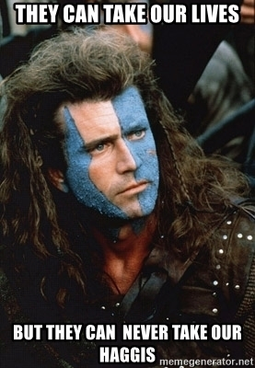
Question 2: Name one of the ingredients listed on the BBC good food recipe for Haggis

Slide 5
Question 3: Name one of the parties (exc. No affiliation) currently holding at least 1 seat in the Scottish Parliament (hint, they all start with “Scottish”)

Slide 6
Question 4: Name any of Scotlands top 5 Highest mountains

Slide 7
Question 5: Name any of the Sean Connery Bond Films

Slide 8
Question 6: Name any number 1 single by Calvin Harris (Hint - There are 9 to chose from)

Slide 9
Question 7: Name one of the three verdicts available for a Scottish jury to pick in a criminal trial

Slide 10
Question 8: Name one of the 5 largest scottish lochs (by volume)

Slide 11
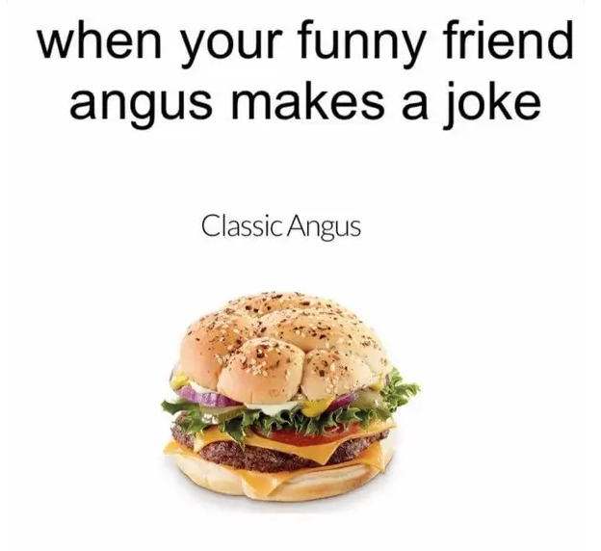
Question 9: Name one of the top 5 most popular baby names in 2020 in Scotland (Either one of the top 5 boys or one of the top 5 girls)

Slide 12
Question 10: Name any one of the 6 of Robert Burns’ most famous works according to visitscotland

Slide 13
Here are the answers fur ye a'
seo na freagairtean dhuibh uile

Slide 14
Question 1: Name a city in Scotland
Glasgow, Edinburgh, Aberdeen, Dundee, Perth, Inverness, Stirling

Slide 15
Question 2: Name one of the ingredients listed on the BBC good food recipe for Haggis.
Stomach, heart, lungs, trimmings, onion, oatmeal, salt, black pepper, coriander, mace, nutmeg, water

Slide 16
Question 3: Name one of the parties (exc. No affiliation) currently holding at least 1 seat in the Scottish Parliament (hint, they all start with “Scottish”)
SNP, SCAUP, SL, SGP, SLD

Slide 17
Question 4: Name any of Scotlands top 5 Highest mountains
Ben Nevis, Ben Macdui, Braeriach, Carin Toul, Sgor an Lochain Uaine

Slide 18
Question 5: Name any of the Sean Connery Bond Films
Dr No, FRWL, Goldfinger, Thunderball, YOLT, DAF

Slide 19
Question 6: Name any number 1 single by Calvin Harris (Hint - There are 9 to chose from)
Promises, One Kiss, Feels, Blame, Summer, Under Control, I need your love, sweet nothing, I’m not alone
Bounce, Feel so Close, Let’s Go, We’ll be coming back, How deep is your love, This is what you came for, Giant

Slide 20
Question 7: Name one of the three verdicts available for a Scottish jury to pick in a criminal trial
Guilty, Not Guilty, Not Proven

Slide 21
Question 8: Name one of the 5 largest scottish lochs (by volume)
Ness, Lomond, Morar, Tay, Awe

Slide 22
Question 9: Name one of the top 5 most popular baby names in 2020 in Scotland (Either one of the top 5 boys or one of the top 5 girls)
Isla, Olivia, Emily, Freya, Ava or Jack, Noah, James, Leo, Oliver

Slide 23




Question 10: Name any one of the 6 of Robert Burns’ most famous works according to visitscotland

Slide 24
We're a' finished
Stayed tuned fur the scores

