Slide 1


ISEL – DEETC Dissertation / Project
Celso de Almeida Fernandes
03-02-2017

Slide 2

Index
Introduction
Compilers
Code Generation Tools
Debugger
Deploy
Remote
Visual Studio Extension
Conclusions

Slide 3
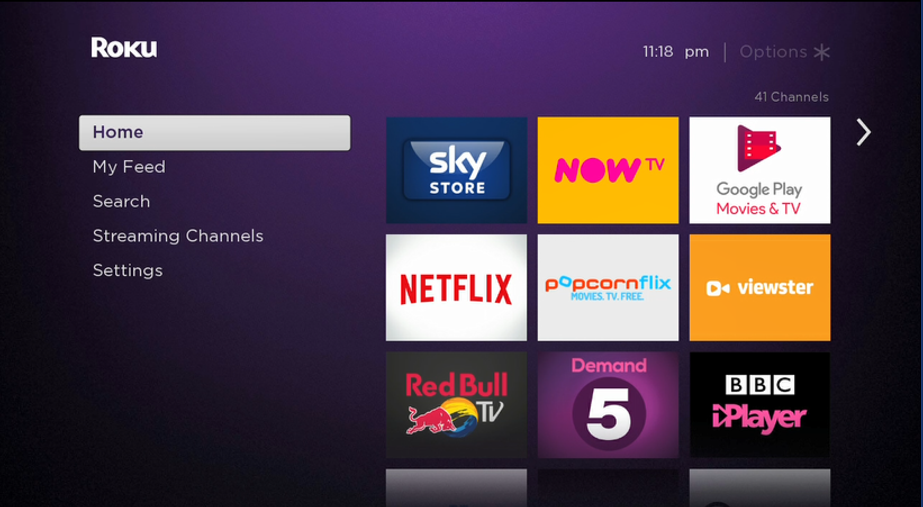
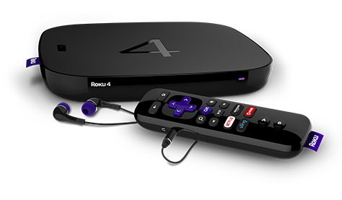
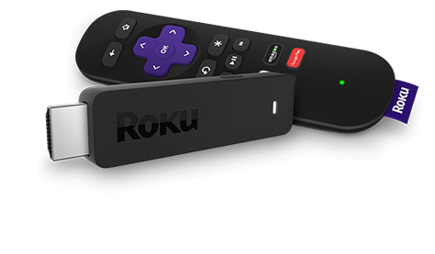
1 - Introduction
Roku
Boxs
BrightScript
Based on VB and JavaScript
Existing tools
Ide – Plugin for Eclipse
Text editors
Syntax Highlight: Sublime, Atom
Deploy
Make file / Coffee script

Slide 4
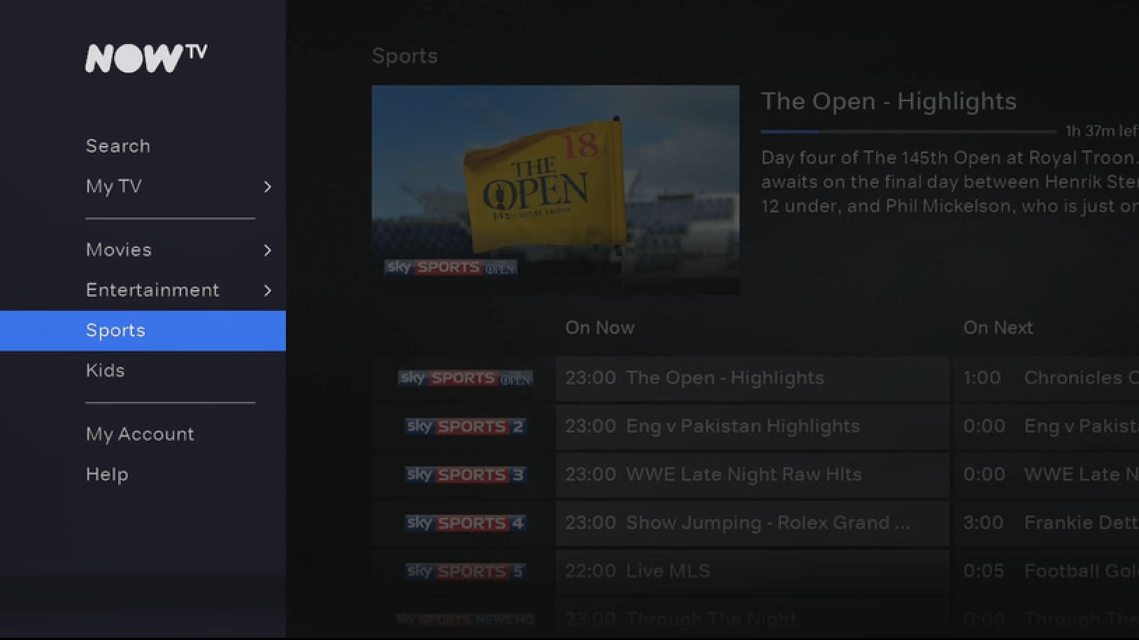

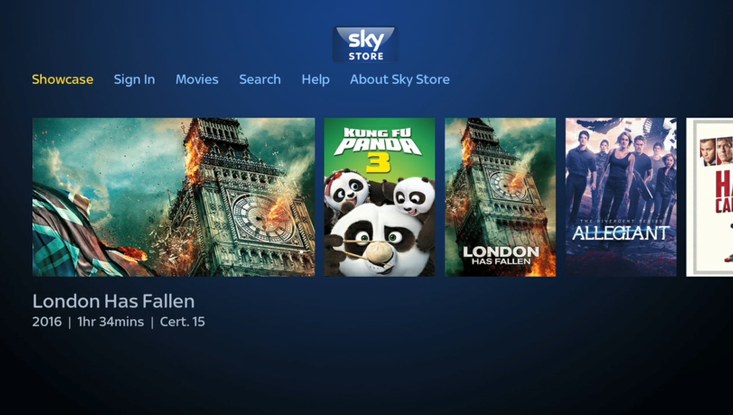
1 – Introduction
Sky
Now Tv
Sky Store

Slide 5
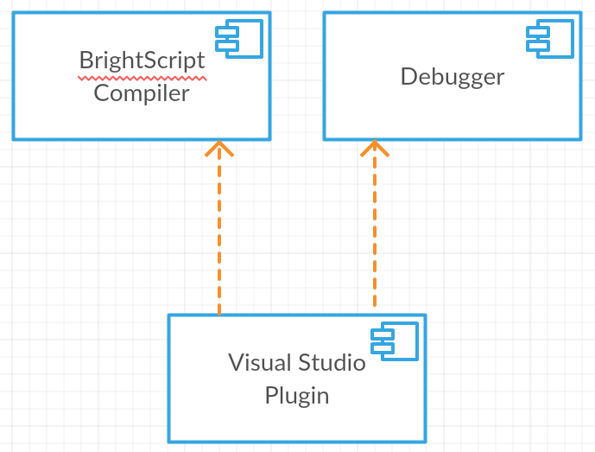
1 - Introduction
Architecture

Slide 6
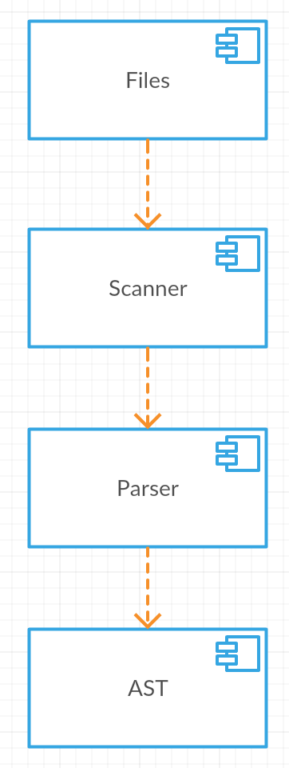
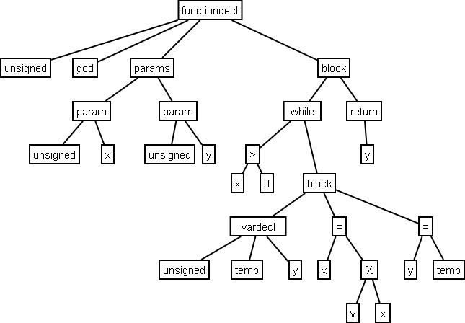
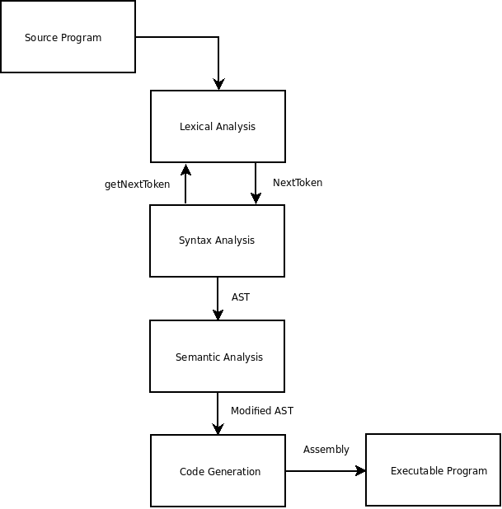
2 - Compilers
Scanner
Parser

Slide 7
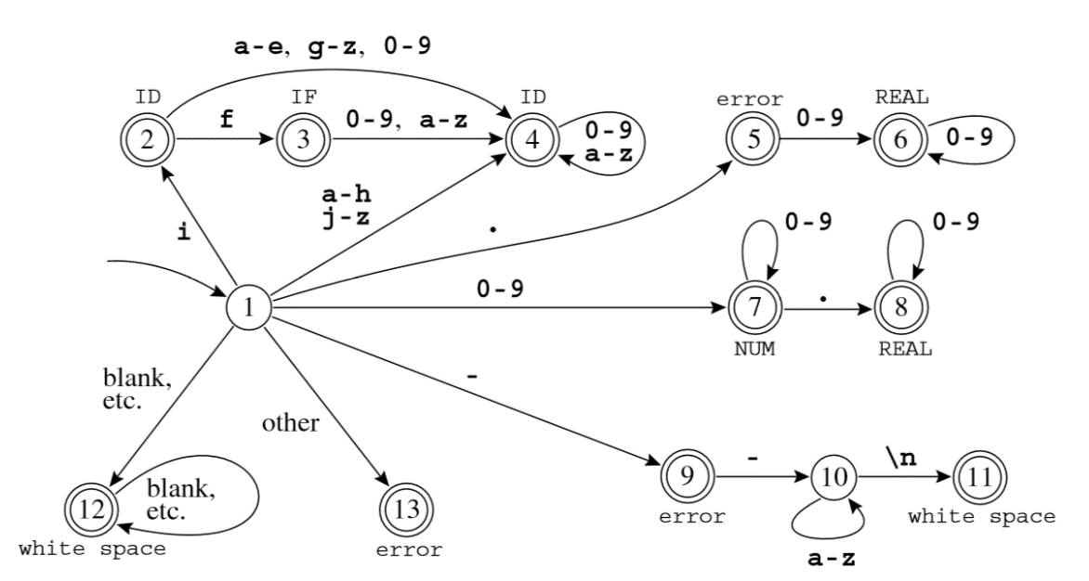
2 - Compilers
Scanner
Regular Expressions
FSA
Finite State Autómata
Generates Tokens

Slide 8
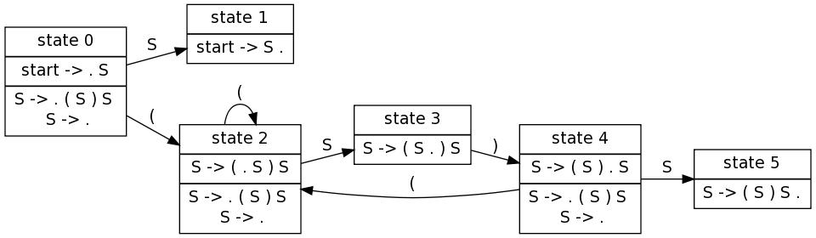
2 - Compilers
Parser
LALR(1)
Look-Ahead token, Left-to-Right - rightmost derivation
symbol → symbol symbol ···symbol
Generates AST (Abstract Syntax Tree)

Slide 9
3 - Code Generation Tools
GPlex - Gardens Point LEX
Generates a Scanner in C#
Uses Lex speciﬁcation
Deterministic Finite Automaton (DFA)
Ident [a-zA-Z_][a-zA-Z0-9_]*
Num [0-9]+
Real ([0-9]+"."[0-9]*)|([0-9]*"."[0-9]+)
Number {Num}|{Real}
{Number} { return (int)Tokens.bsNumber; }
{Ident} { return (int)Tokens.bsIdent; }

Slide 10
3 - Code Generation Tools
Gppg - Gardens Point Parser Generator
Generates a Parser in C#
LALR(1)
Uses Yacc speciﬁcation
symbol → symbol symbol ···symbol
Program : SourceElements EOF { $$ = BuildProgramNode($1); } ;
SourceElements
: EolOpt /* Empty */ { $$ = BuildSourceElementsNode();}
| EolOpt SourceElement SourceElements { $$ = BuildSourceElementsNode($2, $3);}
;
SourceElement
: SubDeclaration { $$ = BuildSourceElementNode($1); }
| FunctionDeclaration { $$ = BuildSourceElementNode($1); }
| bsLibrary bsStr
;

Slide 11
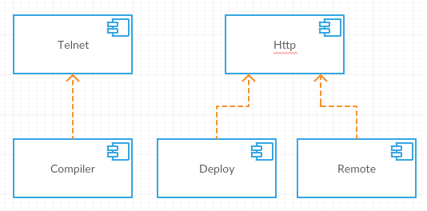
4 - Debugger
Telnet
Communication
Compiler
Scanner
Parser
Deploy
Remote

Slide 12
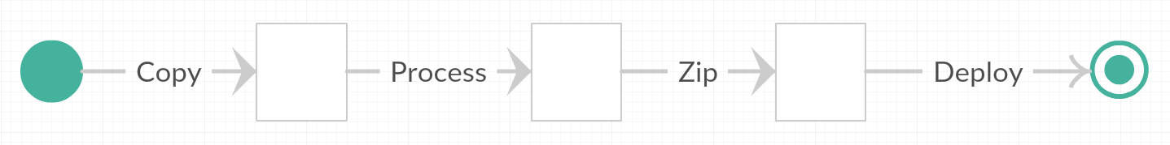
5 - Deploy
Copy files
Change Manifest Version
Build parameters
Replace
Optimize
Remove debug code
Zip Files
Upload to Box
Digest Authentication
Multi-part form

Slide 13
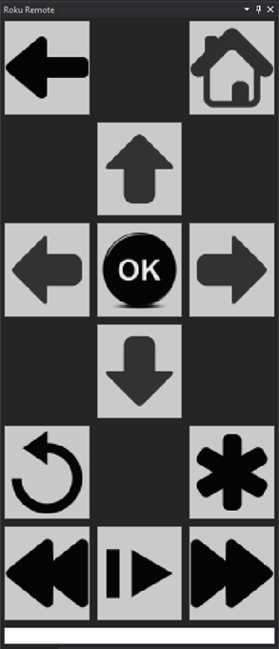
6 - Remote
Emulates Remote
Uses Http Port
Roku External Control Service

Slide 14
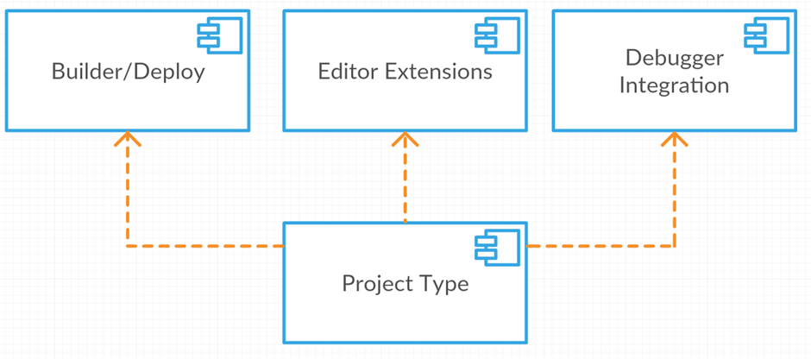
7 - Visual Studio Extension
Project Type
Main project
Installer
Project/Item Templates
Builder/Deploy
Build tasks
Editor Extensions
Laguage service
Debugger integration
Debugger Engine
Telnet

Slide 15
7 - Visual Studio Extension
Used Extension Points
VsPackage
UI Elements, Services, Projects, Editors, Designers
MefComponent
Syntax highlight
Intellisense
Errors
Project Template
Item Template

Slide 16
7 - Visual Studio Extension
Project Type
Main project
Installer
Project/Item Templates
Builder/Deploy
Build tasks
Editor Extensions
Laguage service
Debugger integration
Debugger Engine
Telnet

Slide 17
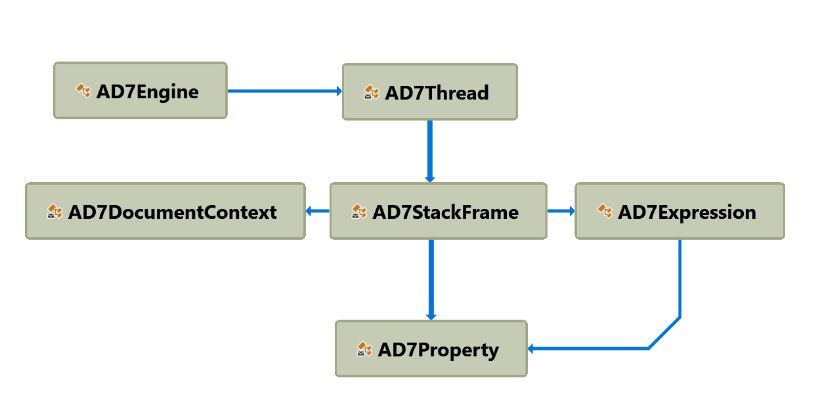
7 - Visual Studio Extension
Register
Launcher
Debugger Engine

Slide 18
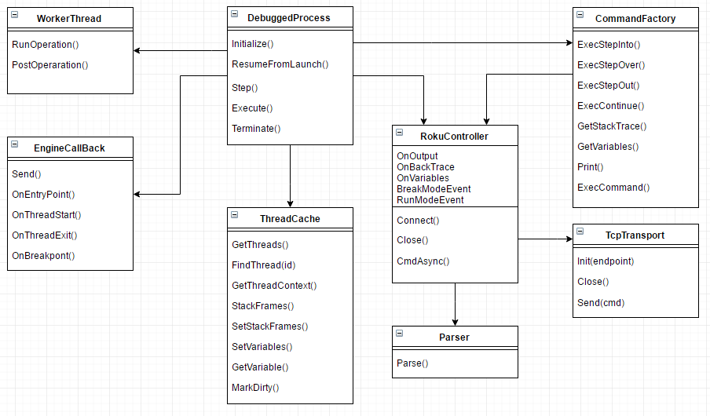
7 - Visual Studio Extension
DebuggedProcess
EngineCallback
RokuController
TcpTransporter
Parser

Slide 19
7-Integração Visual Studio
Demo
Notes:
Create project
Add file
Snake
Show classification
Show intellisense
Show Error Validation
Inline
Error window
Show Remote window
Show ScreenShot window
Show Deploy
Show Debug
Enter debug mode
Show output
Navigate call stack
Show locals window
Expand variable
Show watch window
Add to watch
Step
Continue

Slide 20
8 - Conclusions
Improvements
Support All BrightScript Statments
View variables on the callback stack
Interllisense source
Future work
Import existing code
Scene Graph support
XML UI definition
Multi Thread
Notes:
Create project
Add file
Snake
Show classification
Show intellisense
Show Error Validation
Inline
Error window
Show Remote window
Show ScreenShot window
Show Deploy
Show Debug
Enter debug mode
Show output
Navigate call stack
Show locals window
Expand variable
Show watch window
Add to watch
Step
Continue

Slide 21
Questions? Thanks!

