Slide 1
BrightScript - Debugger
Celso Fernandes – TV Devices / Sky Store

Slide 2
Agenda
Introduction
Compilers
Code Generation Tools
Debugger
Deploy
Remote
Visual Studio Extension
Conclusions

Slide 3
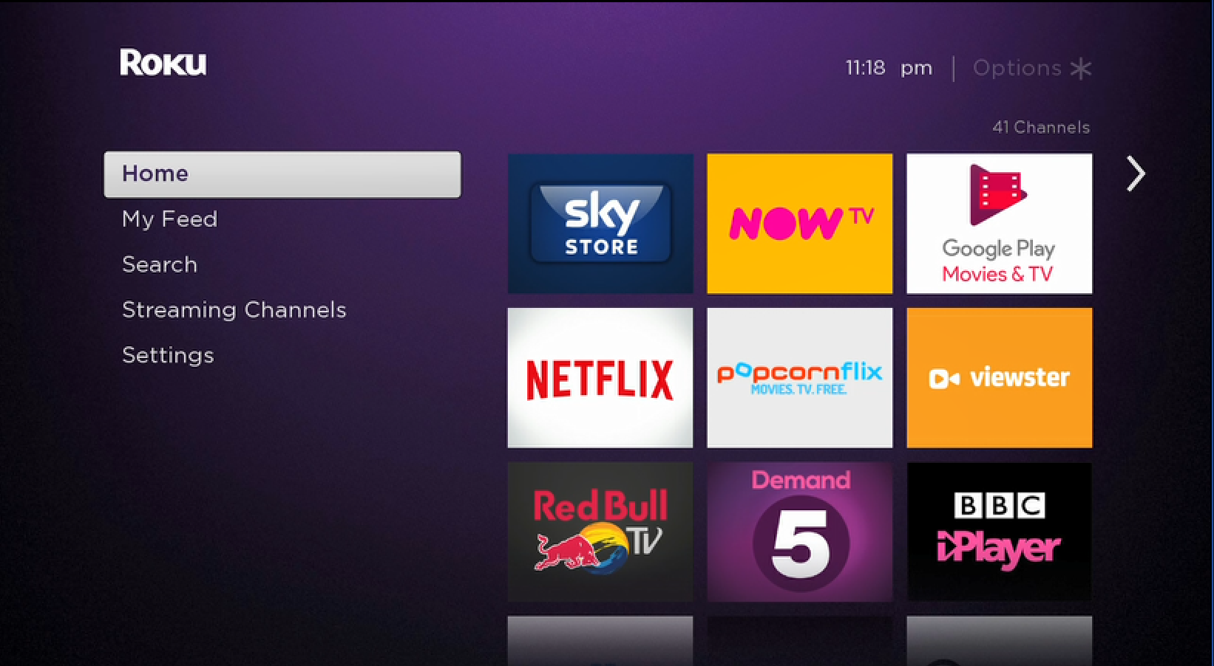


1. Introduction Roku Tools
Roku
Box's
BrightScript
Based on VB and JavaScript
Existing tools
Ide – Plugin for Eclipse
Text editors
Syntax Highlight: Sublime, Atom
Deploy
Make file / Coffee script / Bower / Gulp

Slide 4
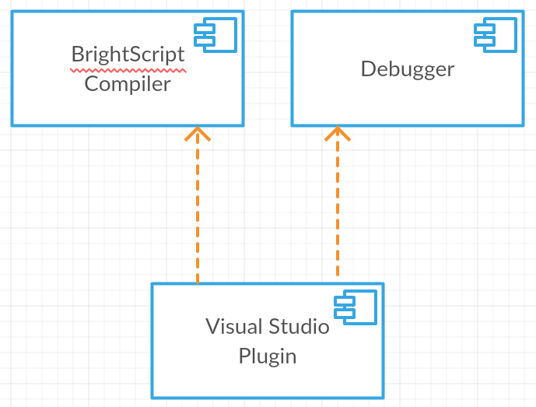
1. Introduction Architecture

Slide 5
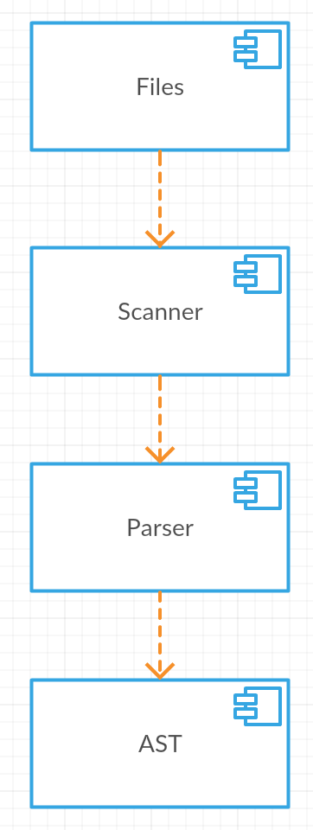
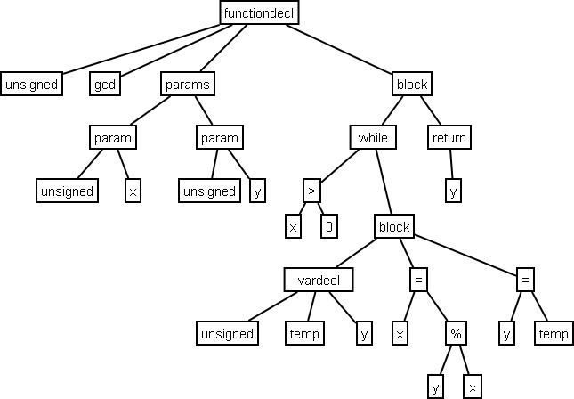
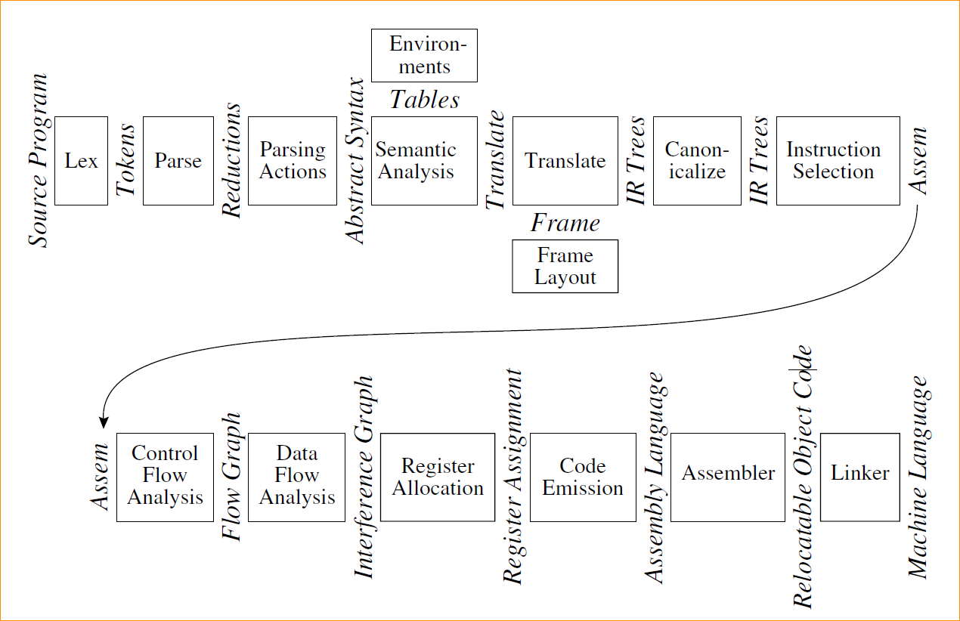
2. Compilers Overview
Scanner
Parser

Slide 6
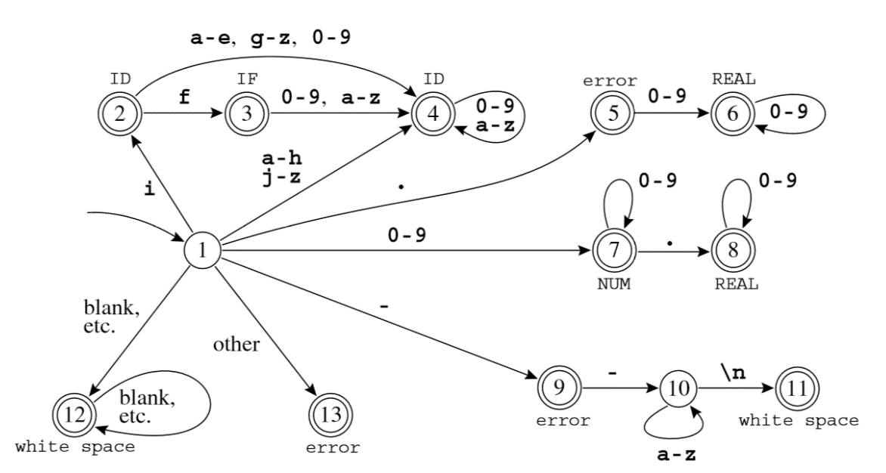
2. Compilers Scanner
Regular Expressions
FSA (Finite State Automata)
Generates Tokens

Slide 7
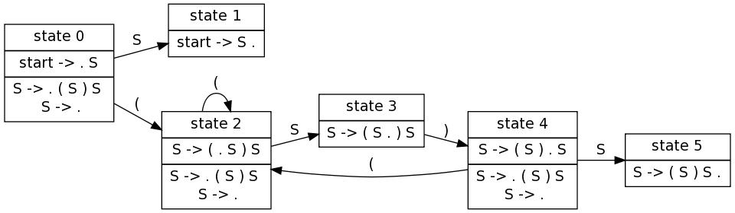
2. Compilers Parser
LALR(1) - Look-Ahead token, Left-to-Right - rightmost derivation
Context-Free Grammars
symbol → symbol symbol ···symbol
Generates AST (Abstract Syntax Tree)

Slide 8
3. Code Generation Tools GPlex - Gardens Point LEX
Generates a Scanner in C#
Uses Lex speciﬁcation
Deterministic Finite Automaton (DFA)
Ident [a-zA-Z_][a-zA-Z0-9_]*
Num [0-9]+
Real ([0-9]+"."[0-9]*)|([0-9]*"."[0-9]+)
Number {Num}|{Real}
{Number} { return (int)Tokens.bsNumber; }
{Ident} { return (int)Tokens.bsIdent; }

Slide 9
3. Code Generation Tools Gppg - Gardens Point Parser Generator
Generates a Parser in C#
LALR(1)
Uses Yacc speciﬁcation
Contex-Free Grammars: symbol → symbol symbol ···symbol
Program : SourceElements EOF { $$ = BuildProgramNode($1); } ;
SourceElements
: EolOpt /* Empty */ { $$ = BuildSourceElementsNode();}
| EolOpt SourceElement SourceElements { $$ = BuildSourceElementsNode($2, $3);}
;
SourceElement
: SubDeclaration { $$ = BuildSourceElementNode($1); }
| FunctionDeclaration { $$ = BuildSourceElementNode($1); }
| bsLibrary bsStr
;

Slide 10
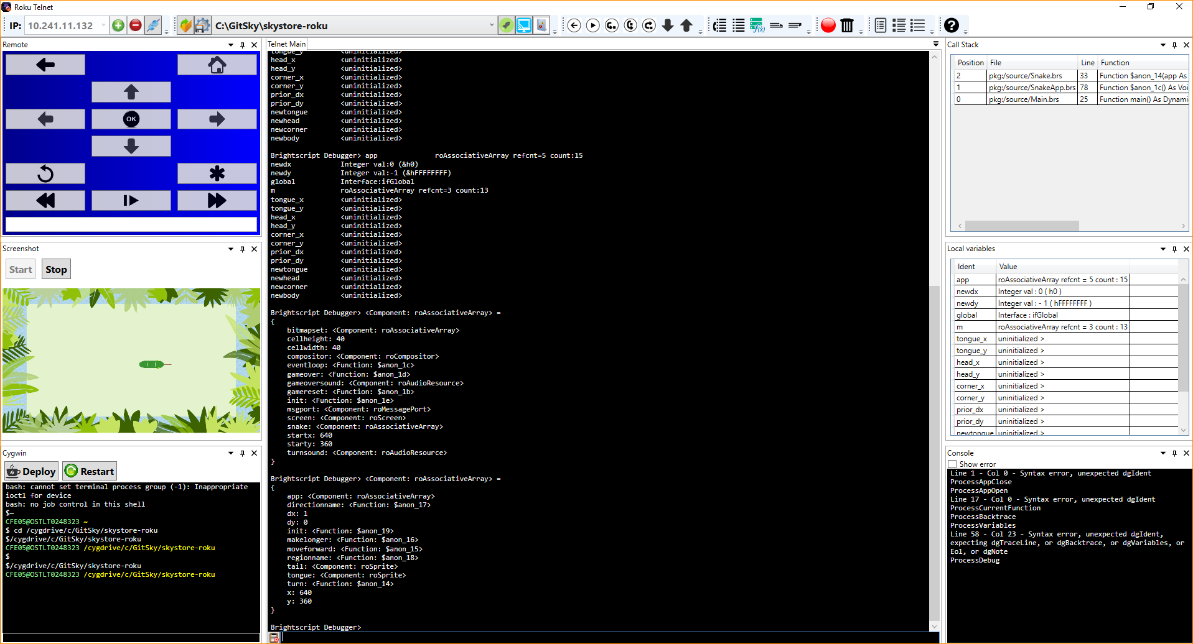
4. Debugger App

Slide 11
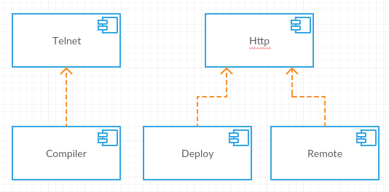
4. Debugger
Telnet
Communication
Compiler
Scanner
Parser
Deploy
Remote

Slide 12

5. Deploy
Copy files
Change Manifest Version
Build parameters
Replace
Optimize
Remove debug code
Zip Files
Upload to Box
Digest Authentication
Multi-part form

Slide 13

6. Remote
Emulates Remote
Uses Http Port
Roku External Control Service

Slide 14
7. Visual Studio Extension Used Extension Points
VsPackage
UI Elements, Services, Projects, Editors, Designers
MefComponent
Syntax highlight
Intellisense
Errors
VS Project System
Project Template
Item Template

Slide 15
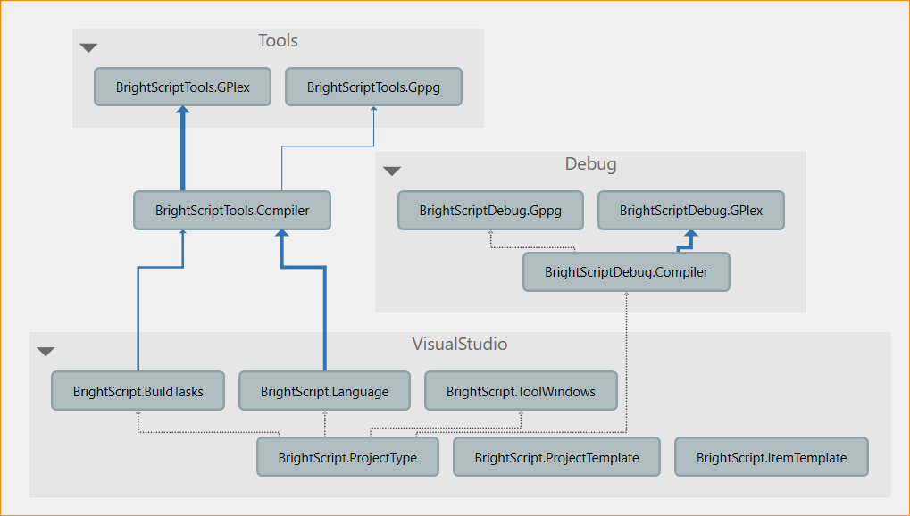
7. Visual Studio Extension Structure
Project Type
Main project/Installer
Project/Item Templates
Builder/Deploy
Build tasks
Editor Extensions
Laguage service
Debugger integration
Debugger Engine
Telnet

Slide 16
7. Visual Studio Extension Project Type – VS Project System
<StringProperty Name="UserName" />
<BoolProperty Name="ProcessOptimize" Description="Should compiler optimize output?" />
<StringProperty Name="ReplaceConfigs" Description="Replace params">
<StringProperty.ValueEditors>
<ValueEditor EditorType="ConfigValueEditor" DisplayName="&lt;Config Value Editor...&gt;" />
</StringProperty.ValueEditors>
</StringProperty>
Project Properties
general.xaml
Costom editor
Build Order
CustomProjectBrs.targets
<Target Name="Build">
<CompileTask BuildPath="$(BuildPath)" Files="@(brsCompile)" />
<CopyToOutputTask
BuildPath="$(BuildPath)" OutputPath="$(OutputPath)"
CodeFiles="@(brsCompile)" ImageFiles="@(image)"
NoneFiles="@(None)" ManifestFiles="@(manifest)"/>
<ArchiveTask BuildPath="$(BuildPath)" OutputPath="$(OutputPath)"
MSBuildProjectName="$(MSBuildProjectName)" />
<DeployTask
BuildPath="$(BuildPath)" OutputPath="$(OutputPath)"
MSBuildProjectName="$(MSBuildProjectName)" BoxIP="$(BoxIP)"
UserName="$(UserName)" Password="$(Password)"/>
</Target>

Slide 17
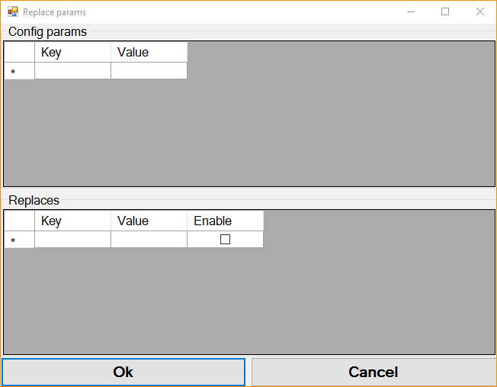
7. Visual Studio Extension Project Type – VS Project System
Costom editor

Slide 18
7. Visual Studio Extension Project Type – VS Project System
<Rule
Name="brs"
DisplayName="brs"
PageTemplate="tool"
Description="brs build items"
xmlns="http://schemas.microsoft.com/build/2009/properties">
<Rule.DataSource>
<DataSource Persistence="ProjectFile" HasConfigurationCondition="True" ItemType="brsCompile" />
</Rule.DataSource>
<StringProperty Name="Identity" DisplayName="File Name" ReadOnly="true" Category="Misc">
<StringProperty.DataSource>
<DataSource Persistence="Intrinsic" ItemType="brsCompile" PersistedName="Identity" />
</StringProperty.DataSource>
</StringProperty>
<StringProperty Name="FullPath" DisplayName="Full Path" ReadOnly="true" Category="Misc">
<StringProperty.DataSource>
<DataSource Persistence="Intrinsic" ItemType="brsCompile" PersistedName="FullPath" />
</StringProperty.DataSource>
</StringProperty>
</Rule>
File properties
brs.xaml

Slide 19
7. Visual Studio Extension Language Extensions – syntax highlighting
_bsTypes = new Dictionary<TokenTypes, IClassificationType>();
_bsTypes[TokenTypes.Cmnt] = standardClassifications.Comment;
_bsTypes[TokenTypes.Keyword] = standardClassifications.Keyword;
//_bsTypes[TokenTypes.Literal] = standardClassifications.Literal;
_bsTypes[TokenTypes.Opr] = standardClassifications.Operator;
_bsTypes[TokenTypes.Number] = standardClassifications.NumberLiteral;
_bsTypes[TokenTypes.Str] = standardClassifications.StringLiteral;
_bsTypes[TokenTypes.Ident] = standardClassifications.Identifier;
_bsTypes[TokenTypes.Funcs] = typeService.GetClassificationType("Funcs");
_bsTypes[TokenTypes.Typs] = typeService.GetClassificationType("Typs");
_bsTypes[TokenTypes.Literal] = typeService.GetClassificationType("Ltr");
BrightScriptClassifier
Maps VsTokens/BrsTokens
ClassificationFormat
Extra formats
BrightScriptTokenTagger
Runs scanner to generate tokens
[Export(typeof(EditorFormatDefinition))]
[ClassificationType(ClassificationTypeNames = "Typs")]
[Name("Typs")]
//this should be visible to the end user
[UserVisible(false)]
//set the priority to be after the default classifiers
[Order(Before = Priority.Default)]
internal sealed class BsTyps : ClassificationFormatDefinition
{
/// <summary>
/// Defines the visual format for the "period" classification type
/// </summary>
public BsTyps()
{
DisplayName = "Typs"; //human readable version of the name
ForegroundColor = Colors.DeepPink;
}
}

Slide 20
7. Visual Studio Extension Language Extensions – Errors
ITextSnapshot textSnapshot = spans[0].Snapshot.TextBuffer.CurrentSnapshot;
SourceText sourceText = this.singletons.SourceTextCache.Get(textSnapshot);
var errors = this.singletons.FeatureContainer.DiagnosticsProvider.GetDiagnostics(sourceText);
foreach (var error in errors)
{
SnapshotSpan newSnapshotSpan = EditorUtilities.CreateSnapshotSpan(textSnapshot, error.Span.startIndex, error.Span.Length);
yield return new TagSpan<ErrorTag>(newSnapshotSpan, new ErrorTag(PredefinedErrorTypeNames.SyntaxError, error.Message));
}
ErrorTagger
ErrorListPresenter
Listen files changes
Create ErrorItems
Show error on list
Open file

Slide 21
7. Visual Studio Extension Language Extensions – Intellisense
CompletionSource
Uses Abstract Syntax Tree (AST)
Funcs list
Generates List
CompletionCommandHandler
Show Popup

Slide 22
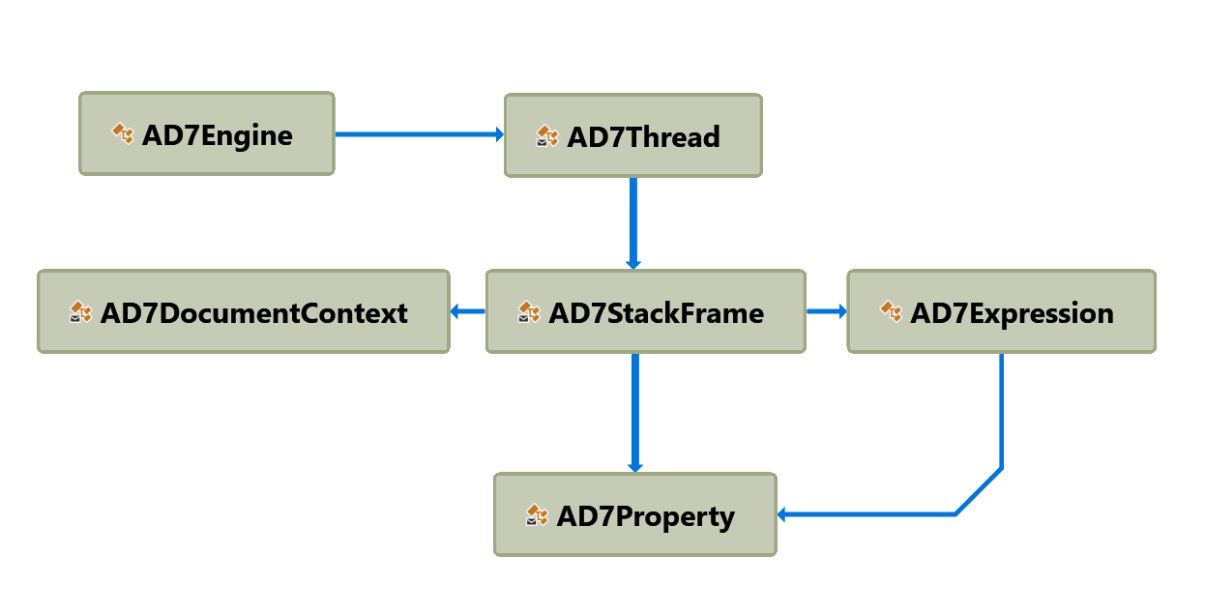
7. Visual Studio Extension Debugger Engine
Register
Launcher
Debugger Engine

Slide 23
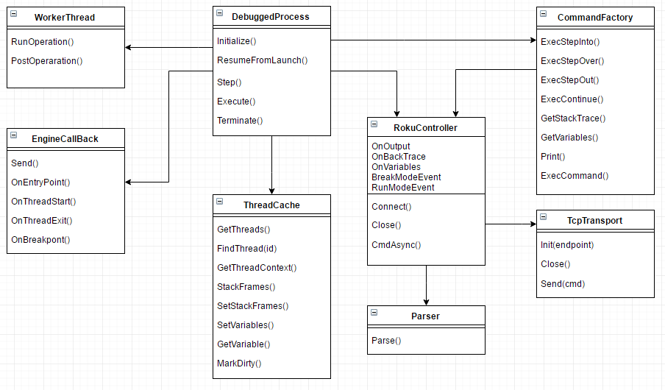
7. Visual Studio Extension Debugger Engine
DebuggedProcess
EngineCallback
RokuController
TcpTransporter
Parser

Slide 24
7. Visual Studio Extension
Demo

Slide 25
8. Conclusions
Improvements
Support All BrightScript Statments
View variables on the callback stack
Interllisense source
Future work
Import existing code
Scene Graph support
XML UI definition
Multi Thread

Slide 26
Thank you for watching Questions?

