Slide 1



A Character-Level LSTM Network Model for Automatically Tokenizing the Würzburg Glosses
Adrian Doyle
John McCrae
Clodagh Downey
Notes:
Abstract:
Examine Difficulties of Tokenizing E.I. Text
Demonstrate Viability of RNN-based Approach for Historical Texts
unconventional spacing
spelling anomalies
Discuss Guidelines for Tokenizing Old Irish Text
Character-Level LSTM Network (creation and assessment)
But first:

Slide 2
Acknowledgements
Digital Arts and Humanities Programme, NUIG
Irish Research Council
Science Foundation Ireland
Annotators:
Maria Hallinan (NUIG)
Daniel Watson (DIAS)
Theodorus Fransen (TCD)
Jody Buckley-Coogan (QUB)

Slide 3
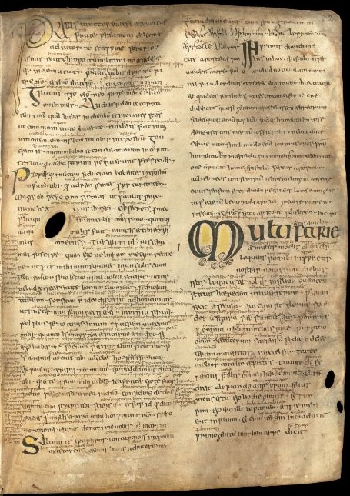
Old Irish and the Würzburg Glosses
Old Irish:
Roughly 7th – 10th century.
Würzburg Glosses:
Notes on Latin text of the Letters of St. Paul.
Dated about the middle of the 8th century.
Earliest large collection of Irish text.
Available at: www.wuerzburg.ie
Notes:
Old Irish Dates
Würzburg Glosses
Digitised as part of this project:
As per TPH v.1
Available at wb.ie
Will be updated as research continues
TPH is relatively diplomatic, resembles that of MS.

Slide 4
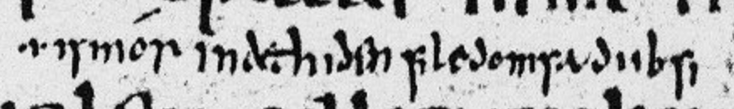
Old Irish – Orthography
Word Division:
Based on stress patterns
Spaces occur between accentual units:
isdiasom = is dia-som, “he is god”
Some “words” split:
nitú nodnail acht ishé not ail, “it is not you (sg) that nourishes it, but it is it that nourishes you (sg.)”
Wb. 26d19
.i. ismór indethiden file domsa diibsi – (p.670) ¹
Is mór in deithiden file dom-sa diib-si. – (p.192) ²
Notes:
Language Uniform – Variation Diachronic, Thurneysen.
However, orthographic standards and linguistic phenomena make it difficult to carry out even rudimentary pre-processing tasks by conventional means.
***CLICK***
Word Division:
Combining based on stress
***CLICK***
MS. example:
26d19: “Great is the concern I have for ye”
***CLICK***
Splitting constituent parts of a verb:
no – empty prefix
ail – conj. form of verbal root, ailid, “to nourish”
-d- – 3rd sg. masc. infixed pron. Class C, nazalising.
-t- – 2nd sg. Infixed pron. Class A (1st and 2nd sg. and pl. Class A freq. used in rel. clauses)
Tokenizer must be able to able to both insert and remove spaces.

Slide 5
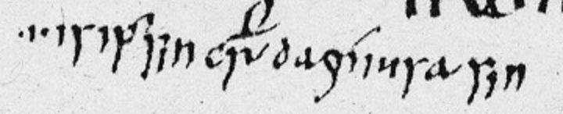
Old Irish – The Verbal Complex
Simple Verbs:
Absolute form: beirid, “he carries”
Conjunct form: beir, e.g. ní beir, “he does not carry”
Compound Verbs:
dobeir, “he gives”; asbeir, “he says”
Formation:
Preverb + verbal root (conjunct form)
do/as + beir
Wb. 26d19
.i. ismór indethiden file domsa diibsi – (p.670) ¹
Is mór in deithiden file dom-sa diib-si. – (p.192) ²
Wb. 14d26
.i. isipersin crist dagníusa sin – (p.596) ¹
.i. Is i persain Chríst da·gniu-sa sin. – (p.144) ²
Notes:
Simple Verbs
Absolute
***CLICK***
conjunct
Historical preverbs
***CLICK***
Compound verbs
***CLICK***
MS. example:
14d26: “It is in the person of Christ I do that”

Slide 6
Old Irish – Language
Infixed Pronouns:
Formation:
Preverb + infixed pronoun + verbal root
do + m’/ t’/ a’/d-n + beir
dobeir -> dombeir, “he gives me”
dogní -> dagní, “he does it”
ailid -> not ail, “which nourishes you”
ailid -> nodnail, “which nourishes it”
Wb. 26d19
.i. ismór indethiden file domsa diibsi – (p.670) ¹
Is mór in deithiden file dom-sa diib-si. – (p.192) ²
Wb. 14d26
.i. isipersin crist dagníusa sin – (p.596) ¹
.i. Is i persain Chríst da·gniu-sa sin. – (p.144) ²
Notes:
Infixed Pronouns Formation
***CLICK***
E.g. 1: dombeir
***CLICK***
E.g. 2: dagní
***CLICK***
E.g. 3: not ail
E.g. 4: nodnail
This complex morphology makes the application of a purely rule-based approach a daunting task, where tokenisation is usually a mere precursor to more complex NLP tasks.
Conventional approach of splitting tokens in accordance with spacing is not plausible.
Also raises a fundamental problem: what should constitute a token?
OI compound verbs comparable to English, “oversee”, “withdraw”
Internalisation of a prep. by such a verb must be accounted for in tokenisation.
No attempt to define a “word” for OI.
However, necessary to set baseline for tokenisation, hence, guidelines.

Slide 7
Guidelines for Tokenizing Old Irish
Based Principally on Agreement Between Existing Editorial Standards
Deviates from Standard where Necessitated by Preservation of Orthographic Details
Need to Balance Complex Morphology against Scarcity of Data
Wb. 26d19
.i. ismór indethiden file domsa diibsi – (p.670) ¹
Is mór in deithiden file dom-sa diib-si. – (p.192) ²
Wb. 14d26
.i. isipersin crist dagníusa sin – (p.596) ¹
.i. Is i persain Chríst da·gniu-sa sin. – (p.144) ²
Notes:
Existing Editorial Standard:
Generally accepted principles (see Stifter).
Provides a good start point for determining token boundaries.
However, variation exists in some aspects between critical editions of texts:
E.g. preverbal particles variously joined, spaced, hyphenated, and separated with punctum.
Also, critical editions are not necessarily a good representation of original text.
May be desirable to maintain spelling conventions and orthographic detail for downstream NLP tasks (discussed in Japan at CCURL workshop 2018).
Balance must be struck between tailoring tokens to account for complex morphology, and for relative scarcity of training data compared to modern languages.

Slide 8
Guidelines for Tokenizing Old Irish
Separate common affixes to reduce POS variety:
domsa -> dom sa
Pre-verbal Particles constitute part of a verb, and are not separated:
dogní, asbeir
not ail -> notail
doárbas (from to-ad-ro-fiad)
Verbal complex maintained as single token:
domanicc, “has come to me”
nondobmolorsa, “because I praise you”
rotchechladar, “shall hear you”
dogníu, “I do” -> dagníu, “I do it”
ni epur, “I do not say”
BUT
niepur, “I do not say it”
Notes:
Guidelines designed to avoid creation of a wide variety of infrequently occurring parts-of-speech where feasible.
Frequent affixes, such as demonst. / emph. suffixes, are separated from preceding tokens.
***CLICK***
Preverbal particles are exceptions to this rule, and form a constituent part of a verb.
***CLICK***
This avoids necessitating reconstruction of reduced parts of a verb, where compounded, during the tokenisation stage.
(doárbas, “has been shown” = pret. form of reconstructed to-ad-fiad with perfective ro).
***CLICK***
Much of the verbal complex constitutes a single token.
This allows verbs with infixed pronouns to be treated like morphological variants of the base verb
This is necessary as the inclusion of an infixed pronoun can alter the morphology of the preverbal particle in some instances (dagníu)
Reconstructing a base-form during tokenisation stage is not desirable.
***CLICK***
Conjunct Particles (neg. interog.) which do not infix a pronoun are exceptions to this rule (ni epur / niepur)
It is expected that morphological analysis will allow for the verbal complex to be further deconstructed downstream using FST-based, morphological analysis techniques developed for modern Irish by UÍ Dhonnchadha and adapted to the Old Irish verb by Fransen.

Slide 9
Inter-Annotator Agreement
 | Cohen’s Kappa Score
Pair 1 – (A1 + A2) | 0.469
Pair 2 – (A1 + A3) | 0.349
Pair 3 – (A1 + A4) | 0.655
Pair 4 – (A2 + A3) | 0.191
Pair 5 – (A2 + A4) | 0.457
Pair 6 – (A3 + A4) | 0.297
Annotator Average Score | 0.403
No Guidelines | -0.058

Slide 10
Character-Level LSTM Model
No. of Hidden Layers | 2
Hidden Layer Size | 53
Input Format | 53x10 Vector
Output Format | 53 (Model 1) OR 2 (Model 2)
Optimiser | Adam
Loss Function | Categorical Cross-entropy
Model | Training Set
Model 1 | Wb. text
Model 1 | CELT texts
Model 2 | Wb. text
Model 2 | CELT texts

Slide 11
LSTM Network’s Kappa with Annotators
 | A1 | A2 | A3 | A4
1 Wb. | 0.2703 | 0.2225 | 0.2842 | 0.2693
1 Celt | 0.0297 | 0.0172 | 0.0563 | 0.0355
2 Wb | 0.2494 | 0.1974 | 0.2613 | 0.2431
2 Celt | 0.1836 | 0.1408 | 0.1805 | 0.1701
Annotator Average Score | 0.403
Annotators - No Guidelines | -0.058

Slide 12
Tokeniser Examples
Original Gloss (Wb. 5b 28):
.i. is inse ṅduit nitú nodnail acht ishé not ail
Model 1 (Wb.):
.i. is inse ṅduit ni tú nodnail acht is hé not ail
Manual Tokenization:
.i. is inse ṅduit ni tú nodnail acht is hé notail
Notes:
Translation:
i.e. it is impossible for thee; it is not thou that nourishest it, but it that nourishes thee.

Slide 13
Go Raibh Maith Agaibh!

