Slide 1
Code-switching in Irish tweets: A preliminary analysis
Teresa Lynn, ADAPT Centre, DCU
Kevin Scannell, St. Louis University
The ADAPT Centre is funded under the SFI Research Centres Programme (Grant 13/RC/2106) and is co-funded under the European Regional Development Fund.

Slide 2
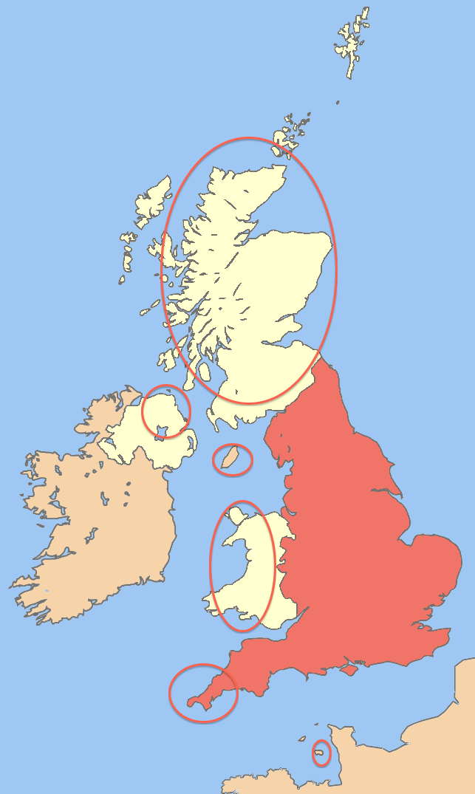
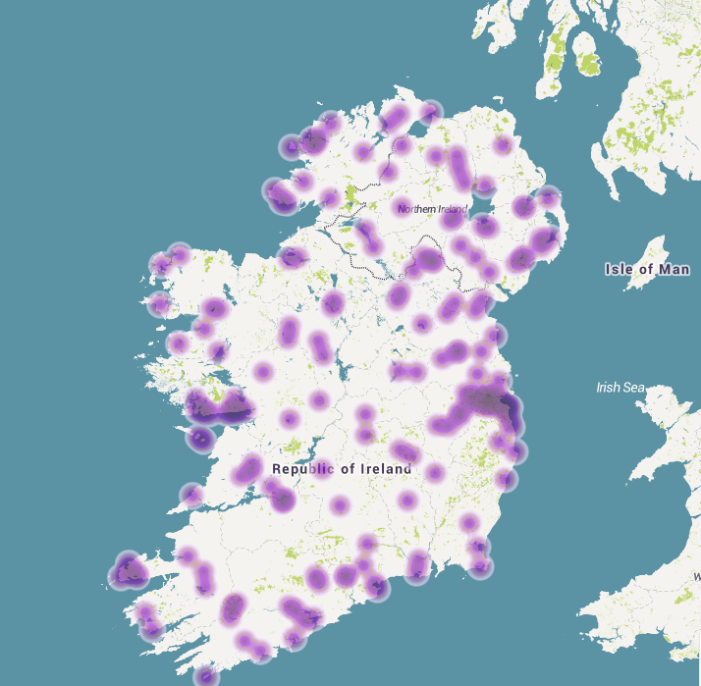


Irish on social media
3.2 million Irish tweets

Slide 3
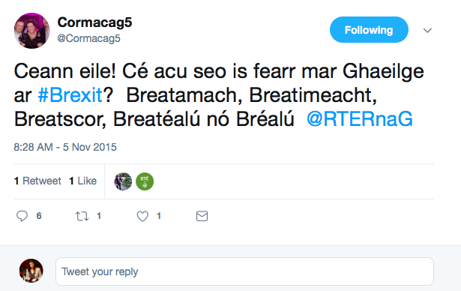
Irish on social media

Slide 4
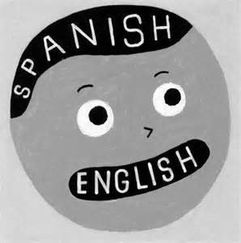
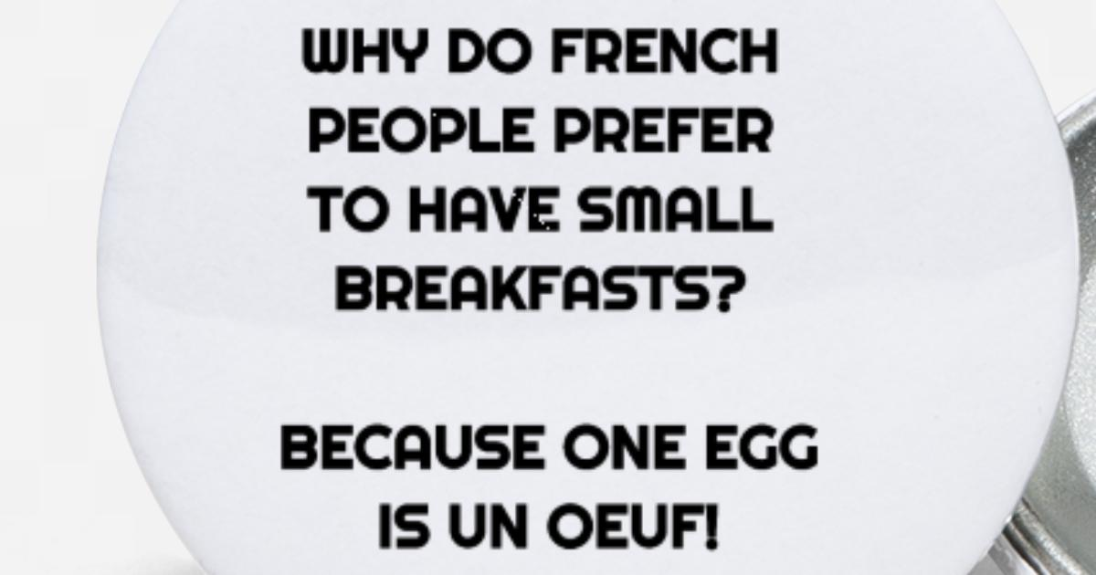
Code-switching
Bilingual Environment
– will find code-switching
Online Environment
– safe place for languages to co-exist

Slide 5
Types of code-switching
Inter-sentential (alternation, grammatical frame entact)
Má tá AON Gaeilge agat, usáid í! It’s Irish Language Week.
`If you speak ANY Irish, use it! It’s Irish Language Week’
Intra-sentential (insertion)
Ceol álainn ar @johncreedon on @RTERadio1 now.
‘Lovely music on @johncreedon on @RTERadio1 now’.
Word-level alternation
Bhfuil do kid ag mixáil Gaeilge agus English?
‘Is your kid mixing Irish and English?’

Slide 6
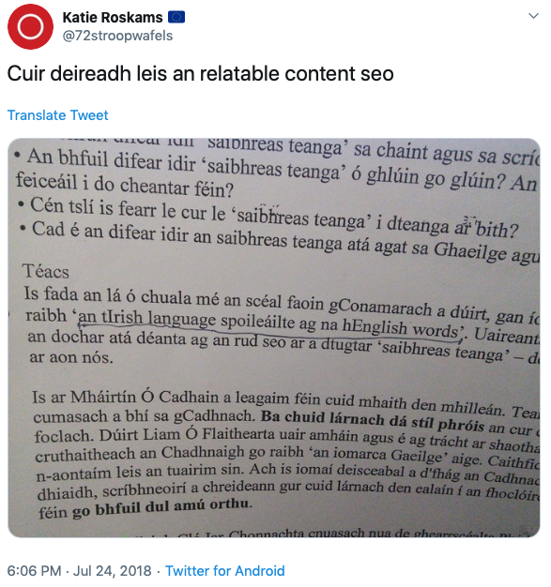
Negative attitudes towards CS

Slide 7
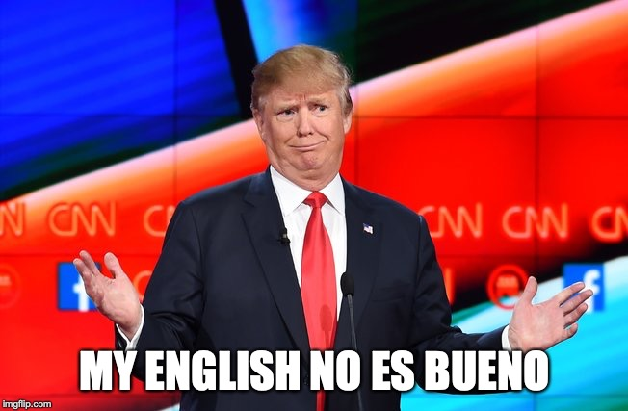
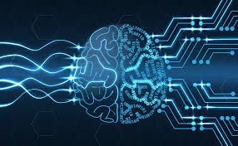
Attitudes…
Former beliefs:
- communicative deficiency / lack of mastery
- lesser fluency/ intelligence
Now understood as:
- indication of strong linguistic ability
- communicative function
- unconscious expression of bilingual
identity

Slide 8
Code-switching in Irish – previous studies
Siobhán Ní Laoire (2016)
Irish-English Code-switching: A Sociolinguistic Perspective
“… has been under-represented in Irish language corpora and in linguistic and dialectological description and analysis of Irish”

Slide 9
Code-switching in Irish – previous studies
Transcribed speech
Hickey (2009) – classroom, Atkinson and Kelly-Holmes (2011) - comedy
Literature
Bannett Kastor (2008) - conduit for comedy (e.g. Dubliners, James Joyce)
Medieval manuscripts
Dumville (1990), Muller (1999), Stam (2017)
Notes:
Much literature discussing code-switching in Irish is in the context of concerns over the impact of Engilsh as dominant language. (Stenson 1993) and Hickey 2009. Atkinson and kelly-holmes – relationship between language and identity
Bannett Kastor – literature from 17th-20th century … deliberate switch points
Prevelance of Irish-Latin code-switching in Medieval Irish manuscripts

Slide 10
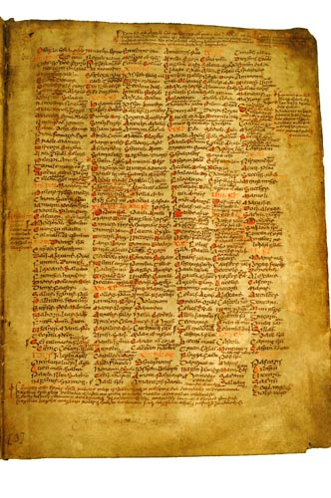
Code-switching in Irish – previous studies
A typology of code-switching in the
Commentary to the Félire Óengusso
Nike Stam (2017)
Martyrology of Óengus (of Tallaght)
Written entirely in medieval Irish (roughly 800AD)
Latin code-switching in the commentary (glossary/margin notes)
Notes:
Umberto Eco: The Name of the Rose
..describes a medieval monastery as “a linguistic hub in which several vernacular languages came into contact with ecclesiastical Latin”
Notes that “it appears that code-switching in writing and in speech are in some ways comparable, especially in informal textual genres”

Slide 11

Our study
Update corpus of 1,537 Irish tweets (Lynn et al, 2015)
removed predominantly-English tweets ➔ 1496 tweets
nuacht is déanaí – Twitter Competition – Help us Reach 20K!
Review English tags (G➔EN)
Add label for code-switching type
Re-run POS-tagging experiments
Analyse switch points

Slide 12
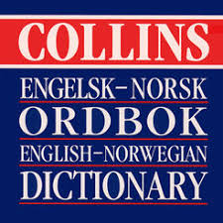
INTER-sentential switching tag
LOL LOL G
- - ,
tell tell EN INTER
ya ya EN INTER
what what EN INTER
- - ,
Más má &
féidir féidir N
leatsa le P
Foclóir foclóir N
Ioruaise Ioruais N
a a T
sheoladh seol V
chúm chuig P

Slide 13
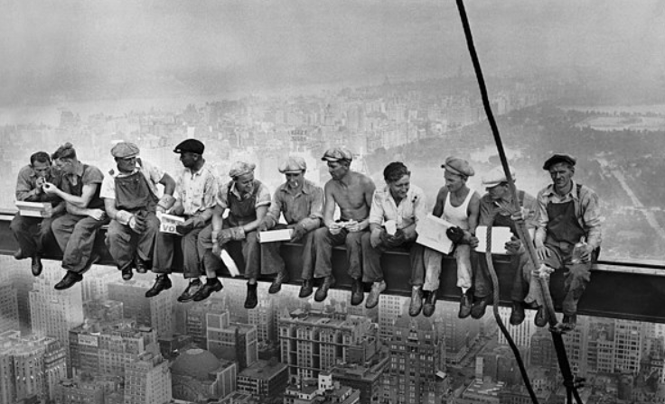
INTER-BI tag
Lón lón N
sa i P
spéir spéir N
/ / ,
MEN MEN EN INTER-BI
AT AT EN INTER-BI
LUNCH LUNCH EN INTER-BI
FILM FILM EN INTER-BI

Slide 14
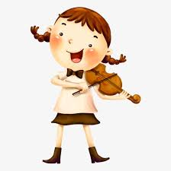
Word switching tag
Tá bí V
an-talent talent EN WORD
go go P
deo deo N
agaibh ag P
in i P
Éirinn Éire ^

Slide 15
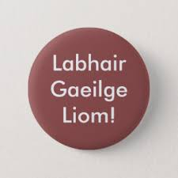
INTRA-sentential tag
Don’t don’t EN INTRA-V
forget forget EN INTRA-V
to to EN INTRA-P
use use EN INTRA-V
the the EN INTRA-D
cúpla cúpla D
focal focal N
ag ag P
obair obair N

Slide 16
Distribution of tags
254 tweets (16%) contain English tokens
INTER: 43% of the English tokens
INTER-BI: 26% of the English tokens
WORD-level: two tokens (an-talent, an-time)
INTRA: 31% of the English tokens

Slide 17
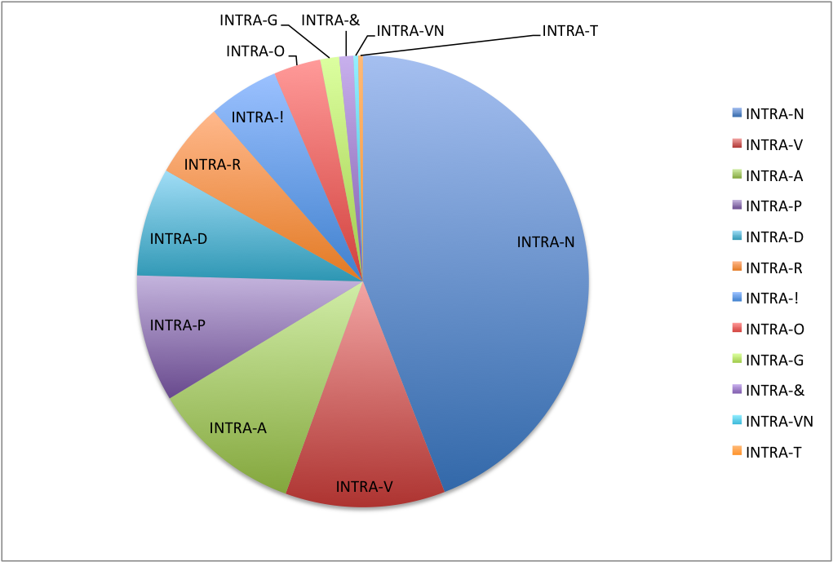
Distribution of INTRA tags

Slide 18
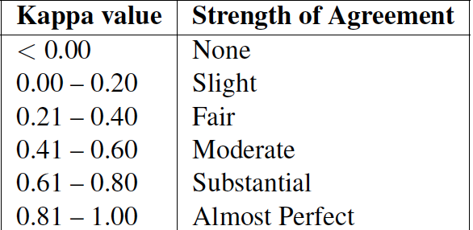
Inter-annotator Agreement
Coarse-grained Kappa | 0.74
Fine-grained Kappa | 0.69
Reviewed all 1496 tweets
943 English tokens
Cohen (1960)’s kappa
Landis and Koch (1977)’s
interpretation of kappa

Slide 19
Experiments
Re-trained 2 statistical POS-taggers:
Morfette (Chrupala et al, 2008)
Uses lemma information
ARK (Owoputi et al., 2013)
Developed for English tweets
No simple option to include lemma (-> used lemma instead of surface form)

Slide 20
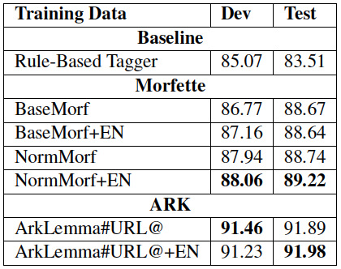
Results (& re-running 2015 experiments)
Notes:
Norm = normalised @ and URL (replacing form and lemma)

Slide 21
Observation of INTRA switching
Noun substitution: Figiúirí nua tally do Chonamara
Noun-adjectives: keyboards beag, podcast úr, an album nua, an stuff corcra
Low frequency of INTRA-V usage:
Wish nach raibh aon obair le déanamh agam
vs
am éigin an bhliain seo sounds good
Notes:
Head of Irish noun compound is the head.
Adjective follows rules of Irish – follows head noun. Vs (New tally figures)
Verbs 5 out of 34 occur alone (no preceding subject): rest are part of a string. English subject can precede the Irish verb, never follows.
Interesitng Muller (1999) oberved a similarly rare switching of verbs from Irish to Latin in historical texts.

Slide 22
Conclusions
Irish speaking online users switch effortlessly
Clever mix across syntax paradigms of both languages
Different types of CS suggest different motivations

Slide 23
Future Work
Expand the corpus
Train system to predict code-switching points
Update annotation guidelines
Parse code-switched tweets (tweet treebank)

Slide 24
Future Work: Sociolinguistic studies
– where to switch?
are there unspoken boundaries?
restrictions? (If Irish verb initial – does it need an Irish subject?)
context
– when to switch?
unknown or no official Irish word? (influence terminology development)
bilingual identity?
humour/ for greater impact?

Slide 25

#GRMA
Go raibh maith agaibh
Thank you (pl)
teresa.lynn@adaptcentre.ie
@cigilt

