Slide 1
Leveraging backtranslation to improve machine translation for Gaelic languages
Meghan Dowling Teresa Lynn Andy Way
The ADAPT Centre is funded under the SFI Research Centres Programme (Grant 13/RC/2106) and is co-funded under the European Regional Development Fund.
The ADAPT Centre is funded under the SFI Research Centres Programme (Grant 13/RC/2106) and is co-funded under the European Regional Development Fund.

Slide 2
The question
Can we use existing datasets in one language to create artificial datasets for another closely related language?
Irish and Scottish Gaelic

Slide 3
Overview
Linguistic background
MT background
Data
Method
Results and Conclusions
Future Work

Slide 4
Linguistic background

Slide 5
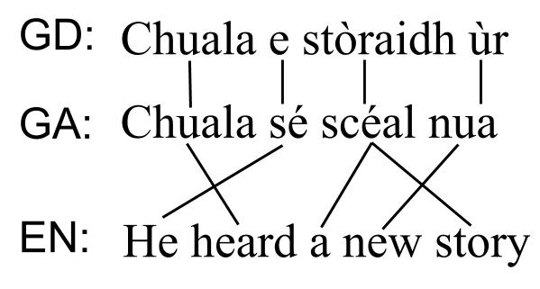
Word order

Slide 7




Inflection
Craggy Island
Oileán an Chreagáin
‘Rocky Island’
creag
a’ chreag
creagan
na creige
rock/a rock
the rock
rocks
of the rock
carraig
an charraig
carraigeacha
na carraige

Slide 8
MT background

Slide 9
Backtranslation
Creation of artificial bilingual data through the machine translation of monolingual data
Can combine 2 different types of MT, e.g. RBMT, SMT, NMT
MT might benefit from more data, even if of low quality

Slide 10
MT background
RBMT
Pipeline of rules etc (Scannell, 2006)
SMT (Scannell, 2014)
NMT (Chen, 2018)

Slide 11
Data

Slide 12


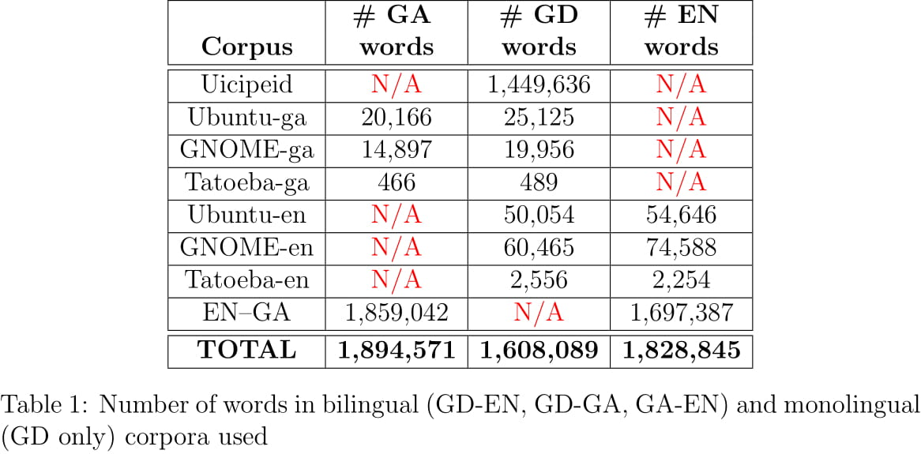

Data

Slide 13
Method

Slide 14
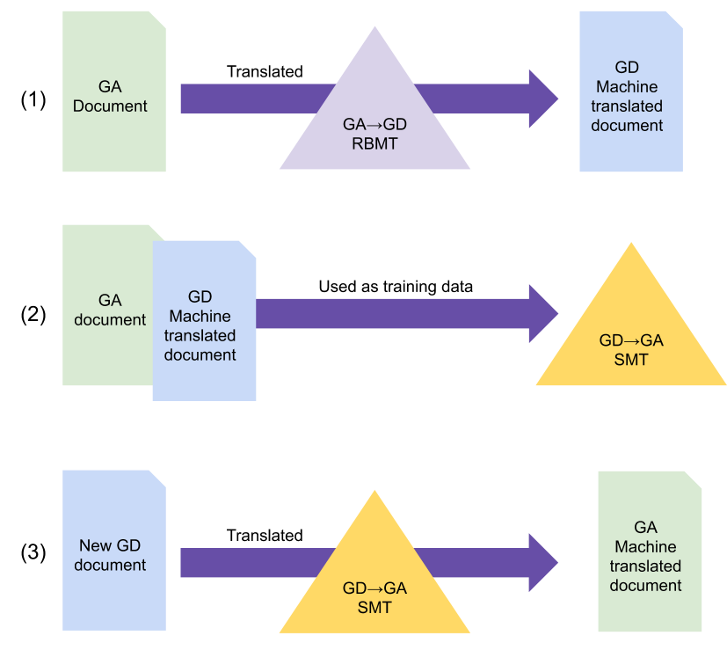
GA<->GD Method

Slide 15
Experiment set-up
Experiment 1: GD->GA
Authentic data: Ubuntu + GNOME
Artificial data: Uicipeid
Test data: Tatoeba-ga
Experiment 2: GA->GD
Authentic data: Ubuntu + GNOME
Artificial data: GA dataset
Test data: Tatoeba-ga
Default Moses parameters

Slide 16
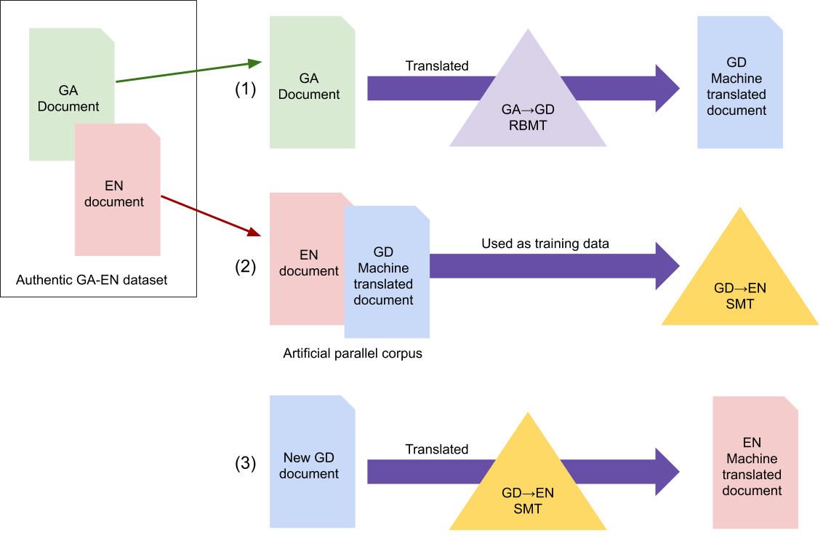
GD<->EN Method

Slide 17
Experiment set-up
Experiment 3: GD->EN
Authentic data: Ubuntu + GNOME
Artificial data: GA dataset
Test data: Tatoeba-en
Experiment 4: EN->GD
Authentic data: Ubuntu + GNOME
Artificial data: GA dataset
Test data: Tatoeba-en
Parameters: 6-gram language model
Hierarchical reordering tables

Slide 18
Part A: Baseline (authentic only)
Part B: Artificial only
Part C: Authentic + artificial

Slide 19
Results

Slide 20
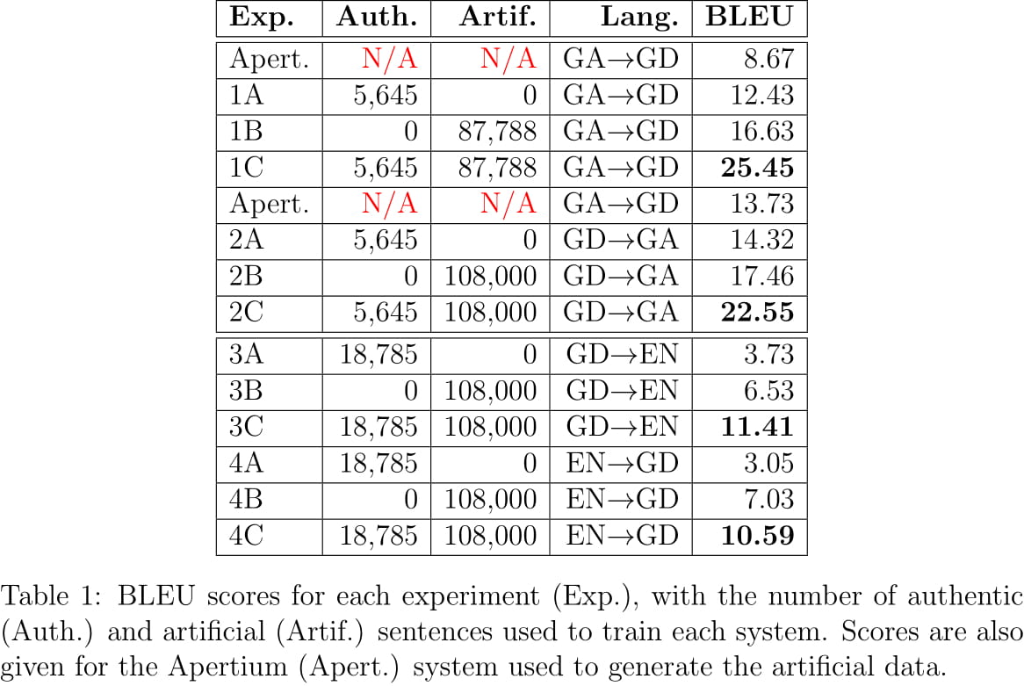
Results

Slide 21
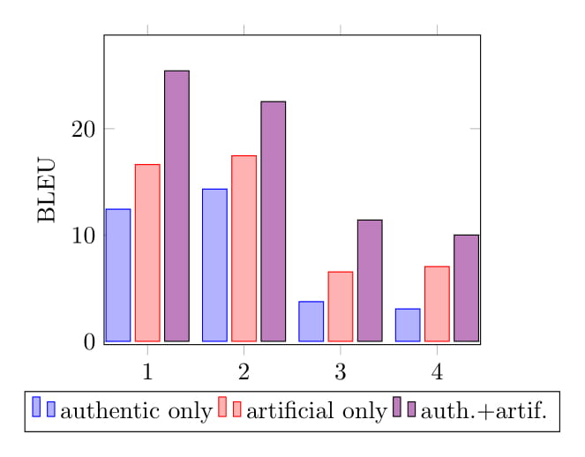
Results

Slide 22
Conclusions
BLEU of artificial data only > BLEU of authentic data only
highest BLEU = artificial + authentic combined
backtranslation usable for low resource MT - even when MT used to create data of low quality

Slide 23
Future work
Human evaluation
Other MT to create artificial data (e.g. Scannell, 2006)
Assess quality in cases where GA & GD differ linguistically
Different domains
Extend to other Celtic languages, e.g. Manx

Slide 24

Go raibh míle maith agaibh!
@ismisemeg
@adaptcentre
@cigilt
@andyway

