Slide 1
A Green Approach for an Irish App
Refactor, reuse and keeping it real
Monica Ward, School of Computing, Dublin City University
Maxim Mozgovoy/Marina Pugina, University of Aizu, Japan

Slide 2
Irish Language Learning
‘All’ students study Irish
Some exceptions (dyslexia, new to Ireland)
Primary school
30 mins per day
Secondary school
160 mins a week
Still very ‘chalk and talk’ and ‘sage on the stage’

Slide 3
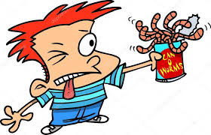
Irish Language Teaching
Everyone has an opinion
Recent National Council for Curriculum and Assessment (NCCA) review
Can of worms

Slide 4
Irish Language Teaching
Primary school teachers are generalists
Some may not be comfortable teaching Irish
(Although it is the deciding factor for selecting applicants)
Not native speakers
Wide range of ability and interest in Irish
Impact of teacher’s confidence on teaching

Slide 5
Irish Language Teaching
Secondary school teachers – specialists
2 years post graduate study in education
Schools struggle to find teachers
Very traditional approach to teaching
Memorising chunks of text
Students don’t understand
Sad curriculum content

Slide 6
Irish Language Teaching
Not a ‘Modern Foreign Language’
Level of attainment after 13 years of study
Bad
Good (given the level of exposure?)
Language pedagogy
Not just reading, writing, listening, speaking
Cultural awareness, pragmatics
New sounds
Courage to make mistakes
Paradoxical role of Irish in Ireland

Slide 7

Language Learning Apps
Language learning is difficult
Motivation is very important
Modern apps
Duolingo
Buso
Memrise
Freemium model

Slide 8
Language Learning Apps
33 languages … the usual suspects plus
Irish 954K learners
Welsh 347K learners
Navajo 251K learners
Klingon 500K learners
Translation approach
Gamified approach
Community development + employees approach

Slide 9
Irish App Development Challenges
Many apps have limited coverage
Reading, writing, listening, speaking
Sentence construction limited
Computer Assisted Language Learning (CALL)
Very difficult
Teachers, linguists, pedagogical specialists, software engineers, programmers, NLP specialists, UI designers … language learners

Slide 10
Irish App Development Challenges
Challenging for ‘big’ languages
Even more so for Less Commonly Taught Languages (LCTLs) and Less Resourced Languages (LRLs)
Need to be resourceful
Limited finance
Limited experts
Intelligent (I) CALL + NLP harder to do
This applied to Celtic languages

Slide 11
Irish CALL
Very few apps
No ‘big’ market
Some websites built by enthusiasts
Hard to deal with learner input
Spelling issues
Dialect issues

Slide 12
Irish Language Teaching and Learning
Challenge | Comment
CALL development is difficult | Especially for LCTLs
Teacher confidence | Not L1 speakers
Pedagogical approach | Room for improvement
Paradoxical attitudes | Theory vs reality

Slide 13
WordBricks - Aims
Japanese university students learning English
Scratch-like interface
Visual learning paradigm
Each POS has a particular colour and shape
Learners can only construct grammaticaly correct sentences
Gives students a chance to explore

Slide 14
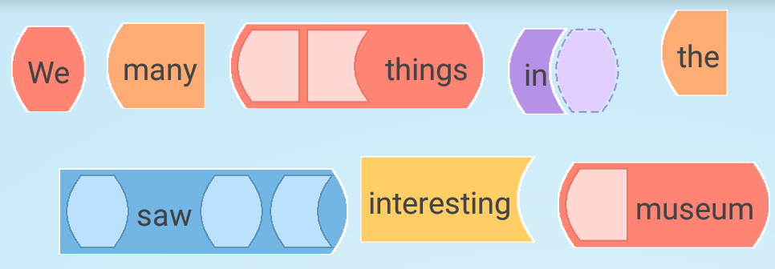
WordBricks

Slide 15
Irish WordBricks
Built using WordBricks infrastructure
Pedagogical material already covered by teacher
Limited vocabulary
Should be familiar to students
Example sentences
Free-form sentences
Aligned to the Irish curriculum

Slide 16
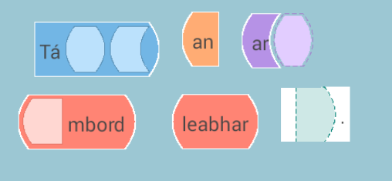

Slide 17
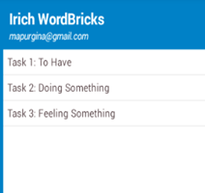

Slide 18
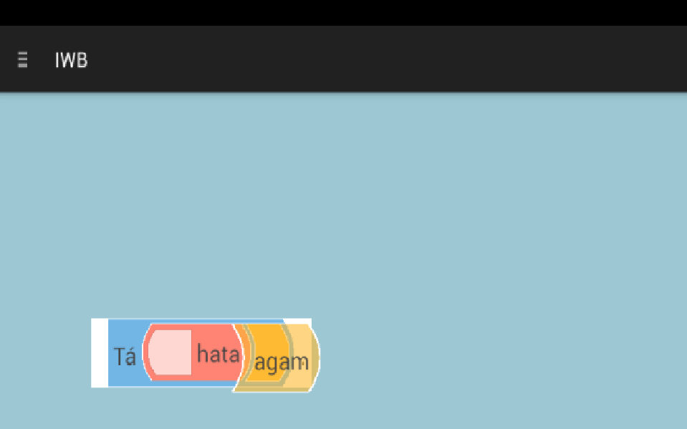

Slide 19
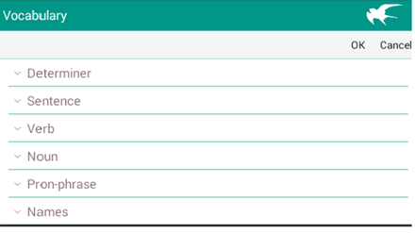

Slide 20
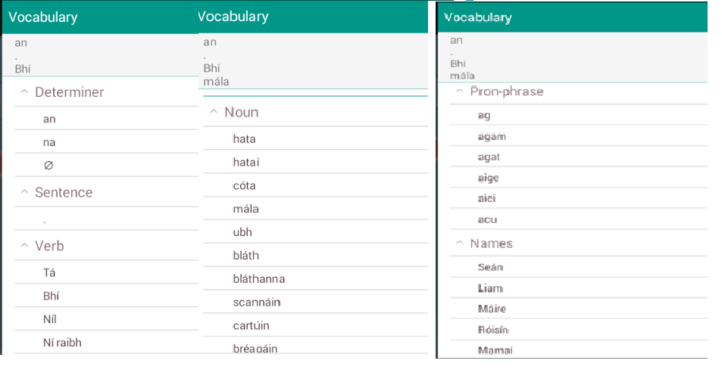

Slide 21
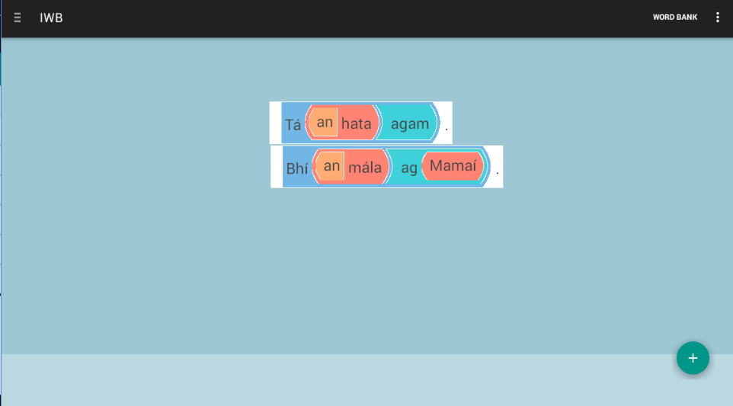

Slide 22
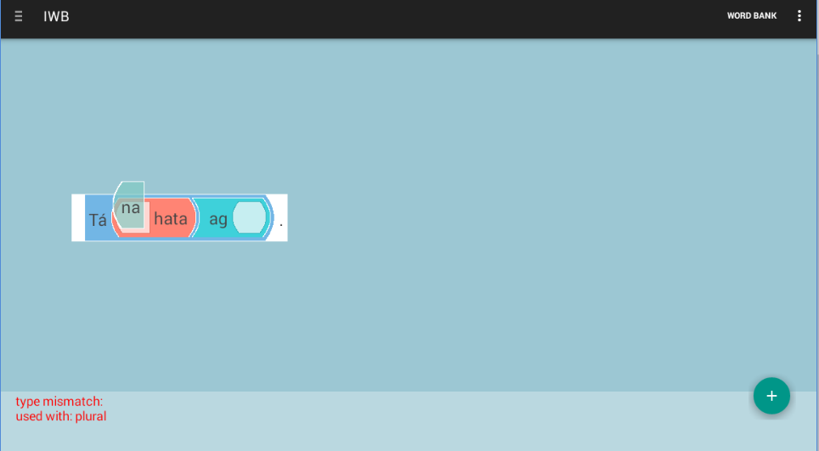

Slide 23
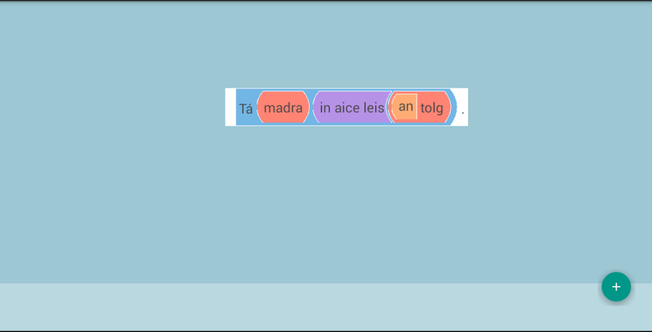

Slide 24
Irish WordBricks – Topics Covered
To have something
Tá hata agam.
Doing something
Tá Seán ag rith
Feelings
Tá áthas ar Liam
Location
Tá leabhar ar an mbord
Questions
An raibh Áine ag ithe?

Slide 25
Irish WordBricks - Refactoring
Refactoring
Existing code modified without changing its external behaviours
Usually when code smell is detected
…. but in this case due to making infrastructure ‘language independent’

Slide 26
Irish WordBricks - Refactoring
WordBricks
Japanese learners
University level
English
Out of classroom
Developers knew the L2
Irish WordBricks
Irish learners
Primary school
Irish
In classroom
Developers did not know the L2

Slide 27
Irish WordBricks - Reuse
Imagine trying to develop a morphological analyser from scratch
With limited linguistic knowledge
No time, no support
Imagine trying to develop a parser and treebank from scratch
With limited linguistic knowledge
How long would it take?

Slide 28
Irish WordBricks - Reuse
Finite State Morphological Analyser
Uí Dhonnchadha (2002)
A great, accurate, high quality resource
Parser and Treebank
Lynn (2016)
A great, accurate, high quality resource
No need to reinvent the wheel

Slide 29
Irish WordBricks – Real-World Focus
Many CALL apps tested in controlled environment
Don’t make it to the ‘wild’
Not robust
Need additional resources
Not curriculum aligned
Irish WordBricks (IWB)
User-centred design approach
Curriculum aligned

Slide 30
Methodology
Iterative, agile approach
Phase 0
Consultation with teachers and learners
Manual development of pilot version
Would it work?
Internal WordBricks refactoring required

Slide 31
Methodology
Vocabulary and POS info in informal, ad-hoc format
IWB Engine
IWB App
Phase 0 of Irish Word Brick development

Slide 32
Methodology
Have
Format: bí (verb) + optional article + noun + (with pronoun) or (with Prep + Noun)
Example 1
Tá hata agam. I have a hat.
Example 2
Bhí an hata agam. I had the hat.
Tok. Lem. POS Meaning
Tá bí Verb Verb+VI+PresInd Is
Bhí bí Verb VI+PastInd+Len Was
hata hata Noun Masc+Com+Sg hat
agam ag Pron Prep+1P+Sg (with me)
Sample informal information for ‘to have’ construction

Slide 33
Methodology
Phase 1
Example sentences encoded in an XML file
IWB engine is a black box
Difficulties around how to structure the info
(Remember the Word Bricks developers did not know any Irish)

Slide 34
Methodology
Vocabulary and POS info in XML format
IWB Engine
IWB App
Phase 1 of Irish Word Brick development

Slide 35
Methodology
Phase 2
Process automated
Finite State Morphological Analyser – FSMA (Uí Dhonnchadha)
Parser and Treebank (Lynn)
Advantage
Beginners with limited language knowledge
Limited vocabyulary

Slide 36
Methodology
Tá hata ag Seán
FSMA
Parser + Treebank
IWB Engine
IWB App
Phase 2 of Irish Word Brick development

Slide 37
Irish WordBricks –in the wild
Used in two different schools
2nd class (7-8 years), 3rd class (8 -9) and 5th class (10-11)
Boys-only, girls-only school
3 evaluation cycles
Some for 3 sessions, some for 5
Experience broadly similar over the different contexts

Slide 38
Irish WordBricks –in the wild
Class | Age | School | Y1 | Y2 | Y3
3rd | 8-9 | Boys | 72
5th | 10-11 | Boys | 52
2nd | 7-8 | Boys |  | 72
5th | 10-11 | Girls |  | 52
5th | 10-11 | Boys |  |  | 75
Total |  |  | 124 | 124 | 75
Overall: 323 students and 13 different teachers

Slide 39
Irish WordBricks - Students

Slide 40
Irish WordBricks - Students

Slide 41
Irish WordBricks - Students

Slide 42
Irish WordBricks - Students
Many suggestions for improvements
Want more difficult sentences
Translation
Want more words
Would like it gamified
Loads of ideas on this topic

Slide 43
Irish WordBricks - Students
Comments
“This would be great for people who are struggling”
“Really good, fun and easy to use”
“I am exempt from Irish, but it looked interesting”
“I love the method it uses to create sentences. It’s a bit like a puzzle in a way. I also adore the trial and error style.”

Slide 44
Irish WordBricks - Students
Comments
“I didn’t really find it easy to put the words into the sentences”
“Every Irish word & English subtitles”
“Very, very, very, very, very …. Amazing”
“Great help, can’t wait until it’s on the app store :-)”

Slide 45
Key Features
Refactored an existing app
Otherwise, it would have taken too long
Reuse existing NLP resources
Otherwise, it wouldn’t have worked
Keeping it real
Built in conjunction with teachers and students
Curriculum aligned
Designed with the realities of the Irish classroom

Slide 46
Reflections
Still some work to do on automation
Teachers liked the app
Thought it was beneficial and enjoyable
More exposure to the language
Students enjoy the app
Could be used by learners of any age
Go Raibh Maith Agaibh

